Slide 1
1 / 10
Playbook for Uber Eats & Postmates Portfolio
Uber · 2026 Strategy & Operations Analyst Intern - West & Postmates
Zoe Wang
May 14, 2026
AGENDA
Intro
01
Case walkthrough
02
LTV calculator
03
About me · Why this role · My Projects
3Ms: Map → Move → Multiply
User side · Merchant side
City diagnosis → LA retention pilot → Uber One LTV

Slide 2
PART 1 · INTRODUCTION
2 / 10
About Me – Left brain: data. Right brain: story.
BRIEF INTRO
MSBA @ Santa Clara University · Marketing Strategy & Operations
Marketing Analyst at Top Streaming Platforms in China · Founder of TUTU Academy · Building AI Agent with Lam Research
Content Creator on RedNote & YouTube
PAST PROJECT
A
Previously · Founder
B
2026.01 – 2026.05 · Lam Research
TUTU Academy
Competitive Intelligent AI Agent
Grew from 0 → 70K followers through content
3,000+ paying users · 1,600-member community
Iterated product directly from user feedback loops
Built end-to-end AI agent for Global Product Marketing team
Cut routine competitive-research time by ~70%
Ramped on semiconductor-equipment domain from scratch
Cross-functional with IT, Marketing, and leadership
WHY THIS ROLE
1
Why S&O
2
Why Uber West
3
Why Now
The S&O playbook: strategy → ops → impact.
I love that the role is close to business and owns the call AND the result.
Eats × PM is a real portfolio puzzle.
At Uber, there are best practices in dealing with massive data.
“In the Know” — the brand awareness PM is leveraging.
Bring my content, growth, and social media experience here.

Slide 3
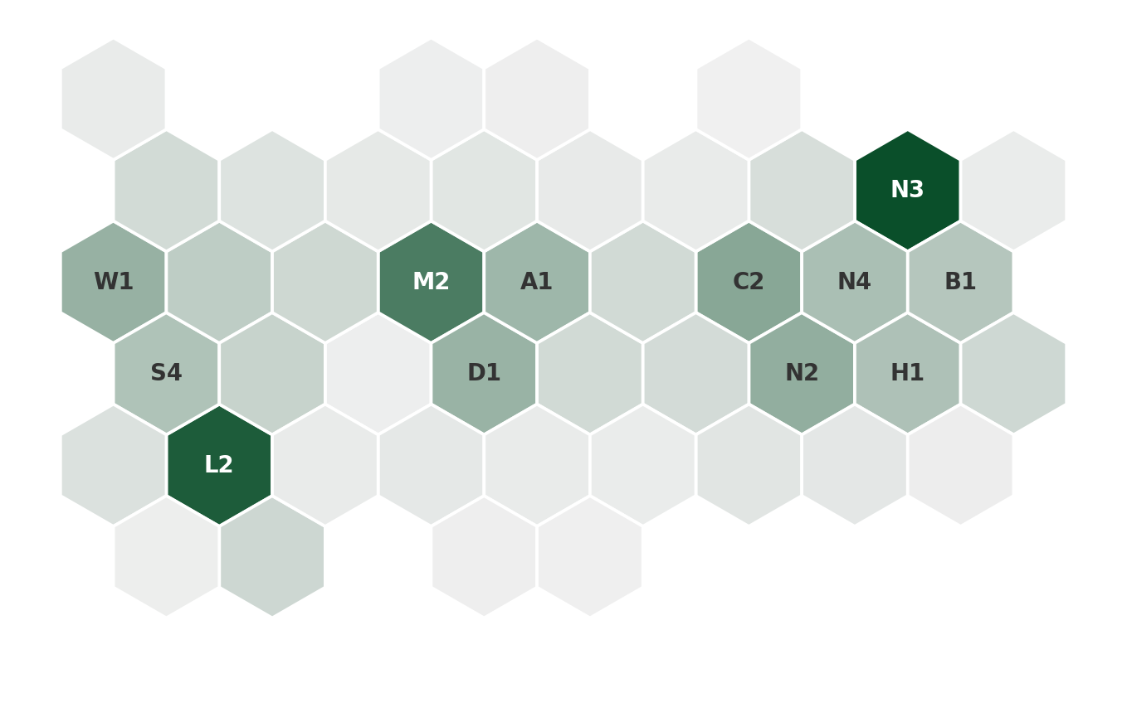
PART 2 · STRATEGIC HOOK
3 / 10
Food delivery isn't one national market —
it's 44 city-level battles, played with Uber's two-brand portfolio.
US food delivery · 2023
44 US metros · Uber combined gross bookings
Today's three moves
~$80B
Color depth = Uber (Eats + PM) gross bookings
M
Map
Gross order value · third-party platforms
Diagnose city health — how Eats and PM each grow.
US national share · 2023
M
Move
DoorDash
65%
An Eats × PM retention pilot in LA.
Uber (Eats + PM)
24%
M
Multiply
Others
11%
Uber One LTV — a cross-category bundle.
~$20K
~$320K
~$2.8M
min city
median
max city
Sources: Bloomberg Second Measure / Earnest Analytics / Statista, 2023.
Source: Case dataset (single-month sample, 2023).

Slide 4
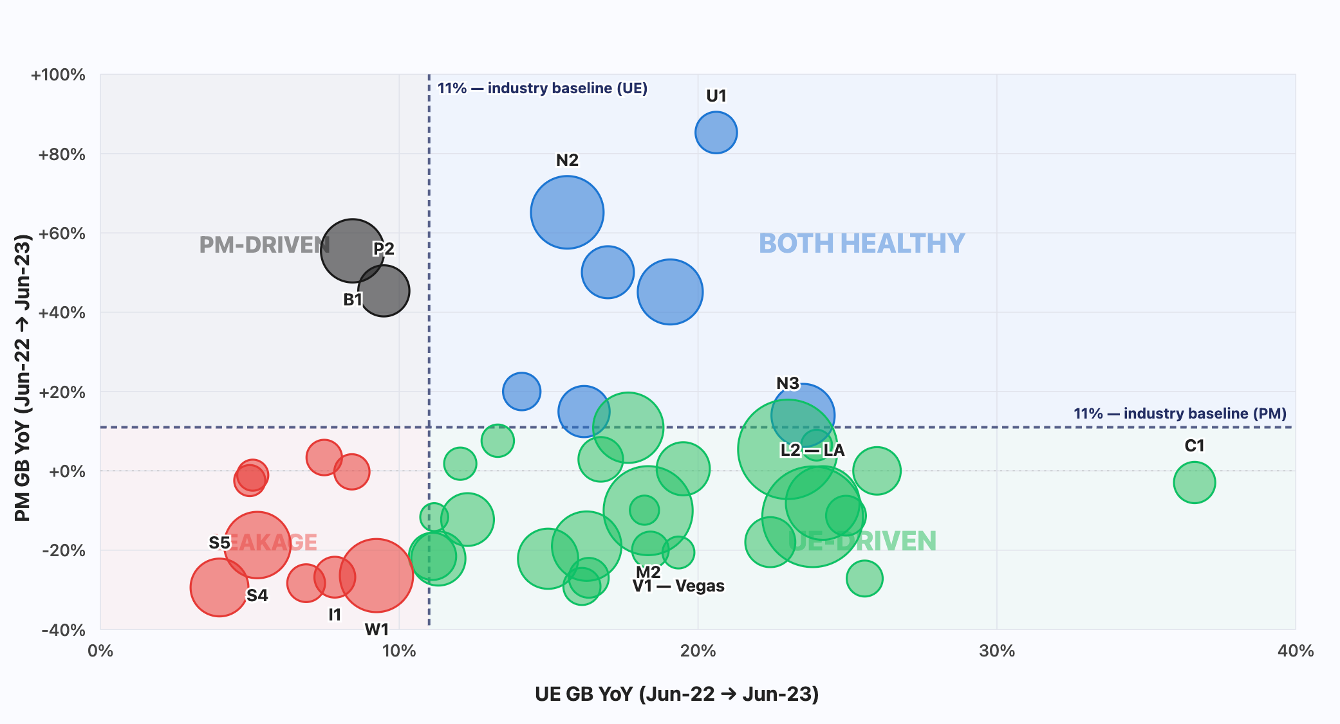
PART 3 · MAP — CITY HEALTH
4 / 10
Map — read each city by how Eats and PM each grow
Threshold = food-delivery industry baseline ~11% YoY (Bloomberg Second Measure). Bubble Size = Combined GB
2 cities
7 cities
9 cities
26 cities

Slide 5
PART 3 · MAP — WHY PM EARNS ITS PLACE
5 / 10
Eats and PM aren't the same brand —
Hypothesis: PM is a differentiator capturing users, occasions, and merchants UE structurally cannot.
1
Reach
2
Curation
3
Occasions
Brand pull in a price-sensitive market
"In the Know" — premium merchant mix
Late-night, alcohol, "Anything"
60% of US delivery users multi-home (CivicScience 2023)
77% of UE users also use DD (Earnest Analytics 2023)
PM is one of the few brand-pull platforms
SMB: PM 85% vs UE 79%
AOV: PM $32.57 vs UE $28.99 (+12%)
UE more constrained by chain Plus/Premium commission tiers
PM users describe it in "premium" terms
LA-origin brand with strong influencer ecosystem
PM‘s marketing has owned late-night, alcohol, and “Anything occasions
UE has the products but no equivalent social tone and user mindset
Sources: Case dataset (SMB / AOV / GB) · CivicScience 2023 · Earnest Analytics 2023 · PM brand history + social listening.
Caviar parallel — DoorDash kept its premium-curated brand separate for 5+ years post-acquisition
~20 urban-premium markets · no fast food, no grocery · only 4+ star Yelp restaurants · Michelin / Zagat / Infatuation partnerships
The 1+1>2 portfolio logic applies — PM isn't a supplement to UE, it's a niche asset with a distinct user profile.

Slide 6
PART 3 · MAP — DIM PLAYBOOK
5 / 10
DIM playbook — Eats × PM gets a different action in each tier
PM = 10% of Uber US food delivery (GB-weighted, 2023)
Threshold logic: 20% = PM is strong locally. 5% = below this, PM presence is too low to justify dedicated retention spend.
Tier
Rule
Strategic action
Defend
PM share ≥ 20%
AND combined YoY ≥ +11%
PM is a local stronghold and the city is healthy,
both brands invest to protect PM's identity and watch for chain encroachment from DD.
2 cities
Investigate
Combined YoY < +11%
AND PM share ≥ 5%
1+1>2 priority tier, we run the retention pilot.
PM uses brand-pull + curated supply to retain at-risk users
UE recovers convenience-driven volume.
14 cities
Maintain
PM share 5–20%
AND combined YoY ≥ +11%
BAU operations, no new retention spend.
Monitor PM share trend (move to Defend if ≥ 20%, Migrate if < 5%).
Use as test markets for tactics that scale to Investigate.
11 cities
Migrate
PM share < 5%
UE-led growth; consolidate PM operations.
Operational cost of dedicated PM retention not justified at this presence level.
17 cities
Per-city tier assignment + bubble chart in the interactive dashboard →

Slide 7
PART 4 · MOVE — THE METRIC
6 / 10
Move the metric — PM Active Eater pool retention
Hypothesis: AE retention is the upstream lever — moving it lifts the rest.
Active Eater retention — shaped by 3 levers:
Spend gap — PM vs UE
AE retention (primary lever) · NE → AE conversion (early retention) · NE acquisition (top-of-funnel)
Existing-eater incentive (% of GB)
PM user-base YoY — June 2022 → June 2023
PM
3.92%
New Eaters
-37.4%
User Base: 1.1K / mo
UE
2.82%
Active Eaters
-24.2%
User Base: 13.5K / mo
$ per Active-Eater-month
PM
$5.67
Why AE retention is the primary lever:
Biggest base — 13.5K AE/mo vs 1.1K NE/mo (12× larger absolute lift potential)
Reusable playbook — retention mechanics scale city-to-city; acquisition needs per-city redesign
Compounds into LTV — retained users order for years; we capture the multi-year LTV, not just a single order
UE
$3.83
PM spends +48% more per user, yet bleeds more.
Hypothesis: Segmentation is the gap.

Slide 8
PART 4 · MOVE — SIZE OF PRIZE
7 / 10
Size of prize — start in LA, scale to Investigate cluster
LA PM annualized decline
Scenarios — LA pilot (Y1 GB defended)
~$1.42M
Scenario
Y1 GB defended
AE pool saved (Y1)
Assumption
(Industry benchmark: + 1-4 pp)
Conservative
+1pp retention · 41% arrest
$568K
~510 AE saved
per year of LA PM Gross Bookings at risk
Base
+2pp retention · 87% arrest
$1.21M
~1,234 AE saved
Methodology
Optimistic
+3pp retention · full arrest
$1.42M
~1,427 AE saved
Annualized run-rate
Jun 2022 PM GB: $1,020K / month
Jun 2023 PM GB: $903K / month
Monthly gap: $118K × 12 = $1.42M / year
Investigate Tier Scale-up
Investigate tier (14 cities) = $3.1M / year annualized PM GB decline.
At Base +2pp retention cluster-wide: $2.7M Y1 GB defended, ~2,700 AE saved
Industry context: DoorDash 2022 = −$1.4B net loss; Uber Eats 2022 first EBITDA-positive at 5% margin.
GB is the short-term defense. The 3-year LTV view across the ~2,700 saved AE is the real strategic prize.

Slide 9
PART 5 · MULTIPLY — LTV
8 / 10
LTV — the compounding prize
DECISION-DRIVEN LTV — 3 SCOPES
UBER ONE —
Cross-category bundle
Eats + Rides + PM in one membership.
DashPass cannot match this — it's delivery only.
NARROW
$114
PM standalone NetRev only
Conservative ROI floor
~12%
PM sub penetration today
(case data: $273K sub rev / 222K user-mo / $9.99)
CROSS-PLATFORM
$150
~3× headroom for sub-driven LTV uplift
PM + UE + attributed Rides
vs DashPass ~40% on DD →
Retention engine value-tier scoring
Apply LTV to Scenario ‘BASE’
Saved ~2,700 AE × $150 cross-platform LTV
= $405K 3-year LTV uplift
with 20% Uber One conversion: ~$482K+
SUBSCRIBER
~$292
Sub member with frequency lift × cross-platform
Sub-conversion economics
Full methodology & formulas in the LTV calculator →

Slide 10
PART 6 · RETENTION ENGINE
9 / 10
Retention engine in LA
Hypothesis: Precision matching of user signals to promo design lifts PM AE retention by ≥2pp in LA.
The matching engine — daily batch (co-designed with Marketing team)
USER signals (input)
PROMO design (output)
LTV tier historical value (90-day NetRev × forward potential)
Churn risk recency × frequency-drop × engagement signals
Behavior order time, merchant preference, AOV pattern
→
Type cash credit · % off · free delivery · curated · sub conversion
Amount calibrated to user value × churn urgency
Timing send window matched to user's order pattern
20% randomized holdout → measures pure incremental lift, validates the hypothesis.
Success metrics (trackable in 60-90 days):
Retention lift (T vs C)
Redemption rate
Incremental GB defended
+2pp base
health signal
financial proxy
3-month launch:
Week 1-4 Define & Align (hypothesis validation · stakeholder alignment · tier rules + promo library v1) ·
Week 3-7 Design & Stand Up (A/B test w/ Analytics · sign-off · infra build) ·
Week 6-12 Launch & Monitor (soft → full launch · weekly recalibration · agent skill)

Slide 11
PART 6 · METRICS TO INSTRUMENT
10 / 10
Data we need to instrument
Engine signals (user-level) + LTV validation (placeholders → measurements).
Category A · Engine signals
Category B · LTV validation
1
Recency signal
1
Cross-platform NetRev per user
days_since_last_PM_order, per user
sum(NR) for user_id across PM/UE/Rides/Uber One
Powers churn risk score in tier classifier
Replaces: $148 cross-platform LTV (currently estimated)
2
Frequency-drop signal
2
Sub frequency lift (PM-specific)
(orders_30d / orders_prior_30d) − 1, per user
(orders/mo, sub) ÷ (orders/mo, non-sub control)
Quantifies "slipping" — drives At-Risk tier flag
Replaces: 1.8× DD benchmark (borrowed proxy)
3
Behavioral fingerprint
3
Causal retention lift
order_hour × merchant_category mix (last 90d)
retention(treatment) − retention(holdout)
Drives promo timing × type matching (BQ dim.)
Replaces: 91% retention proxy (aggregate, not user-level)
All 6 pullable from internal event data + user-level join. Together: takes retention engine from estimate to measurable production system.

