Slide 1
Postmates gets LA.
The business question is whether LA users come back.
Postmates LA: Retention & Frequency Analysis
Synthetic data with self-designed schema
Zoe Wang · Strategy & Operations Analyst Intern Mini Case

Slide 2
THE SETUP
Postmates must own repeat, not just reach
BRAND ROLE
S&O PROBLEM
LA OPPORTUNITY
Independent challenger brand inside Uber Delivery.
Must prove distinct value, not just co-exist with Uber Eats.
Move from brand awareness to repeat behavior.
Translate 'in the know' positioning into measurable, habitual ordering.
LA's culture-driven, trend-sensitive audience is the ideal proving ground.
Local merchants + cultural relevance may create a repeat advantage.
Core question: Does Postmates' differentiated merchant mix actually drive higher repeat behavior in LA?
Analytical scope
cohort retention · segment behavior · merchant mix · promo dependency · delivery experience · social signal framework

Slide 3
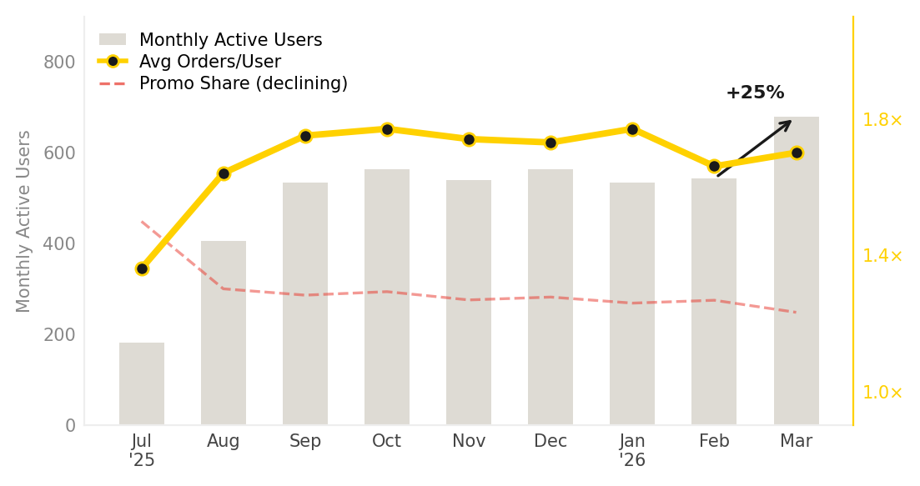
EXECUTIVE SNAPSHOT
Growth is accelerating — but repeat quality is still the question
1.72×
avg orders / user (LA avg)
41%
promo order share (↓ declining)
$23.1
avg order value
Topline growth is healthy, but at 41% promo mix, repeat quality deserves scrutiny. The next question is who comes back.

Slide 4
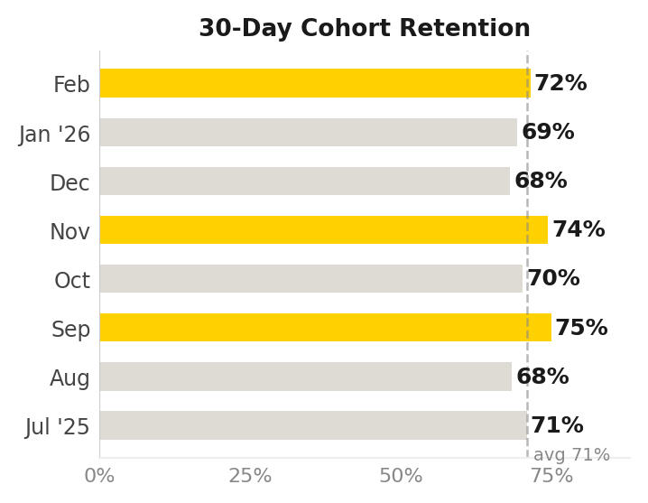
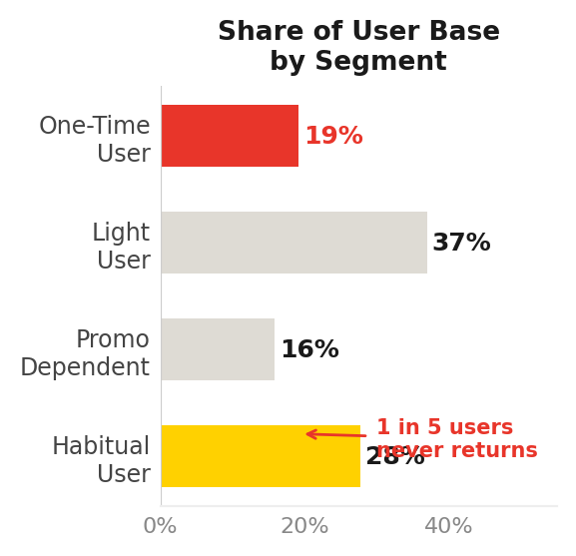
RETENTION DIAGNOSIS
The biggest opportunity: turning first orders into habits
OPPORTUNITY SIZING
one-time users
873
× 20% convert to 2nd
= 175
Incremental Orders
≈ $ 4.0K
Incremental GMV
One-time users are the clearest retention leak in LA. Converting 20% of them to a second order would add ~175 orders and ~$4.0K GMV.

Slide 5
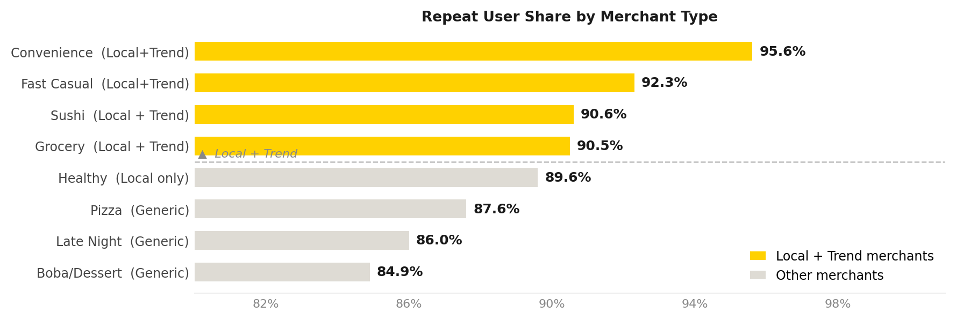
BRAND → BEHAVIOR
'In the Know' is measurable: local + trend merchants show the strongest repeat behavior
Postmates’ “in the know” positioning shows behavioral proof: local + trend merchants lead the repeat chart. Curated supply looks like a key retention lever in LA.

Slide 6
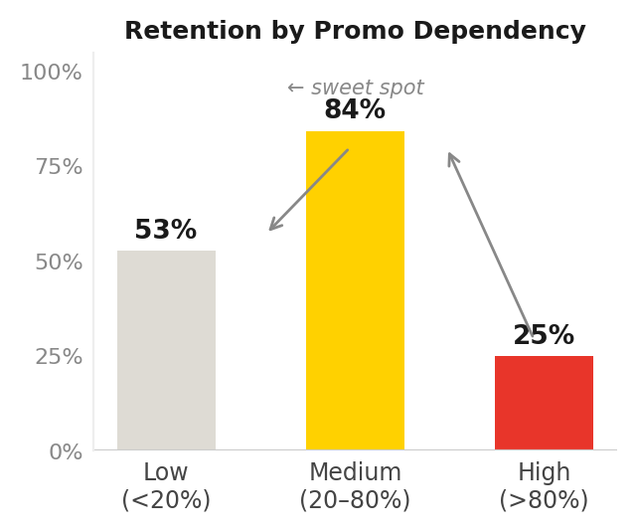
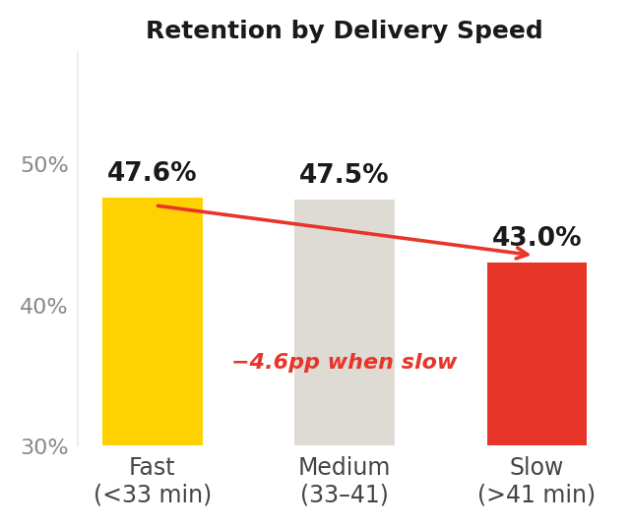
RISKS + OPPORTUNITY
Two growth quality risks — and one realistic retention opportunity
SCENARIO
if 20% of one-time
users convert to
a 2nd order
+175
Incremental orders
= ~$ 4 K
incremental GMV
High promo dependency appears lower quality. The more durable upside is improving second-order conversion through discovery-led retention, not heavier discounting.

Slide 7
SOCIAL SIGNAL FRAMEWORK
Can social buzz act as an early demand signal for local merchant curation?
01
INPUT SIGNALS
02
ANALYTICAL LAYER
03
OPERATIONAL USE
Social velocity
lead-lag analysis: Does buzz precede demand by 3–7 days?
Operational use
Feature rising merchants in-app Target CRM nudges before demand peaks
A/B test: signal-led curation vs. organic discovery cohort
Creator + influencer buzz
Hashtag acceleration
Mention growth
Signal scoring: Which signals predict repeat-friendly merchants?
→
→
Local relevance
Event & pop-up spikes
User overlap:
Do retained users over-index on signal-led merchants?
KPIs:
2nd-order conversion rate
repeat rate merchant GMV lift
Neighborhood buzz
Merchant emergence
New openings
Trending merchants
Aggregated via dedicated social listening tools (Brandwatch, Sprout Social)
S&O team builds the bridge between social data & order data
Closes the loop: buzz → curation → retention
Hypothesis: If social buzz leads demand by 3–7 days, Postmates can feature merchants before they peak. Business implication: That turns “in the know” from brand intuition into a measurable curation advantage.

Slide 8
From POSTMATE IT to POSTMATE IT AGAIN
Three bets, ranked by speed-to-signal
01
02
03
Second-Order Activation
Local Discovery Merchandising
Social Signal Scoring
WHAT TO TEST
WHAT TO TEST
WHAT TO TEST
A/B test: generic discount vs. local merchant rec vs. reorder nudge — triggered 48 hrs post-first-order.
Increase local + trend merchant exposure in first 30 days. Test discovery-oriented supply vs. control cohort.
Score merchant trend velocity using social buzz + creator data (Google Gemini / API). Target CRM nudges to rising merchants.
KPI
KPI
KPI
2nd-order conversion rate
time-to-2nd-order
30D repeat rate
local merchant order share
Signal-to-order lead time
cohort repeat rate
4 wks
6 wks
8 wks

Slide 9
HOW THIS WAS BUILT
How I built this case
01
02
03
04
Schema Design
SQL Analysis
Python & visualization
Strategic Narrative
+ AI Workflow
Designed 4 linked SQL-compatible tables: users, merchants, orders, monthly metrics — mirroring real S&O data models with realistic distributions.
Wrote retention queries: 30-day cohort analysis, segment-level repeat behavior, promo dependency, merchant mix breakdowns.
Processed query outputs, built segment aggregations, generated Matplotlib charts styled for brand clarity and data legibility.
Translated analysis into an Uber-style business review narrative. Used AI to refine hypotheses, wording, and deck structure.
→
→
→
Custom synthetic data
SQL · cohort / segment analysis
pandas · matplotlib · numpy
presentation · S&O storytelling
Skills:
SQL · Python (pandas, matplotlib) · Data modeling · Business storytelling · AI-assisted workflow design

