Slide 1
Transactions
Transaction Concept
Transaction State
Implementation of Atomicity and Durability
Concurrent Executions
Serializability
Testing for Serializability.

Slide 2
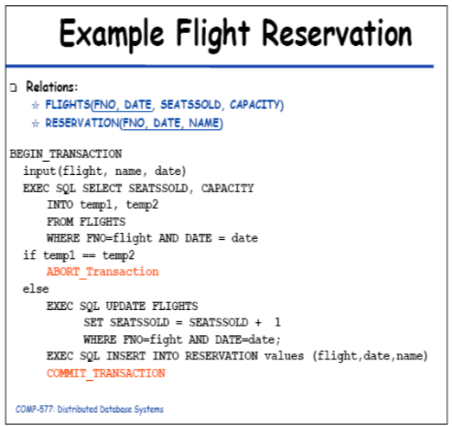
Example: Flight Reservation Transaction
A transaction is a unit of program execution that accesses and possibly updates various data items.

Slide 3
Transaction Concept
A transaction is a unit of program execution that accesses and possibly updates various data items.
A transaction must see a consistent database before its execution.
During transaction execution the database may be inconsistent.
When the transaction is committed, the database must be consistent.
Two main issues to deal with:
  Failures of various kinds, such as hardware failures and system crashes
  Concurrent execution of multiple transactions

Slide 4
ACID Properties
To preserve integrity of data, the database system
must ensure:
Atomicity. Either all operations of the transaction are properly reflected in the database, or none are.
Consistency. Execution of a transaction in isolation preserves the consistency of the database.
Isolation. Although multiple transactions may execute concurrently, each transaction must be unaware of other concurrently executing transactions. Intermediate transaction results must be hidden from other concurrently executed transactions.
  That is, for every pair of transactions T_{i} and T_{j}, it appears to T_{i} that either T_{j}, finished execution before T_{i} started, or T_{j} started execution after T_{i} finished.
Durability. After a transaction completes successfully, the changes it has made to the database persist, even if there are system failures.

Slide 5
Example of Fund Transfer Transaction
Transaction to transfer $50 from account A to account B:
  1. read(A)
  2. A := A – 50
  3. write(A)
  4. read(B)
  5. B := B + 50
  6. write(B)
Atomicity requirement — if the transaction fails after step 3 and before step 6, the system should ensure that its updates are not reflected in the database, else an inconsistency will result.
Consistency requirement – the sum of A and B is unchanged by the execution of the transaction.

Slide 6
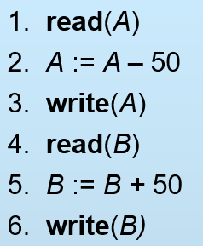
Example of Fund Transfer (Cont.)
Isolation requirement — if between steps 3 and 6, another transaction is allowed to access the partially updated database, it will see an inconsistent database
(the sum A + B will be less than it should be).
Can be ensured trivially by running transactions serially, that is one after the other. However, executing multiple transactions concurrently has significant benefits, as we will see.
Durability requirement — once the user has been notified that the transaction has completed (i.e., the transfer of the $50 has taken place), the updates to the database by the transaction must persist despite failures.

Slide 7

Transaction State
Active, the initial state; the transaction stays in this state while it is executing
Partially committed, after the final statement has been executed.
Failed, after the discovery that normal execution can no longer proceed.
Aborted, after the transaction has been rolled back and the database restored to its state prior to the start of the transaction. Two options after it has been aborted:
  restart the transaction – only if no internal logical error
  kill the transaction
Committed, after successful completion.

Slide 8
Concurrent Executions
Multiple transactions are allowed to run concurrently in the system. Advantages are:
  increased processor and disk utilization, leading to better transaction throughput: one transaction can be using the CPU while another is reading from or writing to the disk
  reduced average response time for transactions: short transactions need not wait behind long ones.
Concurrency control schemes – mechanisms to achieve isolation, i.e., to control the interaction among the concurrent transactions in order to prevent them from destroying the consistency of the database

Slide 9


Schedules
Schedules – sequences that indicate the chronological order in which instructions of concurrent transactions are executed
  a schedule for a set of transactions must consist of all instructions of those transactions
  must preserve the order in which the instructions appear in each individual transaction.

Slide 10
Example Schedules
Let T₁ transfer $50 from A to B, and T₂ transfer 10% of the balance from A to B. The following is a serial schedule (Schedule 1), in which T₁ is followed by T₂.
Schedule 1

Slide 11
Example Schedule (Cont.)
Let T₁ and T₂ be the transactions defined previously. The following schedule (Schedule 2) is not a serial schedule, but it is equivalent to Schedule 1.
Schedule 2
In both Schedules 1 and 2,
the sum A + B is preserved.

Slide 12

Example Schedules (Cont.)
The following concurrent schedule (Schedule 3) does not preserve the value of the sum A + B.
Schedule 3

Slide 13
Serializability
Basic Assumption – Each transaction preserves database consistency.
Thus serial execution of a set of transactions preserves database consistency.
A (possibly concurrent) schedule is serializable if it is equivalent to a serial schedule. Different forms of schedule equivalence give rise to the notions of:
  1. conflict serializability
  2. view serializability
We ignore operations other than read and write instructions, and we assume that transactions may perform arbitrary computations on data in local buffers in between reads and writes. Our simplified schedules consist of only read and write instructions.

Slide 14
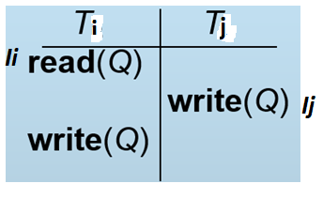
Conflict Serializability
Instructions l_{i} and l_{j} of transactions T_{i} and T_{j} respectively, conflict if and only if there exists some item Q accessed by both l_{i} and l_{j}, and at least one of these instructions wrote Q.
1. l_{i} = read(Q), l_{j} = read(Q). l_{i} and l_{j} don’t conflict.
2. l_{i} = read(Q), l_{j} = write(Q). They conflict.
3. l_{i} = write(Q), l_{j} = read(Q). They conflict
4. l_{i} = write(Q), l_{j} = write(Q). They conflict
A conflict between l_{i} and l_{j} forces a (logical) temporal order between them. If l_{i} and l_{j} are consecutive in a schedule and they do not conflict, their results would remain the same even if they had been interchanged in the schedule.

Slide 15
Conflict Serializability (Cont.)
If a schedule S can be transformed into a schedule S´ by a series of swaps of non-conflicting instructions, we say that S and S´ are conflict equivalent.
We say that a schedule S is conflict serializable if it is conflict equivalent to a serial schedule
Example of a schedule that is not conflict serializable:
T₃ T₄
read(Q)
write(Q)
write(Q)
We are unable to swap instructions in the above schedule to obtain either the serial schedule < T₃, T₄ >, or the serial schedule < T₄, T₃ >.

Slide 16

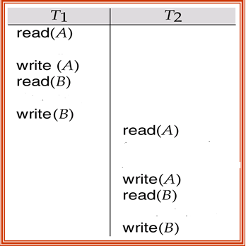
Conflict Serializability (Cont.)
Schedule 4 below can be transformed into Schedule 1, a serial schedule where T₂ follows T₁, by series of swaps of non-conflicting instructions. Therefore Schedule 4 is conflict serializable.
Schedule 4
Schedule 1

Slide 17
View Serializability
Let S and S´ be two schedules with the same set of transactions. S and S´ are view equivalent if the following three conditions are met:
  1. For each data item Q, if transaction T_{i} reads the initial value of Q in schedule S, then transaction T_{i} must, in schedule S´, also read the initial value of Q.
  2. For each data item Q if transaction T_{i} executes read(Q) in schedule S, and that value was produced by transaction T_{j} (if any), then transaction T_{i} must in schedule S´ also read the value of Q that was produced by transaction T_{j} .
  3. For each data item Q, the transaction (if any) that performs the final write(Q) operation in schedule S must perform the final write(Q) operation in schedule S´.
As can be seen, view equivalence is also based purely on reads
and writes alone.

Slide 18
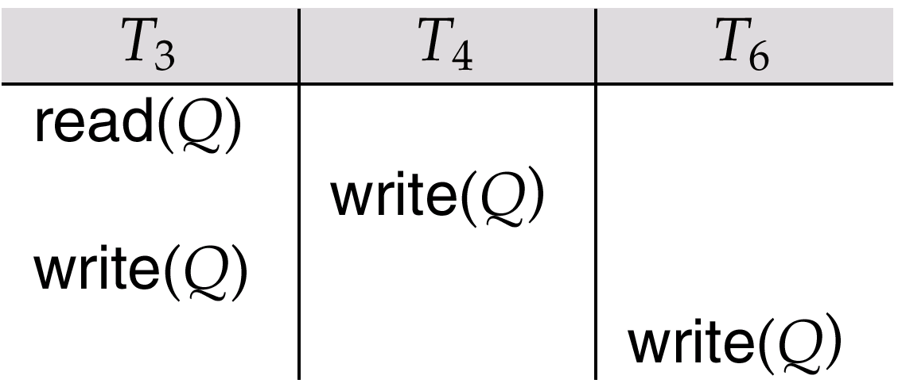
View Serializability (Cont.)
A schedule S is view serializable it is view equivalent to a serial schedule.
Every conflict serializable schedule is also view serializable.
Schedule 5 (below) — a schedule which is view-serializable but not conflict serializable.
Every view serializable schedule that is not conflict
serializable has blind writes.

Slide 19
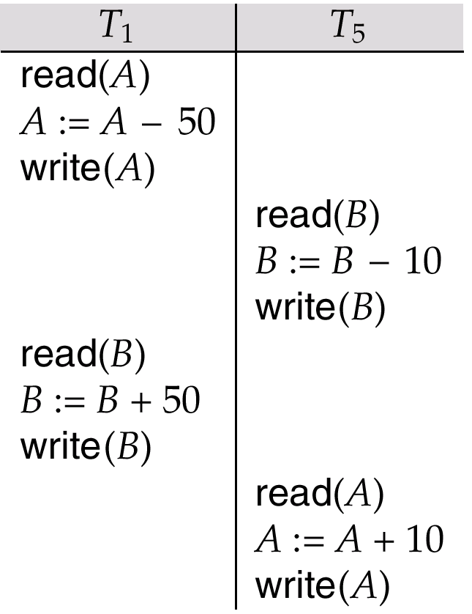
Other Notions of Serializability
Schedule 6 given below produces same outcome as the serial schedule < T₁, T₅ >, yet is not conflict equivalent or view equivalent to it.
Determining such equivalence requires analysis of operations other than read and write.

Slide 20
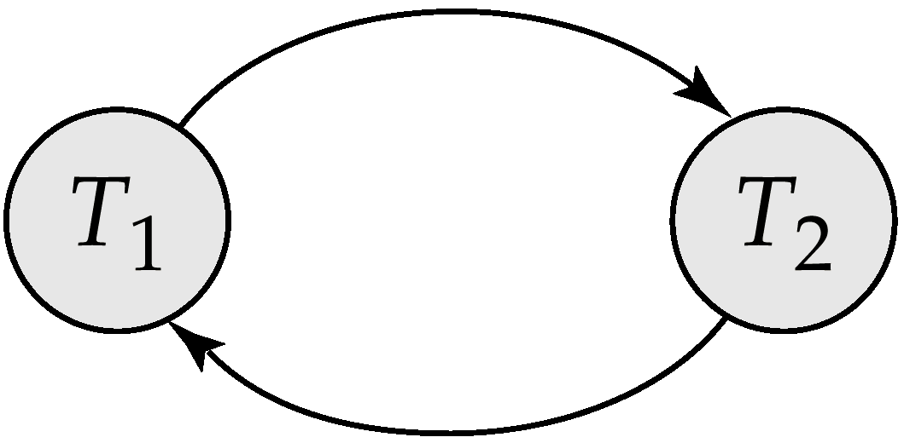
Testing for Serializability
Consider some schedule of a set of transactions T₁, T₂, ..., T_{n}
Precedence graph — a direct graph where the vertices are the transactions (names).
We draw an arc from T_{i} to T_{j} if the two transaction conflict, and T_{i} accessed the data item on which the conflict arose earlier.
We may label the arc by the item that was accessed.
Example 1
x
y

Slide 21
Example Schedule (Schedule A)
T₁ T₂ T₃ T₄ T₅
read(X)
read(Y)
read(Z)
read(V)
read(W)
read(W)
read(Y)
write(Y)
write(Z)
read(U)
read(Y)
write(Y)
read(Z)
write(Z)
read(U)
write(U)

Slide 22
Precedence Graph for Schedule A
T₁
T₂
T₄
T₃

Slide 23
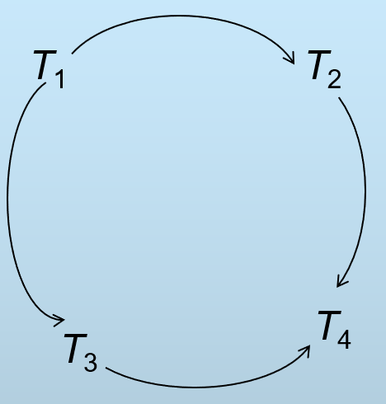
Test for Conflict Serializability
A schedule is conflict serializable if and only if its precedence graph is acyclic.
Cycle-detection algorithms exist which take order n² time, where n is the number of vertices in the graph. (Better algorithms take order n + e where e is the number of edges.)
If precedence graph is acyclic, the serializability order can be obtained by a topological sorting of the graph. This is a linear order consistent with the partial order of the graph.
For example, a serializability order for Schedule A would be
T₅ → T₁ → T₃ → T₂ → T₄ .

Slide 24
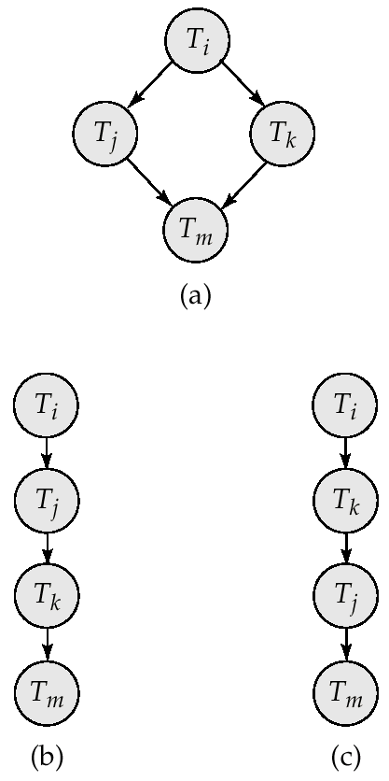
Illustration of Topological Sorting

Slide 25
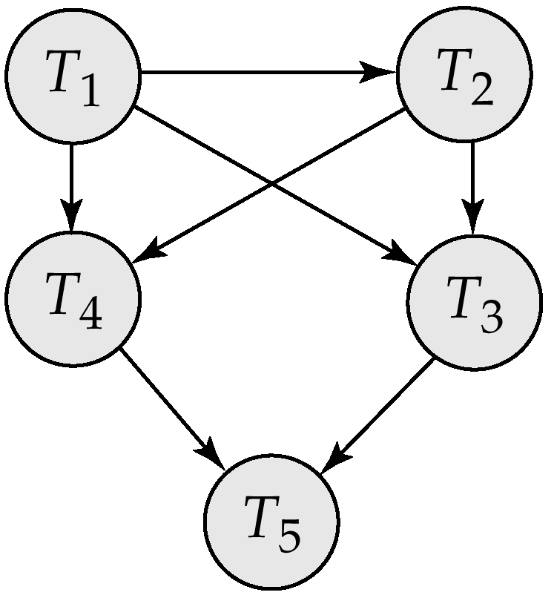
Precedence Graph

Slide 26
Test for View Serializability
The precedence graph test for conflict serializability must be modified to apply to a test for view serializability.
The problem of checking if a schedule is view serializable falls in the class of NP-complete problems. Thus existence of an efficient algorithm is unlikely.
However practical algorithms that just check some sufficient conditions for view serializability can still be used.

Slide 27
Concurrency Control vs. Serializability Tests
Testing a schedule for serializability after it has executed is a little too late!
Goal – to develop concurrency control protocols that will assure serializability. They will generally not examine the precedence graph as it is being created; instead a protocol will impose a discipline that avoids nonseralizable schedules.
Tests for serializability help understand why a concurrency control protocol is correct.

Slide 28
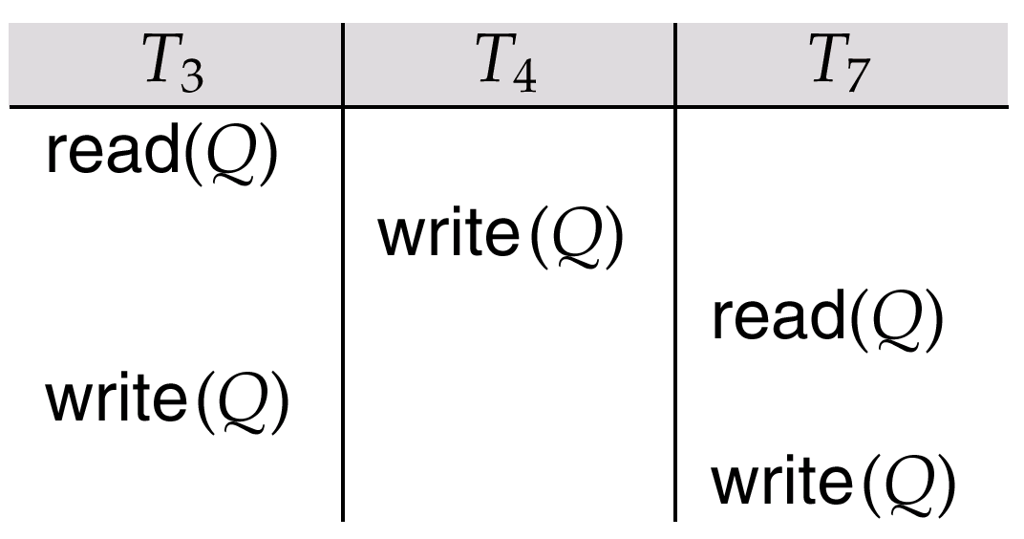
fig. 15.21

