Slide 1
Genetic Neural Network for Anomaly based network intrusion detection
Janou Milligan
Zachary Kennedy

Slide 2
CONTENTS
Our Project
The Process
Results

Slide 3
The Project
For this project, we’re focusing on cyber security which has recently become a major focus for a variety of artificial intelligence (AI) applications

Slide 4
Breaking it down
Cyber Security—a field of study that focuses on protecting computer systems, networks, data, programs, devices, and users from outsiders with malicious intent.
This largely focuses on the implementation of different tools such as firewalls, intrusion detection systems (IDS), honeypots, and others to evaluate, manage, and protect the security of data within all sectors of society.
Our project focuses on the development of an IDS by applying AI and machine learning (ML) algorithms to create a model capable of efficiently identifying/distinguishing between when a system is being attacked or not.
There are three main types of IDS: Network Intrusion Detection Systems (NIDS), Network Node Intrusion Detection Systems (NNIDS), and Host Intrusion Detection Systems (HIDS). For this project, we are focusing on developing an anomaly NIDS based on various classification models and neural networks. Utilizing ensemble methods, we aim to create a hybrid model capable of accurately predicting attacks.

Slide 5
Introducing the Data set
The models we use in testing will all be trained on the NSL-KDD data set.
This data set is a revision of the KDD’99 data set which came with numerous disadvantages such as:
Redundant records in training sets
Duplicate records in test sets
Exceedingly large amounts of data in the training and test sets
The NSL-KDD data set addresses some of the issues above to make it less biased and more consistent. The package also comes with subsets of the original data set prepared for training and testing

Slide 6
Our Approach
Our data set will lead the model to predict one of two outcomes: normal or attack. This shows that the nature of our project lies more on the use of classification models over regression models.
In recent years, a number of studies have already explored the applications of popular approaches such as random forests, support vector machines, and Naïve Bayes to name a few.
For our project, we decided to implement a neural network trained in conjunction with popular classification algorithms. A lot of research focuses on the evaluation of standalone models with a handful emphasizing a hybrid approach, and even fewer implementing a hybrid neural network.
Additionally, we also plan to explore the possibility of implementing an IDS model through low-code libraries to propose an easier process for model creation.

Slide 7
The Process
Stacking
The stacking process involves fitting different models onto the same data set and using another model to learn based on their predictions
Boosting
The boosting process involves using models that correct the predictions made by previous models, giving back a weighed average of those predictions
For this we decided on using the XGBoost framework, which will also help reduce processing times
The process we use for creating our models is as follows:
Data Preprocessing
For the NSL-KDD data set, this involves feature scaling all numerical values and encoding categorical strings using the Pandas dummy encoding method.
Model Training and Optimization
To train our models, we’re focusing on using the PyCaret library in order to implement classification model requiring minimal code outside the data preprocessing phase.
Additionally, we make use of stacking and boosting methods, through PyCaret, to further optimize our model
Model Evaluation
After the final model has been created, we use PyCaret to evaluate it on the initial dataset.

Slide 8
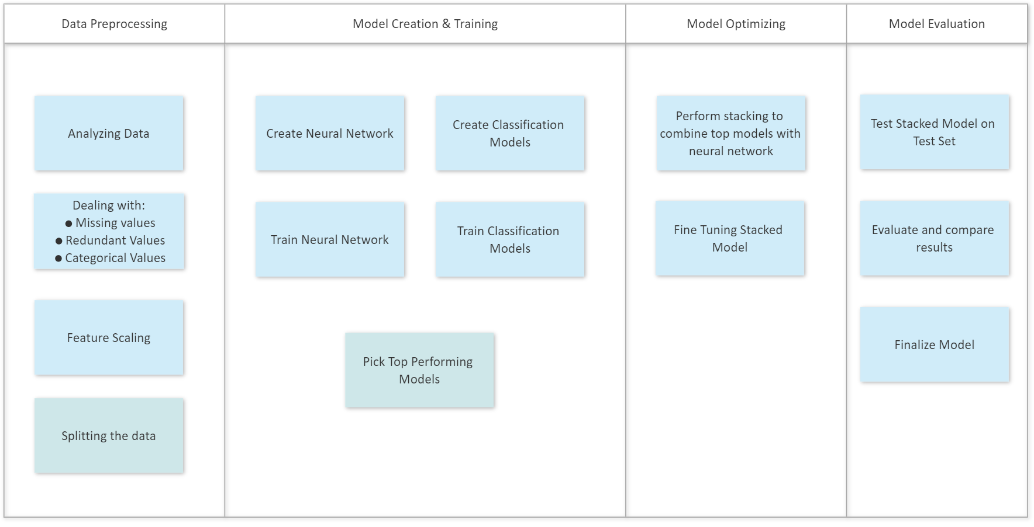
The Process (Illustrated)

Slide 9
Model Creation & Results

Slide 10
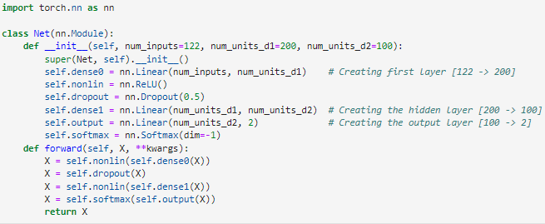
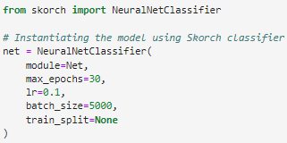
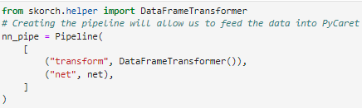
Creating the Neural Network
For this project, we create a simple neural network using the Torch library:
Afterward, we instantiate it and make it compatible with SKORCH
Finally, we create a pipeline to pass the data to PyCaret
Above, we define a simple, three-layer neural network
This also defines how we wish to fold and split the data, as well as the amount of epochs.
With this, our neural network is complete and ready to be fitted to the data

Slide 11
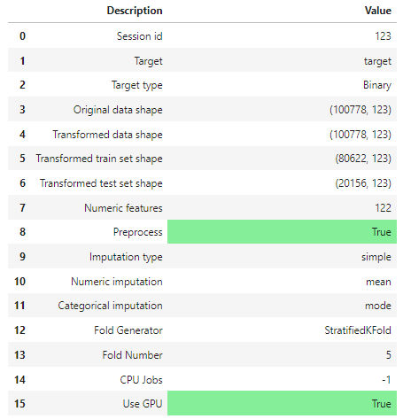
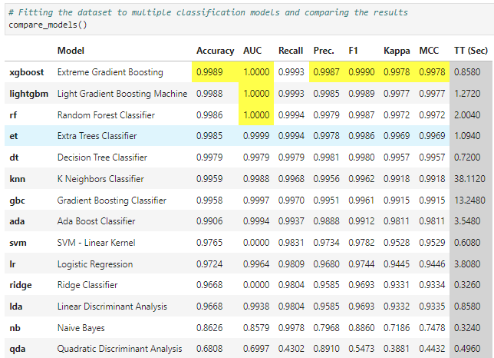
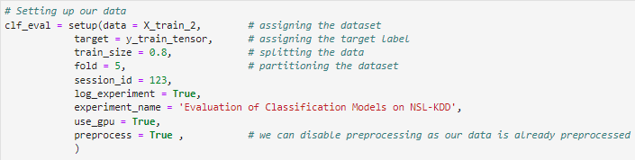
Creating Classification Models
The process for creating classification models is simpler
Below is a summary of the data, along with the data shapes, and enabled settings
Finally, we can generate and compare multiple classification models on our dataset
First, we set up PyCaret with our training data, as well as any other parameters for the model
We also define our folds, whether we train the models on the CPU or GPU, and preprocessing
Although our data has already been preprocessed, disabling this feature seems to restrict us from using other functions so we keep it enabled here

Slide 12
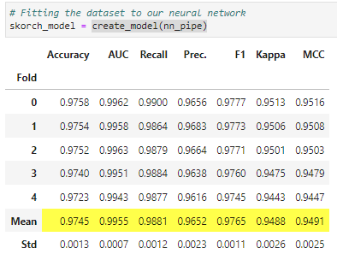

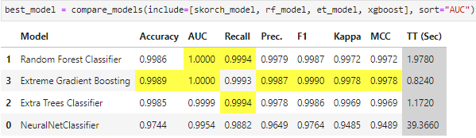
Using Pycaret to Run our Neural Network
Using the same process illustrated in the previous slide, we can get results from our neural network
Here, we create instances of the top three performing classification models and compare them to the neural network
These results will serve as the baseline for which we will compare our final model
Here, we create a model based on our neural network and obtain the above results

Slide 13
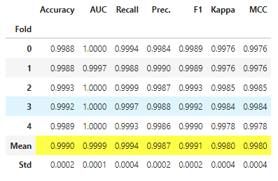
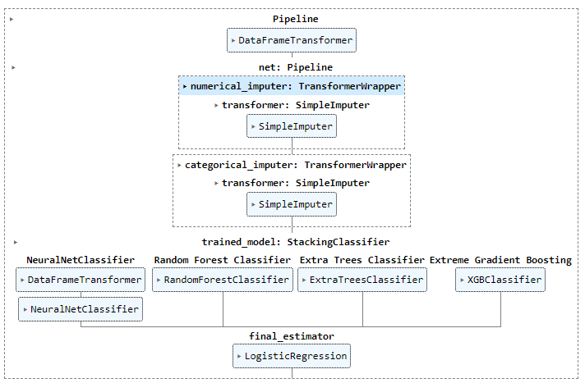
Stacking All the models
With all the models created, we can stack them to create our final model
Here we use PyCaret to easily stack our four models into one, creating our final neural classification model
As shown, our final model is comparable to our baseline models and even outperforms them in some areas

Slide 14
Analyzing the Results
Using the evaluation metrics precision, recall, accuracy, and f1-scores shown on the left, we can evaluate the effectiveness of our models.
All of these scores are based off true positive (TP), true negative (TN), false positive (FP), and false negative (FN) values
Precision—measures performance by comparing the amount of TPs with predicted positive values
TP / (FP + TP)
Recall—measures performance by comparing TPs with the actual amount of positive values
TP / (FN + TP)
Accuracy—the ratio of TP and TN to all positive and negative observations
(TP + TN) / (TP + FN + TN + FP)
F1-score—the harmonic mean of the precision and recall score
2 * Precision * Recall / (Precision + Recall)

Slide 15
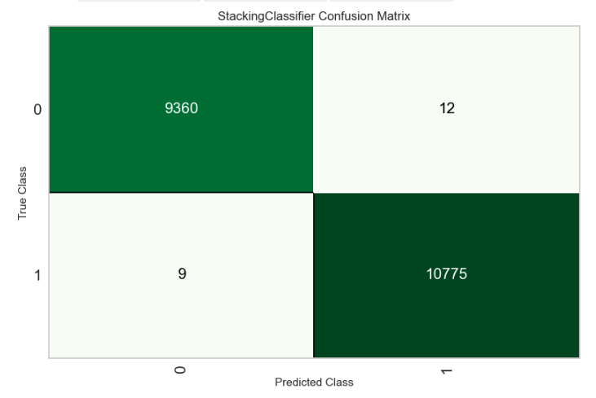

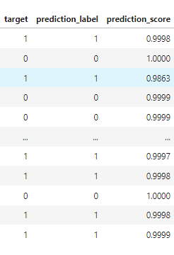
Predicting On the Test Set
Finally, we can run our model on the test set and analyze the predictions made.
The comparison is between the predicted values (prediction_label) made by the model vs. the actual value (target)
In this comparison, 1 is used to represent a normal packet while 0 is used to represent an attack/suspicious packet
We then analyze the confusion matrix in order to determine the amount of wrongly predicted labels
Here, we see that the model incorrectly predicted 21 (12 + 9) labels
We see that we have a total of 12 false negatives and 9 false positives

Slide 16
Final Remarks
By the end of the process, we ended up with a neural classification model comparable to the top classification models.
Additionally, this was done with relatively little code outside of the preprocessing phase, which was necessary to make the neural network compatible with the PyCaret’s library and would otherwise be unnecessary.
Our results show that the combination of top classification algorithms with neural networks shows great potential in the development of cybersecurity and the development of IDSs
Furthermore, this shows that the development of such models can be done relatively simply when compared to more traditional methods

