Slide 1
PicoFramework
A lightweight application framework for Raspberry Pi Pico W and Pico 2 W

Slide 2
What is PicoFramework?
A structured C++ framework for embedded development on RP2040
Inspired by modern web frameworks (e.g., Express.js, Nest.js and similar products)
Ideal for building networked, event-driven IoT applications
Open source, MIT license for any use

Slide 3
Why PicoFramework?
Inspired by application frameworks like Express.js, Nest.js for javascript and frameworks like Laravel for php
Limited flash and RAM has historically made it hard to replicate these frameworks on microcontrollers
The Pico and particularly the Pico 2 have a significant amount of flash, and the available RAM is enough to support an application framework
Although the Pico SDK is extensive it does not have FreeRTOS underpinning it, it also lacks components such as out-of-the box HTTP handling in the manner of the ESP3. It has a strong bare-metal focus
PicoFramework is the first real framework for multitasking application development on microcontrollers in the style of highly capable application frameworks like Express.js

Slide 4

Designed for:
IoT controllers (e.g., irrigation, HVAC, lighting)
Network-connected sensors and edge devices
Rapid prototyping of connected hardware
Familiarity for C++ developers
Design architecture that is easily understandable
Extensibility

Slide 5

Features at a Glance
MVC-style application structure
HTTP server with routing and middleware
JWT authorization and token generation, password hashing
Http Client with fluent builder style requests
Event-driven system with task scheduler
Sd Card storage manager with persistent json support

Slide 6
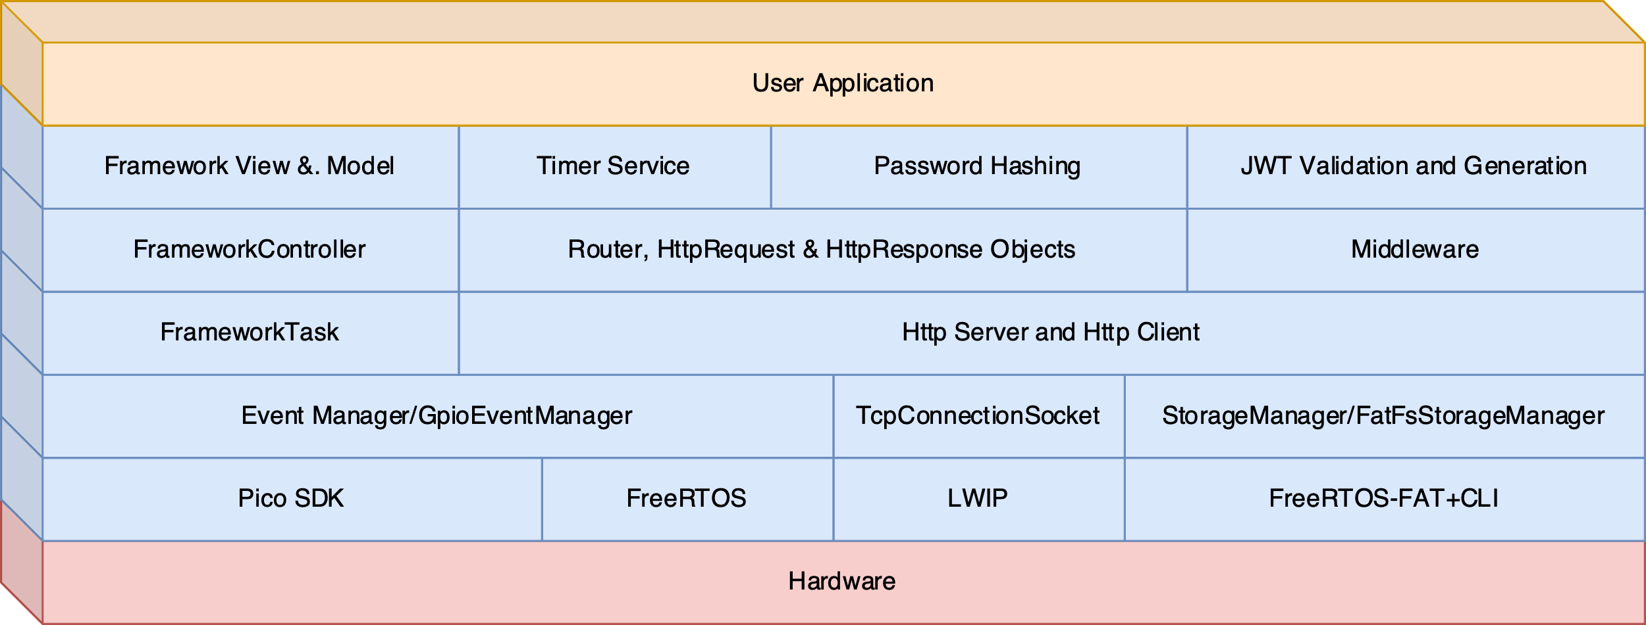
PicoFramework Components
Comprehensive but light framework

Slide 7
Embedded MVC
Model – stores app config (e.g. schedules)
View – serves HTML/JS from SD card (or your own StorageManager like littleFs)
Controller – handles requests and logic
Inspired by Express.js, adapted for C++

Slide 8
The App
App::App(int port) : FrameworkApp(port, "AppTask", 2048, 1), controller(nullptr), scheduler(nullptr)
{
std::cout << "App constructed" << std::endl;
}
void App::initRoutes() {
router.addRoute("GET", "/api/v1/programs", [this](HttpRequest &req, HttpResponse &res, const std::vector<std::string> &params)
{
this->scheduler->handle_get_programs(req, res, params);
});
…
void App::run() {
waitFor(FrameworkNotification::NetworkReady);
controller = Controller::get_instance();
controller->start();
scheduler = Scheduler::get_instance();
scheduler->start();
initRoutes();
server.start()
while (true) {// app loop}

Slide 9
The App
class MyApp : public FrameworkApp {
public:
MyApp() : FrameworkApp(80, "MyApp") {}
void onStart() override {
TRACE("App starting up...");
// Initialize sensors, state, etc.
}
void poll() override {
// Main loop logic here
}
void onEvent(const Event& e) override {
// Handle events here
}
};

Slide 10
Routing System (Express.js-style)
Add routes via router.addRoute(method, path, handler)
REST-friendly: GET, POST, PUT, DELETE
Lambdas or method pointers as handlers
Per-route and global middleware
Path parsing and matching with variables
Built-in /auth route handler for JWT token test (can override)
Route debug printing (adding, handling routes)
router.addRoute("GET", "/info", [](Request &req, Response &res) { res.sendText("System Info Page"); });
router.addRoute("POST", "/config", configHandler, {authMiddleware});

Slide 11
Routing Example
Add routes in your app controller:
router.use(loggingMiddleware);
router.addRoute("GET", "/index.html", [this](HttpRequest &req, HttpResponse &res, const std::vector<std::string> &params) {
this->router.serveStatic(req, res, params);
}); router.addRoute("GET", "/api/v1/programs", [this](HttpRequest &req, HttpResponse &res, const std::vector<std::string> &params) {
this->scheduler->handle_get_programs(req, res, params);
}); router.addRoute("GET", "/api/v1/programs/{name}", [this](HttpRequest &req, HttpResponse &res, const std::vector<std::string> &params) {
this->scheduler->handle_get_program(req, res, params);
}); router.addRoute("GET", "/api/v1/zones", [this](HttpRequest &req, HttpResponse &res, const std::vector<std::string> &params) {
this->controller->handle_get_zones(req, res, params);
}); router.addRoute("POST", "/api/v1/programs", [this](HttpRequest &req, HttpResponse &res, const std::vector<std::string> &params) {
this->scheduler->handle_add_program(req, res, params);
}); router.addRoute("PUT", "/api/v1/programs/{name}", [this](HttpRequest &req, HttpResponse &res, const std::vector<std::string> &params) {
this->scheduler->handle_update_program(req, res, params);
}); router.addRoute("DELETE", "/api/v1/programs/{name}", [this](HttpRequest &req, HttpResponse &res, const std::vector<std::string> &params) {
this->scheduler->handle_delete_program(req, res, params);
});

Slide 12
Response Handling
res.setStatus(401).send("{\"error\":\"Unauthorized\"}");
Or via helper
JsonResponse::sendError(res, 401, "INALID_TOKEN", "Invalid token");
void sendError(HttpResponse& res, int statusCode, const std::string& code, const std::string& message) {
json j = {
{"success", false},
{"error", {
{"code", code},
{"message", message}
}}
};
res.status(statusCode).json(j);
}

Slide 13
Middleware and Auth
Support for per-route and global middleware:
router.addRoute(GET, "/auth", authMiddleware, &AuthController::handle);
JWT-based authentication with token verification and generation
Optional at build time via PICO_HTTP_ENABLE_JWT

Slide 14
JWT Authentication
Middleware-based token checking
Authorization: Bearer <jwt> parsing
HMAC signature validation
[Token expiry verification]
Protected route support with fallback 401 response
JWT secret from build or config

Slide 15
Controller Example
[this needs updating]
void ZoneController::start(HttpRequest& req, HttpResponse& res) {
auto name = req.getPathParam("name");
zoneService.startZone(name);
res.sendJson({{"status", "started"}});
}

Slide 16
Event System
[check event names]
Post and subscribe to system-wide events
Broadcast capable
eventManager.subscribe(EventType::NetworkReady, this);
onEvent(const Event& e) handles callbacks
Used by TimerService, GpioHandler, custom logic
EventManager::getInstance().subscribe(mask(EventType::GpioChange), this);
TRACE("[Controller] Subscribed to GpioChange events\n");
GpioEventManager::getInstance().enableInterrupt(15, GPIO_IRQ_EDGE_RISE | GPIO_IRQ_EDGE_FALL);

Slide 17
Event Handling
void Controller::onEvent(const Event& event) {
switch (event.type) {
case FrameworkNotification::TimerTick:
_state = WAITING_FOR_PROGRAM;
break;
case FrameworkNotification::RunProgram:
handleRunProgram();
break;
case FrameworkNotification::ProgramStartTime:
handleStartTime();
break;
case FrameworkNotification::ZoneEndTime:
handleZoneEnd();
break;
case FrameworkNotification::GpioChange:
::handleGpioEvent(event);
break;
…

Slide 18
TimerService
Supports one-shot and recurring timers
scheduleAt(timestamp, EventType::StartZone)
scheduleDailyAt("06:00", EventType::PumpOn)
Backed by RTC or AON time (external RTC support coming)

Slide 19
Storage Support
SD card file serving via FatFs using 4-bit SDIO (or SPI)
Upload via multipart/form POST (single file only)
JsonService for config/model persistence
All file logic can be excluded at build time [exclusion being worked on right now]

Slide 20
HTTP Client
HttpRequest with fluent builder API
Full URL parsing with .setUri()
TLS support with root certificate verification
HttpResponse object with status, headers, body, file-saving
Chunked transfer decoding
HttpClient abstraction under-the-hood
printf("\nTLS test to Raspberry Pi example\n");
response = request.setRootCACertificate(BROWSER_ROOT_CA)
.get("https://fw-download-alias1.raspberrypi.com/net_install/boot.sig");
if (!response.ok()) {
printf("RPi Failed to fetch data\n");
}
else{
printf("TLS request sent successfully\n");
printf("RPi Response: %s\n", response.getBody().c_str());
}

Slide 21
Http Client Fluent Builder
Build your request:
request.setHost("httpbin.org")
.setProtocol("http")
.setUri("/get")
.setMethod("GET")
.setUserAgent("PicoFramework/1.0");
Send and check for success:
response = request.send();
if (response.ok()) {
printf("Request sent successfully\n");
printf("Status: %d\n", response.getStatusCode());
printf("Body:\n%s\n", response.getBody().c_str());
} else {
printf("Plain HTTP GET failed\n");
}

Slide 22
Optional Features
TLS via mbedTLS and altcp (client-side only right now)
JWT authentication and middleware
SD/FatFs file system and upload handling
Enable/disable via CMake options

Slide 23
Custom Extensions
Add your own Controllers, Services, Models
Support user-defined events and handlers
Flexible logging and tracing system
Designed for adaptation, not lock-in

Slide 24
Where It Stands
v0.1.0 release nearly complete (target May early release for discussion and feedback)
Includes working HTTP server, HTTP client, eventing, routing, storage, MVC
Roadmap: WebSockets?, OTA?, CLI?
More examples to come

Slide 25
Get Involved
Open source under MIT license
GitHub: https://github.com/picoframework
Consulting, support, and customization available
Let's build better embedded apps together

Slide 26
Testing (In Progress)
CppUTest for embedded unit testing
Mocha for end-to-end testing
[Some mocks available for host CppUtest]

Slide 27
Documentation
Full Doxygen comments for:
Public headers
Core framework classes
Utility functions
File-level doc blocks
More complete docs coming

