Slide 1
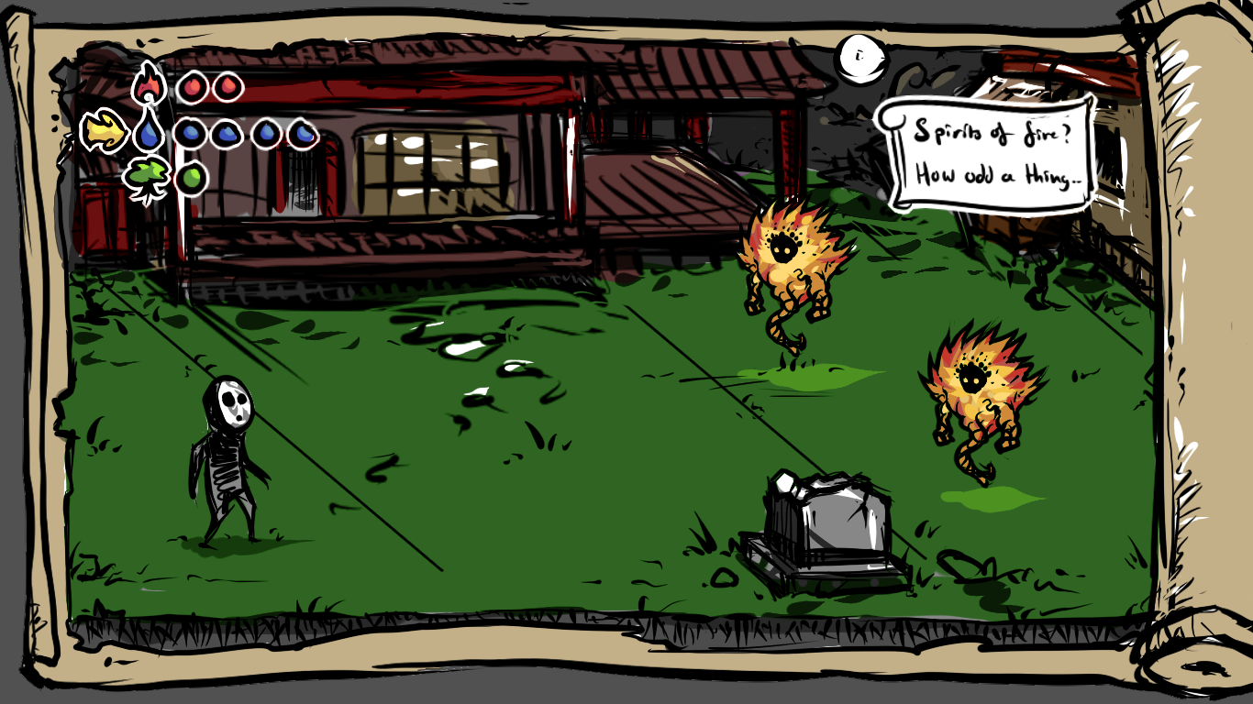
JIAN
Grupp 12
Possession
Producer/Lead prog:
André Åström
Lead Artist:
Christoffer Svensson
Lead Designer:
Marcus Svensson
Evelina Venngren
Alex Untoro
Nicolina Åkerfelt
Notes:
Hello everyone,
My name is André Åström, and I am from group twelve.
We chose the concept “Possession” from group eight.

Slide 2
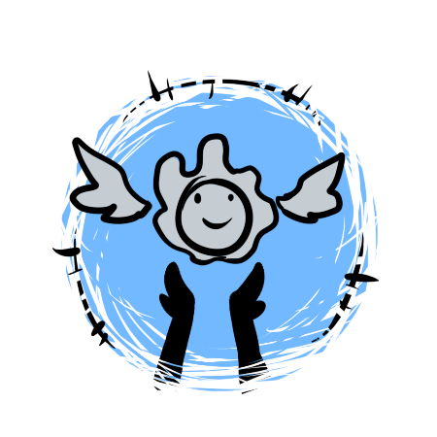
Improvements
Better workflow
Soft coding
The design document
Notes:
1.
Better workflow, more experienced in both programming and animating. Allowing for faster production. Also we have better communication between the programmers, so we check each others code more frequently and giving feedback.
2.
We got a start for simple soft coding in .txt files. Making it possible for both programmers and artists to playtest the game and making tweaks.
3.
Before we did not have someone who could be considered a dedicated designer, who could update the design document, but now we have someone who update it quite frequently. Giving it a better and more cohesive structure.

Slide 3
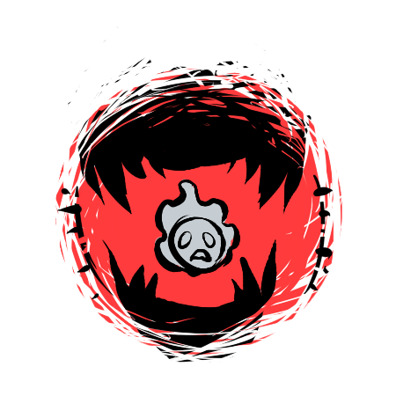
Setbacks
Pressure
Distribution of work
SCRUM
Notes:
1.
We got quite a lot of graphical components left to draw, and also some content left to put into the game such as power ups. With just two weeks left, this is getting stressful. When we want to have as much time possible for playtesting.
2.
We have been oblivious to the fact that the leads have more of an administrative role, so we have not been having a good work distribution.
3.
We have also been neglecting to update the feature definition, product backlog as well as the task tracker. Meaning that someone who would join our group would not be able to understand what was going on just by looking at the SCRUM.

Slide 4
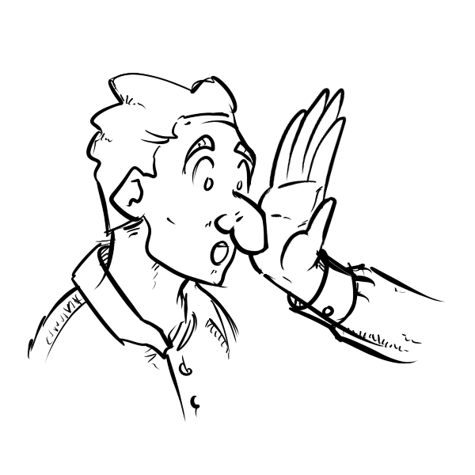
How to - prevent
Less complexity to the design
Be more pessimistic
Convey the pipeline earlier
Backlog + Feature definition + Task tracker
Notes:
1.
Be a bit less complex on the design choices, like we have done with our boss. Instead of some monstrous boss with fire, water and wood attributes. We simple made it into a floating mask with some flames.
2.
By being pessimistic we would probably have achieved the first point by itself. Also we would have accounted for more hours on smaller things, leading to different design choices.
3.
If we had defined a pipeline from the beginning instead of started working right away, we would have had a better structure and probably been working more efficiently as well.
4.
If we would have been going through the backlog, the feature definition and the task tracker once a week, it would have been much easier to update the design document.

Slide 5
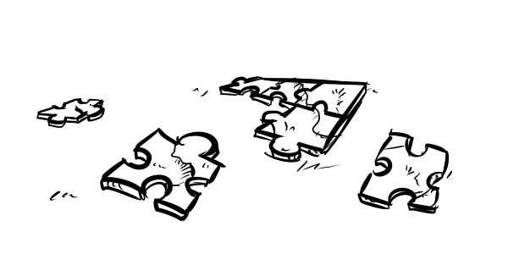
How to - solve
Implementing the prevent points
Notes:
We should be able to fix most of our issues by implementing our prevent points. Such as the SCRUM and the pipeline. It is probably to late to increase our pessimism, however we are surely going to scrap some things that are not essential to the game itself.

Slide 6
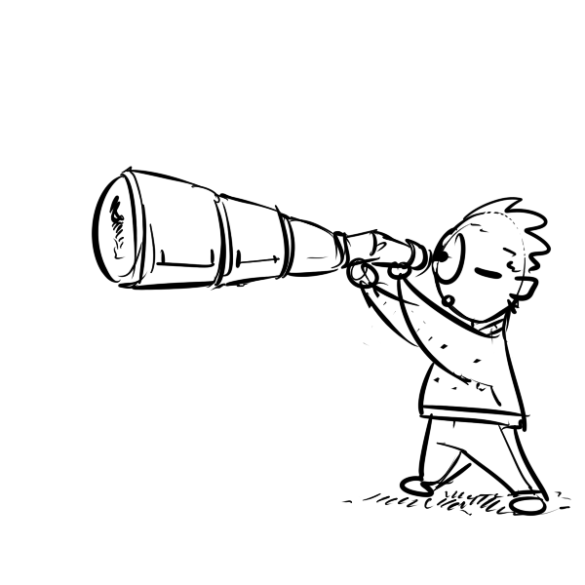
Final focuses
Enemy AI’s
Level design
Sound
Playtesting
Notes:
1.
The AI behaviour of our enemies are essential to the core gameplay, as without their different behaviour there are not any actual challenge in the game.
2.
Our level design is also essential for our tutorial part, since we do not want to use test to teach our players the way they play our game.
3.
To achieve the moody feeling of our game, implementing some howling winds and tapping footstep sounds are invaluable.
4.
After implementing the AI and the level design, we want to playtest as much as we can. So that we balance it to the best of our abilities.

