Slide 1
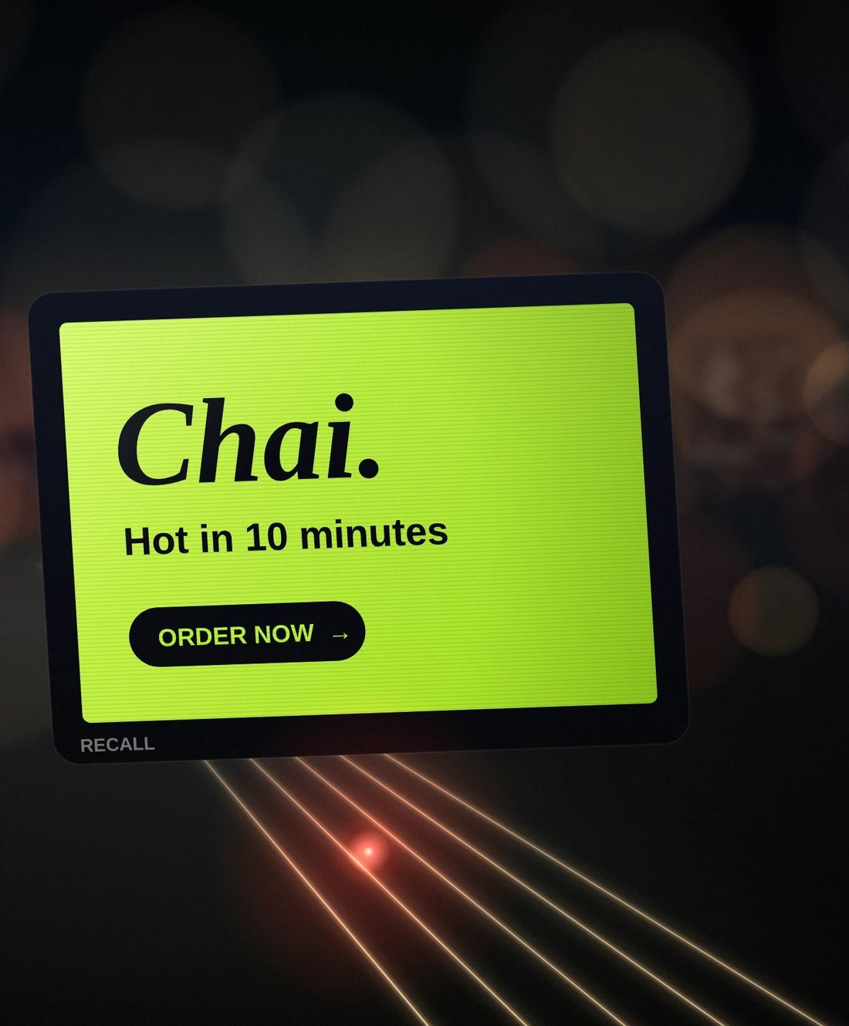

Your brand, on the streets tonight
SEED ROUND · NOVEMBER 2026
Moving LED screens on delivery and bike-taxi two-wheelers in Hyderabad. Brands pay by the bike-hour, never per view.
₹5 Cr
Built
Aug 2027
seed we are raising
platform, tested
POC starts
Prateek Medikonda, founder · Confidential
Notes:
RECALL puts moving LED screens on the delivery and bike-taxi two-wheelers already on Hyderabad's streets. Brands book bike-hours; riders are paid for the hours they move. We are raising a ₹5 Cr seed (Jan 2027), with a ₹3 Cr round 2 planned for Mar 2028 on POC data: ₹8 Cr in all. The platform is built and tested. Source: model v5.4 (5 Nov 2026).

Slide 2
Screens on the bikes already on every street
RECALL IN ONE MINUTE
₹3 Cr
₹1.47 Cr
Built
₹5 Cr
POC revenue
POC cost, about
The whole platform
Seed we are raising
40 brands × ₹2.5 L a month × 3 months, plus GST
Riders, team, running costs and buffer. The POC adds about ₹1.53 Cr.
Rider app, brand portal, staff portal, screen player, billing ledger
Plus ₹3 Cr round 2 in March 2028, ₹8 Cr in all
First profit in February 2028. Most cash used: ₹2.30 Cr; the bank never falls below ₹2.70 Cr.
Then: 15,500 bikes in 5 cities by 2031, with ₹557 Cr of revenue we keep and ₹156 Cr profit before tax.
Source: model v5.4 (5 Nov 2026). Revenue we keep = billed, less agency and aggregator cuts. Before GST.
Notes:
Four numbers: ₹3 Cr of POC revenue (40 brands × ₹2.5 L + GST a month, Aug–Oct 2027), about ₹1.47 Cr of POC cost (so the POC adds about ₹1.53 Cr), a platform that is already built, and a ₹5 Cr seed followed by ₹3 Cr in March 2028, ₹8 Cr in all. February 2028 is the first profitable month. The most cash the plan ever uses is ₹2.30 Cr, and the bank never falls below ₹2.70 Cr (Jul 2027, after the screen kits are paid and just before the POC fees come in). 2031: 15,500 bikes in 5 cities, ₹557 Cr revenue we keep, ₹156 Cr profit before tax. Source: model v5.4 (5 Nov 2026).

Slide 3



Offline ads are costly and blind
THE PROBLEM
Online is crowded
Offline is costly
Offline is blind
Feeds are packed. Ads get skipped and forgotten.
Hoardings need big budgets and long lock-ins.
A hoarding cannot tell a brand who saw it, where or when.
RECALL is an alternative to offline: hoardings, pamphlets and newspaper inserts. Not another online ad platform.
Notes:
Positioning from PRODUCT_V54: RECALL is an alternative to offline (hoardings, pamphlets, newspaper inserts), not an online ad platform. The old deck's market-share statistics are left out because they are not in the repo sources.

Slide 4
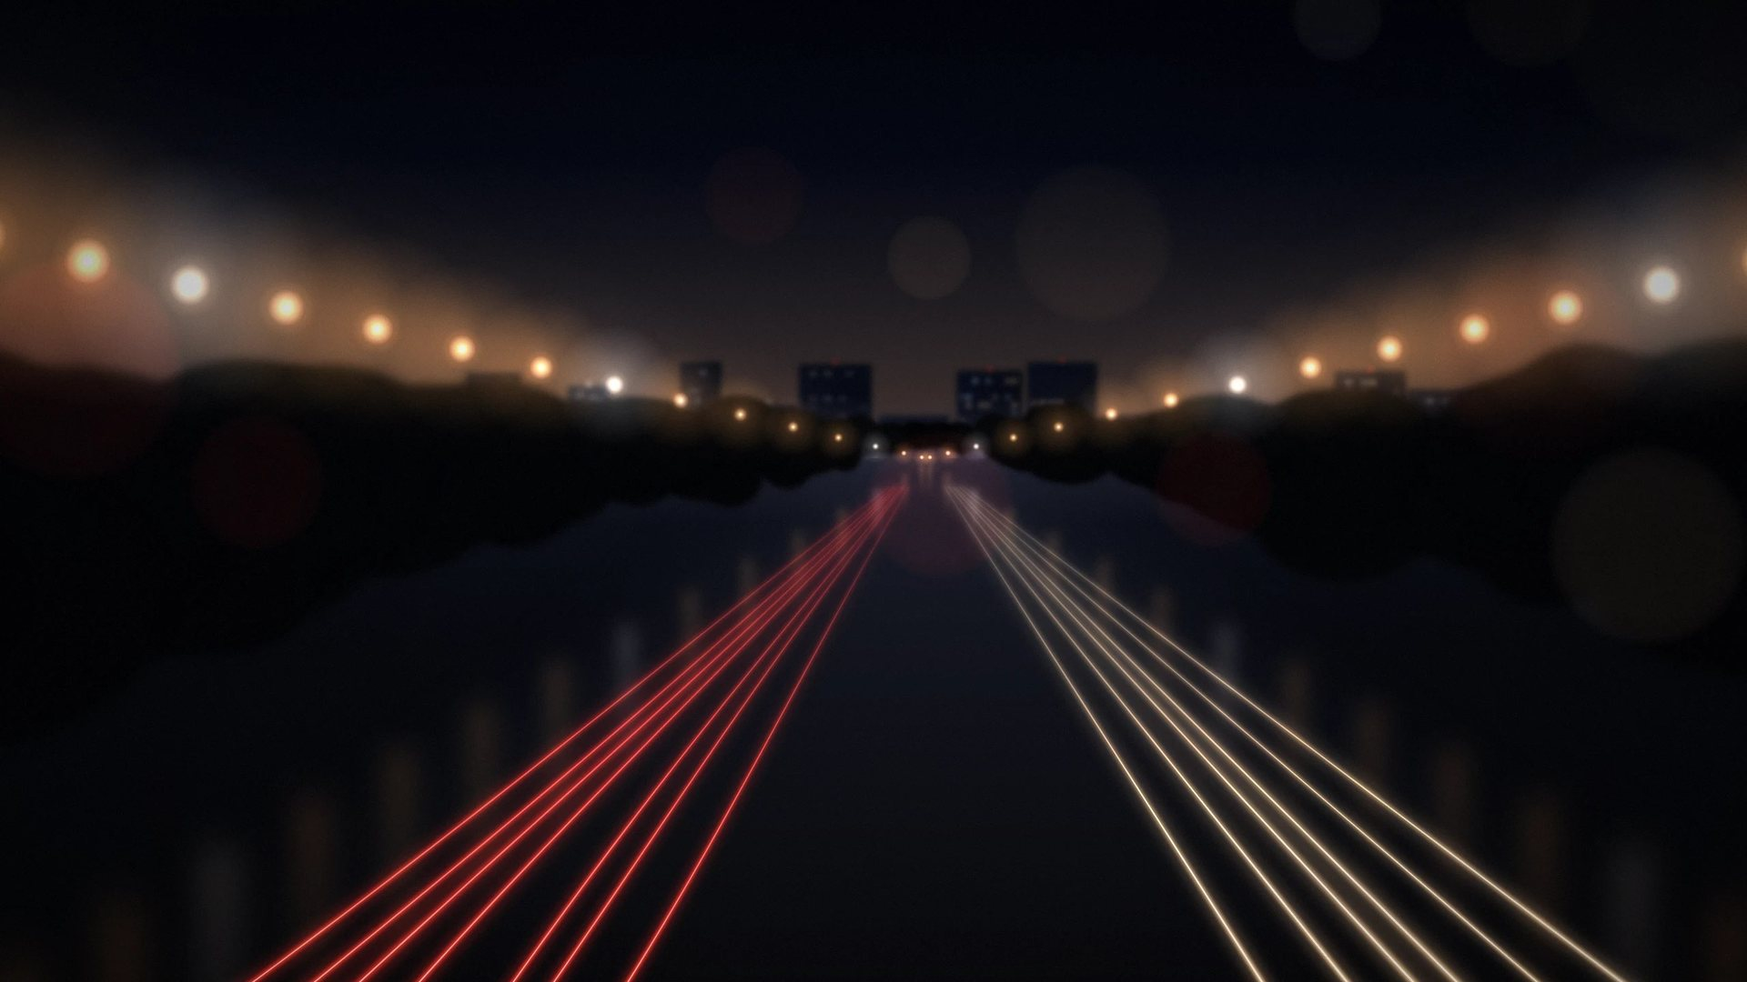
The back of every delivery bike is a screen. Nobody sells it.
THE INSIGHT
01
02
03
Riders are on every street, all day: homes, offices and markets.
We pay them for every moving hour inside our areas.
Brands pay only for bike-hours, with proof of every play.
Notes:
The idea: delivery and bike-taxi two-wheelers already cover the city. RECALL turns the back of each bike into a bookable screen. Riders earn for moving hours; brands buy bike-hours.

Slide 5
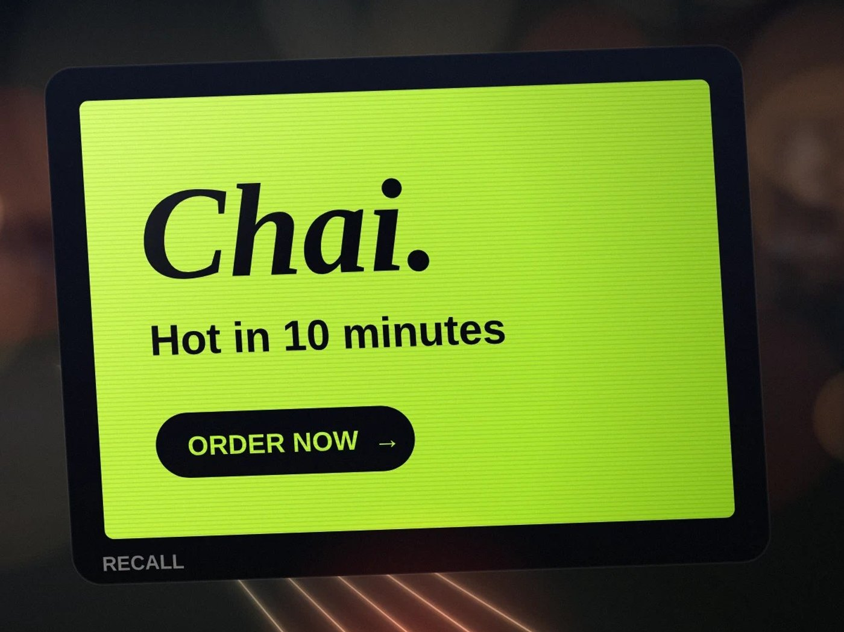





A 28-inch screen that runs itself
THE SCREEN
28-inch P2.5 LED, up to 5,000 nits
Readable in sunlight, dims itself at night. IP65 front.
11-hour battery
768 Wh LiFePO4: about 11 hours at about 60 W.
Android box with 4G and NavIC GPS
Saves ads and replays them. Plays only inside our areas.
Every play signed on the screen
The cloud never invents a play. Billing uses only these records.
2 MP AI camera that only counts people
Pictures wiped in under a second. No video stored or sent, no faces. Counts are never billed.
Kit v2.1, before GST: ₹49,100 a POC kit (screen part ₹47,300 + camera ₹1,800), ₹41,600 a new bike, cap ₹52,000 · Road test: 4 kits on 3 bikes, 25 Jan – 8 Feb 2027 · Illustration.
Notes:
Kit v2.1 (27 Oct 2026, in the model 5 Nov 2026): 28-inch P2.5 outdoor LED (640 × 320 mm, up to 5,000 nits), IP65 front and IP54 back, sun hood and fan; Android controller (RK3568 with an AI chip, 4G, NavIC GPS); 12.8 V 60 Ah LiFePO4 battery (768 Wh), about 11 hours at about 60 W; 4-point rack bolted to the bike's strong points, stainless hinge, 2-point lock; under about 8 kg (to confirm on the sample). Cost before GST: ₹49,100 a POC kit (₹47,300 screen part + ₹1,800 RECALL camera), 210 kits = ₹1.03 Cr; ₹41,600 for a new bike after the POC (₹40,100 + ₹1,500). Kit cap ₹52,000. The camera stays RECALL's; riders buy the screen part on Dhanlaxmi Bank loans (₹55,800 / ₹47,300 with GST). Road test on 4 sample kits (₹2.93 L before GST) on 3 bikes, 25 Jan – 8 Feb 2027; mount and hinge design ₹0.43 L, Nov–Dec 2026. Camera counts are proof in reports, never the bill. DPDP legal check before the POC.

Slide 6
Brands buy whole bike-hours, nothing else
WHAT BRANDS BUY
PEAK
NORMAL
LITE
THE PROMISE
₹300
₹250
₹220
Madhapur, Tuesday 5–6 pm, 20 bikes
8–11 am, 5–11 pm
11 am–5 pm
11 pm–2 am
4,000 plays
Prices per bike-hour, plus 18% GST.
One bike-hour = 240 spots of 15 seconds
inside Madhapur in that hour, on at least 20 different bikes.
200 plays of the brand's ads
40 RECALL
If short: made up within 2 hours in that area, else the same hour next day, else refunded.
Full bike-hours only, no shared slots: on that bike, in that hour, only that brand plays.
At least 5 bikes and ₹15,000 a booking, paid in advance, plus 18% GST.
Offers only for long plans: 6 months 8% off, 12 months 12% off.
Never billed per view. People counts are estimates.
Notes:
PRODUCT_V54 (decided 21 Oct 2026): full bike-hours only; Peak ₹300 (08–11, 17–20, 20–23), Normal ₹250 (11–17), Lite ₹220 (23–02), plus 18% GST. One bike-hour = 200 brand plays + 40 RECALL spots. Minimum 5 bikes and ₹15,000 per booking; 100% in advance. Offers: 6 months 8%, 12 months 12%; never below ₹220. Up to 10% of plays may fall just outside the boundary. One free 1-week trial per business. Source: model v5.4 (5 Nov 2026), rulebook v5.4.

Slide 7
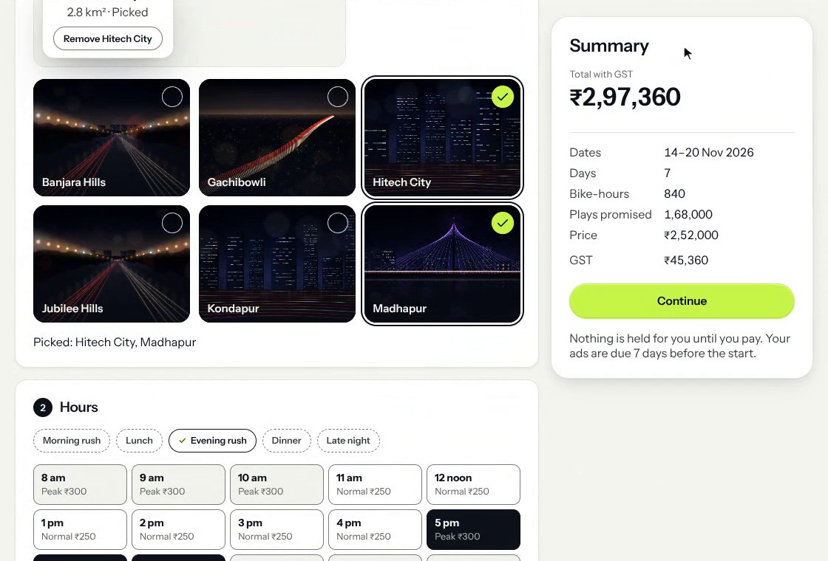
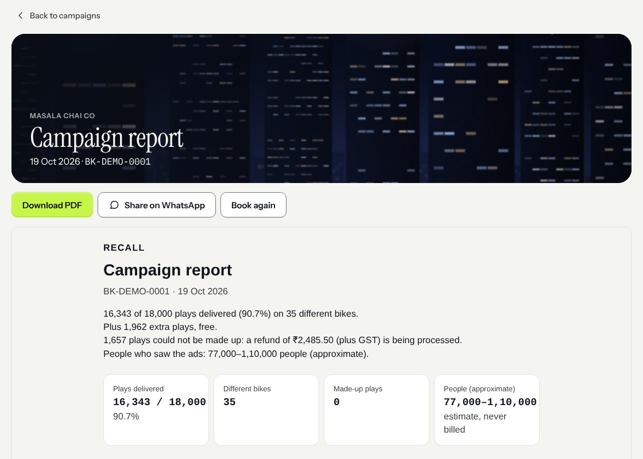
Brands book in minutes and get proof after
PRODUCT · BRAND PORTAL
Book: pick areas, hours, days and bikes. The price shows at once.
Report: plays delivered, different bikes, make-ups, and people (an estimate, never billed).
Notes:
Real screens from the working brand portal, with demo data. The portal has 9 screens: sign in, business, campaigns, book, ads, review and pay, final report, invoices, help (PRODUCT_V54).

Slide 8
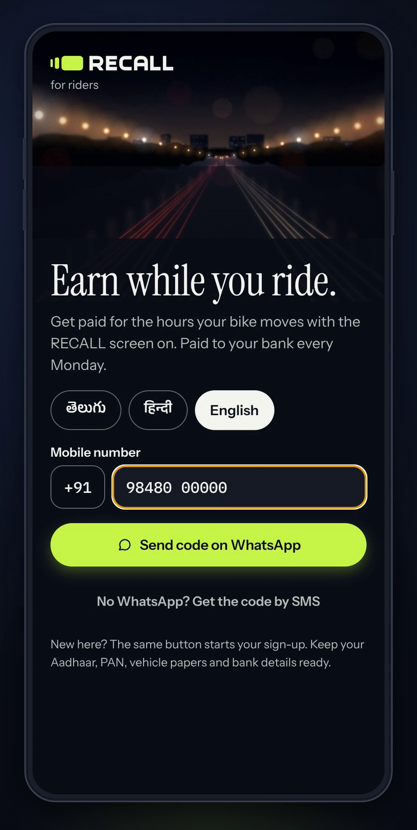
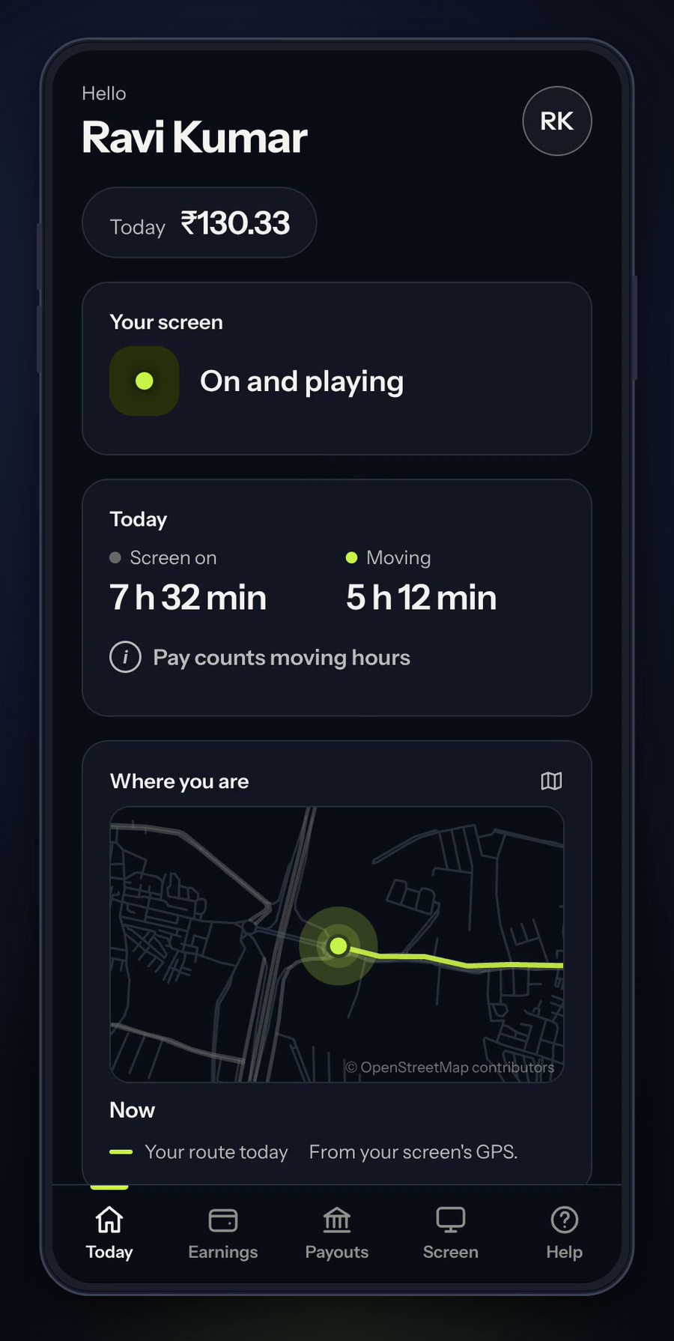
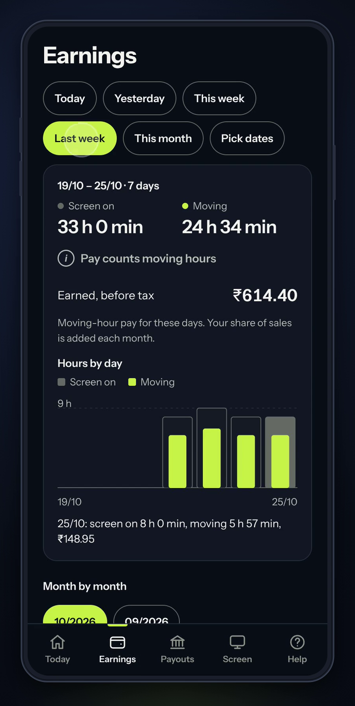





Riders see every rupee they earn
PRODUCT · RIDER APP
Sign in with a WhatsApp code
Telugu, Hindi or English
Pay counts moving hours only, from the screen's GPS
Paid to his bank every Monday
Screen status, today's route, earnings by day and month
Welcome
Today
Earnings
Notes:
Real screens from the rider app (React Native), demo data. Riders sign in with a WhatsApp code, see moving hours and earnings, and are paid every Monday.

Slide 9
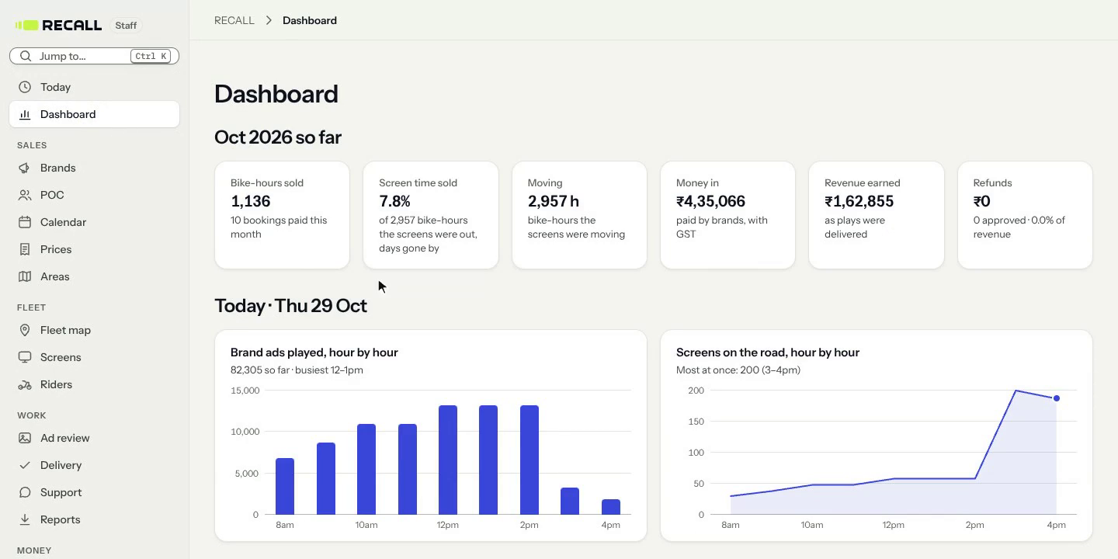
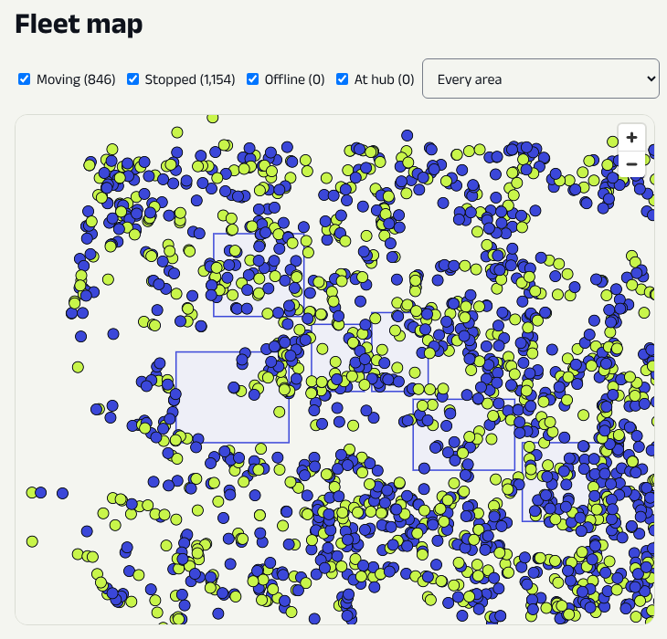
One portal runs the whole fleet
PRODUCT · STAFF PORTAL
Dashboard: bike-hours sold, money in, plays hour by hour.
Fleet map: 2,000 simulated bikes on Hyderabad roads.
Also: areas, prices, ad review, POC, riders, payouts, money and an audit log. Every change is logged.
Notes:
Real screens from the staff (admin) portal with demo and simulator data. Nothing is deleted; every change records who, what, when, before and after.

Slide 10
Riders earn by the hour and own the screen
RIDERS
AFTER THE POC
DURING THE POC
THE SCREEN LOAN
₹25 a moving hour + 25% of sales
Fixed ₹2,000 / ₹4,000 / ₹6,000 a month
Dhanlaxmi Bank lends, the rider owns
The 25% is of what his hours sold, after the agency and aggregator cuts.
About ₹13,350 a month at 70% sold; about ₹11,560 in hand while he repays the screen.
Outside our areas: no pay, and the screen is blank.
Plus a founding bonus up to ₹6,000 a month: full at 150 moving hours, in proportion from 100.
Up to ₹8,000 / ₹10,000 / ₹12,000, paid weekly.
₹3,000 for finishing and keeping the screen: his loan down payment.
New riders: ₹47,300 with GST, all financed, no down payment. EMI about ₹1,771.
POC riders: ₹55,800 with GST; the ₹3,000 bonus is the down payment, ₹52,800 financed. EMI about ₹1,977.
36 EMIs after a 3-month holiday. Never on our books; the camera stays ours.
Riders get about ₹37 of every ₹100 billed (Dec 2028). Screen part ₹47,300 / ₹40,100 before GST (POC / new). Paid hours capped at 260 a month.
Notes:
Rider pay: after the POC ₹25 a moving hour inside our areas + 25% of what his hours sold after the agency and aggregator cuts, about ₹13,350 a month at 70% sold; nothing outside our areas, and the screen is blank there. POC: base ₹2,000 / ₹4,000 / ₹6,000 paid weekly + founding bonus up to ₹6,000 a month (full at 150 moving hours within 15 km of Hitech City, in proportion from 100 h, none below). Screen loans with Dhanlaxmi Bank (term sheet in progress), 36 EMIs after a 3-month EMI holiday. New riders after the POC: no down payment, the full ₹47,300 with GST (₹40,100 before GST) is financed, EMI about ₹1,771, about ₹11,560 in hand. About 150 POC riders: screen ₹55,800 with GST (₹47,300 before GST); the ₹3,000 finishing bonus is the down payment inside it, so ₹52,800 with GST is financed, EMI about ₹1,977, about ₹11,360 in hand. The loan never touches RECALL's books; RECALL puts a 5% first-loss deposit (₹2,366) per new bike. The camera stays RECALL's. Source: model v5.4 (5 Nov 2026), DECISIONS 5 Nov 2026.

Slide 11
Each bike earns a profit from 2028
UNIT ECONOMICS
One bike, one month · Dec 2028 · 2,000 bikes · 70% sold
Billed to brands
₹36,750
We keep, after 12% cuts
₹32,300
Rider pay
−₹13,500
All other costs and buffer
−₹12,600
Profit before tax
₹6,200 19%
At 15,500 bikes (Dec 2031): ₹9,100 a bike a month, 28%.
Break-even: 46% sold at 2,000 bikes, 37% at 15,500.
An unsold moving hour costs ₹25; a sold one adds about ₹70.
Source: model v5.4 (5 Nov 2026). Before GST, rounded to ₹100. Tech is subscriptions only (the platform is built): about ₹1 of every ₹100.
Notes:
Model v5.4 'Unit Economics', one bike for one month at 70% sold, 2,000 bikes (Dec 2028): billed ₹36,750; we keep ₹32,300 (88%) after the 10% agency and 2% aggregator cuts; rider incl. gig fee ₹13,500; tech (subscriptions, AI tools, screen data) about ₹400; screens, cameras, field and new bikes ₹2,500; sales, gateway, marketing ₹4,500; team and office ₹2,800; buffer ₹2,400; so all other costs and buffer about ₹12,600. Profit before tax ₹6,200 (19%), after tax ₹4,700. At 6,300 bikes ₹7,800 (24%); at 15,500 bikes ₹9,100 (28%). Break-even share sold 46% / 41% / 37%, below the 55% bike gate. The new bike's screen is the rider's, on a bank loan; RECALL pays the ₹1,500 camera (before GST), the ₹2,366 deposit and ₹2,500 onboarding. Where ₹100 goes (Dec 2028): agency 10, aggregator 2, rider 37, team and office 8, tech 1, field/screens/support 7, sales+gateway+marketing 12, buffer 6, tax 4, profit 13.

Slide 12

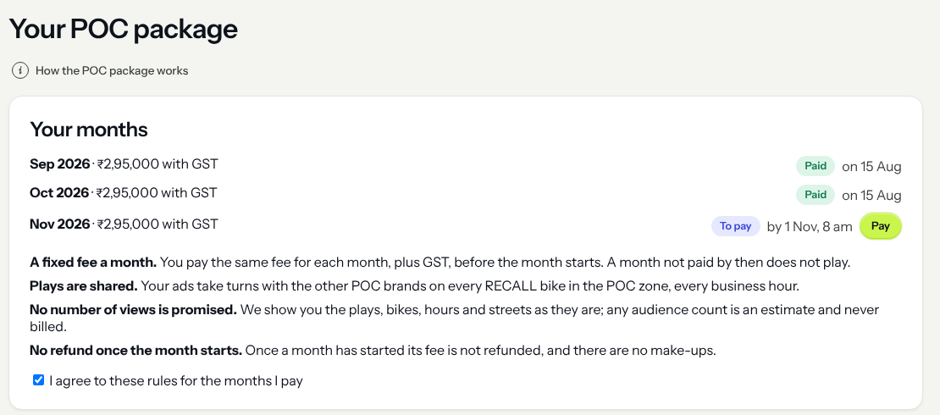



40 brands, 200 bikes, 3 months
THE POC · AUG–OCT 2027
40 brands
₹2.5 L + GST a month each, by bank transfer before each month starts.
200 bikes
Within 15 km of Hitech City, from 8 am to 2 am.
Every bike-hour
5 plays for each brand + 40 RECALL spots. Bikes on one street show different brands.
The POC page in the brand portal (demo data). Built and tested.
Nothing promised beyond plays
Why a POC: real plays, real riders and real invoices before regular selling starts in November 2027.
Each brand sees its plays, bikes and streets. No views promised, no make-ups.
Notes:
POC package (DECISIONS 24 and 29 Oct 2026): up to 40 brands at a fixed ₹2.5 L a month + GST, invoiced and paid before each month; up to 200 bikes; every bike-hour 200 brand plays = 5 for each of 40 brands + 40 RECALL spots; nothing promised; no make-ups or refunds. Zone: 15 km of Hitech City (Cyber Towers). No agency or aggregator cuts on POC packages. Before it: 210 Kit v2.1 kits fitted Feb–Jul 2027, after a road test of 4 sample kits on 3 bikes, 25 Jan – 8 Feb 2027. Source: model v5.4 (5 Nov 2026).

Slide 13
The POC pays for itself
THE POC · MONEY
₹3 Cr
in from brands: 40 × ₹7.5 L for 3 months, before GST
₹1.47 Cr
about what the 3 months cost
₹1.53 Cr
POC profit. About 20 brands would cover the cost
210 Kit v2.1 kits (₹49,100 each before GST, ₹1.03 Cr) are bought before the POC, outside this cost. Screen loans pay ₹71.0 L back in Nov 2027. Model v5.4 (5 Nov 2026).
Notes:
Model v5.4 'Pre-POC & POC costs', Aug–Oct 2027, ₹ lakh before GST: rider pay 60.9 (base ₹2K/4K/6K + full founding bonus); non-tech team 24.3 (founder, ops, sales, 2 account managers, finance); buffer 14.2; brand creative, launch, reports, marketing 8.1; warehouse running 7.7; screen SIMs, cloud and subscriptions 6.4; field team 5.8; ₹3,000 finishing bonus 4.5 (150 riders; it is the down payment on the rider's ₹55,800 with GST screen loan); AI tokens and support tools 3.0, office 3.0, insurance 3.0, permits 3.0, support desk 1.8, screen loss 1.2 (grouped as 15.0). Total 146.8. Revenue 300 (40 brands × ₹2.5 L × 3, by bank transfer before each month), so the POC adds 153.2. No tech team (the platform is built) and no agency cut on POC packages. 'About 20 brands' (146.8 ÷ 7.5) is simple arithmetic, not a model output. Money in the bank goes from ₹2.70 Cr just before the POC to ₹4.42 Cr at its end.

Slide 14

The platform is built and tested
TECHNOLOGY
Rider app
Brand portal
TESTED
Sign-up, hours, pay, help
Book, ads, pay, reports
Ledger always balances (thousands of random tests)
No play counted twice; never over 240 a bike-hour
15,500 screens reporting every 30 seconds
Payout run for 15,500 riders in 2.5 minutes
Our own security review: no high-risk findings open
Staff portal
Screen player
Fleet, areas, POC, payouts
Android, plays offline
Billing ledger
Fleet simulator
Still to do: real service accounts, outside security audit (₹2 L, Jun 2027), road test of 4 sample kits on 3 bikes (25 Jan – 8 Feb 2027).
Double-entry, in paise
Up to 15,500 bikes
₹2.9 L
₹2 L
₹9.2 Cr
tech before the POC (the old plan had ₹78 L)
outside security audit, Jun 2027
all tech 2027–31; no tech team, CTO optional
Notes:
BUILD_PLAN roadmap: P0–P5 and P7.7–P7.8 done; P6 real integrations wait for company accounts; P7 code done (outside audit, staging, road test need accounts, bikes and people). POC_READINESS quality bars: property tests on the ledger and play counting, simulation at 200/2,000/15,500 bikes, load test 15,500 screens every 30 s, payout run 2.5 minutes. Tech is subscriptions only (decided 4 Nov 2026): ₹2.9 L before the POC (₹0.4 L a month + ₹0.5 L set-up; the old plan had ₹78 L), ₹2 L outside security audit in Jun 2027, ₹9.2 Cr over 2027–31 (v5.3: ₹31.1 Cr), none of it people. A CTO is optional and off in the plan; switched on, it adds ₹4.5 L a month from Mar 2027. Source: model v5.4 (5 Nov 2026).

Slide 15
A large offline market, and room to lead
MARKET AND COMPETITION
₹5,500 Cr
2,600–4,100
≈ 715
Indian outdoor advertising (IOAA)
brands in Hyderabad (our estimate)
brands to serve by Dec 2028: about ₹7.5 Cr billed a month
Who | What it is | What we note
Hoardings, pamphlets | Fixed spots or one-off prints | Costly, and no proof of who saw it
AdOnMo | About 50,000 mostly fixed screens | FY25 revenue ₹134.4 Cr, loss ₹33.1 Cr (Inc42)
Gojek GoScreen | Motorbike top-box screens, Jakarta, 2020 | Sold reach, not hours; no public news since 2021
RECALL | Screens on two-wheelers in every lane | Sold by the bike-hour; every play signed
Notes:
Market: IOAA ₹5,500 Cr (BUSINESS_CONTEXT). Hyderabad pool 2,600–4,100 brands; Dec 2028 target ≈ ₹7.5 Cr billed a month = 15 large (₹10 L) + 100 mid (₹3 L) + 600 small (₹50,000) ≈ 715 brands (MODEL_V52). Competitors from MODEL_V52 and Prateek's v5.4 deck (AdOnMo FY25: Inc42). Model v5.4 keeps the same brand mix.

Slide 16
15,500 bikes in 5 cities by 2031
THE PLAN
Year | Bikes | Cities | Revenue kept | Profit before tax
2027 | 200 | 1 | ₹4.3 Cr | −₹0.98 Cr
2028 | 2,000 | 1 | ₹46 Cr | ₹6.95 Cr
2029 | 6,300 | 2 | ₹160 Cr | ₹37.9 Cr
2030 | 12,450 | 4 | ₹385 Cr | ₹105.2 Cr
2031 | 15,500 | 5 | ₹557 Cr | ₹156.5 Cr
Cities: Hyderabad, then Bengaluru (2029), Pune and Chennai (2030), Mumbai (2031).
Billed in 2031: ₹633 Cr before cuts. Bank in Dec 2031: ₹233 Cr.
Source: model v5.4 (5 Nov 2026), 70% of hours sold, before GST. ₹8 Cr raised in all. Estimates, not guarantees.
Notes:
Model v5.4 five-year table: bikes 200 / 2,000 / 6,300 / 12,450 / 15,500; cities 1 / 1 / 2 / 4 / 5; revenue we keep ₹4.3 / 46 / 160 / 385 / 557 Cr; profit before tax −0.98 / 6.95 / 37.9 / 105.2 / 156.5 Cr; profit after tax −0.98 / 5.5 / 28 / 79 / 117 Cr; bank at December 3.5 / 10.9 / 34 / 113 / 233 Cr. Billed before cuts ₹52 Cr in 2028, ₹633 Cr in 2031. Tech is subscriptions only: ₹9.2 Cr over the five years. City dates: Bengaluru Apr 2029, Pune Jan 2030, Chennai Apr 2030, Mumbai Jan 2031.

Slide 17
From seed to five cities
MILESTONES
Nov–Dec 2026
25 Jan – 8 Feb 2027
Aug–Oct 2027
Feb 2028
Dec 2028
Mount and hinge design; 4 road-test kits ordered
Road test: 4 sample kits on 3 bikes, 15 days
POC: 40 brands, 200 bikes
First profitable month
2,000 bikes in Hyderabad
Jan 2027
Feb–Jul 2027
Nov–Dec 2027
Mar 2028
2029–2031
₹5 Cr seed closes
Sign 40 brands, open the warehouse, fit 200 screens
~150 riders take screens on bank loans; selling starts
₹3 Cr round 2
Bengaluru, Pune, Chennai, Mumbai: 15,500 bikes
A new city opens only after the cities before it are profitable 3 months in a row.
Notes:
Timeline (model v5.4, 5 Nov 2026): mount and hinge design 9 Nov – 24 Dec 2026 and 4 sample kits ordered from 23 Nov 2026, after the lawyer's first written view; about ₹4.9 L (with GST) of road-test money is spent in Nov–Dec 2026 and paid by the seed investors as an early part of the ₹5 Cr seed, not extra money. Seed closes Jan 2027. Road test 25 Jan – 8 Feb 2027 on 3 bikes. Feb–Jul 2027 build-out, 210 kits ordered Jun and fitted, 40 founding brands signed; Aug–Oct 2027 POC; Nov–Dec 2027 cooling (~150 riders take screens on Dhanlaxmi Bank loans, selling at 70% starts); Feb 2028 first profitable month; Mar 2028 round 2; 2,000 bikes Dec 2028; Bengaluru Apr 2029, Pune Jan 2030, Chennai Apr 2030, Mumbai Jan 2031.

Slide 18
The risks, and what protects us
RISKS AND GATES
Risk | What protects us
Brands buy fewer hours than planned (plan: 70%) | Break-even is 46% at 2,000 bikes. We add bikes only above 55% sold.
Rules on ads on two-wheelers | Written legal answers before the 210-kit order. Permits: ₹300 a bike a month.
Camera privacy | Counting happens on the chip; no video stored or sent; no faces. DPDP check before the POC.
Riders leave | Weekly pay, a ₹3,000 finishing bonus, and the rider owns his screen.
Screens fail on the road | Road test of 4 sample kits, 25 Jan – 8 Feb 2027, before the 210-kit order.
Cheating on GPS or plays | Every play is signed on the screen. The cloud never invents a play.
Gates: no fleet hardware before written legal answers · kit cost capped at ₹52,000 · a new city only after 3 profitable months · even at 50% sold, the bank stays above ₹2.7 Cr.
Notes:
Model v5.4 'If sales are slower': at 70% (plan) the lowest bank is ₹2.70 Cr (Jul 2027) and the most cash used ₹2.30 Cr; at 60%, ₹2.30 Cr used and first profit Mar 2028; at 55%, ₹2.40 Cr and May 2028; at 50% (ignoring our 55% bike gate) the bank still never falls below ₹2.70 Cr, ₹3.59 Cr after round 2 (Mar 2029), with ₹4.41 Cr used, so the ₹3 Cr round 2 is enough. Break-even is 46% at 2,000 bikes. Kit cap ₹52,000 (rule G14, 5 Nov 2026), planning cost ₹49,100 before GST. The 4 road-test kits (25 Jan – 8 Feb 2027) are ordered after the lawyer's first written view; the 210-kit order waits for full written answers. ₹250 a bike a month is budgeted for warranty.

Slide 19
Who builds it, and where we stand
TEAM AND STATUS
FOUNDER
HIRING FROM THE SEED
BEFORE THE SEED CLOSES
Prateek Medikonda
Sales lead
Feb 2027
Legal opinion
In progress
Operations lead
May 2027
Dhanlaxmi term sheet
In progress
[Background and past roles: to confirm]
Warehouse manager
Jun 2027
Mount design
Nov–Dec 2026
CTO
Optional
Company and cap table
[to confirm]
Founder salary ₹2.5 L a month from Jan 2027, paid from the seed.
Advisors
[to confirm]
Brand letters of intent
None yet
Status at 5 Nov 2026. Pre-revenue: no brand, bank or regulator has committed yet. Headcount 29 at end-2027, 51 in 2028, 220 in 2031; no tech team.
Notes:
Status at 5 Nov 2026 (model v5.4). RECALL is pre-revenue: no signed brands or letters of intent yet; the 40 founding brands are signed Feb–Jul 2027. The sales lead joins Feb 2027 and the ops lead May 2027. The platform is built and tested, so the plan has no tech team; a CTO is optional and Prateek's decision (switched on, ₹4.5 L a month from Mar 2027). Headcount (non-tech, incl. founder) 29 at end-2027, 51 in 2028, 114 in 2029, 188 in 2030, 220 in 2031, plus field staff. Mount and hinge design runs 9 Nov – 24 Dec 2026; the road test is 25 Jan – 8 Feb 2027. Fill the bracketed parts before sending.

Slide 20
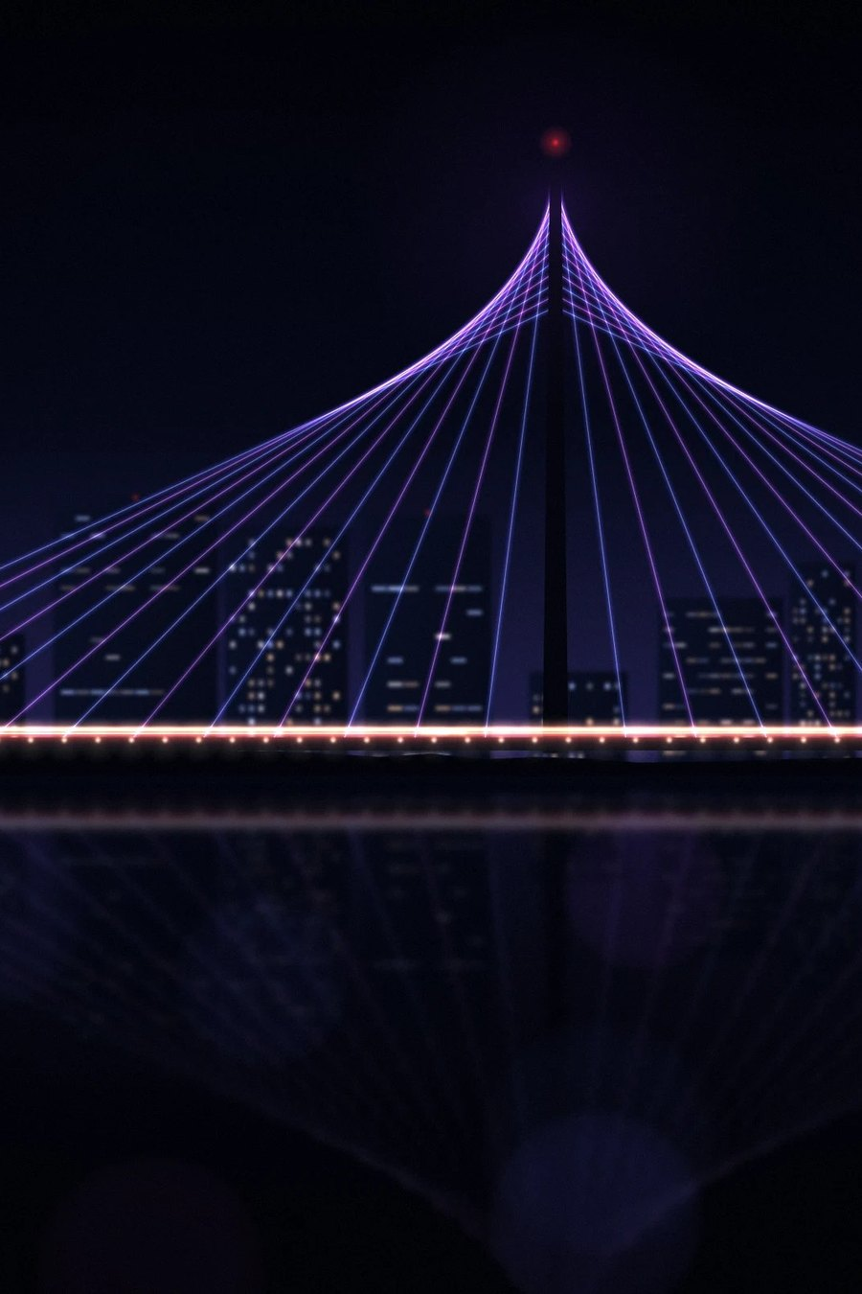
₹5 Cr seed now, ₹3 Cr round 2
THE ASK
₹5 Cr
₹3 Cr
seed, January 2027
round 2, March 2028, raised on POC data
WHAT THE SEED PAYS FOR
₹2.02 Cr
Before the POC: 210 Kit v2.1 kits (₹1.03 Cr before GST), road test, warehouse, team, legal, audit
₹1.47 Cr
The 3 POC months, which bring in ₹3 Cr
₹1.20 Cr
Screen stock for riders who join after the POC (Nov–Dec 2027)
₹2.70 Cr
Lowest money in the bank (Jul 2027). Most cash used: ₹2.30 Cr
Road test (≈ ₹7.25 L with GST, ₹4.9 L of it in Nov–Dec 2026): an early part of the seed, not extra money.
Terms: to be discussed · Prateek Medikonda, prateek.medikonda@gmail.com
Notes:
Funding (model v5.4, 5 Nov 2026): seed ₹5 Cr Jan 2027 + round 2 ₹3 Cr Mar 2028 = ₹8 Cr, unchanged. The seed first pays about ₹6.5 L of pre-seed costs and the founder's January salary, so the founder puts in nothing. Before the POC (Feb–Jul 2027) it pays ₹2.02 Cr: 210 Kit v2.1 kits at ₹49,100 before GST (₹1.03 Cr), founder ₹15 L, warehouse ₹22 L, road test on 4 sample kits ₹2.93 L (25 Jan – 8 Feb 2027), mount and hinge design ₹0.43 L (Nov–Dec 2026), outside security audit ₹2 L (Jun 2027), tech subscriptions ₹2.9 L, sales, legal, office and buffer. The road-test money, about ₹7.25 L with GST in all (about ₹4.9 L of it in Nov–Dec 2026, before the seed closes), is paid by the seed investors as an early part of the ₹5 Cr seed, not extra money. The POC costs about ₹1.47 Cr against ₹3 Cr in. Screen stock in the cooling period ₹1.20 Cr. The most cash the plan ever uses is ₹2.30 Cr; ₹2.70 Cr is still in the bank at the lowest point (Jul 2027). Round 2 pays for growth from 650 to 2,000 bikes, screen stock, bank deposits and the Bengaluru launch. Terms: to be discussed.

