Slide 1
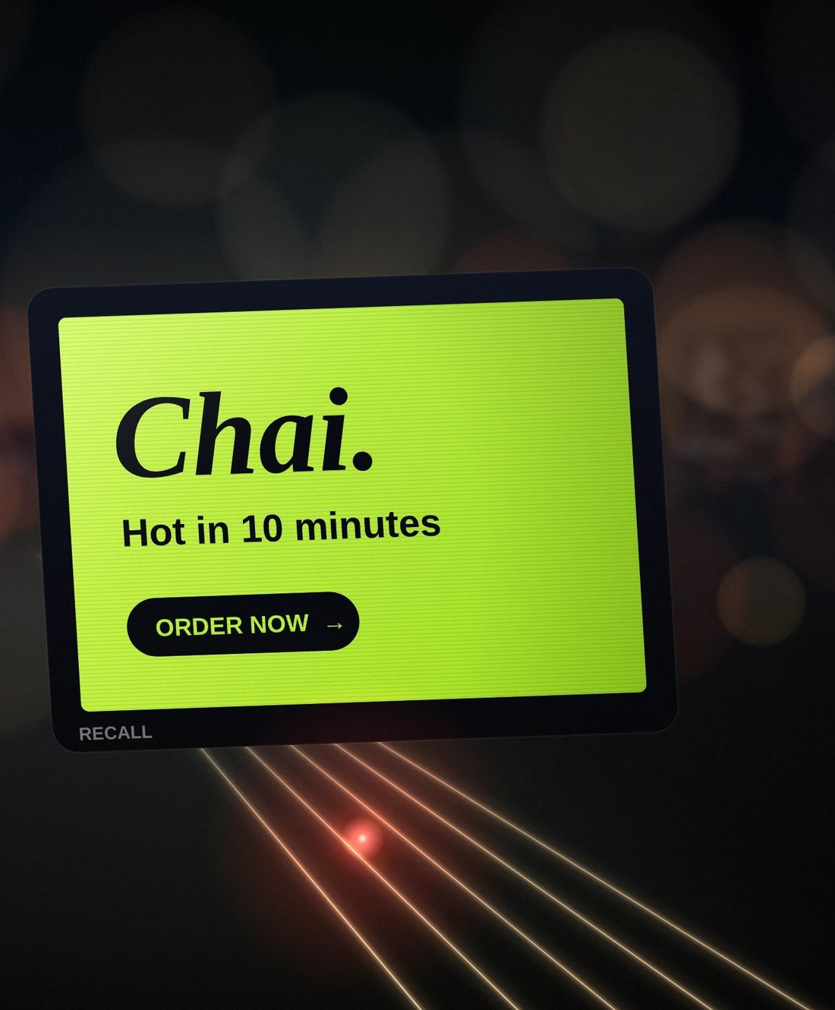

Your brand, on the streets tonight
SEED ROUND · NOVEMBER 2026
Moving LED screens on delivery and bike-taxi two-wheelers in Hyderabad. Brands pay by the bike-hour, never per view.
₹5 Cr
Built
Aug 2027
seed we are raising
platform, tested
POC starts
Prateek Medikonda, founder · Confidential
Notes:
RECALL puts moving LED screens on the delivery and bike-taxi two-wheelers already on Hyderabad's streets. Brands book bike-hours; riders are paid for the hours they move. Sources: PRODUCT_V54.md, MODEL_V53.md.

Slide 2
Screens on the bikes already on every street
RECALL IN ONE MINUTE
₹3 Cr
₹1.51 Cr
Built
₹5 Cr
POC revenue
POC cost, about
The whole platform
Seed we are raising
40 brands × ₹2.5 L a month × 3 months, plus GST
Riders, team, running costs and buffer. The POC pays for itself.
Rider app, brand portal, staff portal, screen player, billing ledger
Plus ₹3 Cr round 2 in March 2028, ₹8 Cr in all
Then: 15,500 bikes in 5 cities by 2031, with ₹557 Cr of revenue we keep and ₹148 Cr profit before tax.
Source: model v5.3 (19 Oct 2026) with the 4 Nov 2026 changes. Revenue we keep = billed, less agency and aggregator cuts.
Notes:
Four numbers: ₹3 Cr of POC revenue, about ₹1.51 Cr of POC cost, a platform that is already built, and a ₹5 Cr seed followed by ₹3 Cr in March 2028. 2031 figures are from MODEL_V53 five-year table (before the 4 Nov tech saving).

Slide 3



Offline ads are costly and blind
THE PROBLEM
Online is crowded
Offline is costly
Offline is blind
Feeds are packed. Ads get skipped and forgotten.
Hoardings need big budgets and long lock-ins.
A hoarding cannot tell a brand who saw it, where or when.
RECALL is an alternative to offline: hoardings, pamphlets and newspaper inserts. Not another online ad platform.
Notes:
Positioning from PRODUCT_V54: RECALL is an alternative to offline (hoardings, pamphlets, newspaper inserts), not an online ad platform. The old deck's market-share statistics are left out because they are not in the repo sources.

Slide 4
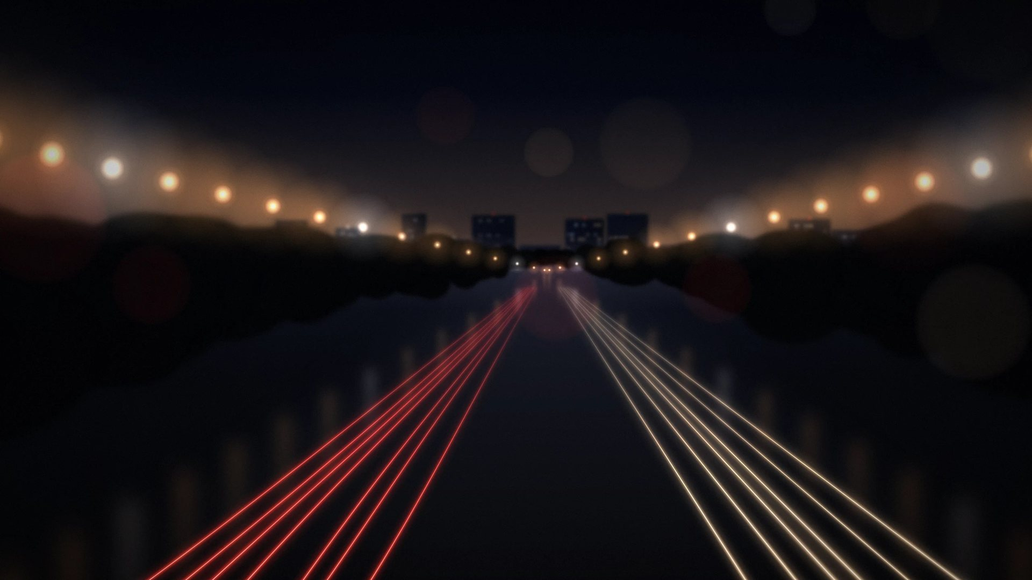
The back of every delivery bike is a screen. Nobody sells it.
THE INSIGHT
01
02
03
Riders are on every street, all day: homes, offices and markets.
We pay them for every moving hour inside our areas.
Brands pay only for bike-hours, with proof of every play.
Notes:
The idea: delivery and bike-taxi two-wheelers already cover the city. RECALL turns the back of each bike into a bookable screen. Riders earn for moving hours; brands buy bike-hours.

Slide 5
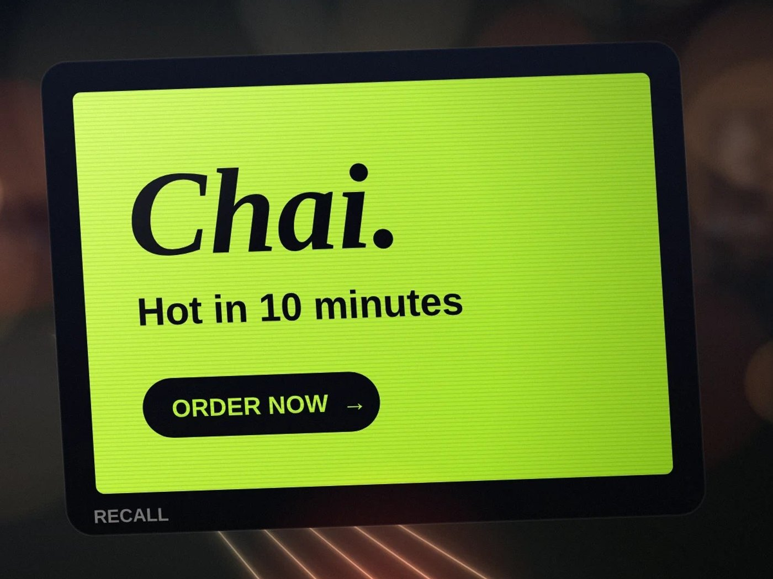





A 28-inch screen that runs itself
THE SCREEN
28-inch P2.5 LED
Bright by day, dimmed at night by our app.
11-hour battery
Lasts a riding day. The camera adds only 1–2 W.
Android box with 4G and GPS
Saves ads and replays them, so it keeps playing with no signal.
Every play signed on the screen
The cloud never invents a play. Billing uses only these records.
AI camera that only counts people
Pictures wiped in under a second. No video stored or sent, no faces. Counts are never billed.
Kit about ₹34,000 before GST: screen ₹31,000 + AI camera about ₹3,000. Illustration.
Notes:
Hardware from BUILD_PLAN P2 and MODEL_V53: 28-inch P2.5 LED, Android controller with 4G and GPS, AI camera module on every screen (decided 19 Oct 2026), 11-hour battery. Camera counts are proof in reports, never the bill. DPDP legal check before the POC.

Slide 6
Brands buy whole bike-hours, nothing else
WHAT BRANDS BUY
PEAK
NORMAL
LITE
THE PROMISE
₹300
₹250
₹220
Madhapur, Tuesday 5–6 pm, 20 bikes
8–11 am, 5–11 pm
11 am–5 pm
11 pm–2 am
4,000 plays
Prices per bike-hour, plus 18% GST.
One bike-hour = 240 spots of 15 seconds
inside Madhapur in that hour, on at least 20 different bikes.
200 plays of the brand's ads
40 RECALL
If short: made up within 2 hours in that area, else the same hour next day, else refunded.
Full bike-hours only, no shared slots: on that bike, in that hour, only that brand plays.
At least 5 bikes and ₹15,000 a booking, paid in advance, plus 18% GST.
Offers only for long plans: 6 months 8% off, 12 months 12% off.
Never billed per view. People counts are estimates.
Notes:
PRODUCT_V54 (decided 21 Oct 2026): full bike-hours only; Peak ₹300 (08–11, 17–20, 20–23), Normal ₹250 (11–17), Lite ₹220 (23–02), plus 18% GST. One bike-hour = 200 brand plays + 40 RECALL spots. Minimum 5 bikes and ₹15,000 per booking; 100% in advance. Offers: 6 months 8%, 12 months 12%; never below ₹220. Up to 10% of plays may fall just outside the boundary.

Slide 7
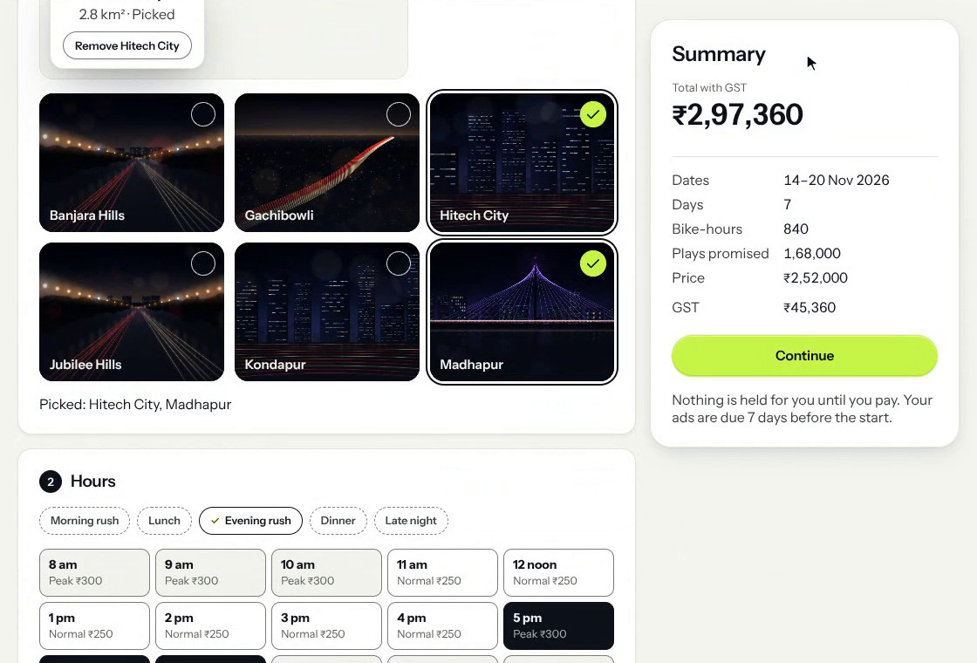
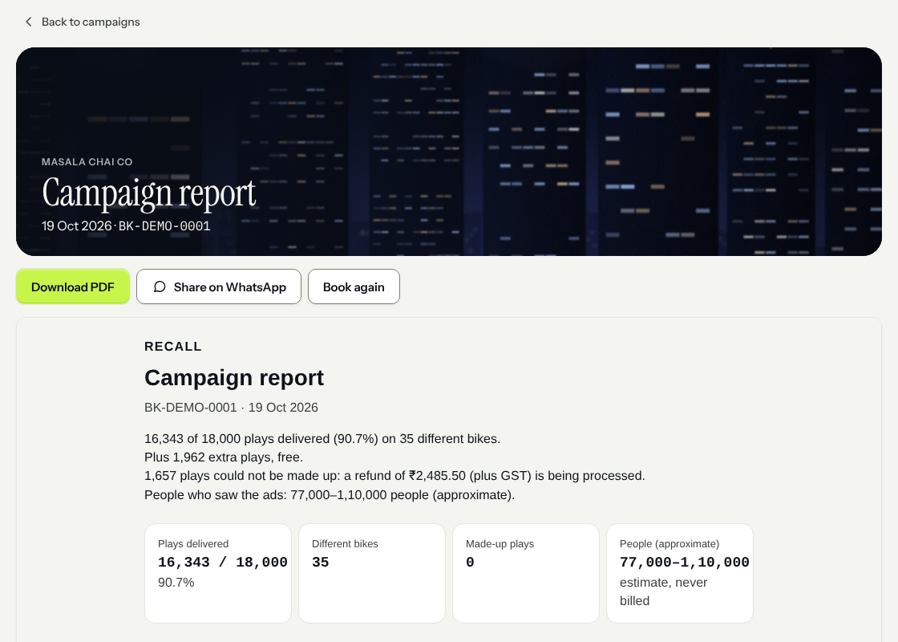
Brands book in minutes and get proof after
PRODUCT · BRAND PORTAL
Book: pick areas, hours, days and bikes. The price shows at once.
Report: plays delivered, different bikes, make-ups, and people (an estimate, never billed).
Notes:
Real screens from the working brand portal, with demo data. The portal has 9 screens: sign in, business, campaigns, book, ads, review and pay, final report, invoices, help (PRODUCT_V54).

Slide 8
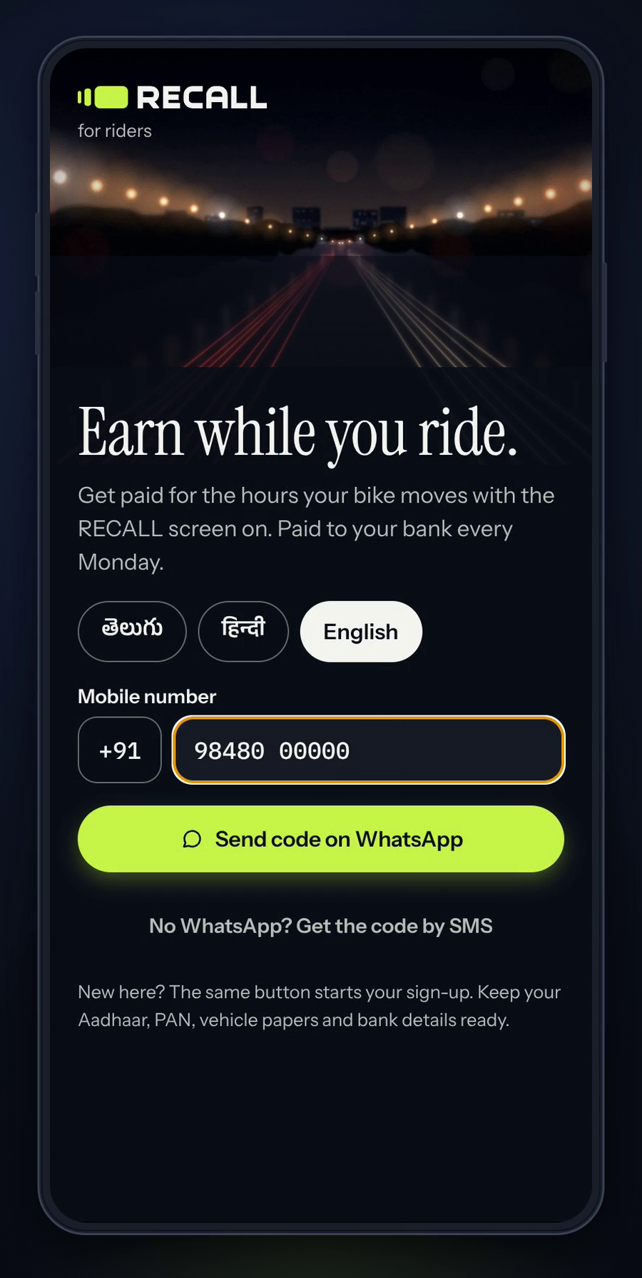
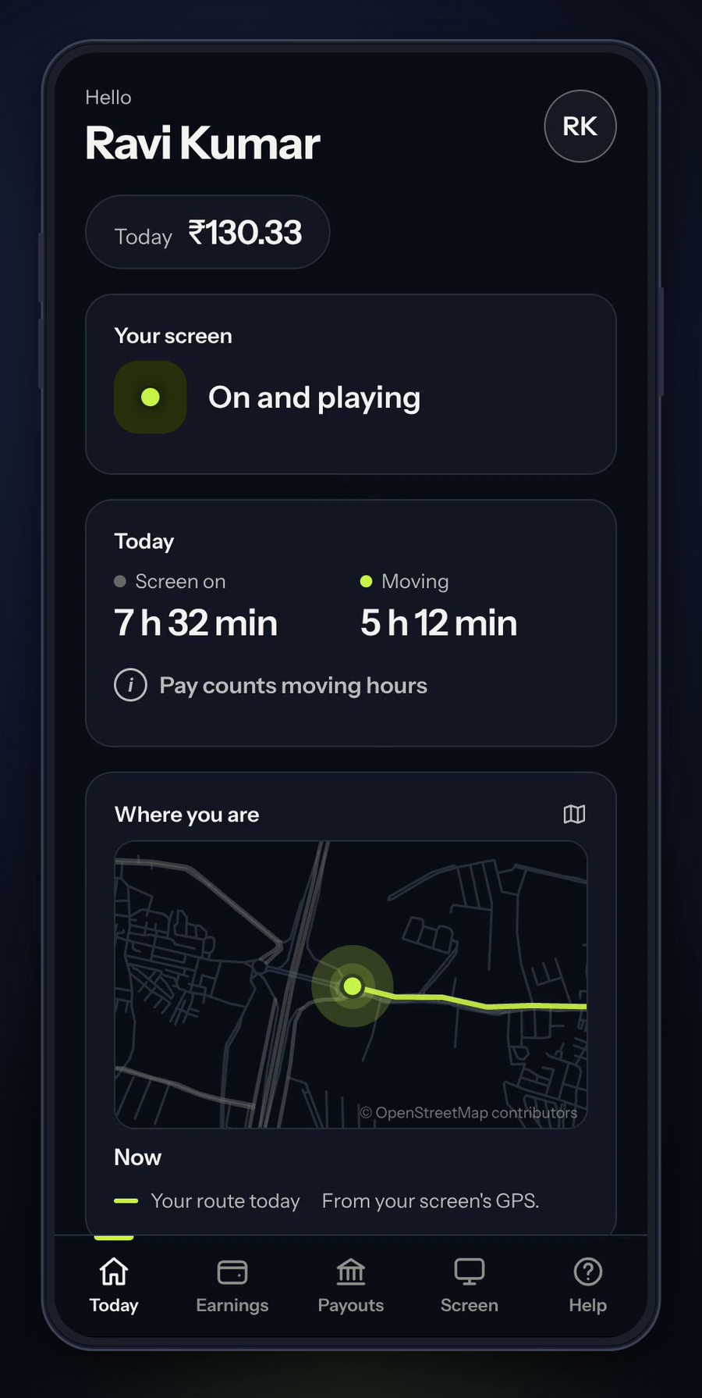
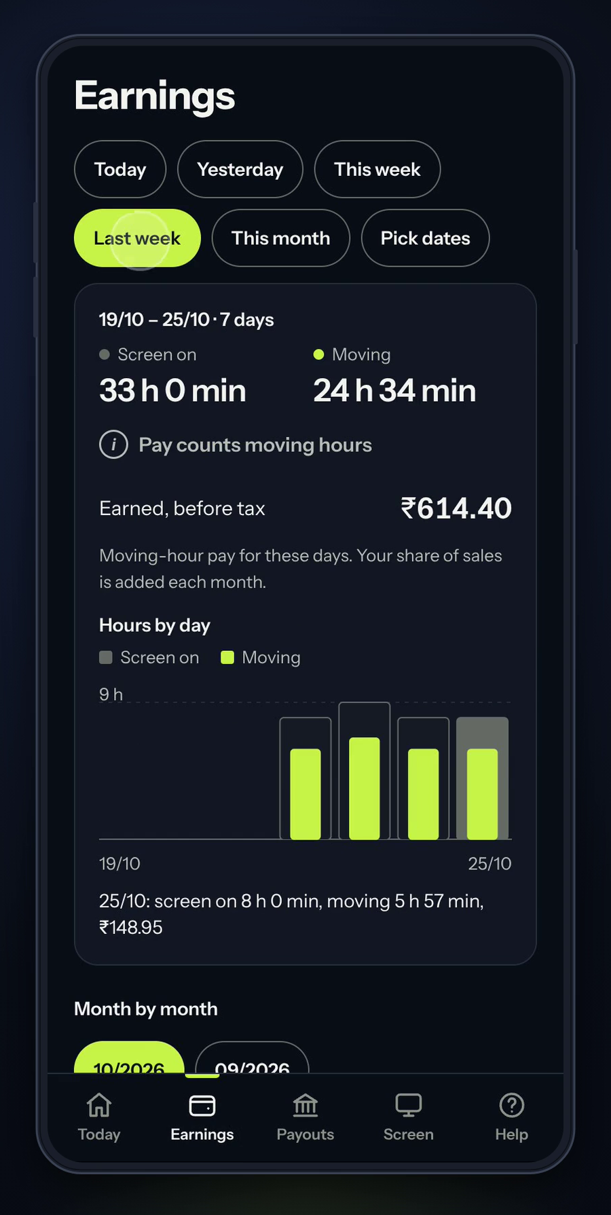





Riders see every rupee they earn
PRODUCT · RIDER APP
Sign in with a WhatsApp code
Telugu, Hindi or English
Pay counts moving hours only, from the screen's GPS
Paid to his bank every Monday
Screen status, today's route, earnings by day and month
Welcome
Today
Earnings
Notes:
Real screens from the rider app (React Native), demo data. Riders sign in with a WhatsApp code, see moving hours and earnings, and are paid every Monday.

Slide 9
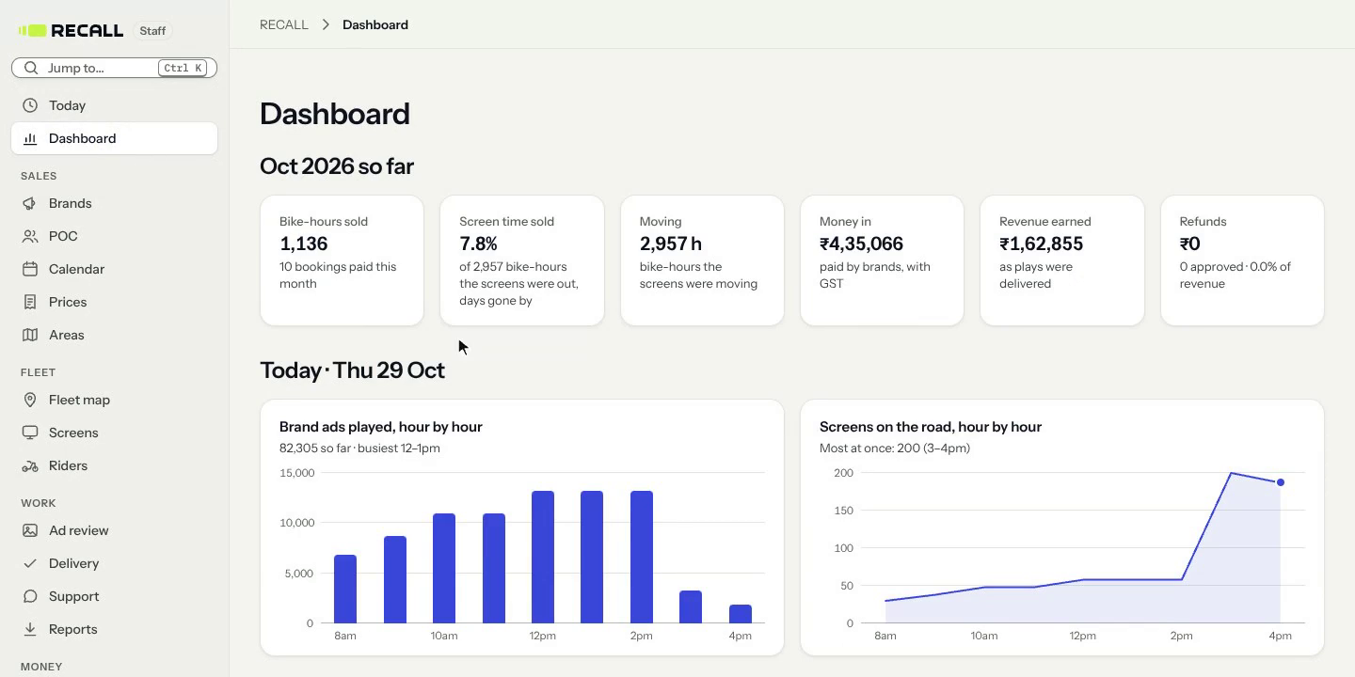
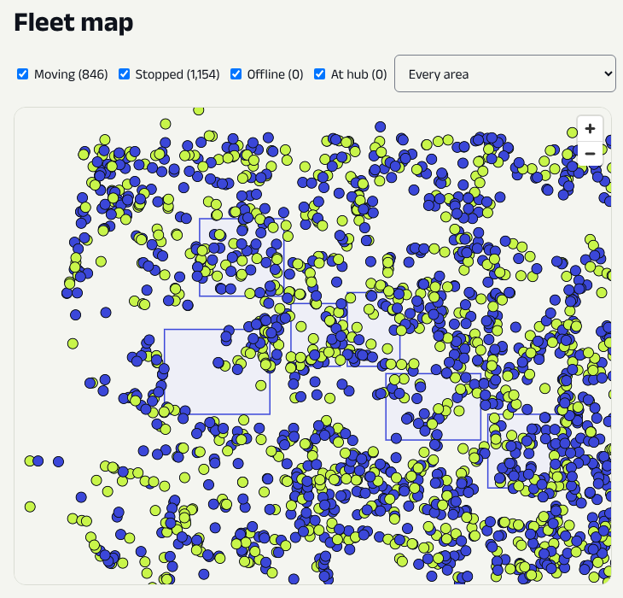
One portal runs the whole fleet
PRODUCT · STAFF PORTAL
Dashboard: bike-hours sold, money in, plays hour by hour.
Fleet map: 2,000 simulated bikes on Hyderabad roads.
Also: areas, prices, ad review, POC, riders, payouts, money and an audit log. Every change is logged.
Notes:
Real screens from the staff (admin) portal with demo and simulator data. Nothing is deleted; every change records who, what, when, before and after.

Slide 10
Riders earn by the hour and own the screen
RIDERS
AFTER THE POC
DURING THE POC
THE SCREEN LOAN
₹25 a moving hour + 25% of sales
Fixed ₹2,000 / ₹4,000 / ₹6,000 a month
Dhanlaxmi Bank lends, the rider owns
The 25% is of what his hours sold, after the agency and aggregator cuts.
About ₹13,350 a month; about ₹12,000 in hand while he repays the screen.
Outside our areas: no pay, and the screen is blank.
Plus a founding bonus up to ₹6,000 a month: full at 150 moving hours, in proportion from 100.
Up to ₹8,000 / ₹10,000 / ₹12,000, paid weekly.
₹3,000 more for finishing the POC and keeping the screen.
The rider buys the screen (₹31,000 + GST) on a bank loan.
EMI about ₹1,370 a month for 36 months, after a 3-month holiday.
The loan is never on RECALL's books. The AI camera stays ours.
Riders get about ₹37 of every ₹100 billed (Dec 2028).
Notes:
Rider pay: after the POC ₹25 a moving hour inside our areas + 25% of what was sold after agency and aggregator cuts (DECISIONS 29 Oct); nothing outside areas and the screen is blank there (DECISIONS 29 Oct). POC: ₹2,000/4,000/6,000 base paid weekly (4 Nov) + founding bonus up to ₹6,000 (full at 150 h, in proportion from 100 h; DECISIONS 24 Oct); ₹3,000 bonus for finishing and keeping the screen (4 Nov). Loan bank: Dhanlaxmi (22 Oct). ≈₹13,350 a month and EMI ≈₹1,370 from MODEL_V52.

Slide 11
Each bike earns a profit from 2028
UNIT ECONOMICS
One bike, one month · Dec 2028 · 2,000 bikes · 70% sold
Billed to brands
₹36,750
We keep, after 12% cuts
₹32,300
Rider pay
−₹13,500
All other costs and buffer
−₹13,900
Profit before tax
₹4,900 15%
At 15,500 bikes (Dec 2031): ₹8,600 a bike a month, 27%.
Break-even: 51% sold at 2,000 bikes, 39% at 15,500.
Model v5.3. The tech line here is from before the 4 Nov 2026 switch to subscriptions only, so real tech cost is lower. The model file is being re-run.
Notes:
MODEL_V53 'One bike, one month' at 2,000 bikes (Dec 2028): billed 36,750; we keep 32,300 (88%); rider incl. gig fee 13,500; other lines total 13,900; PBT 4,900 (15%). At 15,500 bikes PBT 8,600 (27%). Break-even share sold 51% / 44% / 39%. Where ₹100 goes (Dec 2028): agency 10, aggregator 2, rider 37, team and office 8, tech 4, field/screens/support/camera 7, sales+gateway+marketing 12, buffer 7, tax 3, profit 10.

Slide 12

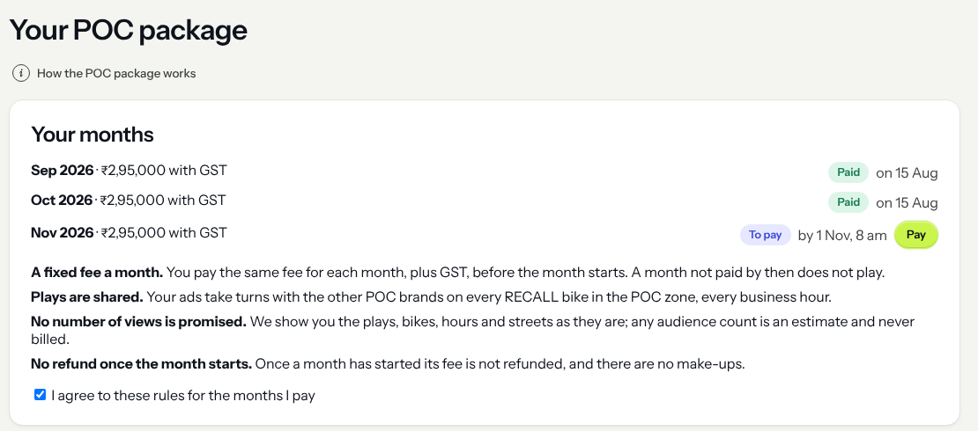



40 brands, 200 bikes, 3 months
THE POC · AUG–OCT 2027
40 brands
₹2.5 L + GST a month each, paid before each month starts.
200 bikes
Within 15 km of Hitech City, from 8 am to 2 am.
Every bike-hour
5 plays for each brand + 40 RECALL spots. Bikes on one street show different brands.
The POC page in the brand portal (demo data). Built and tested.
Nothing promised beyond plays
Why a POC: real plays, real riders and real invoices before regular selling starts in November 2027.
Each brand sees its plays, bikes and streets. No views promised, no make-ups.
Notes:
POC package (DECISIONS 24 and 29 Oct 2026): up to 40 brands at a fixed ₹2.5 L a month + GST, invoiced and paid before each month; up to 200 bikes; every bike-hour 200 brand plays = 5 for each of 40 brands + 40 RECALL spots; nothing promised; no make-ups or refunds. Zone: 15 km of Hitech City (Cyber Towers). No agency or aggregator cuts on POC packages.

Slide 13
The POC pays for itself
THE POC · MONEY
₹3 Cr
in from brands: 40 × ₹7.5 L for 3 months, before GST
₹1.51 Cr
about what the 3 months cost
≈ 21 brands
cover that cost (₹1.51 Cr ÷ ₹7.5 L a brand)
The 210 screen kits with cameras (₹71.4 L) are bought before the POC and are not in this cost. No agency cut on POC packages. Model v5.3 with the 4 Nov 2026 changes.
Notes:
POC cost per MODEL_V53 '4 Nov' changes: 194.9 − 31.5 (tech team) − 13.5 (agency) + about 1.5 (subscriptions) ≈ ₹151 L. Lines from MODEL_V52 POC list: rider pay 60.9; non-tech team 24.3; buffer 17.3; brand creative/launch/reports/marketing 8.1; warehouse 7.7; SIMs, cloud, licences 6.3 + ~1.5 subscriptions; field team 5.8; day-90 bonus 4.5; AI tokens and support tools 3.0, office 3.0, insurance 3.0, permits 3.0, support desk 1.8, screen loss 1.2 (grouped as 15.0). '≈21 brands' is simple arithmetic, not a model output.

Slide 14

The platform is built and tested
TECHNOLOGY
Rider app
Brand portal
TESTED
Sign-up, hours, pay, help
Book, ads, pay, reports
Ledger always balances (thousands of random tests)
No play counted twice; never over 240 a bike-hour
15,500 screens reporting every 30 seconds
Payout run for 15,500 riders in 2.5 minutes
Our own security review: no high-risk findings open
Staff portal
Screen player
Fleet, areas, POC, payouts
Android, plays offline
Billing ledger
Fleet simulator
Still to do: outside security audit, 72-hour test on the sample screen, real service accounts, 2-week road test.
Double-entry, in paise
Up to 15,500 bikes
₹3 L
₹2–3 L
₹60–120
tech before the POC (the old plan had ₹78 L)
tech for the 3 POC months
a bike a month at scale, all in
Notes:
BUILD_PLAN roadmap: P0–P5 and P7.7–P7.8 done; P6 real integrations wait for company accounts; P7 code done (outside audit, staging, road test need accounts, bikes and people). POC_READINESS quality bars: property tests on the ledger and play counting, simulation at 200/2,000/15,500 bikes, load test 15,500 screens every 30 s, payout run 2.5 minutes. Tech costs are subscriptions only (TECH_SUBSCRIPTIONS.md, 4 Nov 2026).

Slide 15
A large offline market, and room to lead
MARKET AND COMPETITION
₹5,500 Cr
2,600–4,100
≈ 715
Indian outdoor advertising (IOAA)
brands in Hyderabad (our estimate)
brands to serve by Dec 2028: about ₹7.5 Cr billed a month
Who | What it is | What we note
Hoardings, pamphlets | Fixed spots or one-off prints | Costly, and no proof of who saw it
AdOnMo | About 50,000 mostly fixed screens | FY25 revenue ₹134.4 Cr, loss ₹33.1 Cr (Inc42)
Gojek GoScreen | Motorbike top-box screens, Jakarta, 2020 | Sold reach, not hours; no public news since 2021
RECALL | Screens on two-wheelers in every lane | Sold by the bike-hour; every play signed
Notes:
Market: IOAA ₹5,500 Cr (BUSINESS_CONTEXT). Hyderabad pool 2,600–4,100 brands; Dec 2028 target ≈ ₹7.5 Cr billed a month = 15 large (₹10 L) + 100 mid (₹3 L) + 600 small (₹50,000) ≈ 715 brands (MODEL_V52). Competitors from MODEL_V52.

Slide 16
15,500 bikes in 5 cities by 2031
THE PLAN
Year | Bikes | Cities | Revenue kept | Profit before tax
2027 | 200 | 1 | ₹4.3 Cr | −₹2.3 Cr
2028 | 2,000 | 1 | ₹46 Cr | ₹4.0 Cr
2029 | 6,300 | 2 | ₹160 Cr | ₹33 Cr
2030 | 12,450 | 4 | ₹385 Cr | ₹98 Cr
2031 | 15,500 | 5 | ₹557 Cr | ₹148 Cr
Cities: Hyderabad, then Bengaluru (2029), Pune and Chennai (2030), Mumbai (2031).
Billed in 2031: ₹633 Cr before cuts.
Model v5.3 (19 Oct 2026), 70% of hours sold. Before the 4 Nov 2026 tech saving; the model file is being re-run.
Notes:
MODEL_V53 five-year table: bikes 200 / 2,000 / 6,300 / 12,450 / 15,500; cities 1/1/2/4/5; revenue we keep ₹4.3 / 46 / 160 / 385 / 557 Cr; PBT −2.3 / 4.0 / 33 / 98 / 148 Cr; PAT −2.3 / 3.6 / 25 / 74 / 111 Cr. Billed 2031 ₹633 Cr (MODEL_V52). City order from MODEL_V52 timeline.

Slide 17
From seed to five cities
MILESTONES
Jan 2027
Aug–Oct 2027
Mar 2028
Dec 2028
₹5 Cr seed closes
POC: 40 brands, 200 bikes
₹3 Cr round 2
2,000 bikes in Hyderabad
Feb–Jul 2027
Nov–Dec 2027
Apr 2028
2029–2031
Sign 40 brands, open the warehouse, fit 200 screens
Riders take screens on bank loans; regular selling starts
First profitable month
Bengaluru, Pune, Chennai, Mumbai: 15,500 bikes
A new city opens only after the cities before it are profitable 3 months in a row.
Notes:
Timeline from MODEL_V52/V53: seed Jan 2027; Feb–Jul build-out and sign 40 founding brands; Aug–Oct 2027 POC; Nov–Dec 2027 cooling (~150 riders take screens on bank loans, regular selling starts); Mar 2028 round 2; Apr 2028 first profitable month; 2,000 bikes Dec 2028; Bengaluru Apr 2029, Pune Jan 2030, Chennai Apr 2030, Mumbai Jan 2031.

Slide 18
The risks, and what protects us
RISKS AND GATES
Risk | What protects us
Brands buy fewer hours than planned (plan: 70%) | Break-even is 51% at 2,000 bikes. We add bikes only above 55% sold.
Rules on ads on two-wheelers | Legal opinion first: no hardware before the answer. Permits budgeted at ₹300 a bike a month.
Camera privacy | Counting happens on the chip; no video stored or sent; no faces. DPDP check before the POC.
Riders leave | Weekly pay, a bonus to finish, and the rider owns his screen.
Screens fail on the road | 72-hour test on a sample screen and a 2-week road test before the fleet.
Cheating on GPS or plays | Every play is signed on the screen. The cloud never invents a play.
Gates: screens are ordered only after 20 brands sign · a new city only after 3 profitable months · even at 55% sold, the bank stays above ₹1.2 Cr.
Notes:
Risks from MODEL_V52 'Risks to be honest about'. Gates from BUSINESS_CONTEXT (seed pitch) and MODEL_V52 rules. The 55% stress figure (₹1.22 Cr lowest) is MODEL_V53 'If sales are slower', before the 4 Nov savings.

Slide 19
Who builds it, and where we stand
TEAM AND STATUS
FOUNDER
HIRING FROM THE SEED
BEFORE THE SEED CLOSES
Prateek Medikonda
Sales lead
Feb 2027
Legal opinion
In progress
Operations lead
May 2027
Dhanlaxmi term sheet
In progress
[Background and past roles: to confirm]
Warehouse manager
Jun 2027
Company and cap table
[to confirm]
CTO
[to confirm]
Brand letters of intent
[to confirm]
Founder salary ₹2.5 L a month from Jan 2027, paid from the seed.
Advisors
[to confirm]
Screen vendor quote
[to confirm]
Status as last recorded (Oct 2026). Incorporation date and letters of intent signed: [to confirm].
Notes:
People and status from BUSINESS_CONTEXT (data room, October 2026). Under the 4 Nov decision, a CTO is a team decision for Prateek, outside the tech line. Fill the bracketed parts before sending.

Slide 20
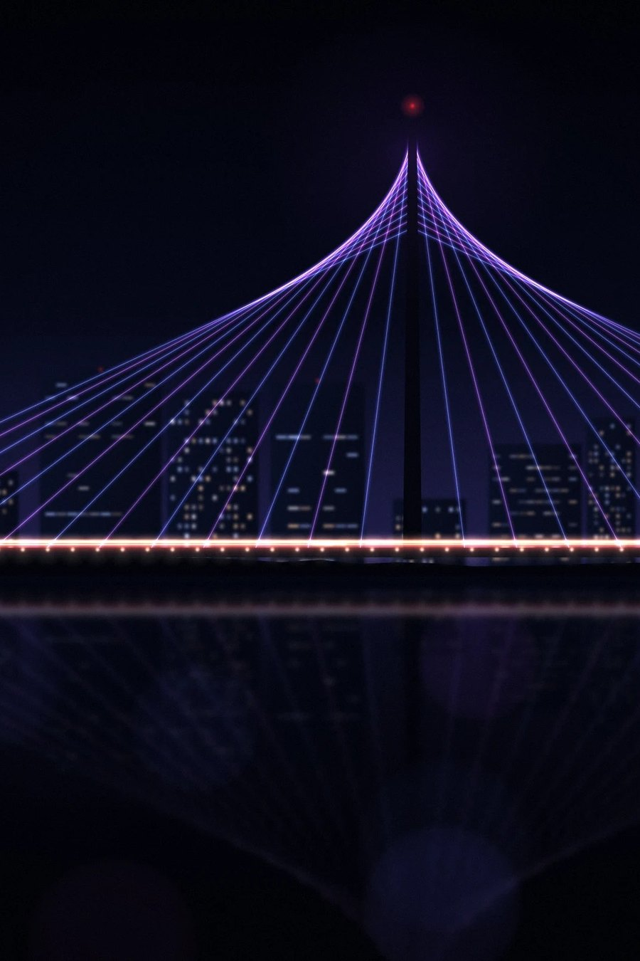
₹5 Cr seed now, ₹3 Cr round 2
THE ASK
₹5 Cr
₹3 Cr
seed, January 2027
round 2, March 2028, raised on POC data
WHAT THE SEED PAYS FOR
₹1.76 Cr
Before the POC: 210 screen kits with cameras (₹71.4 L), warehouse, team, legal
₹1.51 Cr
The 3 POC months, which bring in ₹3 Cr
₹93 L
Screen stock for riders who join after the POC
≈ ₹2.9 Cr
Lowest money in the bank (rough; the model is being re-run)
Valuation: [to confirm] · Contact: Prateek Medikonda, [email and phone to confirm]
Notes:
Funding (MODEL_V53 + 4 Nov changes): seed ₹5 Cr Jan 2027 + round 2 ₹3 Cr Mar 2028 = ₹8 Cr. Before-POC spend about ₹1.76 Cr (was ₹2.51 Cr) incl. 210 kits with cameras ₹71.4 L and about ₹3 L tech; POC about ₹1.51 Cr against ₹3 Cr in; cooling screen stock ₹93 L; lowest money in the bank about ₹2.9 Cr (rough). Round 2 pays for growth to 2,000 bikes, screen stock, bank deposits and the Bengaluru launch.

