Slide 1

BLUESTOCK DATA ANALYST INTERNSHIP · JUNE 2026
Bluestock Mutual Fund Analytics Platform
A comprehensive end-to-end financial analytics solution — integrating data engineering, financial analytics, risk management, and business intelligence for the Indian mutual fund industry.
Python • Pandas • SQLite • SQL • Power BI
Krishnadas P S · B.Tech Computer Science & Business Systems · Model Engineering College, Kochi

Slide 2
PROBLEM & OBJECTIVES
Problem Statement & Project Objectives
The Challenge
Project Objectives
Mutual fund data is fragmented across sources, making it difficult to evaluate fund performance, assess risk, and compare schemes. Traditional reporting lacks integrated dashboards for risk-adjusted returns and industry-wide trend monitoring.
Build an automated ETL pipeline for mutual fund datasets
Design a structured SQLite analytical database
Calculate performance & risk metrics (CAGR, Sharpe, VaR, CVaR)
Analyze investor demographics and behavior
Deliver an interactive Power BI dashboard for decision support

Slide 3
DATA FOUNDATION
Data Sources & Project Scale
The platform integrates 10 distinct datasets covering fund performance, investor transactions, industry trends, and portfolio holdings.
10
40
Datasets
Fund Schemes
Fund master, NAV history, AUM, SIP inflows, transactions & more
Across multiple categories and fund houses
46K+
32K+
NAV Observations
Transactions
Historical Net Asset Value records
Investor transaction records analyzed

Slide 4

DATA ENGINEERING
ETL Pipeline Architecture
Raw Data
Ingest & Clean
Transform & Validate
SQLite DB
The modular Python-based pipeline minimizes manual intervention while ensuring data consistency, reliability, and scalability across all 10 datasets.
Cleaning Steps
Database Loading
Date standardization & duplicate removal
Missing NAV handling with forward-fill
KYC status & amount validation
Expense ratio & Sharpe anomaly checks
Star-schema inspired architecture
Dimension tables: dim_fund, dim_date
Fact tables: nav, transactions, performance, AUM, SIP

Slide 5
DATABASE DESIGN
SQLite Analytical Database
Schema Architecture
Key Benefits
A star-schema inspired design separates descriptive attributes from transactional records, enabling efficient aggregation and reporting.
Reduced data redundancy
Faster aggregation queries
Improved analytical performance
Easier Power BI dashboard integration
Scalable for future datasets
Supported Queries
Top funds by AUM & Sharpe Ratio
Category-wise inflows & SIP growth
Investor demographic analysis
Benchmark comparison
Dimension Tables
Fact Tables
dim_fund · dim_date
fact_nav · fact_transactions · fact_performance · fact_aum · fact_sip

Slide 6
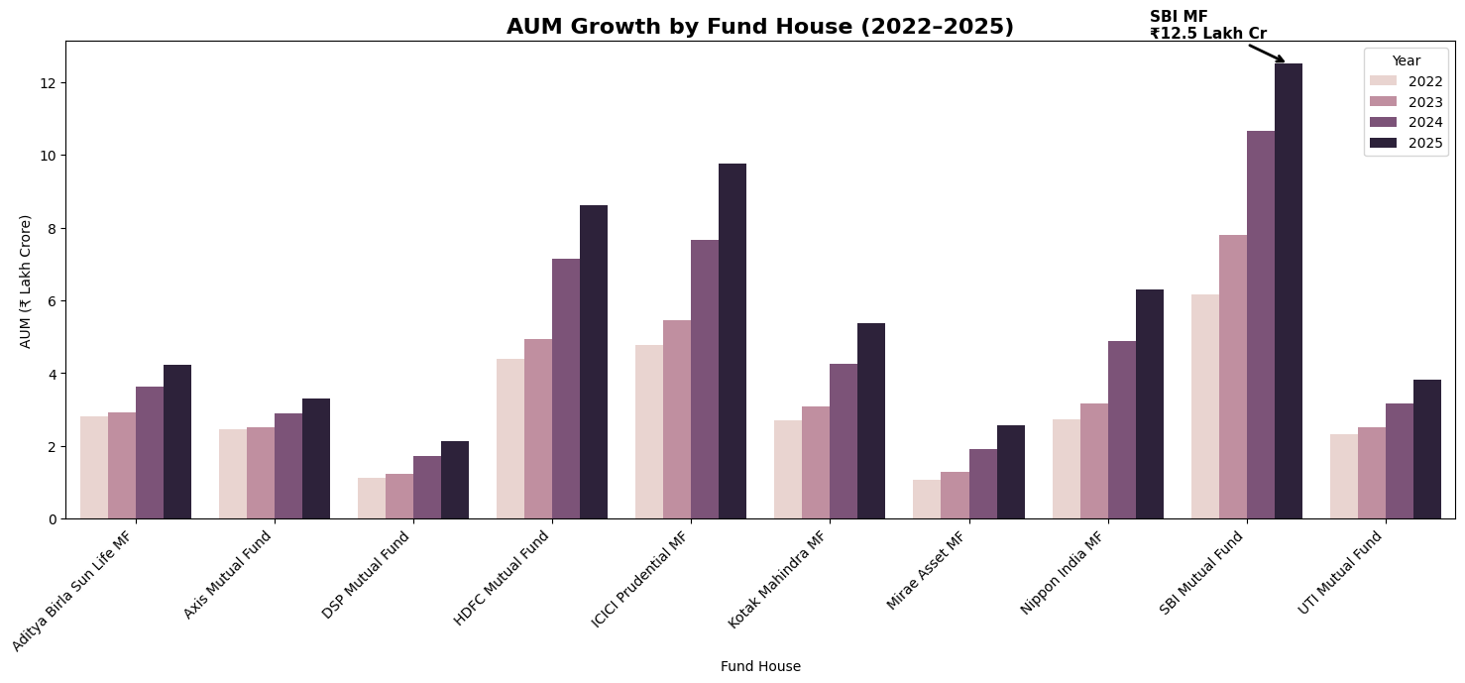
EXPLORATORY ANALYSIS
EDA: Industry Trends & Investor Insights
AUM Growth (₹ Lakh Cr)
SBI Mutual Fund recorded the highest AUM growth during the analysis period, reaching ₹12.5 Lakh Cr by 2025. Industry-wide AUM expanded consistently across all fund houses.
Investor Demographics
26–35 age group dominates at 41.1% of investors
36–45 contributes 24.9%; 18–25 adds 15%
Madhya Pradesh, Punjab & Telangana lead state-wise SIP investment
SIP inflows reached an all-time high of ₹13,302 Cr

Slide 7
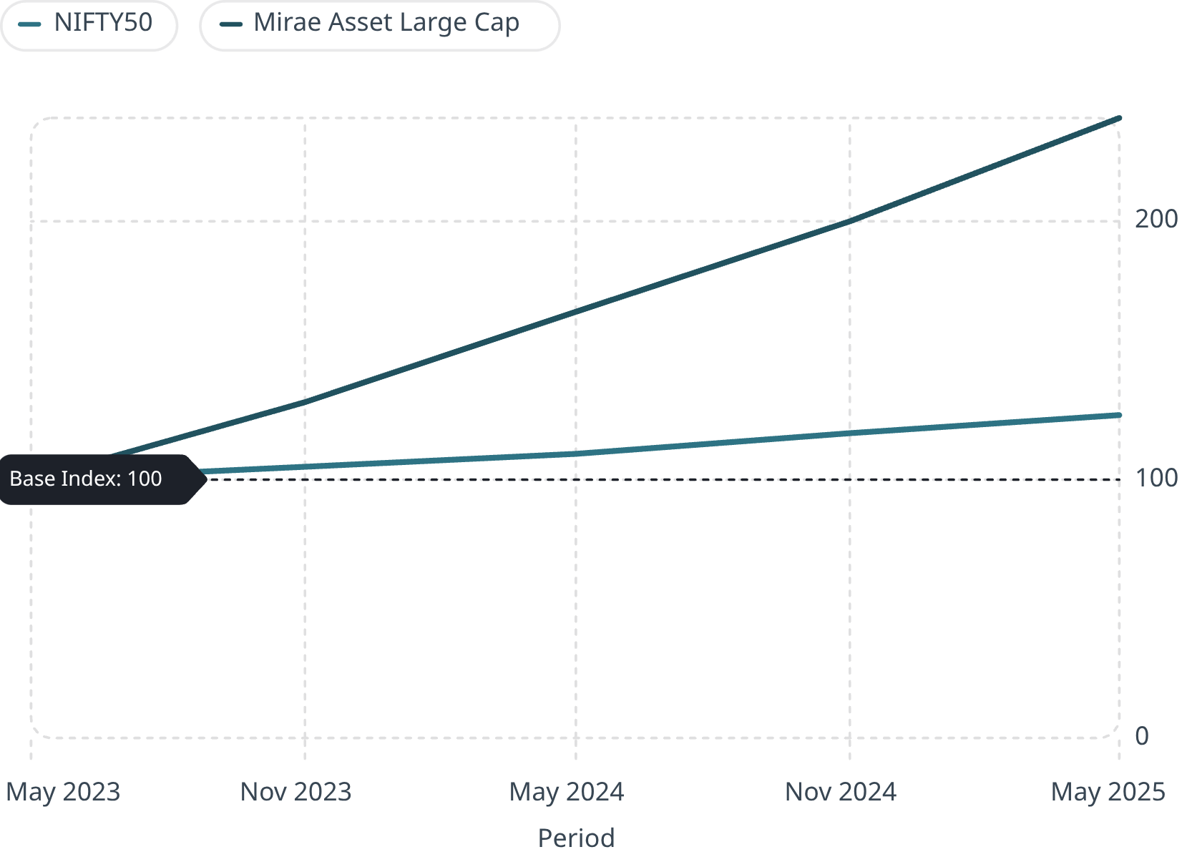
PERFORMANCE ANALYTICS
Performance & Risk Metrics
Performance Metrics
Daily Returns · 1-Year & 3-Year CAGR
Benchmark Returns vs NIFTY50 & NIFTY100
Fund Scorecard Ranking
Risk Metrics
Sharpe Ratio · Sortino Ratio
Alpha · Beta · Maximum Drawdown
Fund Scorecard Weights
Returns 30% · Sharpe 25% · Alpha 20% · Expense Ratio 15% · Drawdown 10%
Several funds generated strong risk-adjusted returns despite moderate absolute returns — underscoring the value of composite evaluation.

Slide 8
ADVANCED ANALYTICS
Advanced Analytics & Risk Modeling
Value at Risk (VaR)
Conditional VaR (CVaR)
Cohort Analysis
Historical VaR calculated at 95% confidence level to estimate maximum expected loss over a given period.
Estimates expected losses beyond the VaR threshold, providing a comprehensive view of tail risk exposure.
Investor cohorts analyzed by transaction timing to identify participation and retention trends across segments.
Fund Recommendation Engine
Sector Concentration (HHI)
Classifies and recommends funds based on performance characteristics and investor risk preferences.
Herfindahl-Hirschman Index measures portfolio concentration and diversification levels across fund holdings.

Slide 9
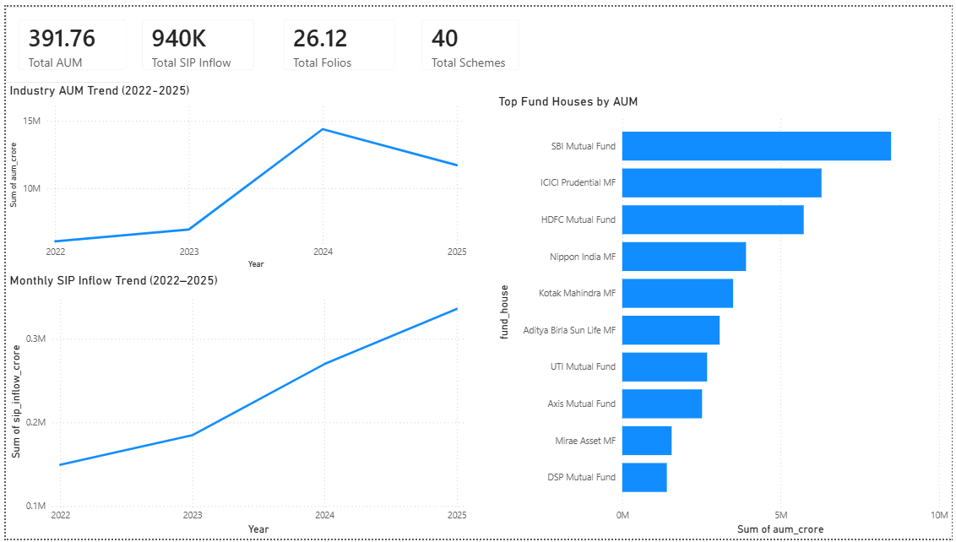
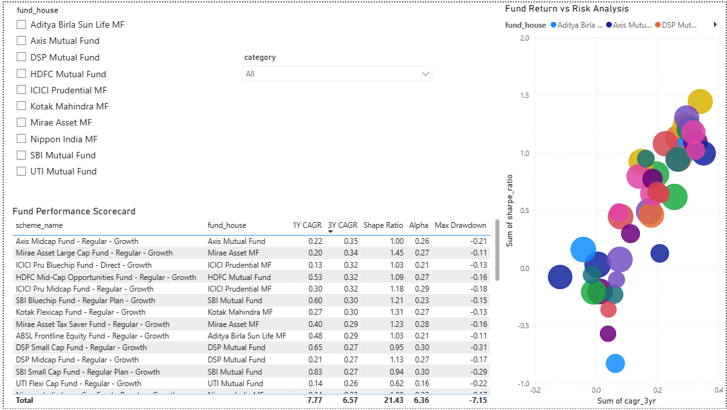
DASHBOARD
Interactive Power BI Dashboard
A four-page dashboard transforms analytical outputs into business-friendly visualizations with interactive filters.
Tools used: Python, Pandas, SQLite, SQL, Power BI
Page 1 — Industry Overview
Page 2 — Fund Performance
Industry KPIs, AUM trends, SIP growth, fund house comparisons
Fund scorecards, risk-return analysis, CAGR metrics, benchmark comparisons

Slide 10
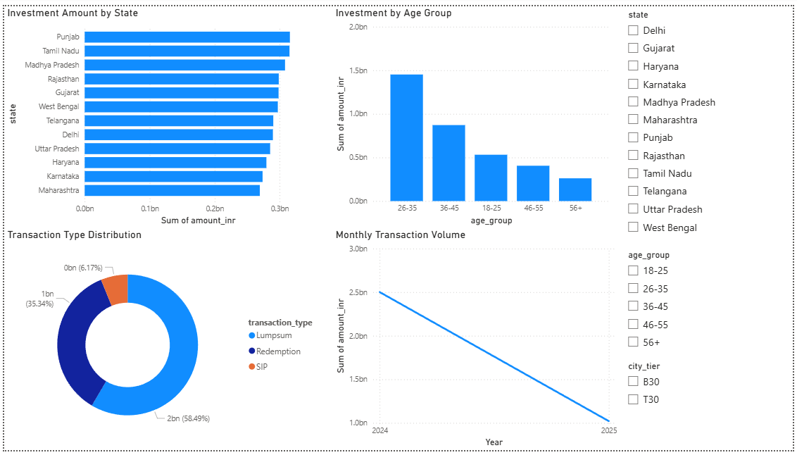
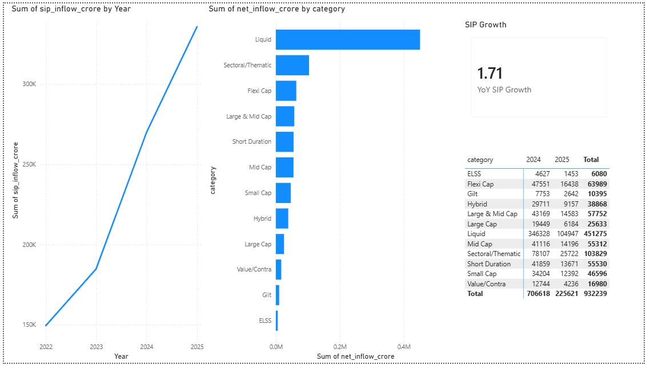
Page 3 — Investor Analytics
Page 4 — SIP & Market Trends
Demographics, geographic participation, transaction patterns, investment behavior
SIP growth tracking, category inflows, market participation trends

Slide 11
INSIGHTS & CONCLUSION
Key Findings, Recommendations & Conclusion
Key Findings
Conclusion
Consistent AUM growth; SIP inflows reached all-time high
26–35 age group leads investor participation (41.1%)
Strong risk-adjusted returns in select schemes
Correlation analysis revealed diversification opportunities
The Bluestock Mutual Fund Analytics Platform successfully integrates data engineering, financial analytics, risk management, and business intelligence into a single solution — transforming raw datasets into actionable investment insights through ETL pipelines, a structured database, advanced risk metrics, and an interactive Power BI dashboard.
Recommendations
Evaluate funds using both return & risk metrics
Encourage SIP investing for long-term wealth creation
Target younger segments & B30 geographic expansion
Integrate VaR/CVaR into investor decision frameworks

Slide 12
Thank You
GitHub Repository:
https://github.com/Picture-Sque/bluestock-mf-capstone Prepared by:
Krishnadas P S

