Slide 1
Traveling salesman problem

Slide 2
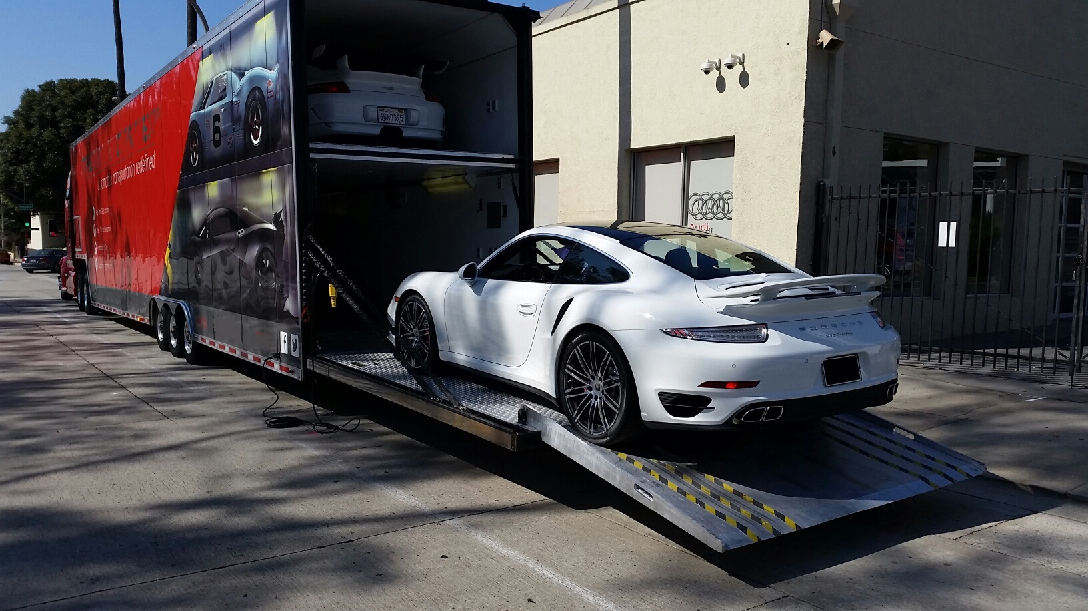



TSP
TSP-D
vs.
TSP-O
NYC
$W_{c}<x$ ?
$C=min(w)$
2.776
1.288
1.629
LA
2.735
MIA
1.546
1.189
HOU
$$Opt(G)=6.799$$
Weights in 1K miles

Slide 3





Tsp
A
Possible Tours
H
B
$$C=V!$$
$$C_{4}=24$$
G
C
$$C_{8}=40,320$$
$$C_{10}=3,628,800$$
$$C_{100}≈9.332e157$$
F
D
E

Slide 4
Certificate verification
MIA | {NYC: 1.288}, {LA: 2.735}, {HOU: 1.189}
NYC | {LA: 2.776}, {HOU: 1.629}, {MIA: 1.189}
LA | {NYC: 2.776}, {MIA: 2.735}, {HOU: 1.546}
HOU | {LA: 1.546}, {NYC: 1.629}, {MIA: 1.189}
✅ “MIA HOU NYC LA MIA“
❌ “MIA NYC LA NYC HOU MIA”
❌ “MIA NYC LA MIA”

Slide 5



NP-HARD Reduction
NYC
NYC
2.776
2.776
$$∞$$
1.629
1.629
LA
2.735
MIA
LA
2.735
MIA
$$≤_{p}$$
1.189
$$∞$$
1.189
HOU
HOU
Hamiltonian Cycle
Traveling Salesman

Slide 6
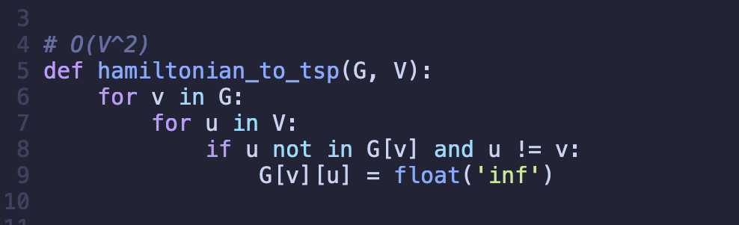

NP-HARD Reduction
$$O(V^{2})$$

Slide 7
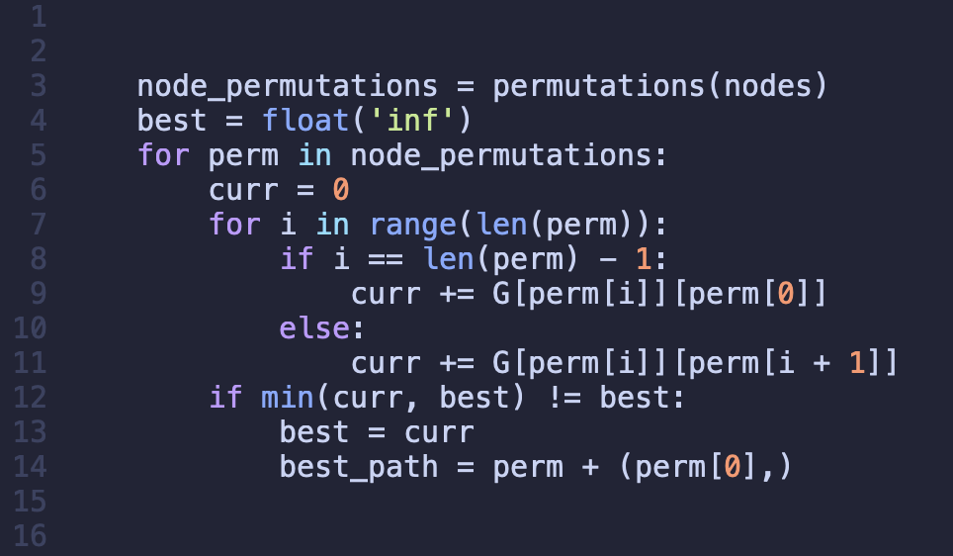

Analytical runtime OF exact solution
$$O(V!∙V)$$

Slide 8
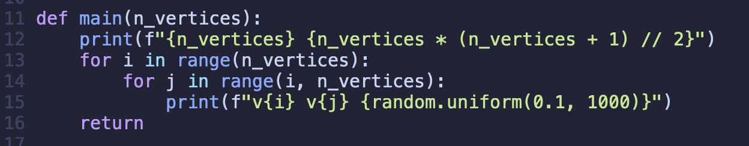
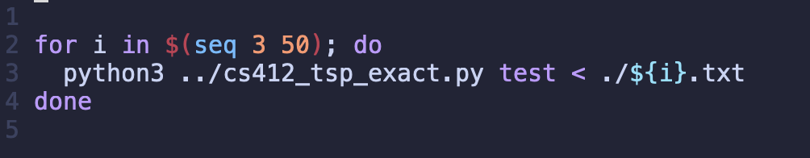
Test creation
          generator.py
run_tests.sh

Slide 9
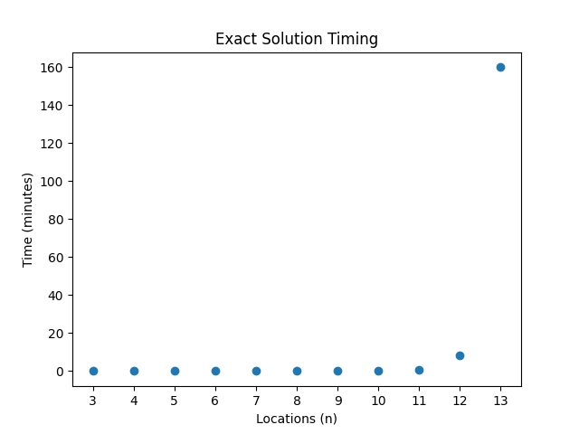






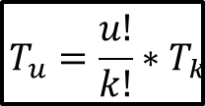




Empirical analysis
$$T_{u}=\frac{u!}{k!}∗T_{k}$$
$$K$$
$$U$$
$$[n_{2}:n_{6}]≤1ms$$
$$n_{14}≈36.4h$$
$$[n_{7}:n_{9}]≤1s$$
$$n_{15}>1.5M$$
$$[n_{10}:n_{11}]≤1m$$
$$[n_{16}:n_{x}]=Y$$
$$n_{12}≈8m$$
$$n_{13}≈2.6h$$

Slide 10
Approximate Solution
def main():
  ** Initialize graph and nodes **
  for each edge in the graph: ← O(n)
  ** build adjacency dictionary **
  # Step 1: Build initial path using Nearest Neighbor heuristic
  path_1 = nearest_neighbor(graph, nodes) ← O(n²)
  # Step 2: Run 2-opt heuristic for local improvement
  path_2 = two_opt(graph, path_1) ← O(n³) worst case
  # Compute final path length and cycle
  tour_length = tour_length(graph, path_2) ← O(n)
  path_3 = path_2 + the first node of path_2 ← turn into a cycle
Two heuristics used in combination:
1. Nearest Neighbor (Greedy)
2. Two-Opt (Local optimal swap)
Polynomial Time:
O(n) (build adjacency dictionary)
+ O(n²) (Nearest Neighbor)
+ O(n²) (Two-Opt pair checks)
+ O(n³) (Two-opt worst case switch)
+ O(n) (Calculate tour length)
= O(n³)

Slide 11
Approximate Solution
The Nearest Neighbor heuristic picks the smallest cost edge first.
This is considered a greedy approach.
Heuristic #1: Nearest Neighbor
Example of Nearest Neighbor:

Slide 12
Approximate Solution
The Two-opt heuristic removes edge crossings.
In TSP, crossed edges usually mean the path is suboptimal.
Heuristic #2: Two-Opt
Example of a simple Two-opt:

Slide 13
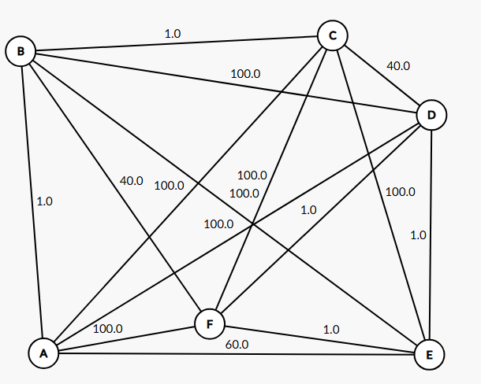
Approximate Solution – non-Optimal test case
**Optimal cycle**:
A → E (60.0) → F (1.0) → D (1.0) → C (40.0) → B (1.0) → A (1.0).
Tour: A E F D C B A
Length: 60 + 1 + 1 + 40 + 1 + 1 = 104.0
**Nearest neighbor from A**:
A → B (1.0) → C (1.0) → D (40.0) → E (1.0) → F (1.0) → A (100.0)
Tour: a b c d e f a
Length: 1 + 1 + 40 + 1 + 1 + 100 = 143.0

Slide 14
Approximate Solution – non-Optimal test case
**Optimal cycle**:
A → E (60.0) → F (1.0) → D (1.0) → C (40.0) → B (1.0) → A (1.0).
Tour: A E F D C B A
Length: 60 + 1 + 1 + 40 + 1 + 1 = 104.0
**Nearest neighbor from a**:
A → B (1.0) → C (1.0) → D (40.0) → E (1.0) → F (1.0) → A (100.0)
Tour: A B C D E F A
Length: 1 + 1 + 40 + 1 + 1 + 100 = 143.0
WHAT ABOUT TWO-OPT?
** Any single 2‑edge swap in A B C D E F A increases cost (e.g., replacing (B,C) + (F,A) = 1 + 100 with (B,F) + (C,A) = 40 + 100), so the algorithm remains at 143.0 rather than reaching 104.0.
NOT BAD…..BUT NOT OPTIMAL

Slide 15
Approximate Solution – non-Optimal test case
**Optimal cycle**:
A → E (60.0) → F (1.0) → D (1.0) → C (40.0) → B (1.0) → A (1.0).
Tour: A E F D C B A
Length: 60 + 1 + 1 + 40 + 1 + 1 = 104.0
**Nearest neighbor from a**:
A → B (1.0) → C (1.0) → D (40.0) → E (1.0) → F (1.0) → A (100.0)
Tour: a b c d e f a
Length: 1 + 1 + 40 + 1 + 1 + 100 = 143.0

Slide 16
Approximate vs exact solution – compare results
plots that compare the result/solution of your exact solution versus the approximation on your test cases. This is where you show the value achieved by both and see how well your approximation did versus the optimal solution.

Slide 17
Approximate vs exact solution – run time (wall clock)
Approximate Solution | Exact Solution | # of nodes
0.0000088 | 0.0000077 | 3
0.0000115 | 0.0000153 | 4
0.0000128 | 0.000052 | 5
0.0000158 | 0.0003112 | 6
0.0000166 | 0.0024893 | 7
0.0000175 | 0.0230878 | 8
0.0000373 | 0.2287903 | 9
0.0000223 | 2.4284377 | 10
0.0000257 | 27.6510172 | 11
0.0000294 | 410.1124702 | 12
0.0000302 | 9600.488107 | 13
0.0000327 | 244000 | 14
0.0000576 | 3.92E+06 | 15
0.0000879 | 7.76E+19 | 25
0.0003045 | 3.04E+59 | 50
0.001417 | 1.87E+153 | 100
0.2630184 | 8.04E+269 | 1000

Slide 18
Approximate vs exact solution – Time Complexity
Worst Case
Lower Bound
Every TSP tour must connect all nodes, and MST is the minimal total edge weight connecting all nodes, so the MST’s length is our lower bound for TSP.
Δ = Tour length found by our algorithm – Lower Bound
Example (test case ’14.txt’):
MST Length calculation ≈ 2565.36
Tour length printed by our algorithm = 2727.8113
Δ = 2727.8113 – 2565.36 ≈ 144.4513
Still Polynomial Time!
O(n) (build adjacency dictionary)
+ O(n²) (Nearest Neighbor)
+ O(n²) (Two-Opt pair checks)
+ O(n³) (Two-opt worst case switch)
+ O(n) (Calculate tour length)
= O(n³)

Slide 19
Enhancing the Approximate Solution
Featuring randomness

Slide 20
Where DO We Fall Short?
No randomness limits graph exploration
Dependent on starting node
Mutates a list while iterating through it

Slide 21
Making Version 3.5, “Zenith”
It was – and is – an iterative process
Randomly determines:
  Starting node
  Min-weight neighbor to choose
  Swapping endpoints in a segment.
Reorders output path to be consistent.
Iterates on solution by looping several times.
Approx. Solution
v2, limited randomness
v2.5, iteration
v3, more randomess
v3.5, more iteration
Zenith

Slide 22
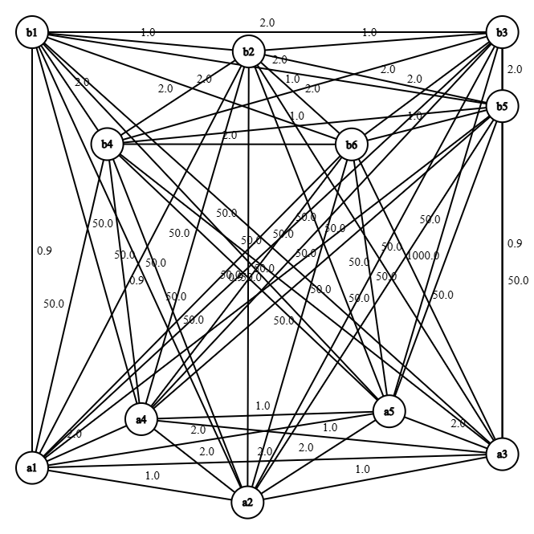
Sample Problem: The GRaph
Cheap edges inside each cluster
Inter-cluster edges designed to mislead:
  Cheap inter-cluster edges are bait
  1000 weight trap edge
  All other inter-cluster edges are moderately expensive
Optimal path: length of 12.6

Slide 23
Sample Problem: The Results

Slide 24
Sample Problem: The Runtimes
Program | Average Runtime (Seconds)
Exact | 36.25096352
Approximate | 0.000046262
Zenith | 0.017063243
Parallelized Zenith | 0.755844638

Slide 25
Takeaways
Randomness and iterative improvement greatly increases accuracy
However, it also greatly increases cost
Ultimately, the tradeoff is worth it

Slide 26

Questions?

