Slide 1
Pitch deck

Slide 2
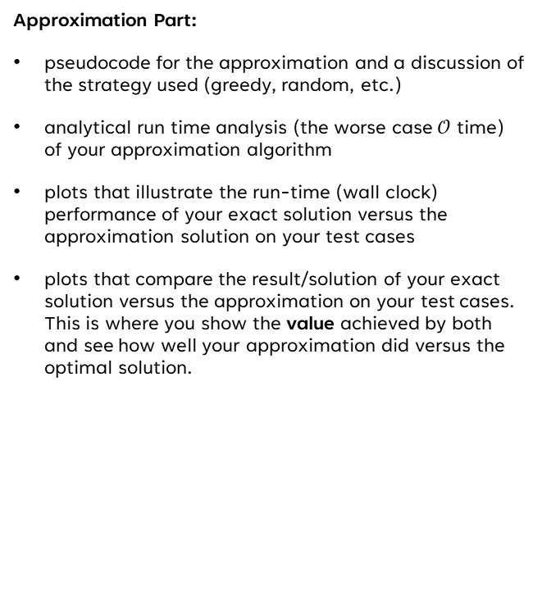
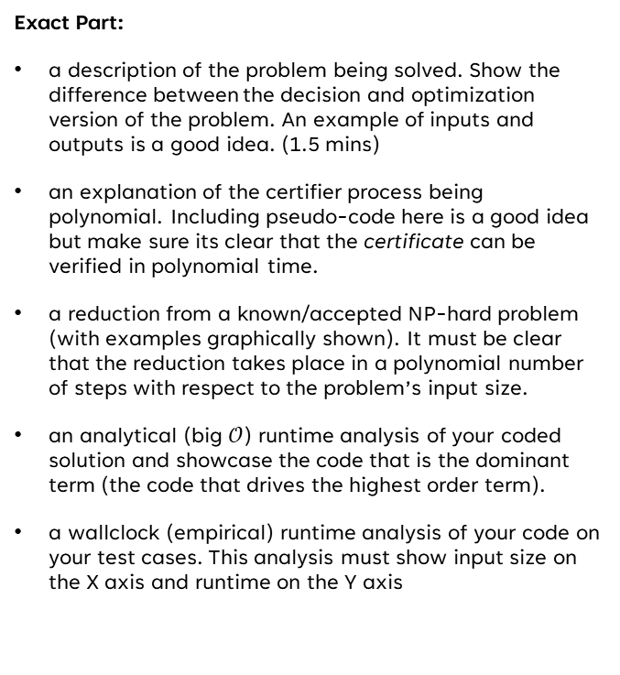
TODO
Exact Part:
a description of the problem being solved. Show the difference between the decision and optimization version of the problem. An example of inputs and outputs is a good idea. (1.5 mins)
an explanation of the certifier process being polynomial. Including pseudo-code here is a good idea but make sure its clear that the certificate can be verified in polynomial time.
a reduction from a known/accepted NP-hard problem (with examples graphically shown). It must be clear that the reduction takes place in a polynomial number of steps with respect to the problem’s input size.
an analytical (big $𝒪$) runtime analysis of your coded solution and showcase the code that is the dominant term (the code that drives the highest order term).
a wallclock (empirical) runtime analysis of your code on your test cases. This analysis must show input size on the X axis and runtime on the Y axis
Approximation Part:
pseudocode for the approximation and a discussion of the strategy used (greedy, random, etc.)
analytical run time analysis (the worse case $𝒪$ time) of your approximation algorithm
plots that illustrate the run-time (wall clock) performance of your exact solution versus the approximation solution on your test cases
plots that compare the result/solution of your exact solution versus the approximation on your test cases. This is where you show the value achieved by both and see how well your approximation did versus the optimal solution.
Part E:
Talk about how you broke things
Talk about how you fixed things
What is your approximation weak on
How does adding more time improve things?
Conclude everything

Slide 3
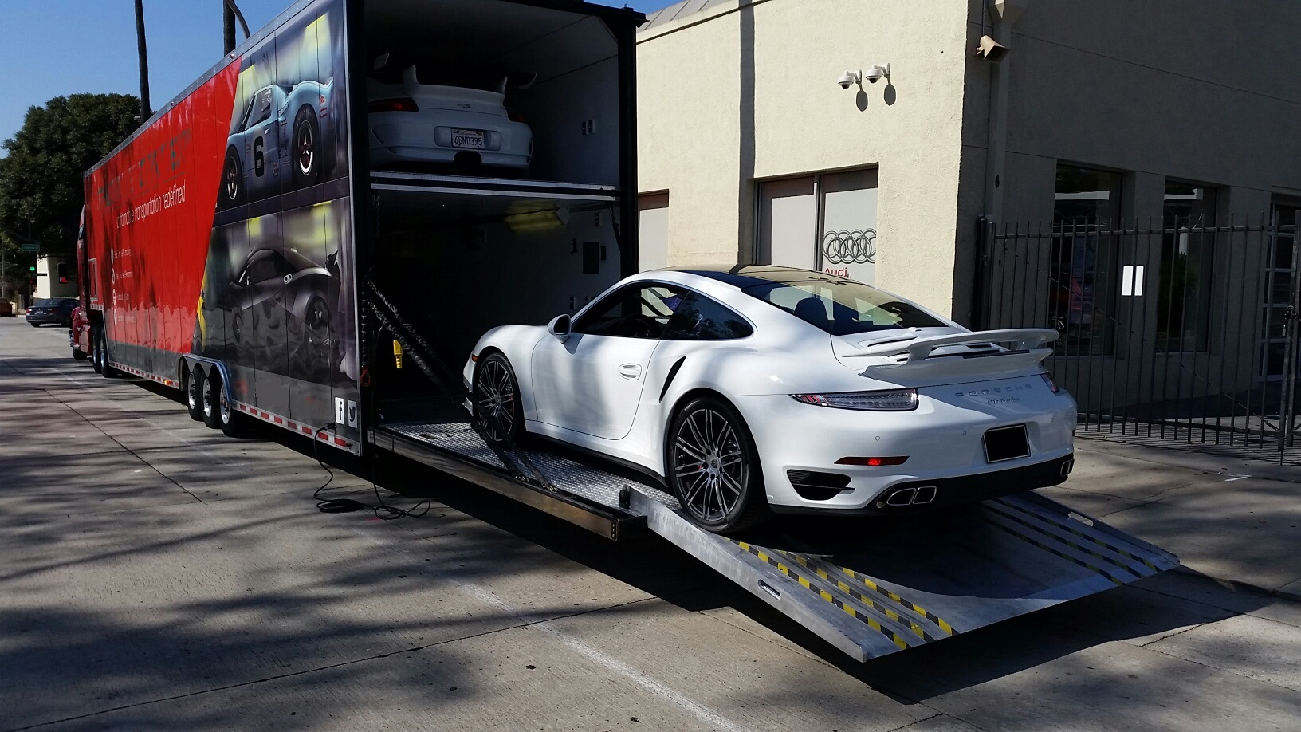
JFK
2.475
1.09
1.74
LAX
2.342
MIA
1.39
1.1
HOU
Weights in 1K miles

Slide 4
JFK
JFK
JFK
LAX
MIA
JFK
JFK
HOU
“Can’t do it boss…”

Slide 5
Certifier verification is polynomial

Slide 6
REDUCTION FROM KNOWN NP-hard SOLution
Reduce from hamiltonian cycle

Slide 7

Analytical runtime Analysis
First beautifully designed product that's both stylish and functional

Slide 8
EMpirical runtime analysis
Unique
First to market
Tested
Authentic
Only product specifically dedicated to this niche market
First beautifully designed product that's both stylish and functional
Conducted testing with college students in the area
Designed with the help and input of experts in the field

Slide 9

Reduction

Slide 10

Enhancing the Approximate Solution
Featuring randomness

Slide 11
Where DO We Fall Short?
No randomness limits graph exploration
Dependent on starting node
Mutates a list while iterating through it

Slide 12
Making Version 3.5
It was – and is – an iterative process
Randomly determines:
  Starting node
  Min-weight neighbor to choose
  Swapping endpoints in a segment.
Reorders output path to be consistent.
Iterates on solution by looping several times.

Slide 13
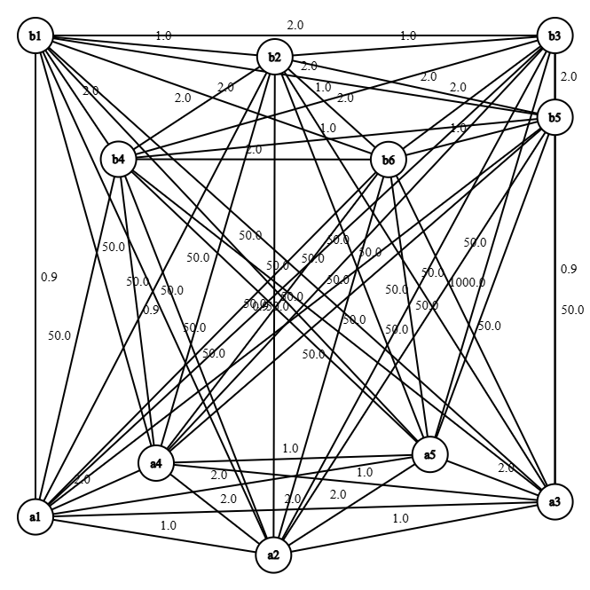
Sample Problem: The GRaph
Cheap edges inside each cluster
Inter-cluster edges designed to mislead:
  Cheap inter-cluster edges are bait
  1000 weight trap edge
  All other inter-cluster edges are moderately expensive
Optimal path: length of 12.6

Slide 14
Sample Problem: The Results
TODO: make into a graph or something
Run exact, approx, and v3.5 100 times each and (bar) graph the different results it yields

Slide 15
Sample Problem: The Runtimes
TODO: make a graph. Run exact, approx., and v3.5 100 times and (bar) graph the runtimes

Slide 16
Takeaways

Slide 17
Conclusions

Slide 18

Thank you
Brita Tamm
502-555-0152
brita@firstupconsultants.com
www.firstupconsultants.com

