Slide 1
presentation of testing results
Analyzed models:
1- Gemini
        Gemini 1.5 flash 002
        Gemini 1.5 flash 001
        Gemini 2.0 flash lite 001
        Gemini 2.0 flash thinking exp
2- Gemma
        Gemma3 1B
        Gemma3 4B
3- Llama
        Llama 3.1 8B
        Llama 3.2 8B
        Llama 3.2 3B

Slide 2
Used Softwares
Python 3.13.3 (PyCharm editor)
Ollama 0.6.6 (Py library: Ollama 0.5.1 )
Google-genai 1.8.0 (Py library)
LibreOffice with Basic maroes

Slide 3
Gemini
The library google.genai has been used to automize tests from at least 12 ‘free-tier’ profiles.
At least 100 requests have been performed from each profile.

Slide 4
Ollama
Ollama is a open source multi-platform software that allows to run locally different LLMs models, avoiding the troubles of initialization.
Gemma and Llama have been executed using this software, due to the high computational cost, it was only possible to test models with few parameters.
A minimum of 300 requests per question have been performed.

Slide 5
Results representation
The results were represented through the use of Boxplots, with the following dimensions:
X: Iteration number
Y: Percentage of correct answers
Box: shows by iteration the correctness of responses across accounts

Slide 6
Box Plots
Gemma and Llama has only one ‘account’ because they run locally
Differences between accounts always converge and about 200 plots have been produced so the diagrams will be categorized as follow:

Slide 7
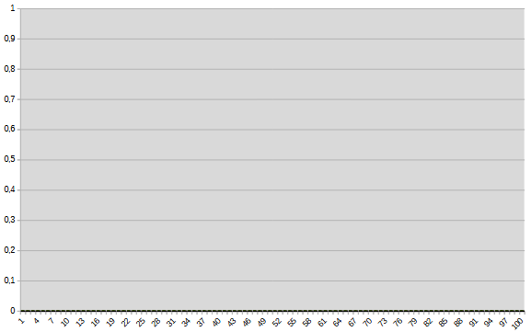
Always Wrong (W)
There are no differences between the models

Slide 8
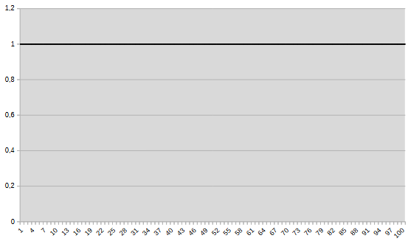
Always Right (R)
There are no differences between the models

Slide 9
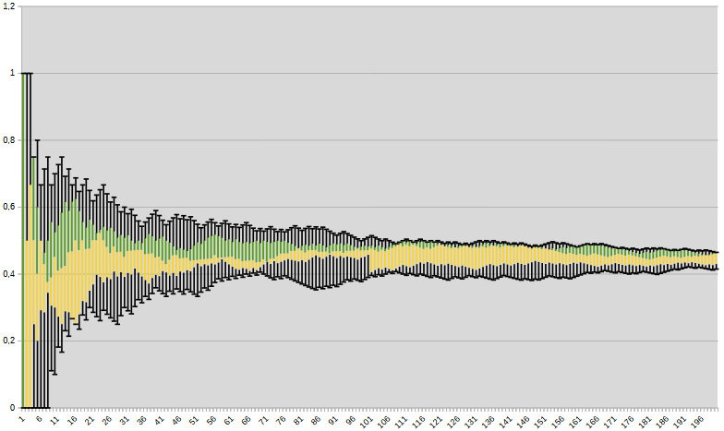
Converges to N (N as number)
Gemini

Slide 10
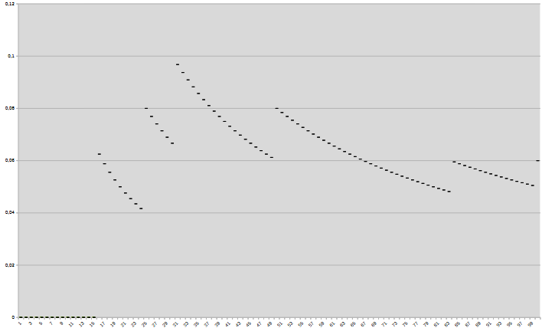
Converges to N (N as number)
Llama and Gemma

Slide 11
Reasoning
Questions from 101 to 106 can be categorized as follow:
101, 102, 105: mathematical reasoning
103, 104: common math problems
106: solve a Sudoku
Also coding can be evalueted by PoT answers.

Slide 12
Q101
Question 101 is about Exponential Calculation, the prompt methodologies used are:
One Shot (OS)
PoT
CoT

Slide 13
Q101 – Llama + Gemma
 | Llama3.2 3B | Llama3.2 1B | Llama3.1 8B | Gemma3 4B | Gemma3 1B
OS | W | W | W | W | W
CoT | 0.030 | 0.05 | 0.095 | 0.14 | 0.25
PoT | 0.033 | 0.065 | 0.075 | 0.038 | W

Slide 14
Q101 - Gemini
 | 2.0 flash thinking exp | 2.0 flash lite 001 | 2.0 flash 001 | 1.5 flash 8B 001 | 1.5 flash 002
OS | 1 | 0.90 | R | 0.02 | 0.08
CoT | R | 0.95 | 0.95 | 0.65 | 0.45
PoT | - | 0.90 | 0.995 | 0.02 | 0.5

Slide 15
Q102
Question 102 is a Simple Exponential Problem about intrests, already indexed by google, the prompt methodologies used are:
One Shot (OS)
PoT
CoT

Slide 16
Q102 – Llama + Gemma
 | Llama3.2 3B | Llama3.2 1B | Llama3.1 8B | Gemma3 4B | Gemma3 1B
OS | W | W | W | W | W
CoT | W | W | W | 0.125 | W
PoT | 0.7 | 0.06 | 0.85 | 0.2 | W

Slide 17
Q102 - Gemini
 | 2.0 flash thinking exp | 2.0 flash lite 001 | 2.0 flash 001 | 1.5 flash 8B 001 | 1.5 flash 002
OS | 0.8 | 0.05 | R | W | W
CoT | 0.8 | 0.3 | 0.15 | 0.005 | 0.4
PoT | - | 1 | R | 0.95 | R

Slide 18
Q103
Question 103 is a Simple Exponential Problem about intrests, same difficulty as 102 nut not indexed by Google, the prompt methodologies used are:
One Shot (OS)
PoT
CoT

Slide 19
Q103 – Llama + Gemma
 | Llama3.2 3B | Llama3.2 1B | Llama3.1 8B | Gemma3 4B | Gemma3 1B
OS | W | W | W | W | W
CoT | 0.01 | W | W | W | W
PoT | W | W | W | W | W

Slide 20
Q103 - Gemini
 | 2.0 flash thinking exp | 2.0 flash lite 001 | 2.0 flash 001 | 1.5 flash 8B 001 | 1.5 flash 002
OS | 0.005 | W | W | W | W
CoT | W | 0.025 | 0 | 0.005 | 0.15
PoT | - | W | W | W | W

Slide 21
Q104
Question 104 is about finding the maximum of the function x*Sin(X), the prompt methodologies used are:
One Shot (OS)
PoT
CoT

Slide 22
Q104 – Llama + Gemma
 | Llama3.2 3B | Llama3.2 1B | Llama3.1 8B | Gemma3 4B | Gemma3 1B
OS | 0.01 | W | 0.01 | W | W
CoT | W | 0.008 | W | 0.5 | 0.008
PoT | 0.05 | W | 0.05 | W | W

Slide 23
Q104 - Gemini
 | 2.0 flash thinking exp | 2.0 flash lite 001 | 2.0 flash 001 | 1.5 flash 8B 001 | 1.5 flash 002
OS | R | 0.2 | W | W | R
CoT | 1 | 1 | 0.95 | 0.7 | 0.995
PoT | - | W | W | 0 | W

Slide 24
Q105
Question 105 is a difficult problem concerning the birth rate, the prompt methodologies used are:
One Shot (OS)
PoT
CoT

Slide 25
Q105 – Llama + Gemma
 | Llama3.2 3B | Llama3.2 1B | Llama3.1 8B | Gemma3 4B | Gemma3 1B
OS | W | W | 0.01 | W | 0.008
CoT | W | W | 0.015 | W | 0.01
PoT | 0.008 | 0.008 | 0.06 | 0.01 | W

Slide 26
Q105 - Gemini
 | 2.0 flash thinking exp | 2.0 flash lite 001 | 2.0 flash 001 | 1.5 flash 8B 001 | 1.5 flash 002
OS | 0.4 | W | W | W | W
CoT | 0.05 | 0 | 0.125 | W | 0
PoT | - | 0.1 | 0.45 | 0 | W

Slide 27
Q106
Question 106 is about solving a simple Sudoku, the prompt methodologies used are:
One Shot (OS)
PoT
CoT
No data available for Gemma and Llama because the sudoku is an image.

Slide 28
Q106 - Gemini
 | 2.0 flash thinking exp | 2.0 flash lite 001 | 2.0 flash 001 | 1.5 flash 8B 001 | 1.5 flash 002
OS | W | W | W | W | W
CoT | W | W | W | W | W
PoT | - | W | W | W | W

Slide 29
Factuality
Questions from 201 to 206 can be categorized as follow:
From 201 to 204: factuality pitfalls
205 and 206: Russel's theory of descriptions

Slide 30
Q201 – Llama + Gemma
 | Llama3.2 3B | Llama3.2 1B | Llama3.1 8B | Gemma3 4B | Gemma3 1B
OS | 0.007 | W | W | W | W
CoT | 0.35 | 0.05 | 0.1 | W | 0.03

Slide 31
Q201 – Gemini
 | 2.0 flash thinking exp | 2.0 flash lite 001 | 2.0 flash 001 | 1.5 flash 8B 001 | 1.5 flash 002
OS | 0.2 | W | W | W | W
CoT | 0.1 | 0.4 | 0.1 | 0.5 | 0.4

Slide 32
Q202 – Llama + Gemma
 | Llama3.2 3B | Llama3.2 1B | Llama3.1 8B | Gemma3 4B | Gemma3 1B
OS | W | 0.02 | W | W | 0.995

Slide 33
Q202 – Gemini
 | 2.0 flash thinking exp | 2.0 flash lite 001 | 2.0 flash 001 | 1.5 flash 8B 001 | 1.5 flash 002
OS | 1 | W | W | W | W

Slide 34
Q203 – Llama + Gemma
 | Llama3.2 3B | Llama3.2 1B | Llama3.1 8B | Gemma3 4B | Gemma3 1B
OS | 0.08 | 0.0035 | 0 | W | W

Slide 35
Q203 – Gemini
 | 2.0 flash thinking exp | 2.0 flash lite 001 | 2.0 flash 001 | 1.5 flash 8B 001 | 1.5 flash 002
OS | 0.0025 | 0.05 | W | W | W

Slide 36
Q204 – Llama + Gemma
 | Llama3.2 3B | Llama3.2 1B | Llama3.1 8B | Gemma3 4B | Gemma3 1B
OS | W | W | W | W | W

Slide 37
Q204 – Gemini
 | 2.0 flash thinking exp | 2.0 flash lite 001 | 2.0 flash 001 | 1.5 flash 8B 001 | 1.5 flash 002
OS | 0.1 | W | W | W | W

Slide 38
Q205 – Llama + Gemma
 | Llama3.2 3B | Llama3.2 1B | Llama3.1 8B | Gemma3 4B | Gemma3 1B
OS | 0.9 | W | 0.4 | 0.4 | W

Slide 39
Q205 – Gemini
 | 2.0 flash lite 001 | 2.0 flash 001 | 1.5 flash 8B 001 | 1.5 flash 002
OS | W | W | W | W

Slide 40
Q206 – Llama + Gemma
 | Llama3.2 3B | Llama3.2 1B | Llama3.1 8B | Gemma3 4B | Gemma3 1B
OS | 0.4 | W | 0.2 | W | W

Slide 41
Q206 – Gemini
 | 2.0 flash lite 001 | 2.0 flash 001 | 1.5 flash 8B 001 | 1.5 flash 002
OS | W | R | W | W

Slide 42
Sussman anomaly
Questions from 301 to 310 can be categorized as follow:
301, 302: Wolf, goat and cabbage problem
303, 304: Blocks world
305, 306, 307, 310: Hanoi tower
308, 309: Ordered stacks (similar to Hanoi tower)
The questions have different degrees of difficulty and obfuscation of the problem.

Slide 43
Q301 – Llama + Gemma
 | Llama3.2 3B | Llama3.2 1B | Llama3.1 8B | Gemma3 4B | Gemma3 1B
CoT | W | W | W | W | W

Slide 44
Q301 – Gemini
 | 2.0 flash thinking exp | 2.0 flash lite 001 | 2.0 flash 001 | 1.5 flash 8B 001 | 1.5 flash 002
CoT | 0.5 | 0.05 | 0.3 | W | 0.025

Slide 45
Q302 – Llama + Gemma
 | Llama3.2 3B | Llama3.2 1B | Llama3.1 8B | Gemma3 4B | Gemma3 1B
CoT | W | W | W | W | W

Slide 46
Q302 – Gemini
 | 2.0 flash thinking exp | 2.0 flash lite 001 | 2.0 flash 001 | 1.5 flash 8B 001 | 1.5 flash 002
CoT | 0.01 | 0 | 0 | W | 0

Slide 47
Q303 – Llama + Gemma
 | Llama3.2 3B | Llama3.2 1B | Llama3.1 8B | Gemma3 4B | Gemma3 1B
CoT | W | W | 0.015 | W | W

Slide 48
Q303 – Gemini
 | 2.0 flash lite 001 | 2.0 flash 001 | 1.5 flash 8B 001 | 1.5 flash 002
CoT | 0.02 | 0.0002 | W | 0.005

Slide 49
Q304 – Llama + Gemma
 | Llama3.2 3B | Llama3.2 1B | Llama3.1 8B | Gemma3 4B | Gemma3 1B
CoT | W | W | W | W | W

Slide 50
Q304 – Gemini
 | 2.0 flash lite 001 | 2.0 flash 001 | 1.5 flash 8B 001 | 1.5 flash 002
CoT | 0.01 | 0.08 | W | 0.006

Slide 51
Q305 – Gemini
 | 2.0 flash lite 001 | 2.0 flash 001 | 1.5 flash 8B 001 | 1.5 flash 002
CoT | W | 0.025 | W | W

Slide 52
Q306 – Llama + Gemma
 | Llama3.2 3B | Llama3.2 1B | Llama3.1 8B | Gemma3 4B | Gemma3 1B
CoT | W | W | W | W | W

Slide 53
Q306 – Gemini
 | 2.0 flash lite 001 | 2.0 flash 001 | 1.5 flash 8B 001 | 1.5 flash 002
CoT | 0 | 0.3 | W | W

Slide 54
Q307 – Llama + Gemma
 | Llama3.2 3B | Llama3.2 1B | Llama3.1 8B | Gemma3 4B | Gemma3 1B
CoT | W | W | W | W | W

Slide 55
Q307 – Gemini
 | 2.0 flash lite 001 | 2.0 flash 001 | 1.5 flash 8B 001 | 1.5 flash 002
CoT | 0 | 0.2 | W | W

Slide 56
Q308 – Llama + Gemma
 | Llama3.2 3B | Llama3.2 1B | Llama3.1 8B | Gemma3 4B | Gemma3 1B
CoT | W | W | W | W | W

Slide 57
Q308 – Gemini
 | 2.0 flash lite 001 | 2.0 flash 001 | 1.5 flash 8B 001 | 1.5 flash 002
CoT | W | 0 | W | W

Slide 58
Q309 – Llama + Gemma
 | Llama3.2 3B | Llama3.2 1B | Llama3.1 8B | Gemma3 4B | Gemma3 1B
CoT | W | W | W | W | W

Slide 59
Q309 – Gemini
 | 2.0 flash lite 001 | 2.0 flash 001 | 1.5 flash 8B 001 | 1.5 flash 002
CoT | 0 | 0.05 | W | W

Slide 60
Q310 – Llama + Gemma
 | Llama3.2 3B | Llama3.2 1B | Llama3.1 8B | Gemma3 4B | Gemma3 1B
CoT | W | W | W | W | W

Slide 61
Q310 – Gemini
 | 2.0 flash lite 001 | 2.0 flash 001 | 1.5 flash 8B 001 | 1.5 flash 002
CoT | W | W | W | W

