Slide 1
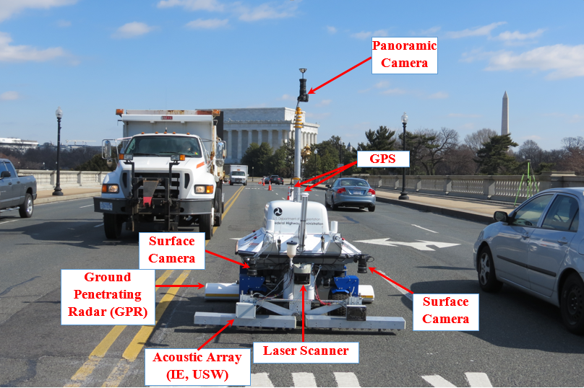
CPE471/671--Mobile Robotics
Project 3-Instruction
Dr. Jim La
Department of Computer Science and Engineering
University of Nevada, Reno
Spring 2025

Slide 2
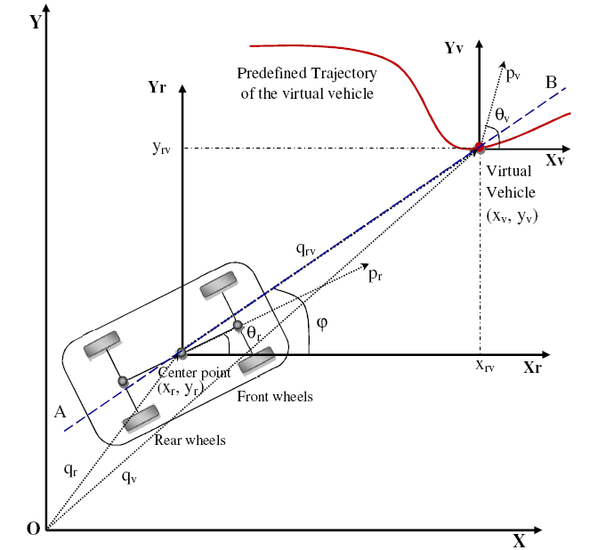
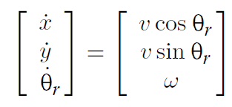
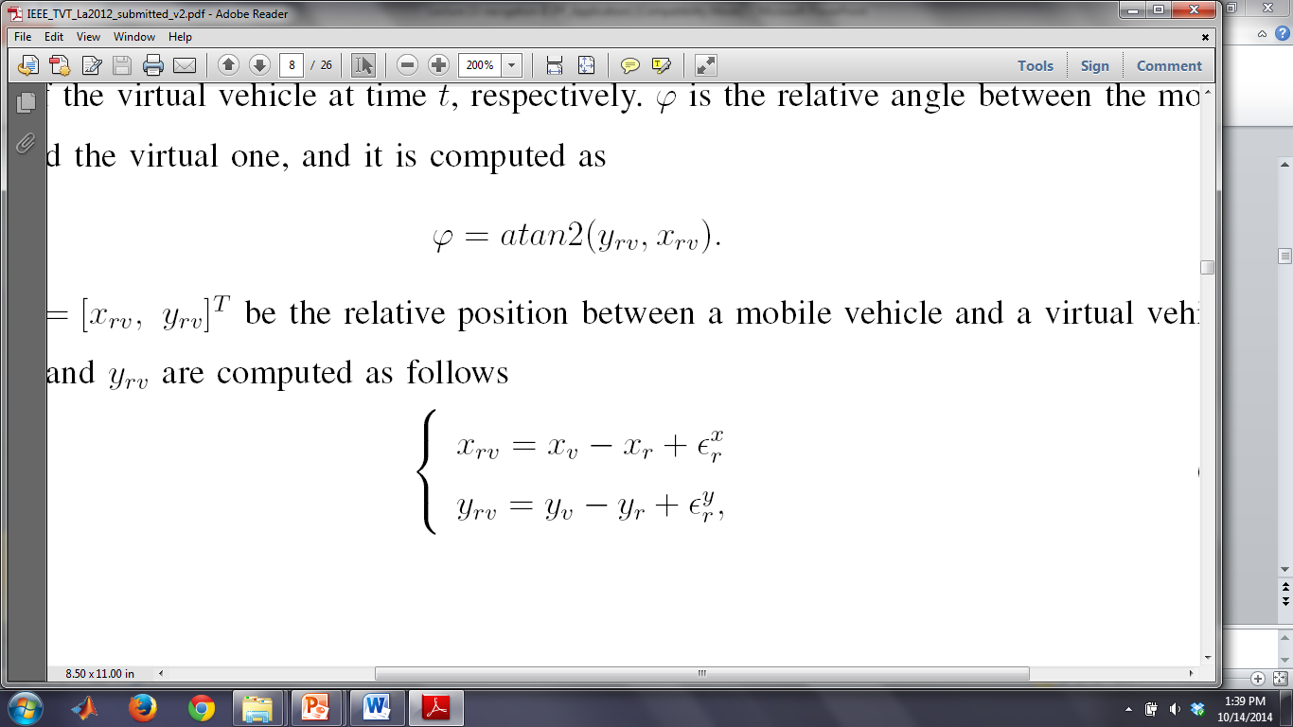
Navigation based on Virtual Target/Vehicle
Robot Dynamics
Relative Position
Relative Heading

Slide 3
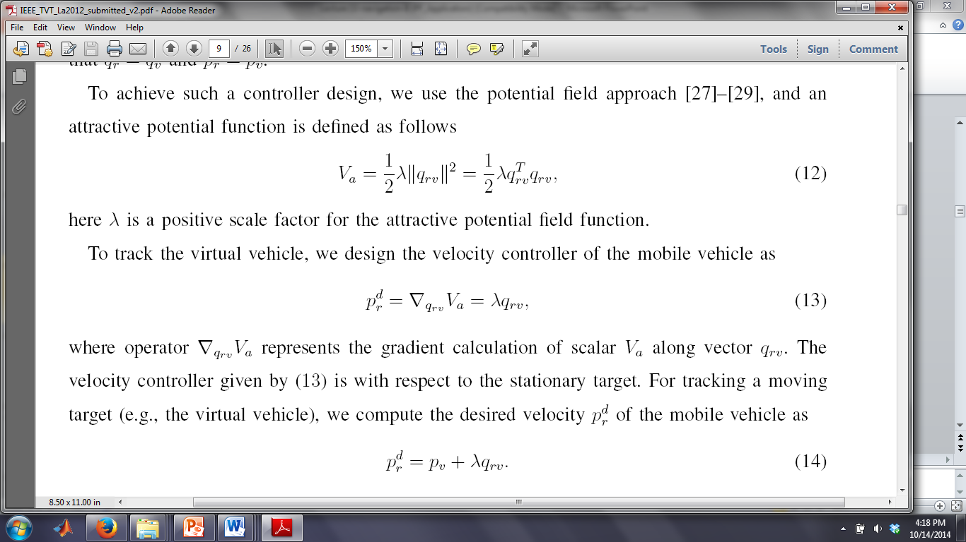
Motion Planning Algorithm
Potential Field Approach
  Attractive Potential Function is defined by:
  Static Point: the desired velocity vector of the robot is calculated:
  Moving Point (Virtual vehicle): the desired velocity vector of the robot is calculated:

Slide 4
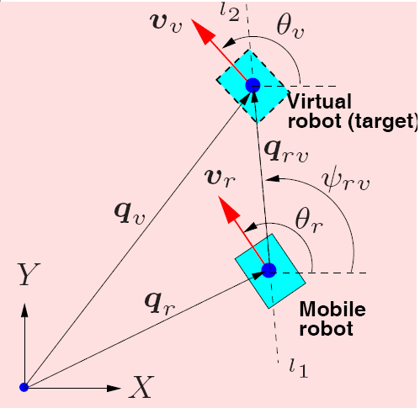
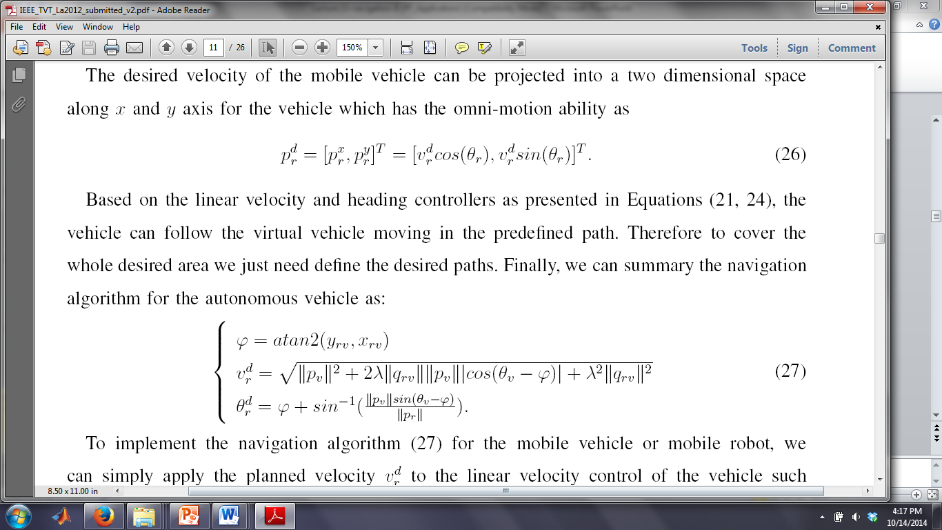
Motion Planning Algorithm
By taking the norm of both side of:
We can get the desired velocity controller of the robot as
We then can get the heading controller of the robot as

Slide 5
Motion Planning Algorithm
In summary, the whole motion planning algorithm for the robot
to track a virtual vehicle or a moving target as follows:
Note, how to get ||p_{r}||
||p_{r}|| = norm (p_{r}) = norm(v^{d}_{r})

Slide 6
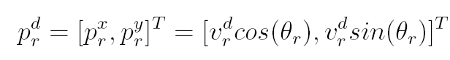
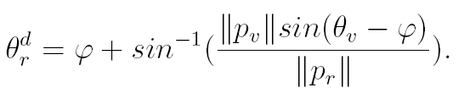
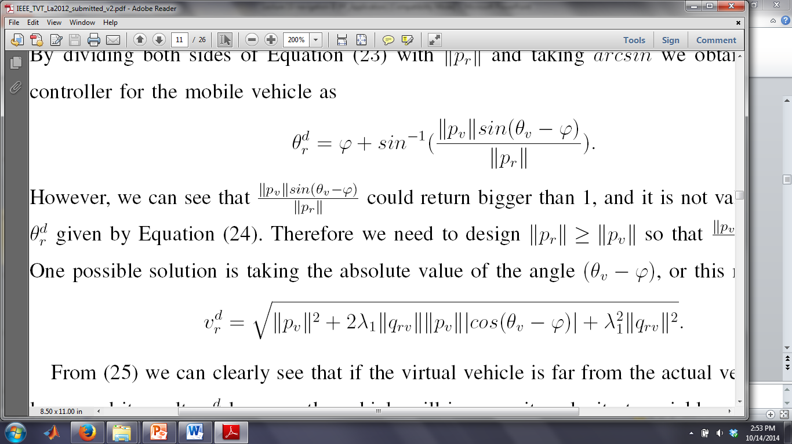
Project to x and y direction:
(Omni-motion control)
Constraints: ???

Slide 7
Motion Planning Algorithm
In summary, the whole motion planning algorithm for the robot
to track a virtual vehicle or a moving target (with constraint)
as follows:

Slide 8
Code - Initialization
% CPE470/670 Project 2: Potential Field Path Planning
import random
import numpy as np
from matplotlib import pyplot as plt
import matplotlib.animation as animation
# Function that generates an array containing <what> copied <times> times
def dup(what, times): return [what for _ in range(0, times)]

Slide 9
Code
# ========Set parameters for simulation============
n = 2 # Number of dimensions
dt = 0.05 # Set time step
t = range(0, 10 * 100, int(dt * 100)) # Set total simulation time
Lambda = 8.5 # Set scaling factor of attractive potential field
maxRobotVelocity = 50 # Set maximum of robot velocity
error = np.array(dup(0, len(t)), np.float64) #np.zeros ((len(t)), np.float64)

Slide 10
Code
#==================Set VIRTUAL TARGET=================
targetPosition = np.array(dup([0, 0], len(t)), np.float64) #Initial positions of virtual target
targetVelocity = 1.2 #Set velocity of virtual target
targetTheta = np.array(dup(0, len(t)), np.float64) # Initial heading of the virtual target
targetDiff = np.array(dup([0, 0], len(t)), np.float64)

Slide 11
Code
#===========Set ROBOT =================
#Set initial state of robot (robot)
robotPosition = np.array(dup([0, 0], len(t)), np.float64) #initial position of robot
robotVelocity = np.array(dup(0, len(t)), np.float64) #Initial velocity of robot
robotTheta = np.array(dup(0, len(t)), np.float64) # Initial heading of the robot

Slide 12
Code
#============Set relative states between robot and VIRTUAL TARGET=================
relativePosition = np.array(dup([0, 0], len(t)), np.float64) #Save relative positions between robot and virtual target
relativeVelocity = np.array(dup([0, 0], len(t)), np.float64) #Save relative velocities between robot and virtual target

Slide 13
Code
#====Compute initial relative states between robot and virtual target====
relativePosition[0,:] = targetPosition[0,:] - robotPosition[0, :] #Compute the initial relative position
#Compute the initial relative velocity
relativeVelocity[0,:] = [
targetVelocity * np.cos(targetTheta[0]) - robotVelocity[0] * np.cos(robotTheta[0]),
targetVelocity * np.sin(targetTheta[0]) - robotVelocity[0] * np.sin(robotTheta[0])
]

Slide 14
Code
#====Set noise mean and standard deviation====
noise_mean = 0.5
noise_std = 0.5 #try 0.2 also

Slide 15
Code
#====Set Variables used in calculation====
Phi = np.array(dup(0, len(t)), np.float64)
# Function which finds the magnitude squared of a vector
def sqrMag(vec): return vec.dot(vec)
# Function which finds the magnitude of a vector
def mag(vec): return np.sqrt(sqrMag(vec))

Slide 16
Main Program
%=========MAIN PROGRAM==================
#=========MAIN PROGRAM==================
for i in range(1, len(t)):
time = (t[i] * 1.495) / 100
#++++++++++CIRCULAR TRAJECTORY+++++++++++
# #Set target trajectory moving in CIRCULAR trajectory WITHOUT noise
targetPosition_x = 60 - 15 * np.cos(time)
targetPosition_y = 30 + 15 * np.sin(time)
targetPosition[i,:] = [targetPosition_x, targetPosition_y] #compute position of virtual target
# #Set target trajectory moving in CIRCULAR trajectory WITH noise
# targetPosition_x = 60 - 15 * np.cos(time) + random.uniform(-noise_std, noise_std) + noise_mean
# targetPosition_y = 30 + 15 * np.sin(time) + random.uniform(-noise_std, noise_std) + noise_mean
# targetPosition[i,:] = [targetPosition_x, targetPosition_y] #compute position of target

Slide 17
Main Program
#Compute the target heading
targetDiff[i,:] = targetPosition[i,:] - targetPosition[i-1,:]
targetTheta[i] = np.arctan2(targetDiff[i,1],targetDiff[i,0])
#Compute target velocity
targetVelocity = mag(targetDiff[i,:])
#.. (Your code is here)

Slide 18
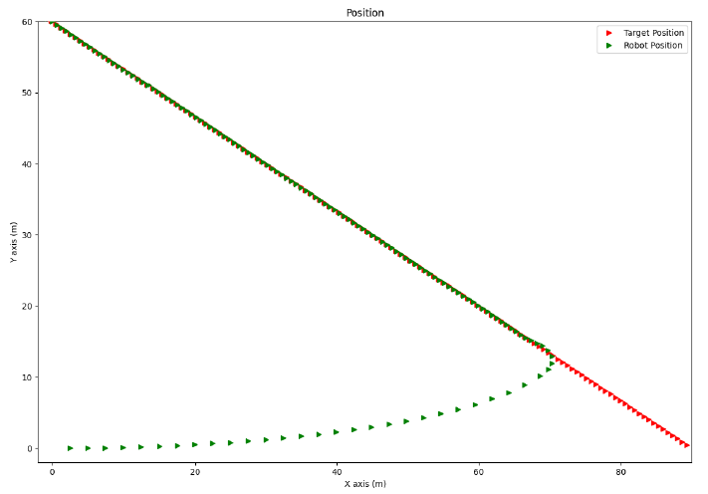
Results: Linear Trajectory

Slide 19
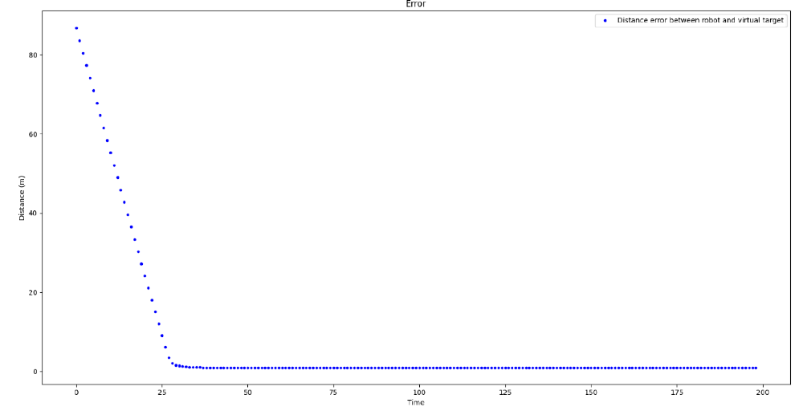
Results: Linear Trajectory

Slide 20
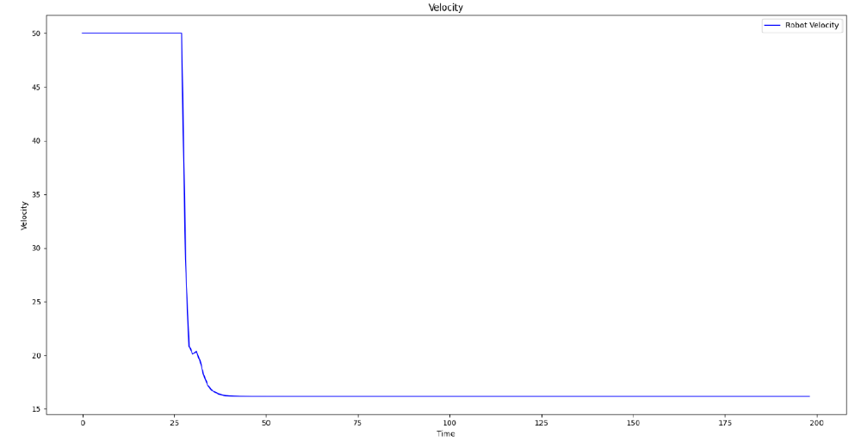
Results: Linear Trajectory

Slide 21

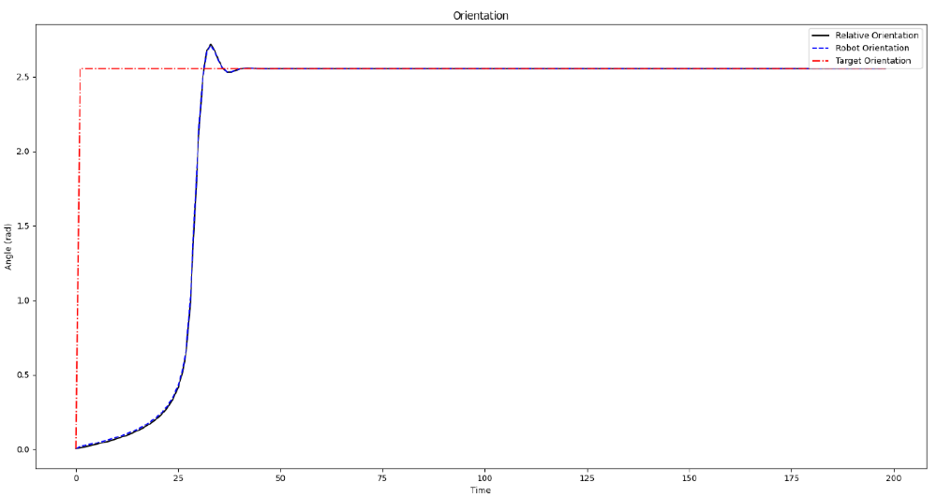
Results: Linear Trajectory

Slide 22
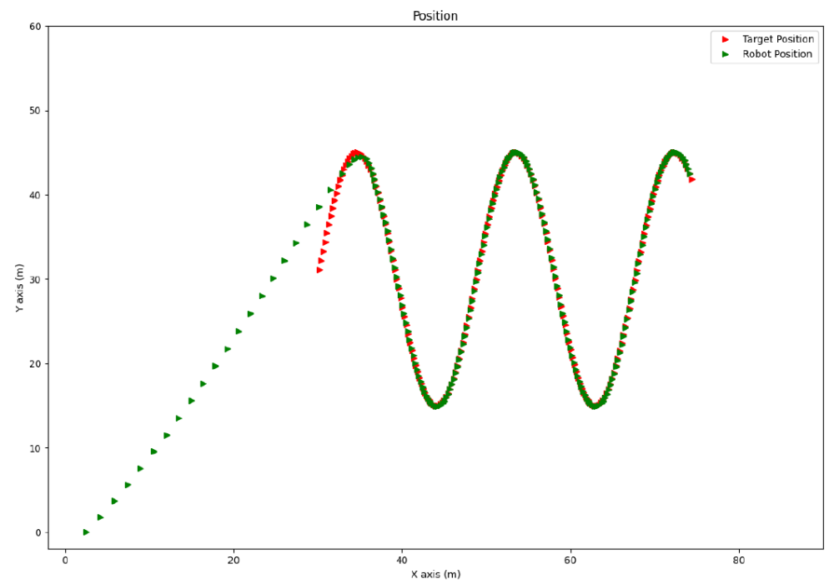
Results: Sinewave

Slide 23
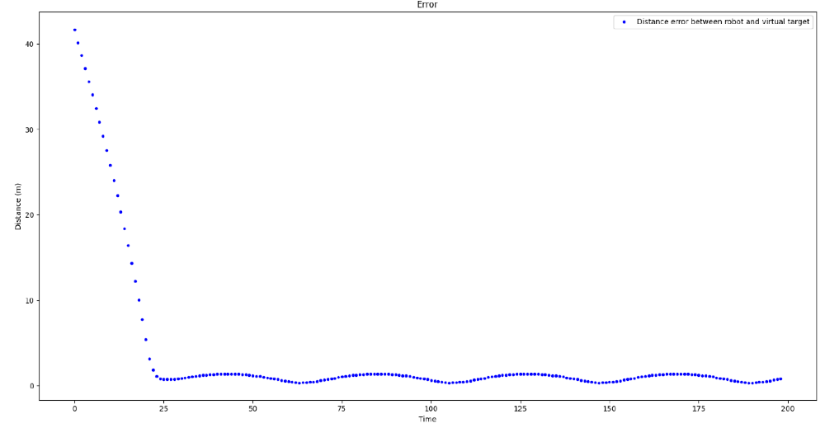
Results: Sinewave

Slide 24
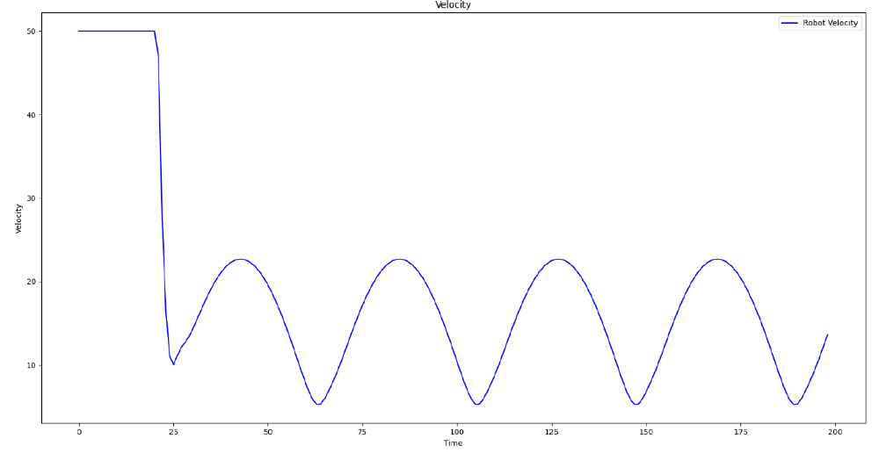
Results: Sinewave

Slide 25
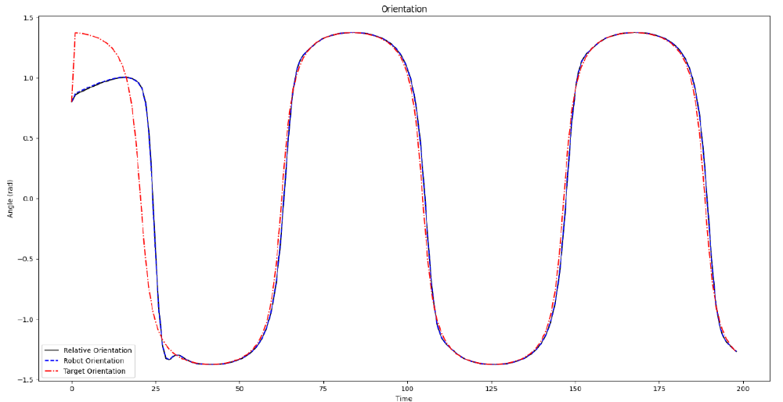
Results: Sinewave

Slide 26
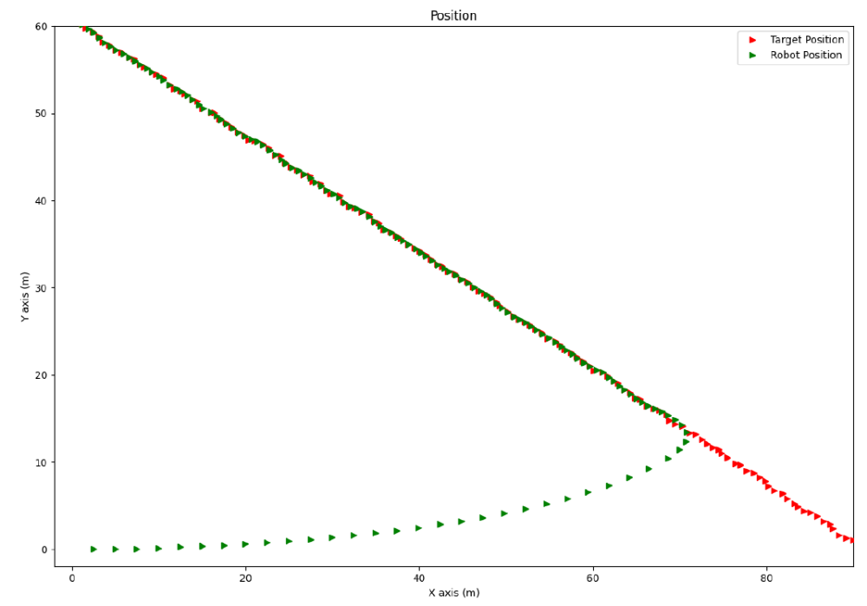
Results: Noisy Linear Trajectory

Slide 27
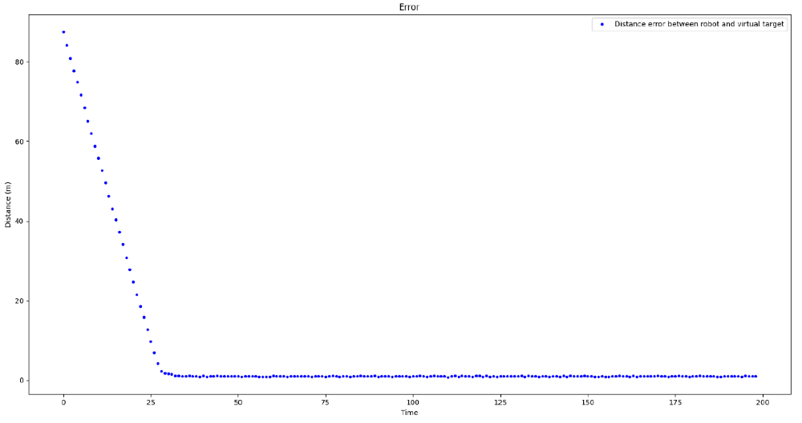
Results: Noisy Linear Trajectory

Slide 28
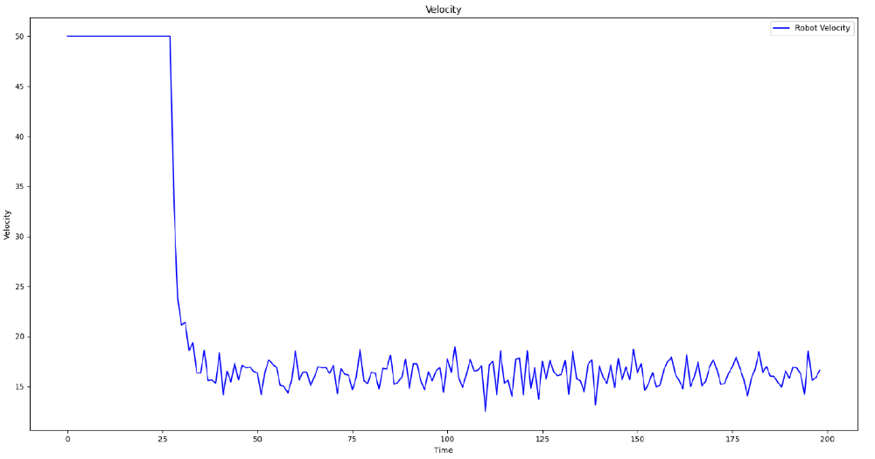
Results: Noisy Linear Trajectory

Slide 29
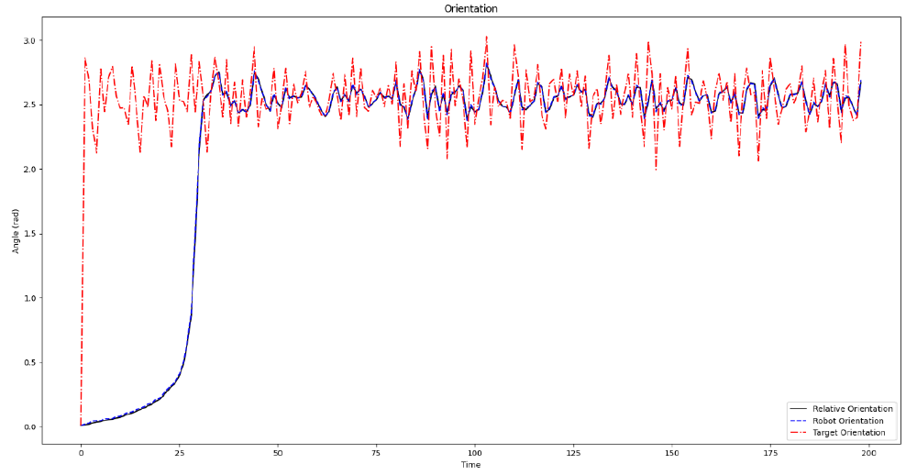
Results: Noisy Linear Trajectory

