Slide 1
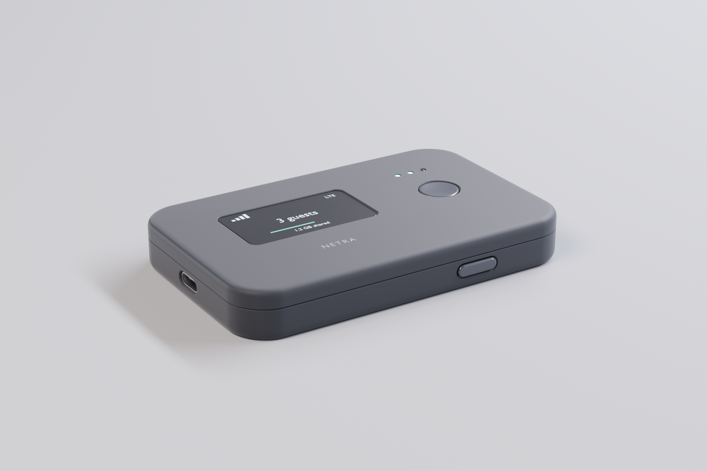
NETRA
Pay-per-use internet access
an AI agent can buy by itself
Pre-seed · October 2026 · Jason Fang
Notes:
Say the line out loud, then go straight to why now.

Slide 2
Software can hold a wallet now.
Nothing sells it a network connection
75M
$24M
of volume through the same standard, most of it on Solana
payments settled over the x402 standard
in the 30 days to 14 September 2026
April 2026
x402 moved under Linux Foundation governance, backed by AWS, Google, Stripe and Visa
Every one of those payments buys an API call, a file or a dataset. None of them buys the connection itself.
Notes:
The timing argument: x402 is standard infrastructure now, and Netra already speaks it on Solana.

Slide 3

Paid access still assumes a human with a credit card
An agent has no way to buy an hour
Captive portals are built for a person tapping “I agree”. Automating that is fragile and usually outside the venue's terms.
HTTP/1.1 402 Payment Required
price: 0.006 SOL / 10 min
pay-to: 9xQeW…f4Kd
deadline: 60s
→ no standard answer exists today
A person next to you has bandwidth to spare
Neither side gets a record: the host can't prove service, the buyer can't prove payment.
In a dead zone, at an event or abroad, there is no way to sell five minutes of it — and a day pass on a US carrier still runs about $10 to $12 abroad.

Slide 4
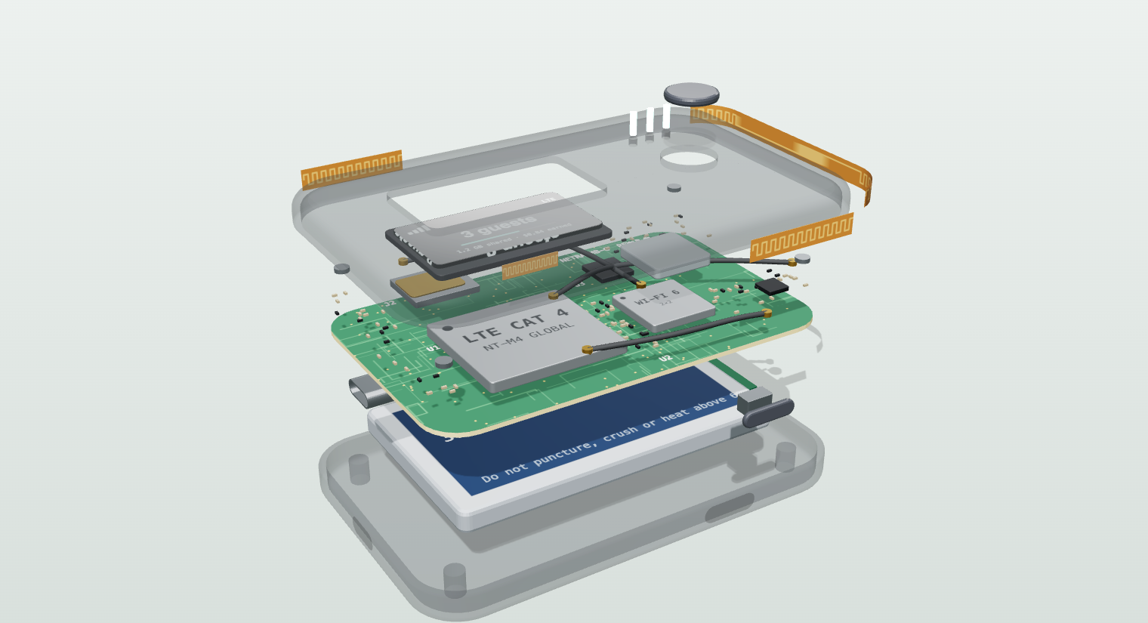
A hotspot that opens only against a verified payment
1
Blocked on arrival
Every site is blocked at the firewall the moment a device joins
2
Paid in seconds
A person pays through the captive portal, an agent answers an HTTP 402
3
Opened and receipted
Netra verifies on chain, opens the session, writes a receipt
Unused minutes are refunded pro rata, automatically.
Notes:
The refund detail is what makes it sound like a product rather than a demo.

Slide 5
Two buyers, one gate
Person
Agent
Joins the hotspot, every site blocked → captive portal asks for payment
Calls the purchase endpoint → 402 reply with price, address, deadline
Pays on Solana
Netra verifies on chain — the firewall opens the session
same gate
Receipt written for both sides
Notes:
A person taps a portal, an agent answers a 402, and the firewall treats them the same way.

Slide 6
Every session leaves a receipt neither side can edit
At payment
At session end
After every session
Session receipt
Closeout
Host score
transaction hash
time actually used
sessions completed
minutes bought
data carried
refund rate
amount paid
refund issued
reliability out of 100
human or agent
Each record is content-addressed, so it cannot be edited after the fact. Hosts carry that history between platforms instead of being locked into one, and buyers can check it before they connect.

Slide 7
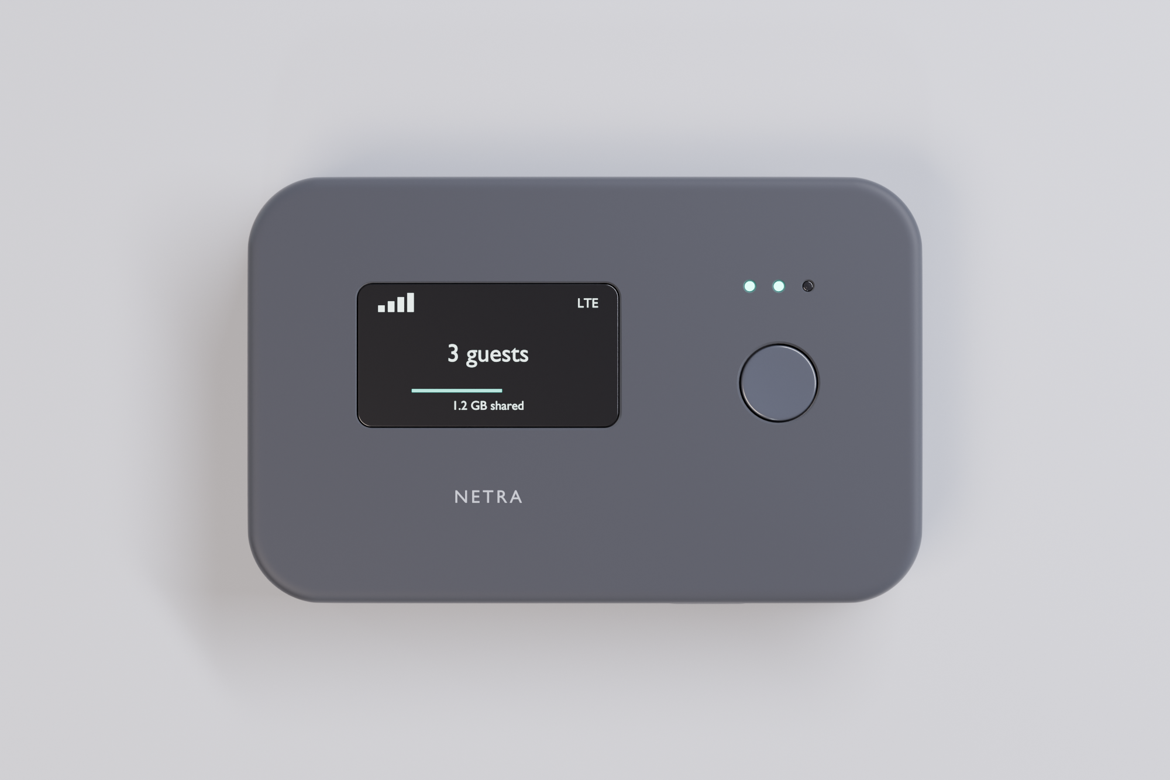
Working end to end, on devnet
✓
Firewall-level gating
traffic blocked until payment clears
✓
Captive portal with wallet checkout
Phantom on Solana, tested on a phone
✓
x402 purchase and extend API
on-chain verification before access opens
✓
Prorated refunds, session ledger, receipts
SQLite, retries, content-addressed records
✓
Agent SDK with a spending cap
auto-extends, no human in the loop
Devnet only · no mainnet custody · no paying users yet
Notes:
Say the limits before you are asked; it buys credibility for everything else.

Slide 8
The first buyer is a developer, not a traveller
Agent platforms
WE START HERE
Need a sanctioned way to buy access. Every x402 client is a prospect with no integration work.
Venue operators
Already sell access by the hour in the Philippines, Kenya, Indonesia — but cheap local billing software serves them today.
Events and pop-ups
Metered guest access with receipts for reconciliation. Short contracts, seasonal demand.
The consumer peer-to-peer marketplace is not the wedge. Wayru shut down in December 2025, Wicrypt dropped its token for subscriptions, and Helium now pays deployers only for real carrier traffic.
Notes:
Naming the graveyard first kills the Helium comparison before an investor raises it.

Slide 9
A cut of every verified session
10%
of each session payment, taken at settlement
One cafe, one month
30 sessions a day at $0.60 an hour
$540 gross
Netra take, 10%
$54
$4
per active device per month for the hosted control plane
Device subscription
$4
Per venue, per month
$58
Free
SDK — volume through it is what makes the take rate worth anything
100 venues → $5.8k monthly recurring revenue
Agent sessions are billed by the minute at $0.01, charged to the agent's own wallet.
Hardware: $38 bill of materials at 10,000 units, sold at $99 — a margin that funds deployment, not the business.

Slide 10
No token, no network effect required on day one
 | What they sell | Who pays | Agent can buy
Helium | Carrier offload capacity | Carriers | No
Roam | Routers and eSIM data | Users and token emissions | No
Wicrypt | Routers plus host subscriptions | Hosts | No
Wayru | Shut down December 2025 | — | —
Portal vendors | Billing software for venues | Venues | No
Netra | Metered access with proof | The buyer, per session | Yes
Those networks need scale before they are useful to anyone. One Netra hotspot is useful on its own, which is why this is a different bet.

Slide 11
Ship the SDK where agents already pay
Now
Q1 2027
Q2 2027
Publish
Get listed
Convert
SDK on npm and a hosted test hotspot anyone can point an agent at
Appear in the x402 service directories agent developers already search
Turn the first ten deployments into references, then sell the operator subscription
Why this order
First 100 deployments
Agent developers are reachable without a sales team: they already pay per request, and Netra is the only thing selling them access. Venue deals follow once there is traffic to point at.
10 pilots → 25 paying venues → 100 by month 18

Slide 12
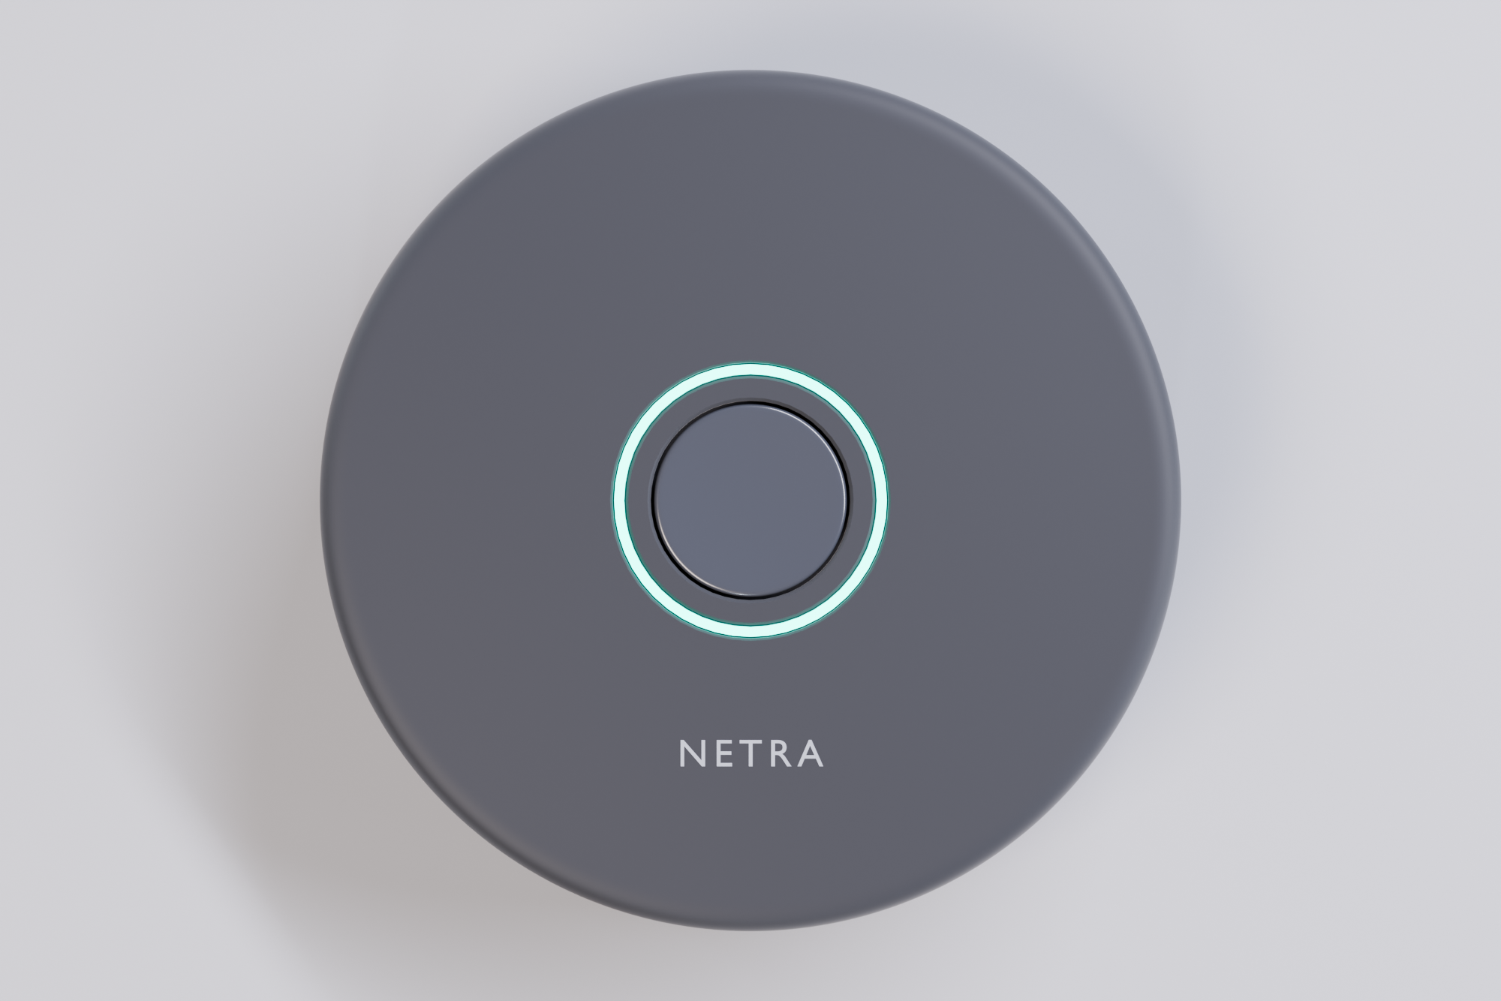
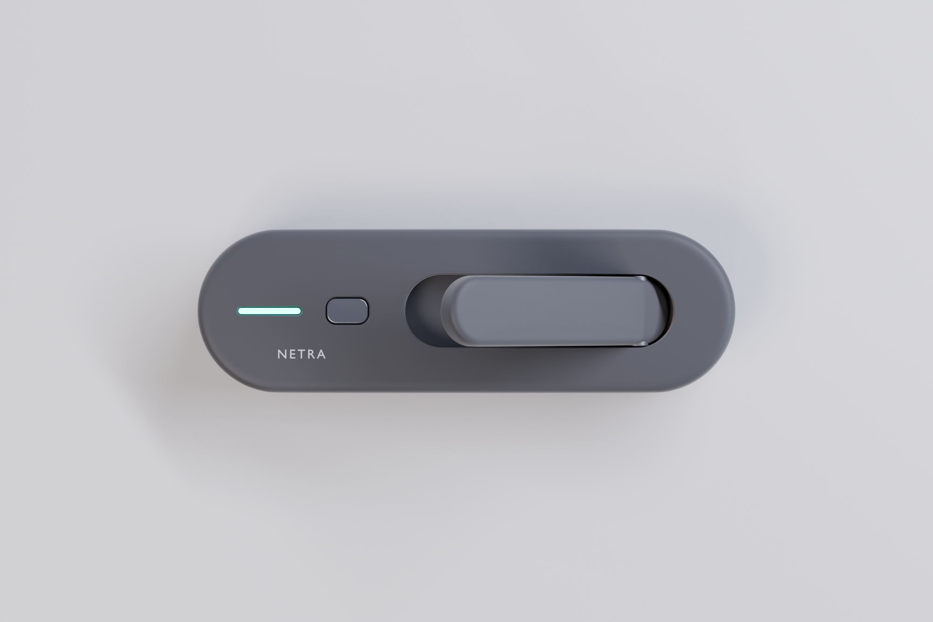
Mainnet, then pilots, then hardware
Three form factors, one control plane. Hardware follows revenue, not the other way round.
Puck
Card
Stick
Q4 2026
Q1 2027
Q2 2027
Q3 2027
Mainnet and stablecoin settlement
Hosted control plane
10 paid pilots
Hardware build
USDC on Solana, custody reviewed
Operators run nothing themselves
Cafes, co-working, one event series
25 units, DVT and certification

Slide 13
Who is building this
Jason Fang
Hiring first
Founding engineer: embedded Linux and networking, to take the gateway from a Mac demo to shipped hardware.
Founder
✓
Built the whole stack solo
firewall gating, on-chain payment verification, session ledger, refunds
✓
Wrote the agent SDK
Advisors wanted
budget caps, auto-extend, hotspot discovery
One telecom operator who has sold access by the hour, one payments lawyer for stablecoin settlement.
✓
Designed the hardware
three form factors modelled and rendered, interactive teardown

Slide 14
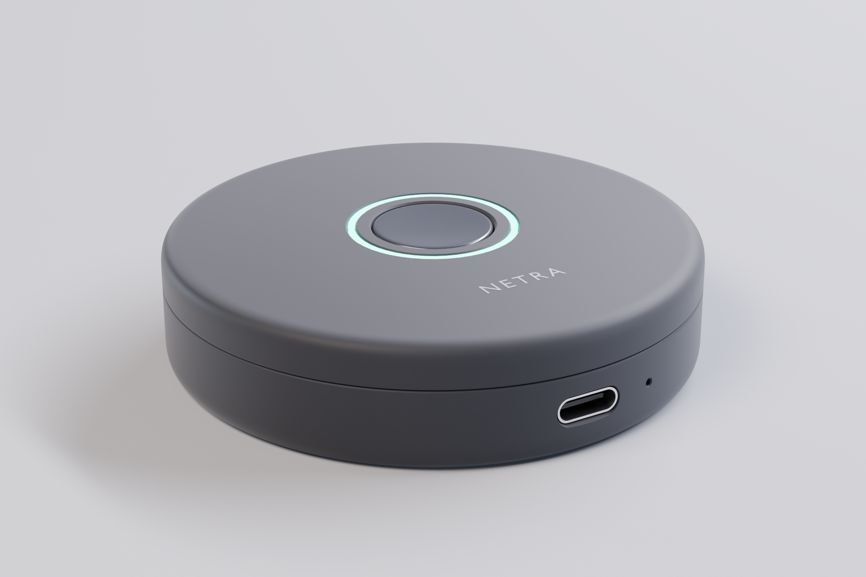
The ask
$750,000
pre-seed · 18 months of runway
Engineering 55%
Hardware 25%
Go to market 20%
What it buys
✓
Mainnet settlement and a hosted control plane
Q1 2027
✓
25 paying deployments
Q2 2027
✓
10,000 agent sessions a month
month 12
jason@netra · pieismath.github.io/netra-viewer

Slide 15
Appendix: how it is built
Phone
Solana
Captive portal in the browser
Control plane · Node
Confirms the payment happened
Blocks traffic with pf firewall rules
Verifies the payment on Solana
Keeps the session ledger in SQLite
Writes and uploads each receipt
Filecoin
Agent
Stores the receipt afterwards
SDK or any x402 client
Host dashboard
Live sessions, hashes, scores
Next.js front end for the marketplace, portal and dashboard. It never touches a chain directly — it asks the control plane.

Slide 16
Appendix: what a record holds
SESSION RECEIPT
Closeout
Written when the session ends: time actually used, data carried, and whether a refund was issued.
session
c4f1a9e2
buyer
agent
minutes
10
amount
0.006 SOL
tx hash
5KJp…r8Qa
Host reputation
paid at
2026-10-05 14:22 UTC
Updated after every session: sessions completed, refund rate, reliability out of 100, and the full success and failure history.
cid
bafybeigd…m4
The CID is calculated from the file's contents, so any edit produces a different ID and the change is obvious.

Slide 17
Appendix: why this stack
Solana
Where x402 volume already is, and fast and cheap enough to gate a live session
Replaces: card rails that cannot charge a cent
x402
An HTTP status code, not an integration — any client that speaks it works with Netra
Replaces: accounts, API keys, custom billing
Filecoin
Receipts outlive the server that wrote them, so reputation is portable
Replaces: a database only the host can read
None of this needs a token. Buyers pay in stablecoins, hosts are paid in stablecoins, and the protocol works with one device on day one.

