Slide 1
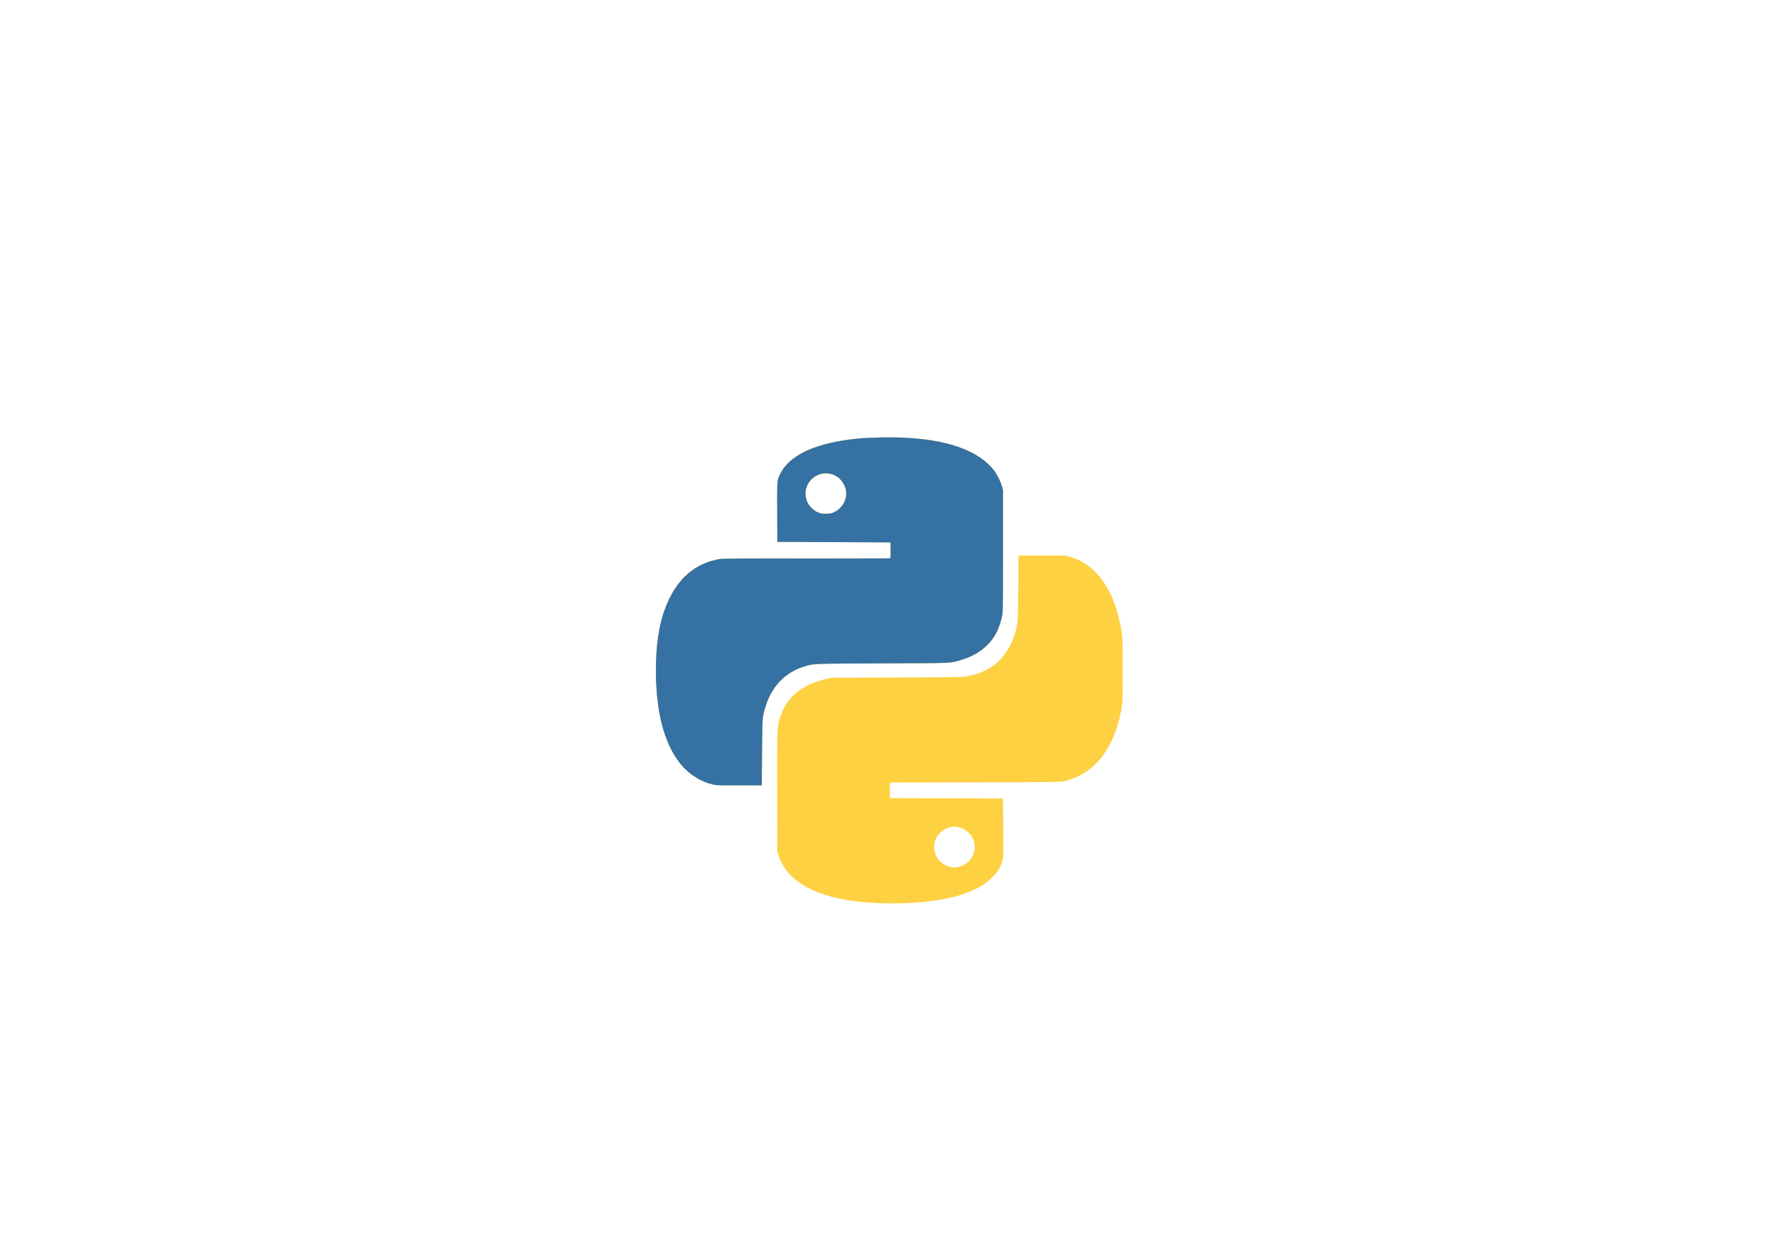
Object Oriented Programming in Python
Quack!!*
* That’s actually a spoiler, you have been alerted.

Slide 2


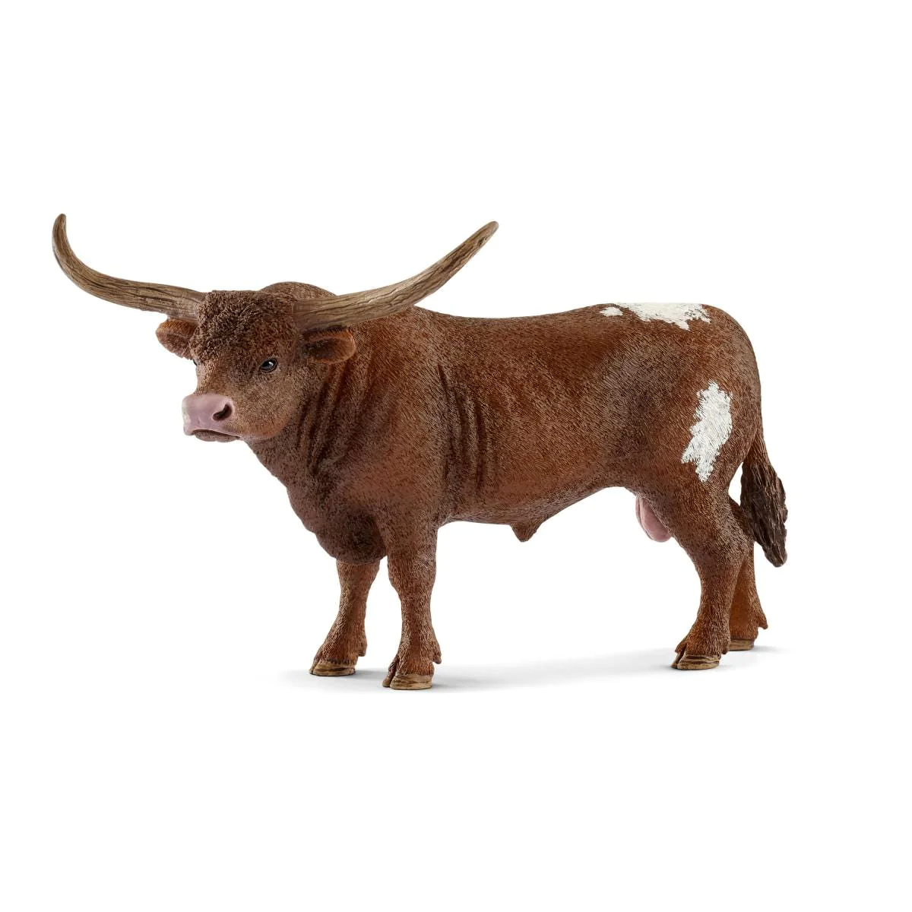

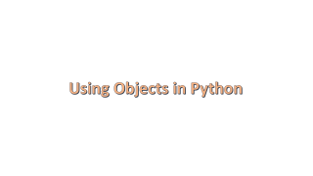
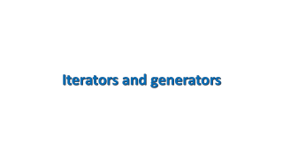

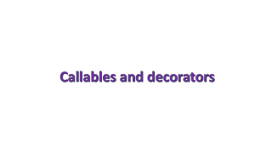
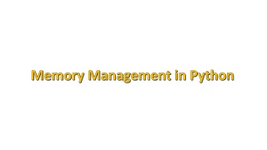
Outline
Warm-Up
Work-out
Advanced Topics
Quack!!

Slide 3

Outline
Warm-Up
Work-out
Advanced Topics
Quack!!

Slide 4


What do you already know about OOP ?
https://app.wooclap.com/OOPINSA

Slide 5
Introduction

Slide 6
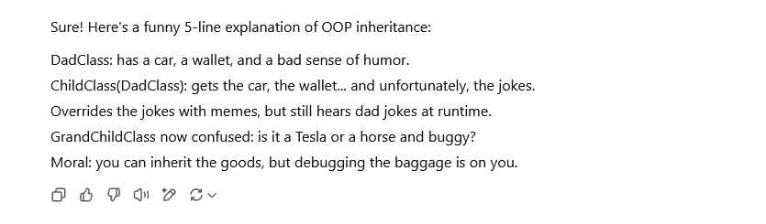
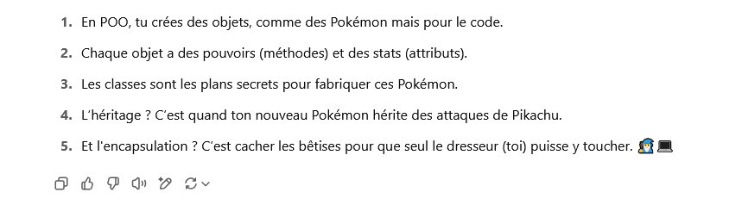
Is OOP funny ?
Probably not

Slide 7
Is OOP funny ? Definitely not !!!
Q: How many software developers does it take to change a light bulb?
A: None. That's a hardware problem.
There are 10 types of people: Those who understand the binary notation and those who don't...
( comment: hahahahhahahhahahaha i can't stop laughing...)

Slide 8
Is OOP useful ? Definitely yes !!!
It allows you to write :
Shorter code
Versatile libraries
Clearer code
Easy to use libraries
Easy to use Graphical User Interfaces (GUI)
Easily extendable libraries
“Elegant“ code

Slide 9
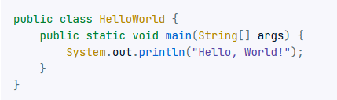

A short overview of the history of OOP
> 1960s
Firstly introduced in Simula
> 1970s
Fully implemented in Smalltalk
> 1980s
Becomes popular thanks to C++
> 1990s
Very popular languages as python and Java
rely on the use of OOP
> 2000 to
present
OOP is used in Javascript, C#
New paradigms start to develop (Go, Rust, Dart …)
Some programming languages (as Java) strongly rely on OOP
Python hello world program
Java hello world program

Slide 10
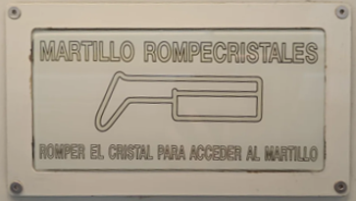

What is OOP ?
It is a programming strategy/paradigm using entities called “objects”.
Despite the fact that some examples found in real life are not
objects in python can be really useful !!
Translation:
Glass breaking hammer
Break the glass to take the hammer

Slide 11
Memory Management in Python

Slide 12
What is the definition of an object in OOP?
Code
In python an object is an abstract entity that contains variables and methods (functions).
The fact that it contains “its own things (variables and functions)” is called “encapsulation”
class (defines the object)
object1 (variable)
object2 (variable)
a
b
c
f()
g()
a
b
c
f()
g()
In python everything is an object including literals !!
(use dir() or type() if you do not believe me)

Slide 13
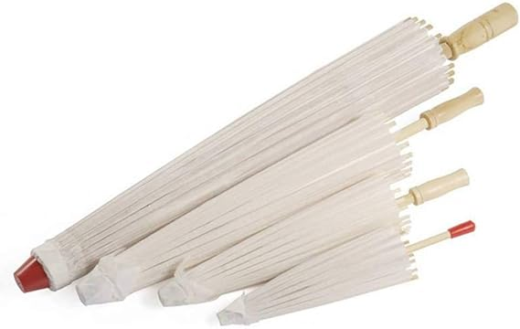
Objects: classes, instances and variables
Code
MyFirstClass
One Class
class_name
Can be used to create several instances of the same class
class_name is a class variable
obj1
obj2
Description of a Japanese umbrella
It has a height and a radius
It can be opened
The point and handle have colors
It is Japanese
Different instances
of the umbrella
=
The actual objects
MyFirstClass
MyFirstClass
instance_name
instance_name
instance_name is an instance variable

Slide 14
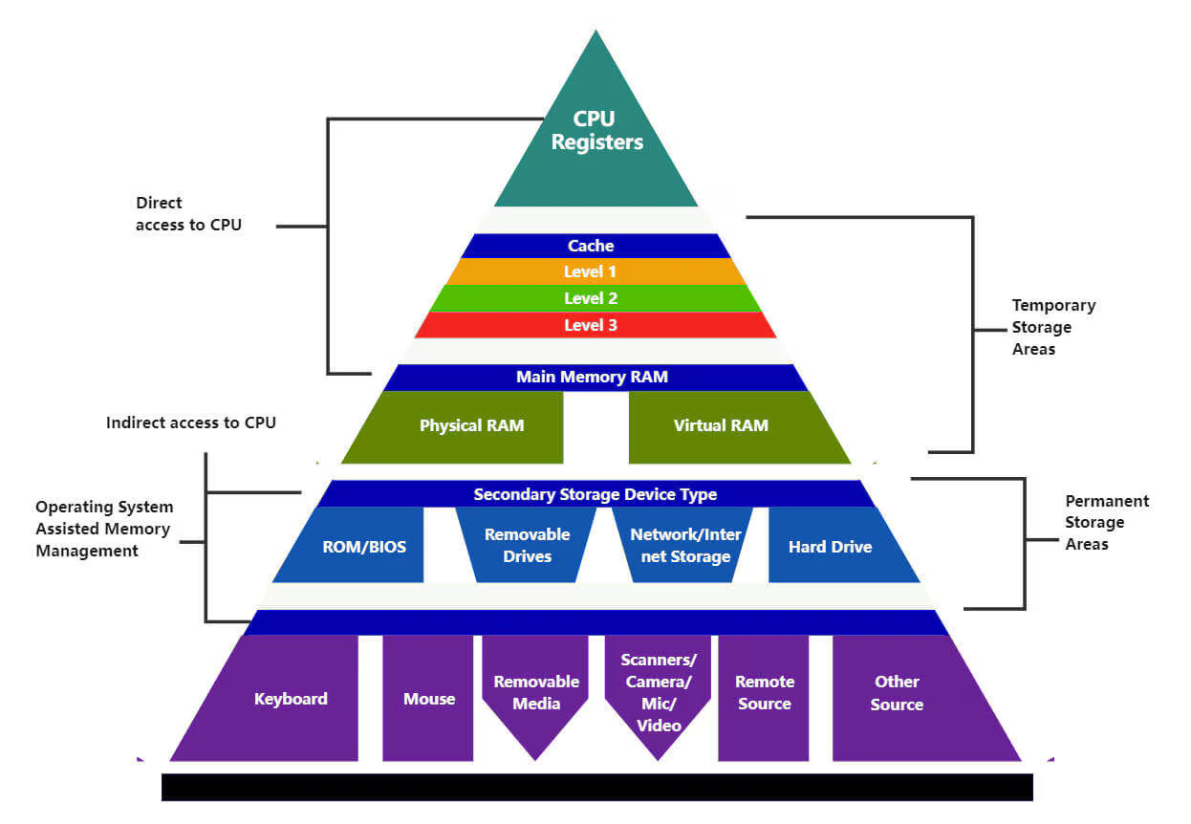
(Very) basic memory management
Memory management in modern CPUs is complex: I will use a simplified model !

Slide 15
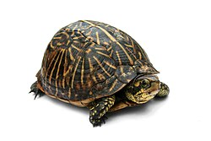
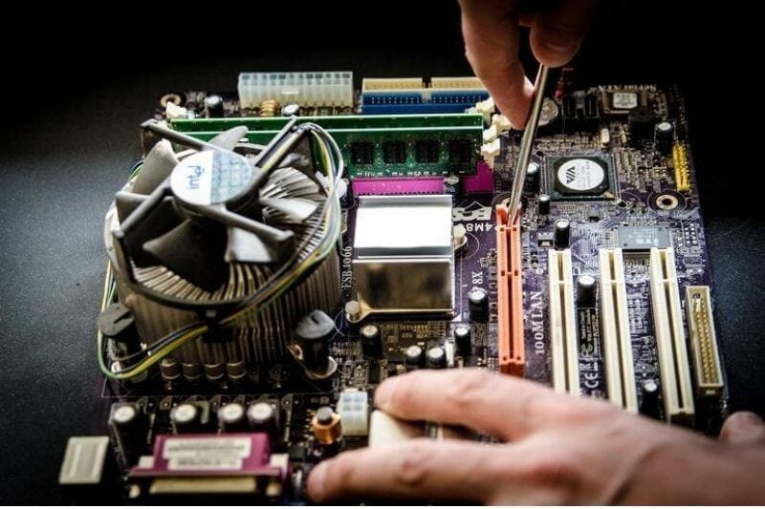

Basic memory management
Random Access Memory (RAM)
Heap memory
Used for objects and global variables
CPU Unit
Stack memory
Microprocessor
Used for local variables
and return values
Avoid using global variables in your programs !!!

Slide 16
Objects, pointers, variables and RAM
funny_ram_joke = ‘’’I couldn't figure out why a male sheep is called
a ram...
Then it hit me.’’’
a = 1
L = [1, 2, 3]
Variables in python store a reference (point) to objects.
(passing by reference paradigm)
Python variables
funny_ram_joke
a
L
object
object
object
binary representation of :
“I couldn't figure out why a male sheep is called a ram...
Then it hit me.”
__class__ = str
….
…
binary representation of 1
__class__ = int
….
__class__ = list
….
object
object
binary representation of 2
__class__ = int
….
binary representation of 3
__class__ = int
….
Random Access Memory (RAM)
= pointer

Slide 17
Local ang global variables
def f(a):
b = a
v = 1
f(v)
Global variable are stored in the RAM
Local variable are stored in the stack
Global variables
This variable are destroyed
when the function returns
v
Python variables
object
a
b
binary representation of 1
__class__ = int
….
Stack Memory
Random Access Memory (RAM)

Slide 18
Assignment and collateral effects
Code
Assignment
L = [1, 2, 3]
L1 = L
def f(x):
pass
f(L)
Collateral effects possible: all variables pointing the same objects are affected
if you modify it using one of them
Python variables
L1
L
object
object
Python variables
binary representation of 1
__class__ = int
….
__class__ = list
….
x
object
object
Stack Memory
binary representation of 2
__class__ = int
….
binary representation of 3
__class__ = int
….
Random Access Memory (RAM)

Slide 19
Copy and deep copy
Code
(shallow) copy and deep copy
import copy
L = [1, 2, 3]
a = copy.copy(L)
b = copy.deepcopy(L)
No collateral effects possible with deep copy (just placebo ☺) but the operation is much slower
Python variables
L
a
b
object
object
object
object
object
binary representation of 1
__class__ = int
….
__class__ = list
….
__class__ = list
….
__class__ = list
….
binary representation of 1
__class__ = int
….
object
object
object
object
binary representation of 2
__class__ = int
….
binary representation of 3
__class__ = int
….
binary representation of 3
__class__ = int
….
binary representation of 2
__class__ = int
….
Random Access Memory (RAM)

Slide 20
Mutable and immutable objects
Mutable objects cannot be modified
L= [1, 2]
L.append(3)
Python variables
L
str
int
“Hello “
….
1
….
Object is modified “in place”
No copy needed and that’s quick !
int
int
2
….
3
….
Random Access Memory (RAM)

Slide 21
Mutable and immutable objects
Immutable objects cannot be modified
s = “Hello”
s = s + “ World!”
Python variables
s
str
Examples: numbers, strings, tuples….
To modify strings you need to create new objects !!!
What happens to all the “old” unused objects in memory ?
“Hello “
….
str
“ Hello World!”
….
str
“ World!”
….
Random Access Memory (RAM)

Slide 22
Smart pointers and the garbage collector
Python has smart pointers
s = “Hello”
s = s + “ World!”
Python variables
s
str
Memory is automatically freed.
That’s smart !
“Hello “
ref_count = 1
str
0
“ Hello World!”
ref_count = 1
str
“ World!”
ref_count = 0
Random Access Memory (RAM)

Slide 23
Smart pointers and the garbage collector
Code
del s
In some cases this does not work
(circular references)
Python variables
Memory is not automatically freed
This is why python has a
GARBAGE COLLECTOR
That periodically checks the memory for the presence of such cases and frees them if needed
WHICH REDUCES PERFORMANCES
s
obj
ref count: 2
1
obj
obj
Random Access Memory (RAM)

Slide 24

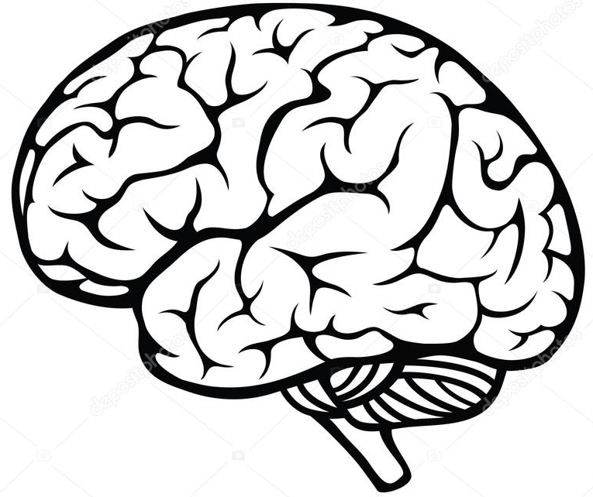

The smartness conservation principle
The quality of the final result is directly proportional to the amount of smartness used to produce it.
The Fazzini corollary (still top secret do not talk about it with anyone)
Pointer Smartness | Programmer Smartness | Program efficiency | Program stability

Slide 25
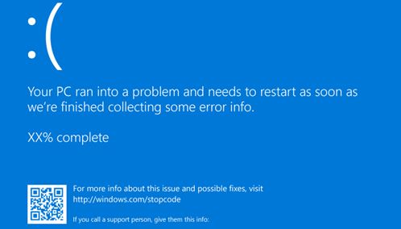

Slide 26
Section Summary
In python everything is accessed as an object
Objects are stored in memory and automatically deleted when not needed anymore
Memory management has a performance cost
You can have (unwanted) collateral effects when copying and passing variables

Slide 27
Using Objects in Python

Slide 28

Key Concepts
The best way (in my opinion) to manage object is
To consider that class functions (method) do not have any special way to access class members
Code
Global variables
This variable are destroyed
when the function returns
ClassWithClassMethod
Local variables
object
object
a
i
a
change_a()
binary representation of i
__class__ = int
….
Stack Memory
Random Access Memory (RAM)

Slide 29

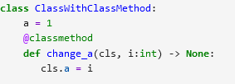
Class methods
You can use class methods by using class objects
To use class methods you need to use the
@classmethod decorator
In general you will rarely need to use calls methods and members (you are allowed to forget this)

Slide 30
Accessing Instance variables
Code
How can I access instance variables ?
using variables
using in class members
self
Global variables
s
obj
a
Local variables
self
i
Stack Memory
Random Access Memory (RAM)

Slide 31
Class functions and instance methods
Code
Class functions are automatically converted to instance methods
You can call a function f using the class
When you call f from an instance of the class self is added as first argument
__Init__ is called when an instance is created
Global variables
C
s
class C:
def f(self):
pass
s = C()
C.f()
s.f()
type
C
error!!
__init(self, …)
f(self, …)
calls
__init__(self, …)
f(self, …)
calls
Random Access Memory (RAM)

Slide 32
Iterators and generators

Slide 33
Callables and decorators

