Slide 1

LevelUp
Software Dependability Presentation
Pierpaolo Cammardella
Università degli Studi di Salerno - Dipartimento di Informatica

Slide 2
Context
LevelUp is a Java web application originally developed in 2021 for the TSW exam as an e-commerce platform to sell online courses, built with JSP, Servlets, and Apache Tomcat, backed by a MySQL database. For this context, the project was revived from a non-functional state, made buildable and testable again, and used as the target for applying the dependability techniques covered by the course.
2021
Original project built
0 → 80+
Java Servlets + JSP
Apache Tomcat 9
Working test suite built from scratch
MySQL
Non-functional → deployed
Maven build
Containerized & running end to end
LevelUp - Software Dependability
2

Slide 3
Goals
Apply a full pipeline of dependability techniques to a real, untested codebase.
1
Buildable locally and in CI/CD
6
Mutation testing campaign
2
Formal specification (JML) verified with OpenJML
7
Performance benchmarking
3
Docker image, orchestrated via Compose
8
Security mechanisms in CI/CD
4
Creating Test Suite
9
Security analysis (GitGuardian, Snyk, SonarCloud)
5
Code coverage analysis
10
No unresolved vulnerabilities
LevelUp - Software Dependability
3

Slide 4
Methodology and Roadmap
Ten checklist items, applied in sequence, each building on the last.
Build
& CI/CD
→
JML
Verification
→
Docker
& Compose
→
Testing
Suite
→
Coverage
(JaCoCo)
→
Mutation
(PiTest)
→
Performance
(JMH)
→
Security
(3 tools)
LevelUp - Software Dependability
4

Slide 5
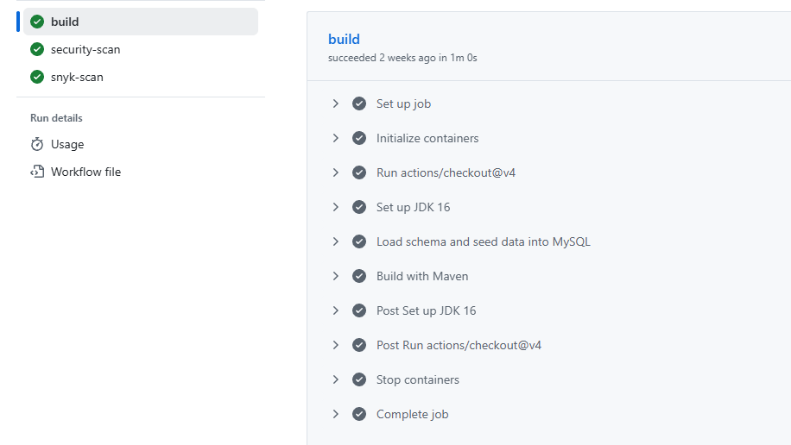
Build & Continuous Integration
Maven build produces a deployable .war for Tomcat 9
GitHub Actions workflow runs automatically on every push
A MySQL service container is spun up in CI, initialized from schema.sql / seed.sql
The full JUnit suite runs against that real database
GitHub Actions run with build job passing, MySQL service included
LevelUp - Software Dependability
5

Slide 6
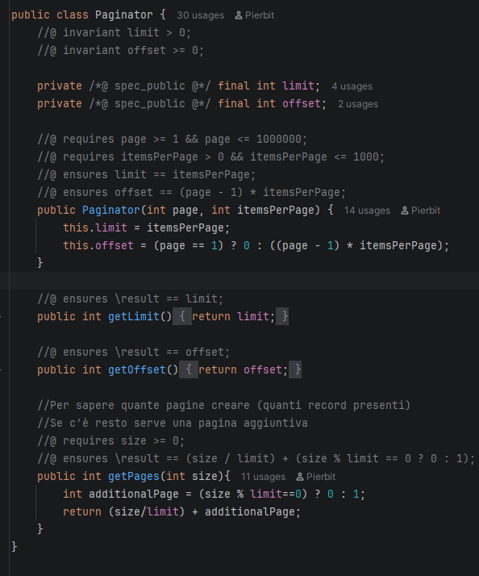
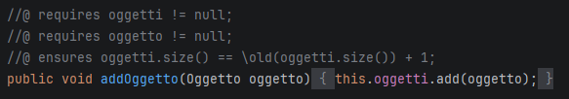
Formal Specification (JML / OpenJML)
Core methods spanning pagination, request validation, cart management, and pricing were annotated with JML preconditions, postconditions, and invariants, and verified using OpenJML's extended static checking.
Paginator (all methods)
RequestValidator.required() / gatherError()
Carrello.addOggetto()
Oggetto.setPrezzo()
RegisterValidator.isValidUsername() / isValidPassword()
LevelUp - Software Dependability
6

Slide 7
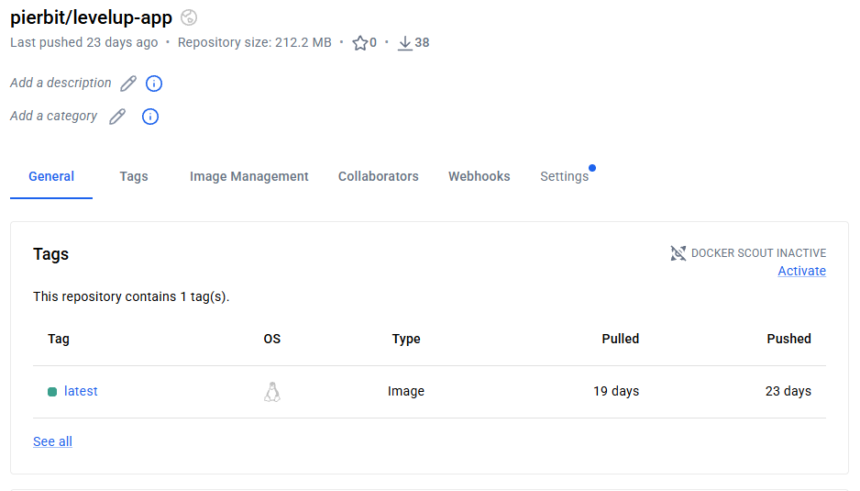
Docker - Containerization & Orchestration
Multi-stage Dockerfile: Maven build stage → Tomcat runtime stage
docker-compose.yml orchestrates the app + a MySQL container
Auto-initialized from schema.sql and seed.sql on first start
Image published to Docker Hub
A real bug found
surfaced in the model layer by moving to Linux-based containers: by default, table aliases are case-sensitive on Unix, but no so on Windows or MacOS. This table-name mismatch caused a runtime SQL error on Linux.
Docker Hub repository page
LevelUp - Software Dependability
7

Slide 8
Testing Strategy
Unit tests
Integration tests
Pure logic & mocked HTTP layer
Paginator, RequestValidator, RegisterValidator, LoginValidator
JUnit 5 + Mockito
Against a real MySQL database
UtenteManager, CorsoManager, CarrelloManager, OrdineManager, and more
Because this layer's entire job is coordinating with the DB correctly
81 tests / 13 test classes / manually designed / automatically executed
LevelUp - Software Dependability
8

Slide 9
Coverage & Mutation Testing
32%
20%
45%
70%
Instruction coverage
(JaCoCo)
Branch coverage
(JaCoCo)
Raw mutation score
(PiTest)
Test strength
(PiTest)
Coverage is concentrated in the Model layer (50–88%), matching where testing effort was mostly focused. The Controller layer was tested less (14–49%), reflecting the fact its mostly delegating business logic to already tested Model methods and forwarding the processed data to JSPs for rendering. The gap between raw mutation score and test strength is explained because 282 of 512 mutants sat on code the test suite never executed at all.
LevelUp - Software Dependability
9

Slide 10
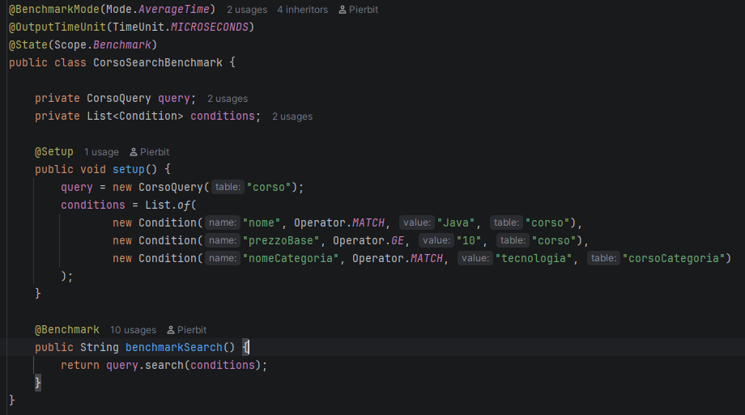
Performance Testing (JMH)
CorsoQuery.search() is the most computationally complex pure-logic method in the codebase (string-building and branching over search conditions), was benchmarked in average-time mode.
0.115 µs/op
± 0.004, across 25 measured iterations
Confirms computation for this method is effectively free and latency in this application comes mostly from database interactions rather than application logic
CorsoSearchBenchmark Class
LevelUp - Software Dependability
10

Slide 11
Security Analysis
GitGuardian
Found a hardcoded DB password across 3 files. Fixed: now supplied only via environment variable / CI secret.
Snyk
Found 11 dependency CVEs. Fixed 10 via version upgrades; 1 unpatchable library documented via a .snyk policy.
SonarCloud
Found 2 real vulnerabilities (weak password hashing, non-serializable session objects). One flagged issue confirmed a false positive.
LevelUp - Software Dependability
11

Slide 12
Key Findings
1
Search silently excluded courses missing a category/tag/creator association
2
CarrelloManager.fetchCarrello() was completely non-functional (SQL statements that threw on every call and unimplemented stubs)
3
Two independent broken UPDATE queries found in different Manager classes (Several methods/lines of unreachable or broken code)
4
Weak (SHA-1) password hashing, replaced with bcrypt, verified end to end
5
Non-serializable objects stored in HttpSession (Reliability)
6
Database password was hardcoded across 3 files
LevelUp - Software Dependability
12

Slide 13
Conclusions
Each technique caught a different, complementary class of issue, no single tool would have found everything.
Formal verification proves properties for all inputs meeting a contract while testing demonstrates behavior on realistic scenarios.
Containerization and security scanning both surfaced real, previously unknown defects in a five-year-old codebase.
The result is a real, deployed, tested, and security-reviewed application.
LevelUp - Software Dependability
13

