Slide 1

MoCoGAN Challenge
Pierfrancesco Ardino - Alessia Bertugli – Marco Gaido

Slide 2

Approach
We make on motion/content encoder with two outputs to initialize h₀ and z_{c}
The encoder output a vector of dimension (batch size, 320)
We repeat the vector along the batch size to have final h₀ and z_{c} of shape (320, 320)
We add Mean Square Error (MSE) loss term
We modify the generator to get better resolution implementing CycleGAN Generator

Slide 3
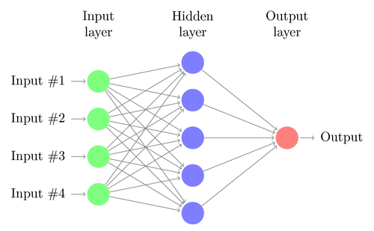
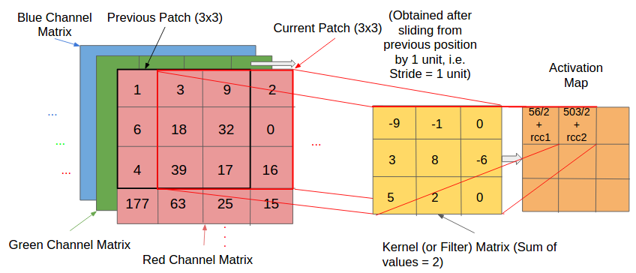
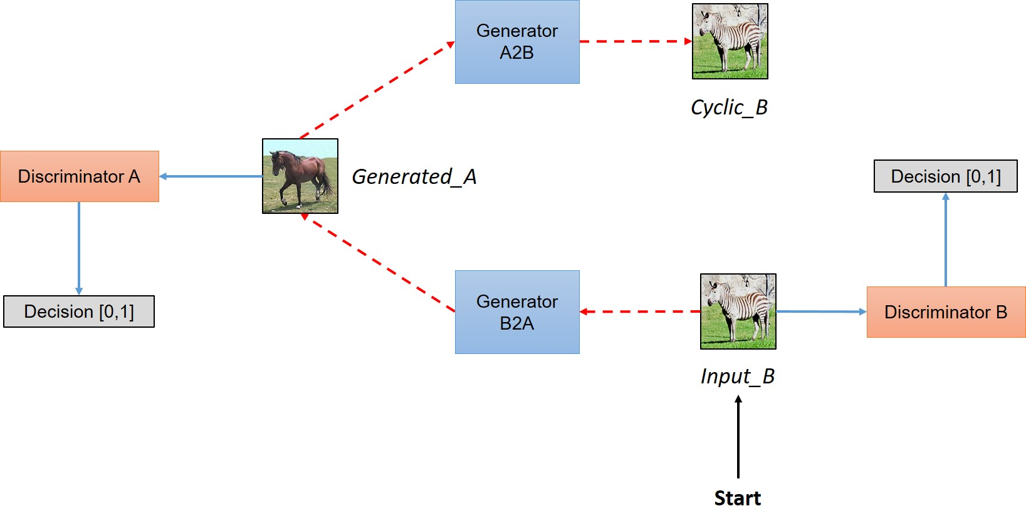
Architectures
Multi-Layer Perceptron Encoder
Convolutional Encoder
CycleGAN Generator

Slide 4
MLP Encoder
fc0 = {Linear} Linear(in_features=12288, out_features=4096, bias=True)
fc1 = {Linear} Linear(in_features=4096, out_features=2048, bias=True)
fc2 = {Linear} Linear(in_features=2048, out_features=1024, bias=True)
fc3 = {Linear} Linear(in_features=1024, out_features=512, bias=True)
fc4 = {Linear} Linear(in_features=512, out_features=256, bias=True)
fc5 = {Linear} Linear(in_features=256, out_features=320, bias=True)
fc6 = {Linear} Linear(in_features=256, out_features=320, bias=True)

Slide 5
Convolutional Encoder
Sequential((0): Conv2d(3, 32, kernel_size=(4, 4), stride=(2, 2), padding=(1, 1)), (1): ReLU(inplace=True), (2): Conv2d(32, 32, kernel_size=(4, 4), stride=(2, 2), padding=(1, 1)), (3): ReLU(inplace=True), (4): Conv2d(32, 64, kernel_size=(4, 4), stride=(2, 2), padding=(1, 1)), (5): ReLU(inplace=True), (6): Conv2d(64, 64, kernel_size=(4, 4), stride=(2, 2), padding=(1, 1)), (7): ReLU(inplace=True), (8): Conv2d(64, 256, kernel_size=(4, 4), stride=(1, 1)), (9): ReLU(inplace=True))
z_c = {Sequential} Sequential((0): View() (1): Linear(in_features=256, out_features=320, bias=True))
z_m = {Sequential} Sequential( (0): View() (1): Linear(in_features=256, out_features=320, bias=True))

Slide 6
CycleGAN Generator

Slide 7
Results

Slide 8
Thank you for your attention!
Pierfrancesco Ardino – Alessia Bertugli – Marco Gaido

