Slide 1
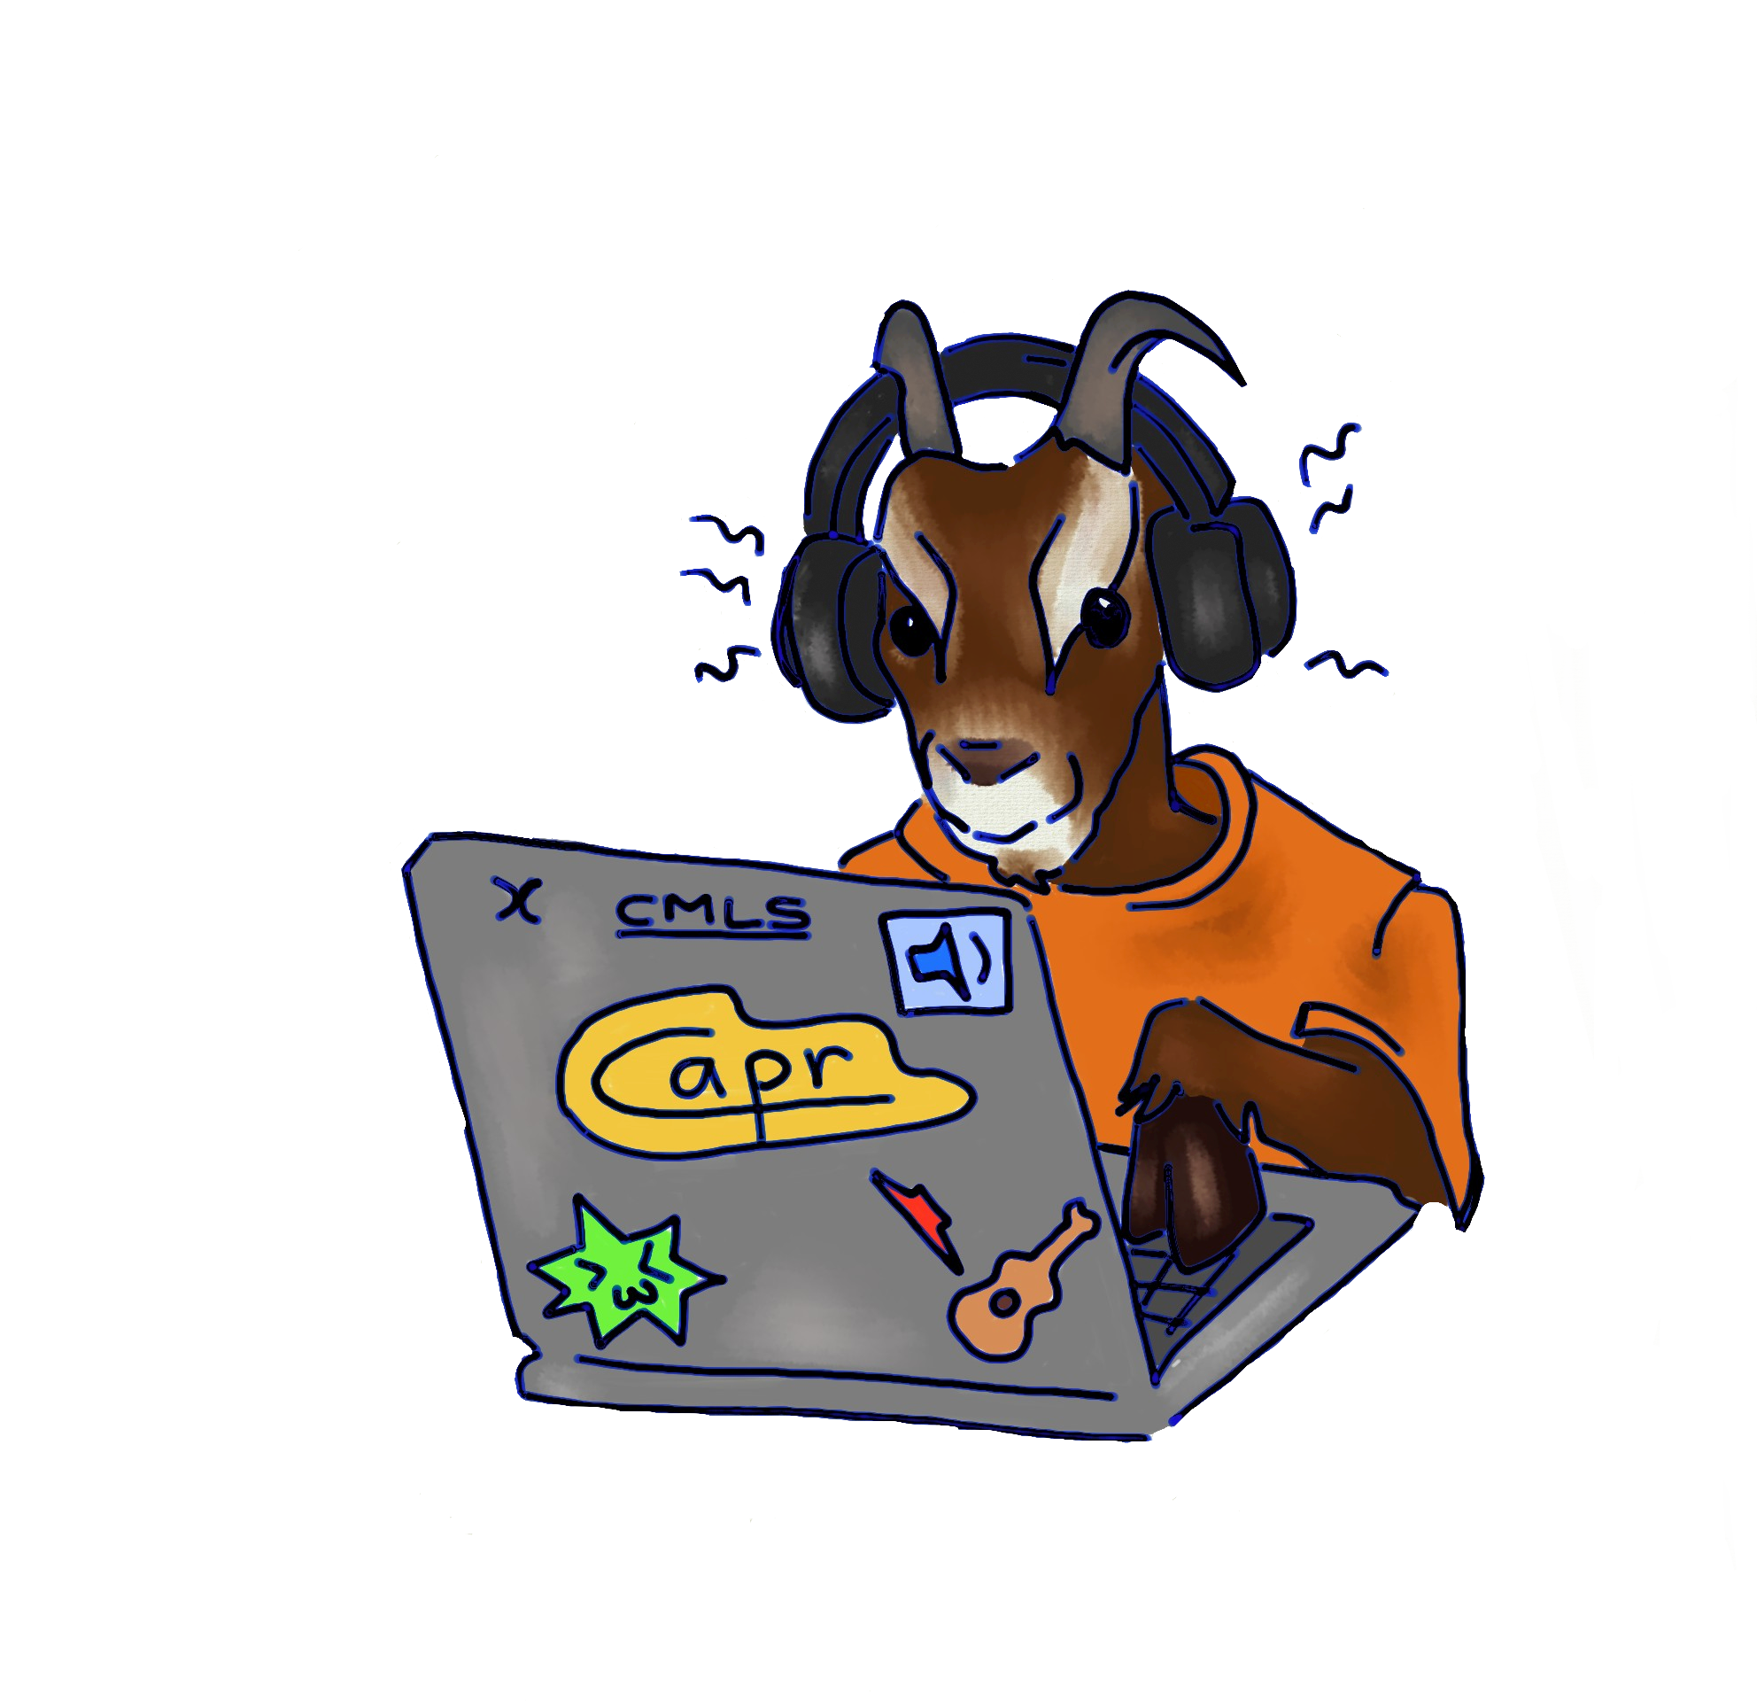

L’Ottavatore
SuperCollider Homework assignment #4
Computer Music: languages and Systems
Politecnico di Milano
Group CAPR
Claudio Eutizi
Andres Bertazzi
Pierluigi Tartabini
Riccardo Martinelli

Slide 2
Structure of the project
GUI
SYNTH STRUCTURE
OTTAVATORE
PANNATORE
RESET
SOURCE GROUP AND PICTH SHIFT GROUP
PANNING GROUP
MIX AND MASTER GROUP

Slide 3

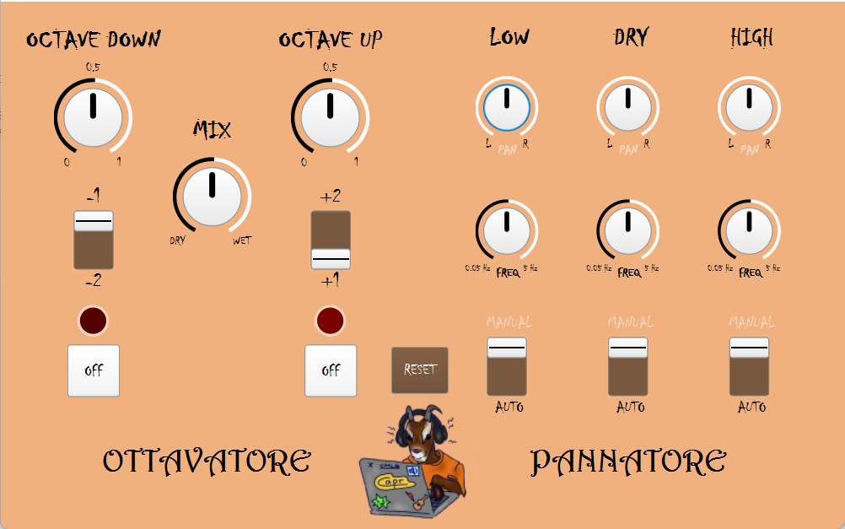

Slide 4
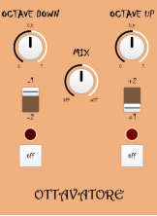
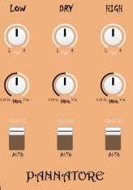
Ottavatore
Pannatore
OCTAVE UP AND OCTAVE DOWN
SWITCHES
KNOB MIX
ON & OFF
PAN KNOB
FREQ KNOB
RESET

Slide 5
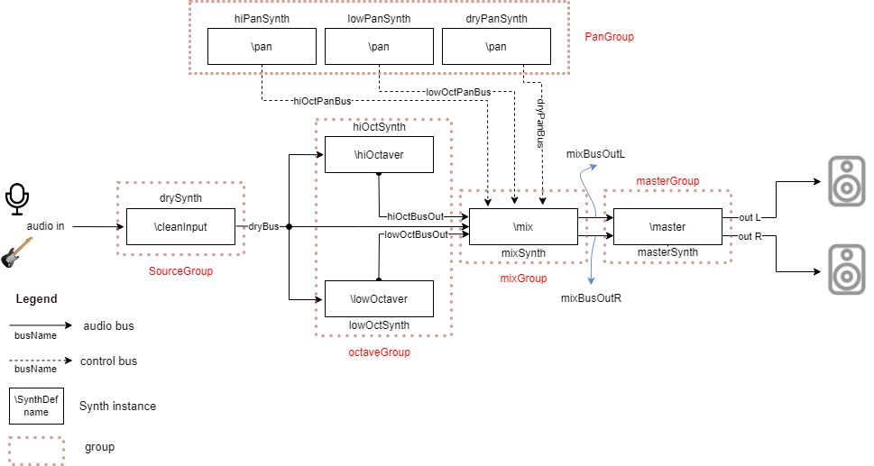

Slide 6



Video
Use this type of slide for visual impact.
You can use images or text here.
Limit your text to key concepts and words so you can explain them during your presentation.

Slide 7
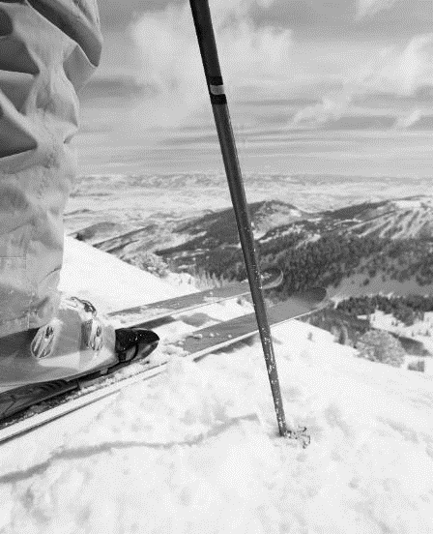
A special day in the era
Include details about a special day from the era you are discussing.
Add an image from the day.
Include the date and, if any, significant people involved.
You can put text in both boxes.
You can put images in both boxes.
You can put text in one box and an image in the other.

Slide 8
Collage of the era
Create a visual representation of the era, including pictures of:

Slide 9

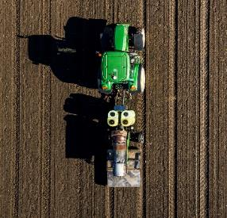
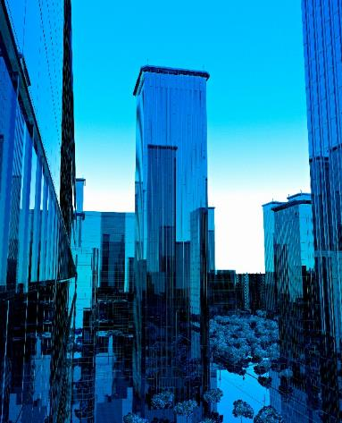


Collage 2 of the era
Create a visual representation of the era, including pictures of:

Slide 10
Letter from the generation
Things to reflect on when writing the letter:
How would they like to be remembered?
What message would they want to share?
Would they give future generations any advice? If so, what would it be?
What do you think the people who lived in that era would say to you about their lives and experiences?
Include a message from the generation to future generations who find the time capsule.
Signed by Gen XYZ

Slide 11
Final slide
Wrap up the trip into history and add your final thoughts, ideas, and questions.
Wrap up description
Wrap up description
Wrap up description

Slide 12
Customize this Template
Template Editing Instructions and Feedback

