Slide 1
Improving Software Design – SOLID Principles
UNIVERSITÀ DEGLI STUDI DI NAPOLI FEDERICO II
SOFTWARE ENGINEERING
Prof. Sergio Di Martino

Slide 2
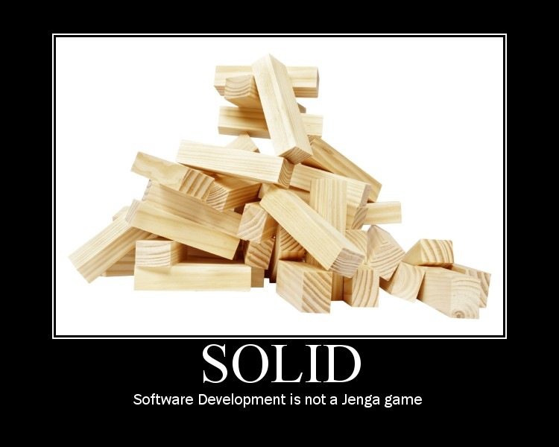

Slide 3
Software “Smells”
The system is rigid
  Hard to change because everything has to change at once
  Shotgun Surgery
The system is fragile
  Changes cause the system to break in the strangest of places.
The system is immobile
  That is, not reusable.
The system is opaque
  Hard to understand.
The system is needlessly complex
The system contains needless repetition.
Have you ever seen software with these problems?

Slide 4
SOLID Design Principles
Introduced by Robert C. Martin between 2000 and 2003
  Design Principles and Design Patterns, Object Mentor 1.34 (2000): 597
  Agile Principles, Patterns, and Practices in C#
Single Responsibility Principle
Open/Closed Principle
Liskov Substitution Principle
Interface Segregation Principle
Dependency Inversion Principle
Notes:
SOLID is an acronym of 5 acronyms

Slide 5
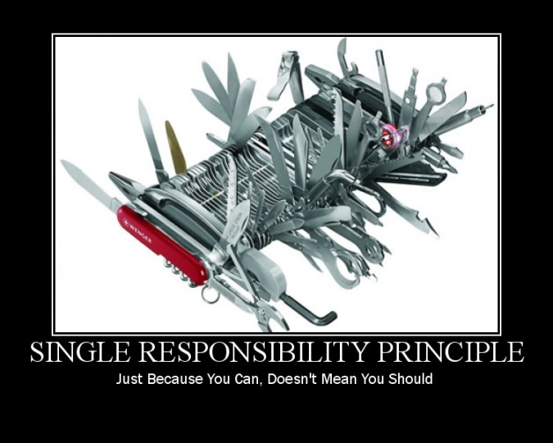
Single Responsibility Principle
Just because you can, doesn’t mean you should.

Slide 6
Single Responsibility Principle
A class should have only ONE Responsibility
A class should have only ONE reason to change
A responsibility is “a reason for change.”
The responsibilities of a class are axes of change.
  If it has two responsibilities, they are coupled in the design, and so have to change together.
If a class has more that one responsibility, it may become fragile when any of the requirements change

Slide 7
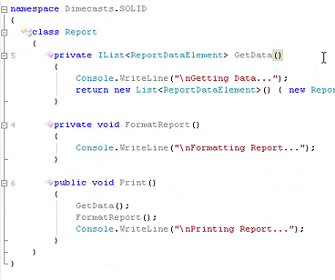
Single Responsibility Principle – Example
Report
GetData()
FormatReport()
Print()

Slide 8
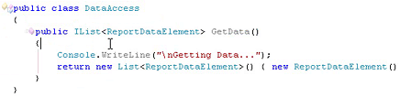
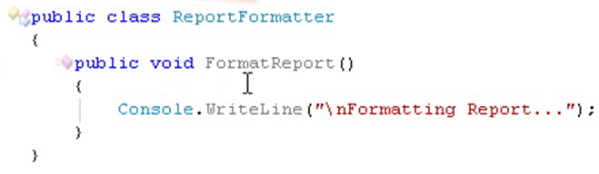
Single Responsibility Principle –
Example V2

Slide 9
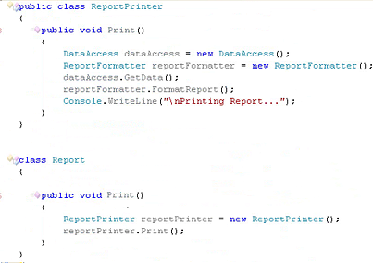
Single Responsibility Principle –
Example V2

Slide 10
Single Responsibility Principle –
Example v2
Report
ReportPrinter
Print()
Print()
Report
GetData()
FormatReport()
Print()
ReportFormater
DataAccess
FormatReport()
GetData()
Notes:
Refactor individual responsibilities to individual classes

Slide 11
Benefits of SRP
Reuse - If all your classes follow the SRP, you are more likely to reuse some of them
Clarity - Your code is cleaner as your classes don’t do unexpected things
Naming - As all your classes have a single responsibility, choosing a good name is easy
Readability - Due to the clarity, better names and shorter files the readability is improved greatly.

Slide 12
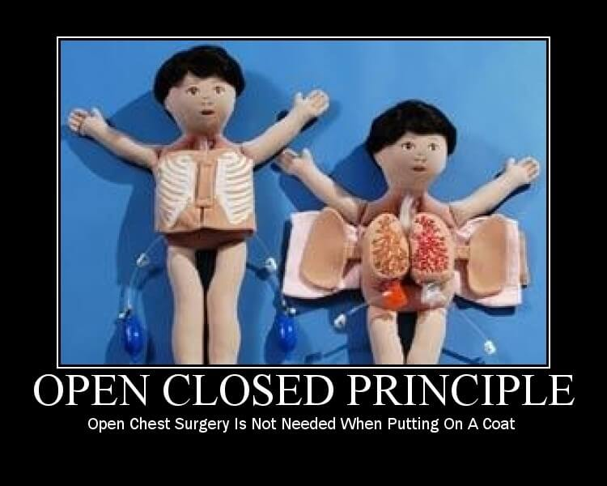
Open/Closed Principle

Slide 13
Open/Closed Principle
Software entities (module, classes, functions, etc.) should be open for extension but closed for modification
Classes should be written so that they can be extended without requiring modification.
  extend the behaviour of a system (in response to a requested change)
  add new code
  But not modifying the existing code

Slide 14
Open/Closed Principle
Once completed, the implementation of a class should only be modified to correct errors; new or changed features would require that a different class be created
Mechanism: Abstraction and subtype polymorphism are the keys to the OCP
  Introducing Abstract Base Classes
  Implementing common Interfaces
  Deriving from common interfaces or classes

Slide 15
OCP – Example
We get a request to change the print requirement
  Format the report into Tabloid (instead of 8-1/2 X 11)
  Print the report to a dot-matrix (instead of laser) printer
Solution 1:
  Modify the code in ReportPrinter and ReportFormatter
  Add some "if" to handle the different possibilities
Solution 2:
  Add specialized subclasses
Report
ReportPrinter
Print()
Print()
ReportFormater
DataAccess
FormatReport()
GetData()

Slide 16
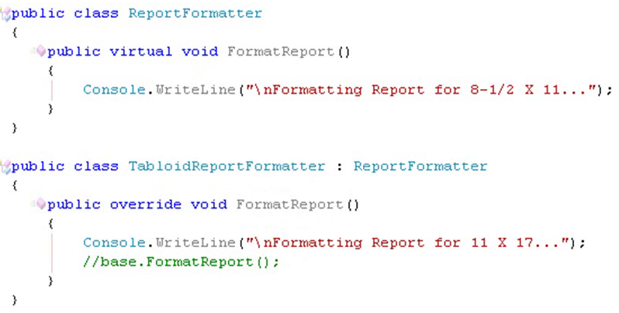
OCP – Example ct.
Report
ReportPrinter
Print()
Print()
ReportFormater
DataAccess
FormatReport()
GetData()
TabloidReportFormater
FormatReport()

Slide 17
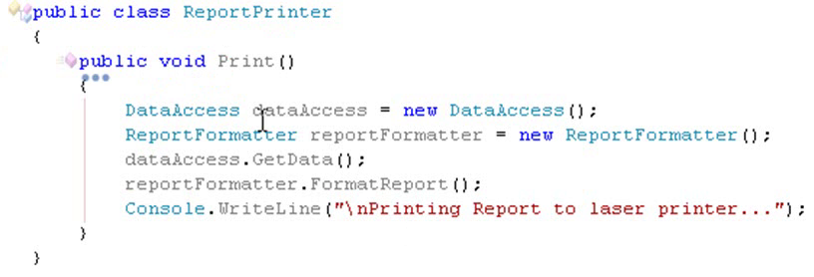
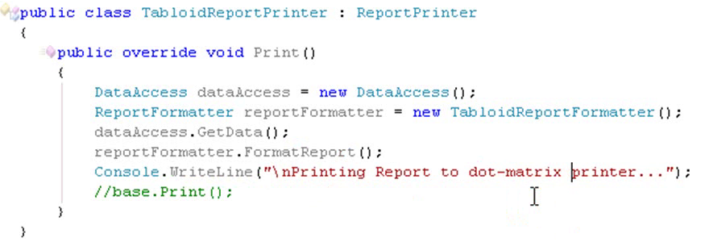
OCP – Example cnt.

Slide 18
OCP – Final Class Diagram
DataAccess
Report
ReportPrinter
GetData()
Print()
ReportFormater
Print()
FormatReport()
TabloidReport
TabloidReportPrinter
TabloidReportFormater
Print()
Print()
FormatReport()
Notes:
We made some minor classes. For instance in the base classes we declared the methods as “Virtual” then to allow derived classes override them

Slide 19
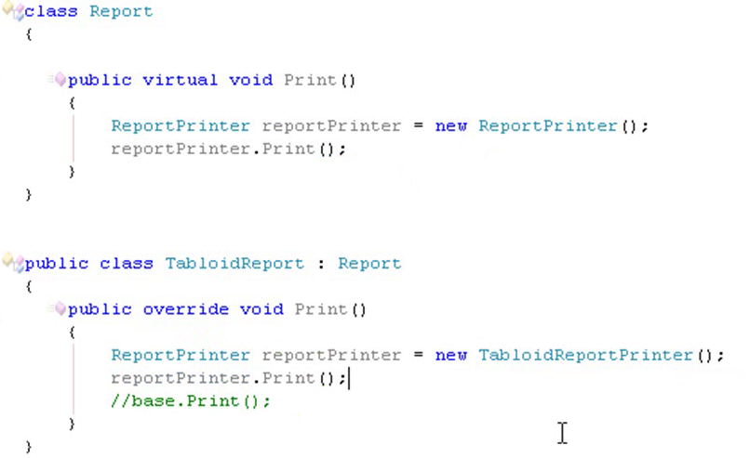
OCP – Example cnt.
Note the extension of the system behaviour without making modification to existing code

Slide 20
Benefits of OCP
design is more stable
  existing (working) code does not change
  changes are made by adding, not modifying, code
  changes are isolated and do not cascade throughout the code
code is potentially easier to test
change is easier to manage
  code is easier to replace
  design is extensible
code is potentially reusable
Higher abstraction

Slide 21
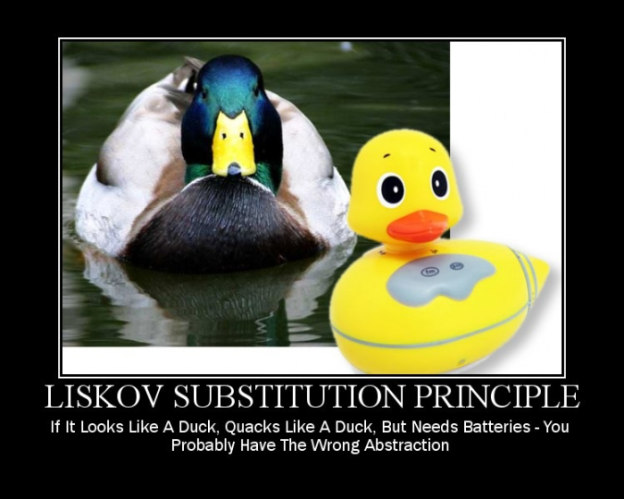
Liskov Substitution Principle

Slide 22
Liskov Substitution Principle (LSP)
Subclasses should be substitutable for their base class
LSP states that if a program module is using a Base class, then the reference to the Base class can be replaced with a Derived class without affecting the functionality of the program module.
“A derived class should have some kind of specialized behaviour (it should provide the same services as the superclass, only some, at least, are provided differently.)”
The contract of the base class must be honoured by the derived class.

Slide 23
Liskov Substitution Principle (LSP)
In basic Object-Oriented principles, “Inheritance” is usually described as an "is a" relationship.
If a “Developer” is a “SoftwareProfessional”, then, the “Developer” class should inherit the “SoftwareProfessional” class.
Such “Is a” relationship is very important in class designs, but it is easy to get carried away and end up in wrong design with bad inheritance.
The “Liskov's Substitution Principle” is a way of ensuring that inheritance is used correctly.

Slide 24
Violazione LSP
public class Rectangle {
private double height;
private double width;
public void setHeight(double h) { height = h; }
public void setWidht(double w) { width = w; }
...
}
public class Square extends Rectangle {
public void setHeight(double h) {
super.setHeight(h);
super.setWidth(w);
}
public void setWidth(double h) {
super.setHeight(h);
super.setWidth(w);
}
}

Slide 25
Wrong Implementation Inheritance
A very similar class is already implemented that does almost the same as the desired class implementation.
Example: I have a List class, I need a Stack class. How about subclassing the Stack class from the List class and providing three methods, Push() and Pop(), Top()?
List
Add
()
Remove()
“Already
implemented”
Stack
Push
()
Pop()
Top()
Notes:
Inheritance is a generalization technique, in which the behavior of a superclass is shared by all its subclasses. Sometimes it is misused as an implementation technique.
Question: Can you give me an example for unwanted behavior?

Slide 26
LSP – Benefits
If LSP is not maintained:
  class hierarchies would be a mess and if subclass instance was passed as parameter to methods method, strange behavior might occur.
  unit tests for the Base classes would never succeed for the subclass.
If this principle is violated, then it will cause the Open-Closed Principle to be violated also.

Slide 27
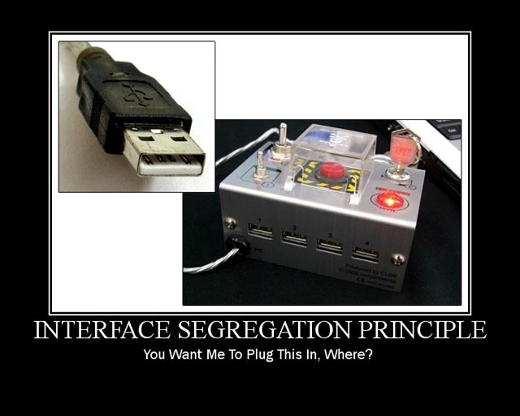
Interface Segregation Principle

Slide 28
Interface Segregation Principle (ISP)
This principle was first defined by Robert C. Martin as: “Clients should not be forced to depend upon interfaces that they do not use“.
Many client-specific interfaces are better than one general purpose interface
  Interfaces should be thin and not fat
  E.g. if you have an interface with 20 methods, then not all implementers of that interface might not implement all of those methods
    Bring large and fat interfaces into smaller ones which classify the related methods

Slide 29
Interface Segregation Principle (ISP)
If you have a class with several different uses, create separate (narrow) interfaces for each use.
The purpose is to make clients use as small and as coherent an interface as possible.
Fat interfaces lead to inadvertent couplings and accidental dependencies between classes.

Slide 30
ISP – A Bad Design
Service
Methods
For ClientA
Methods
For ClientB
Methods
For ClientC
Client A
Client B
Client C
The problem is that any change in Service introduced by one client (e.g., Client A) causes Service and the other clients (Client A and Client C) to be recompiled.

Slide 31
ISP – A Good Design
ServiceA
Methods
For ClientA
Client A
ServiceImpl
Methods
For ClientA
Methods
For ClientB
Methods
For ClientC
ServiceB
Methods
For ClientB
Client B
ServiceC
Methods
For ClientC
Client C
Changes introduced by one client (e.g., Client A) may require its designated interface (ServiceA) and the service implementation to change.
However, other clients (Client A & Client C) and their Interfaces (ServiceB & ServiceC) are not required to change or recompile.

Slide 32
ISP – Another Example
public interface Vehicle {
public void drive();
public void stop();
public void refuel();
public void openDoors();
}
public class MotorBike implements Vehicle {
// Can be implemented
public void drive() {...}
public void stop() {...}
public void refuel() {...}
// Can not be implemented
public void openDoors() {...}
}

Slide 33
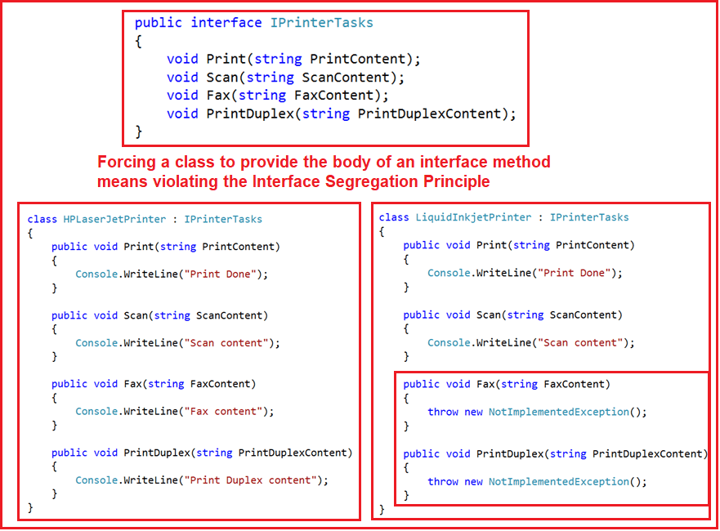
ISP – Yet Another Example

Slide 34
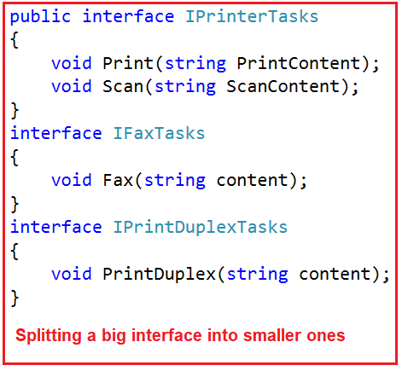
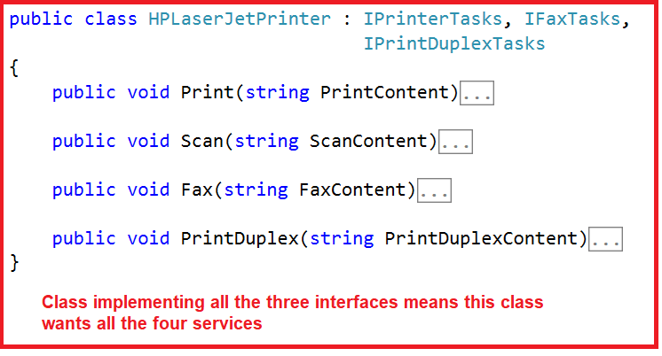
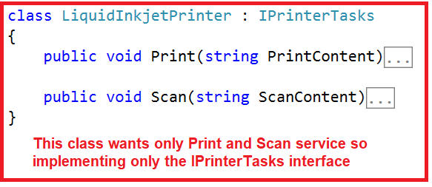
ISP – Another Example V2

Slide 35
ISP – Benefits
Cohesion is increased
  clients can demand cohesive interfaces
Design is more stable
  changes are isolated and do not cascade throughout the code
Supports the Liskov Substitution Principle

Slide 36
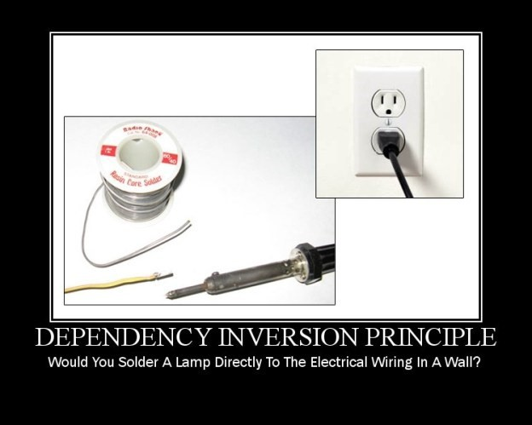
Dependency Inversion Principle

Slide 37
Dependency Inversion Principle (DIP)
High level modules should not depend on low level modules
  both should depend upon abstractions
    Dependency upon lower-level components limits the reuse opportunities of the higher-level components
Abstractions should not depend on details
Change the relation between concrete classes to relationships among abstractions
  Abstraction mechanism: Abstract base classes or Interfaces

Slide 38
Dependency Inversion Principle (DIP)
The goal of the dependency inversion principle is to
  decouple high-level components from low-level components
  such that reuse with different low-level component implementations becomes possible
High level classes should contain the “business logic”, low level classes should contain the details of the (current) implementation.
Access instances using interfaces or abstract classes to avoid dependency inversion.

Slide 39
DIP – Example
DataAccess
Report
ReportPrinter
GetData()
Print()
ReportFormater
Print()
Format()
TabloidReport
TabloidReportPrinter
TabloidReportFormater
Print()
Print()
Format()
Notes:
There is a relationship between Program class and Report class, in terms of concrete classes, rather than abstractions

Slide 40
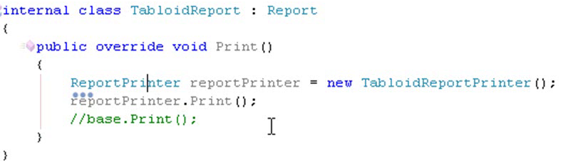
DIP
TabloidReport
ReportPrinter
Print()
Print()
IReportPrinter
<<Interface>>
TabloidReport
Print()
Print()
ReportPrinter
Print()
Notes:
Implementation level relations between TabloidPrint class and ReportPrinter (dependencies in terms of concrete types rather than interfaces)

Slide 41
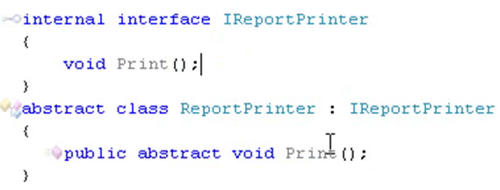
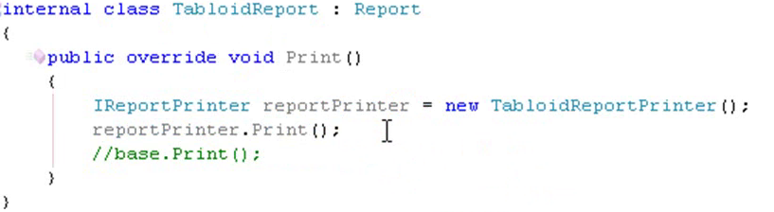
DIP
Notes:
Implementation level relations between TabloidPrint class and ReportPrinter (dependencies in terms of concrete types rather than interfaces)

Slide 42
DIP – Benefits
Enables design by contract
change is easier to manage
  code is easier to replace
  design is extensible
code is potentially easier to test

Slide 43
Sources
Example slides are partly adopted from
  http://dimecasts.net/Casts/ByTag/SOLID%20Principle

