Slide 1

Customer churn analysis

Slide 2
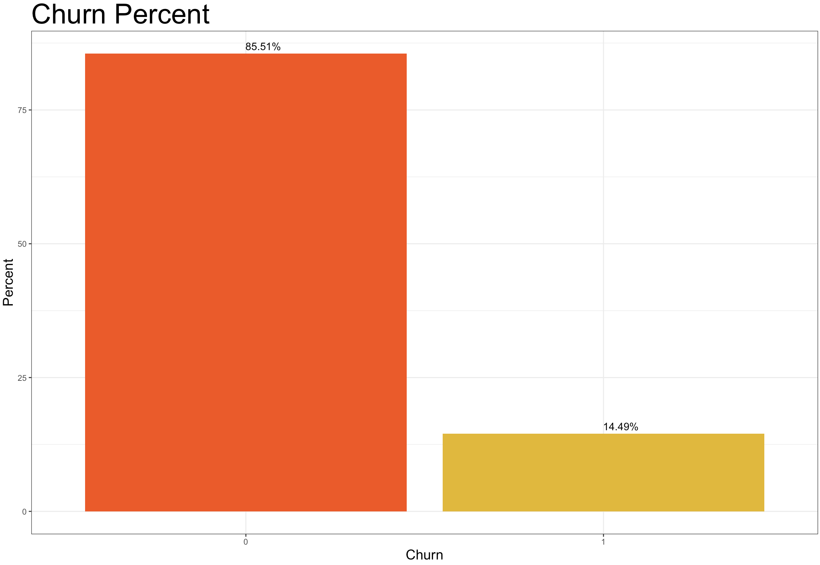
churn rate
Actual Churn proportion
HOW TO DETECT IF OUR CUSTOMERS
ARE LIKELY TO CHANGE PROVIDER?
1. International users
2. Customer service calls
3. Frequent users

Slide 3
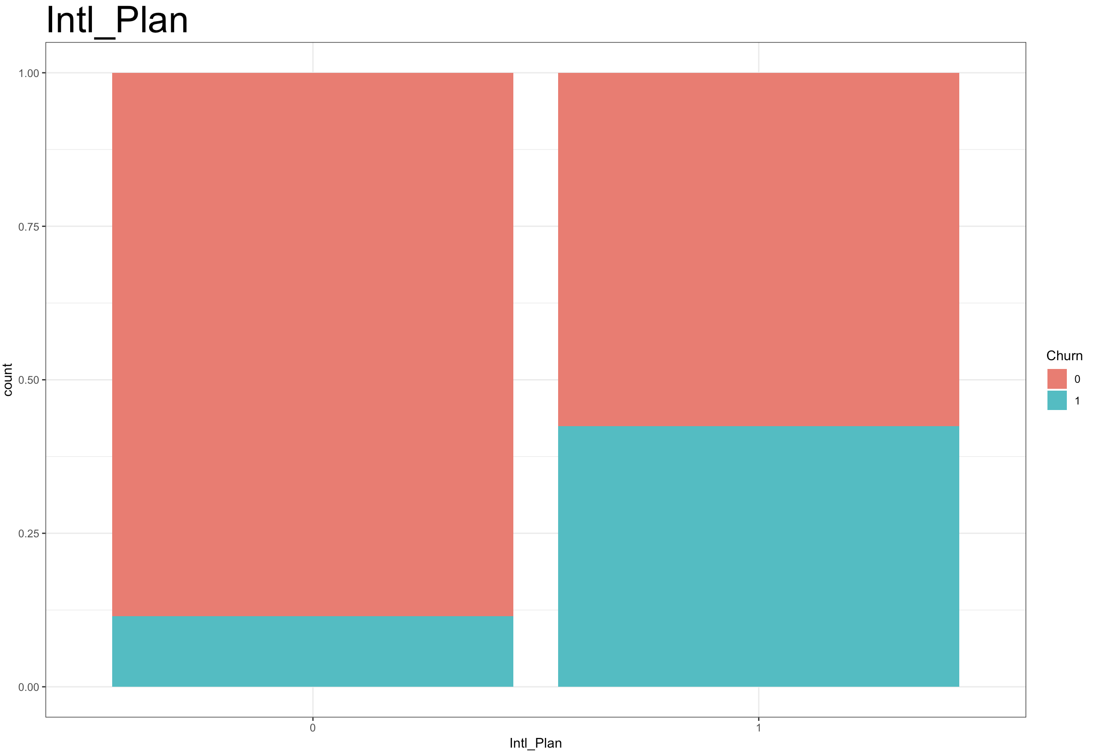

Main concerns
THE DIFFERECE BETWEEN THIS TWO TYPE OF CUSTOMER IS TO HUGE
Churn rate in customers with InternationalPlan active
New business strategy is needed to retain customers that wants an international plan.

Slide 4
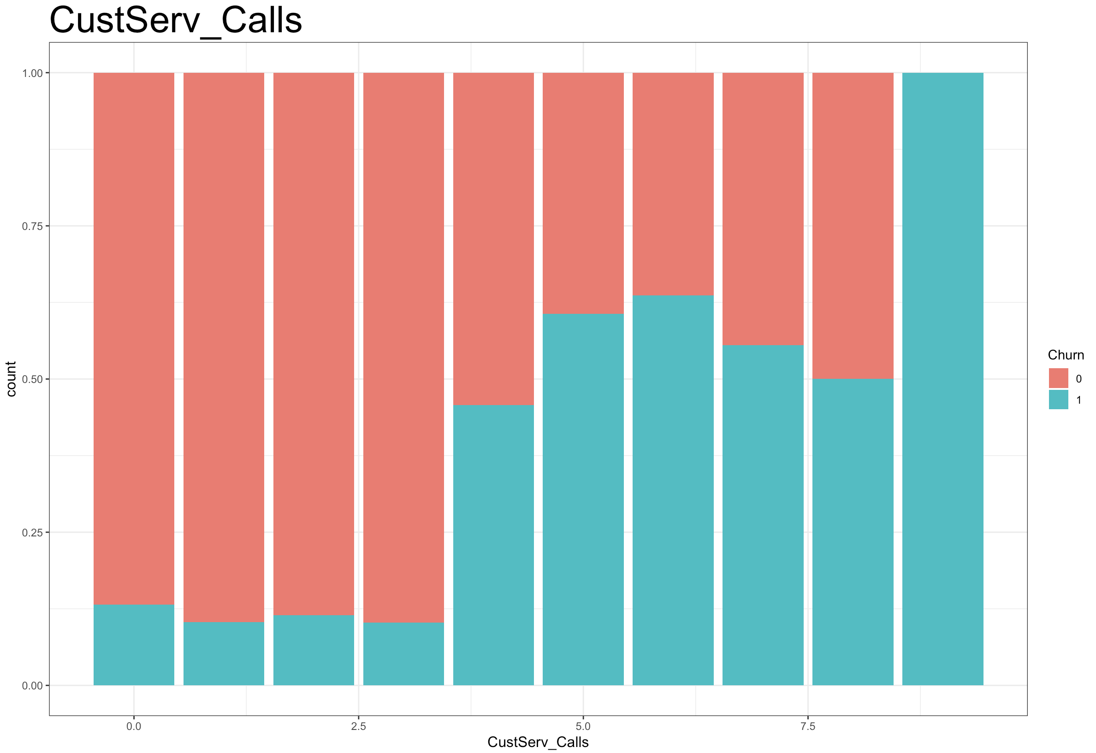
Main concerns
CALLING THE CUSTOMER SERVICE IS CLEARLY A NEGATIVE SIGN
Churn rate in relation with customer service calls
1. Improving the customers service quality
2. Store information of the reason of complain

Slide 5
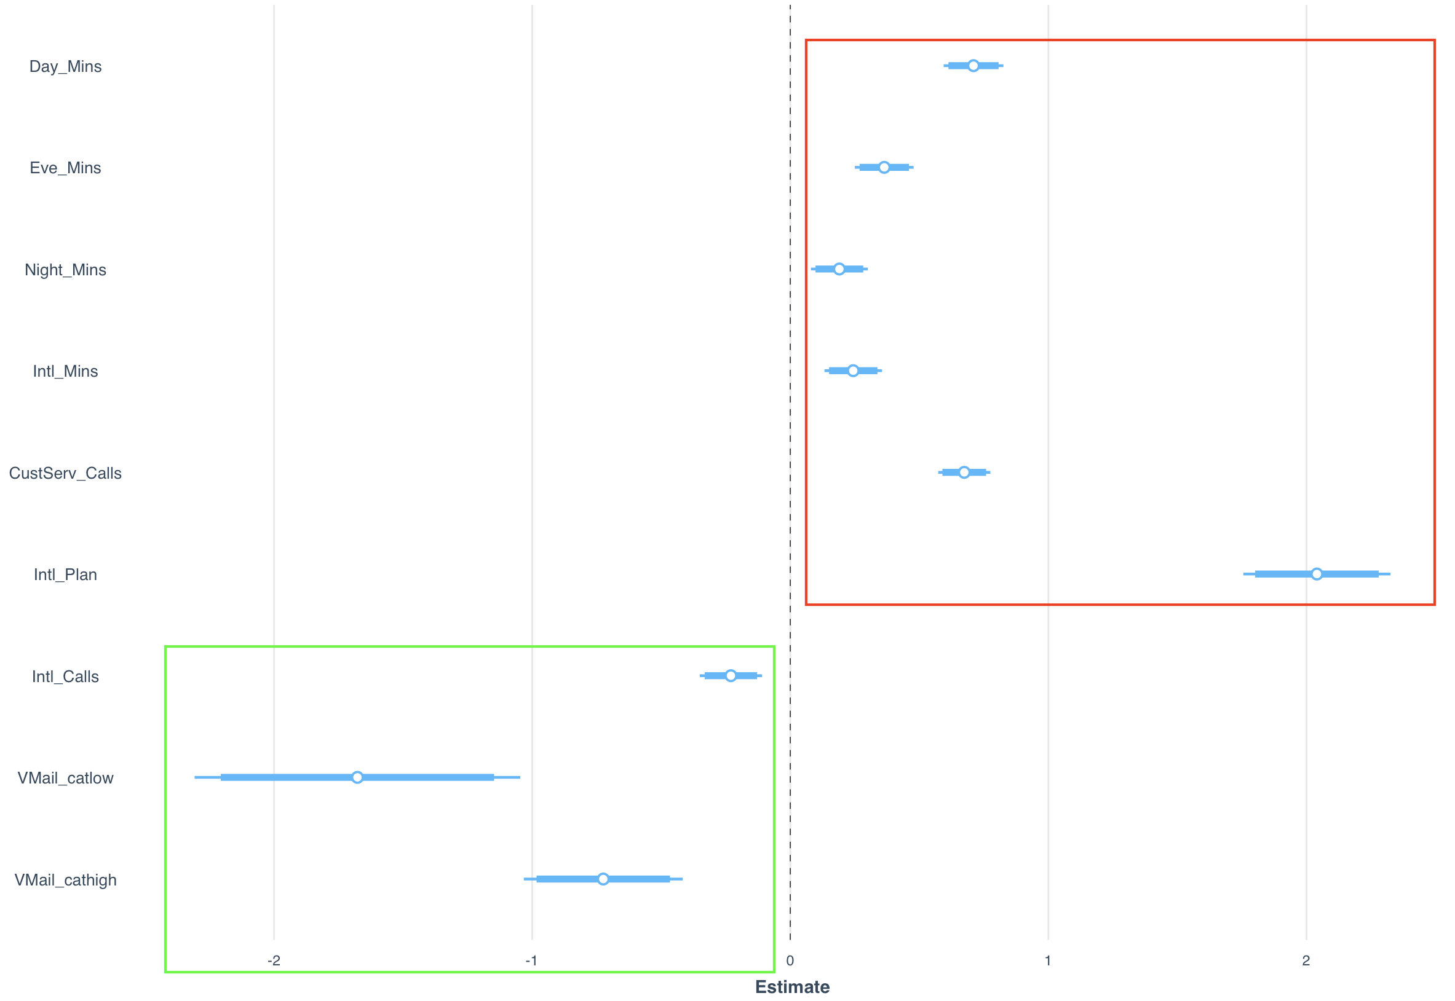
Statistical analysis
Logistic Regression estimates magnitude
THIS VARIABLES IMPACT NEGATIVELY ON THE PROBABILITY OF CHURN
THIS VARIABLE IMPACT POSITIVELY ON THE PROBABILITY OF CHURN

Slide 6
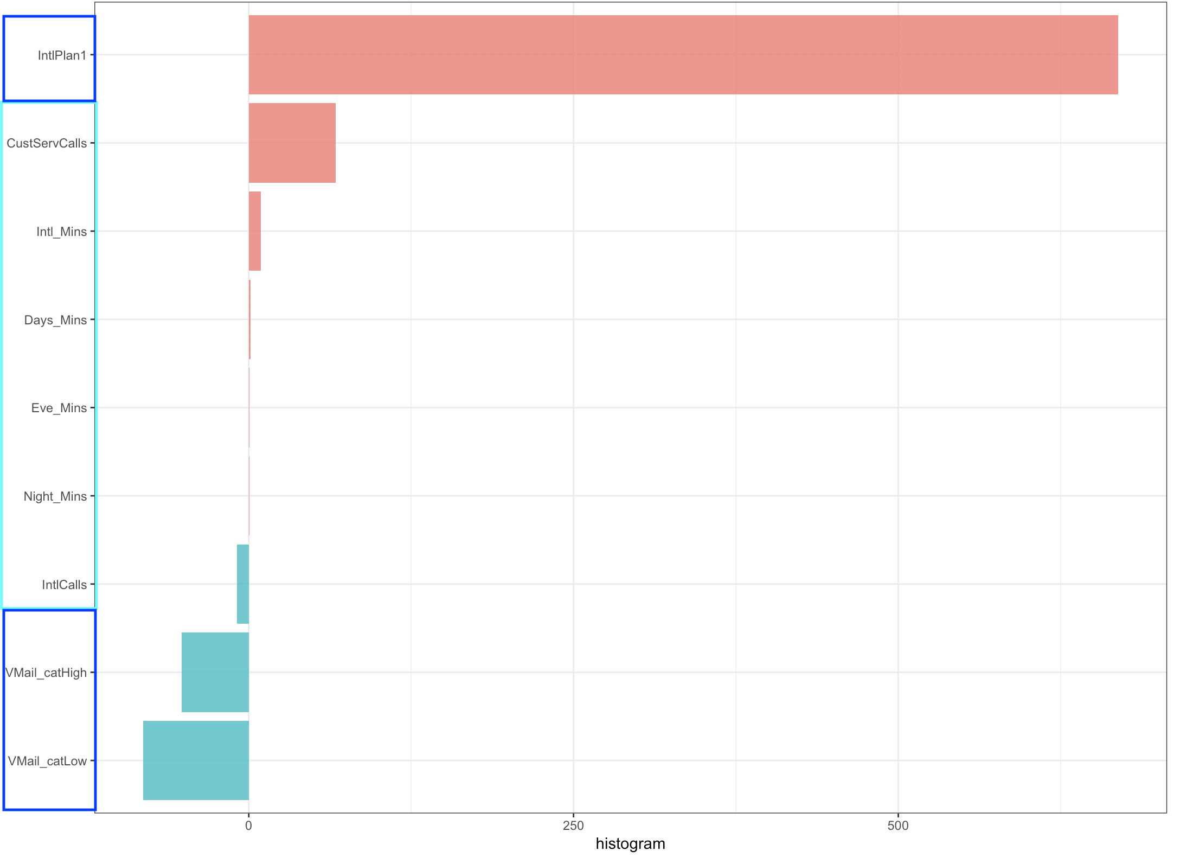
From stastics to insights
ODDS % DIFFERENCE
Keeping at fixed value all the other variables
FOR CATEGORICAL VARIABLE IS IT ILLUSTRATED THE ODDS % CHANGE WITH RESPECT TO REFERENCE CATEGORY
FOR NUMERICAL VARIABLES IS IT ILLUSTRATED THE ODDS % CHANGE PER ONE UNIT INCREASE IN THE VARIABLE

