Slide 1

Customer churn analysis

Slide 2
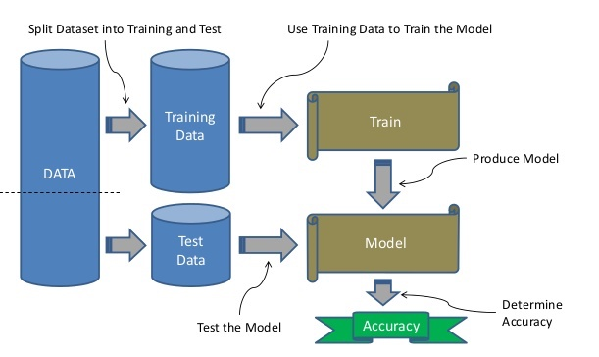
PREDICTION - strategy
STRATEGY USED
1. Set the random seed (54321)
2. Train 80% - Test 20%
(stratified random sample)
3. Calculate accuracy of each model
4. Pick the best one

Slide 3
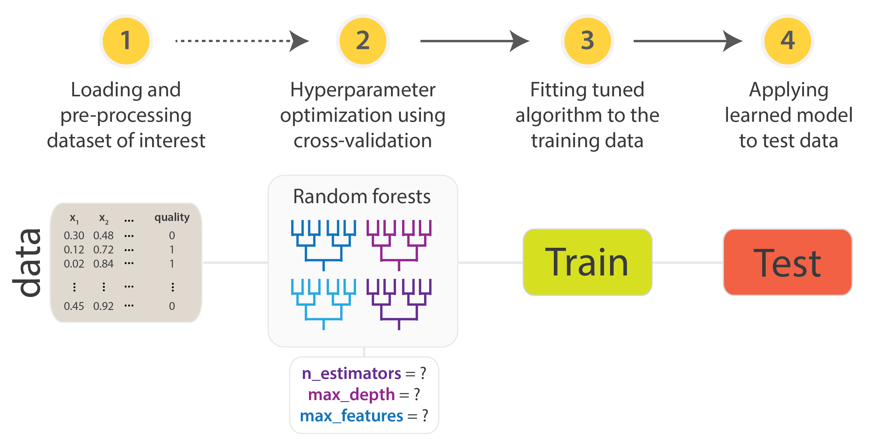
PREDICTION - strategy
STRATEGY USED
5. Tune the parameters
(not done in CV)
6. Train model with hyperparameter tuned
7. Calculate accuracy on the test data
8. Cross validation
(Bootstrap resampling &
Repeated K-fold (K = 10))

Slide 4
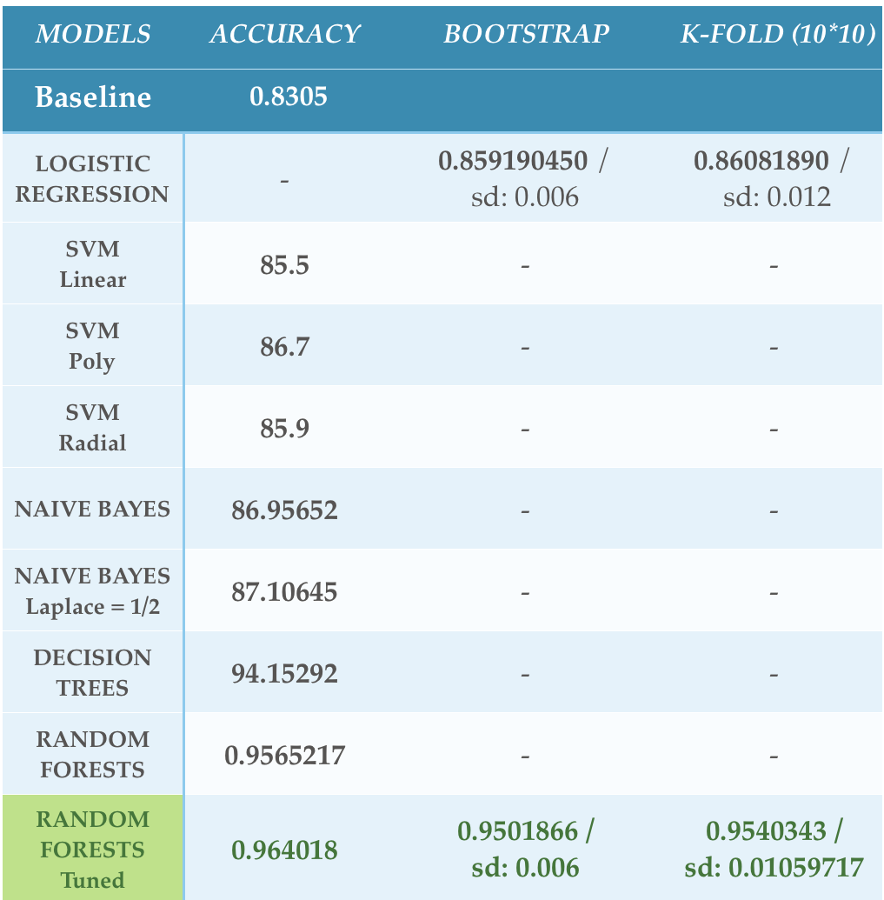

PREDICTION - results
RANDOM FORESTS:
n_tree = 300
m_try = 8
min_node_size = 2
Churn rate in relation with customer service calls
MEAN ACC: 0.95%
STANDARD DEVIATION: 0.006

Slide 5
CLUSTERING - usage
TOTAL MINS PER DAY
VARIABLE USED TO CLUSTER OUR CUSTOMERS
TOTAL CALLS PER DAY
INTERNATIONAL MINS

Slide 6
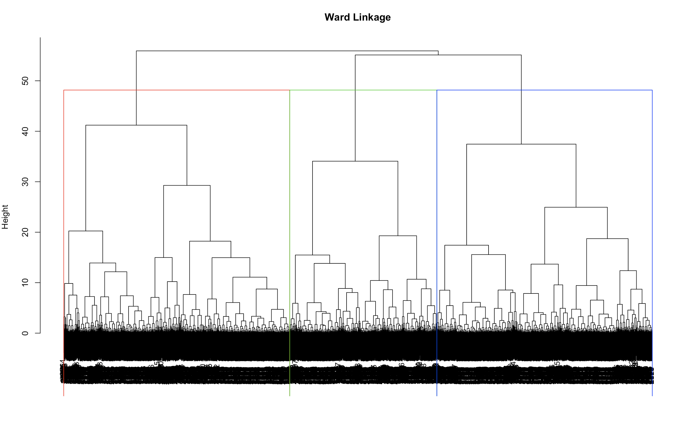
CLUSTERING - METHOD
HIERARCHICAL - WARD LINKAGE
HIERARCHICAL CLUSTERING
WARD LINKAGE
(more compact clusters)
K = 3

Slide 7
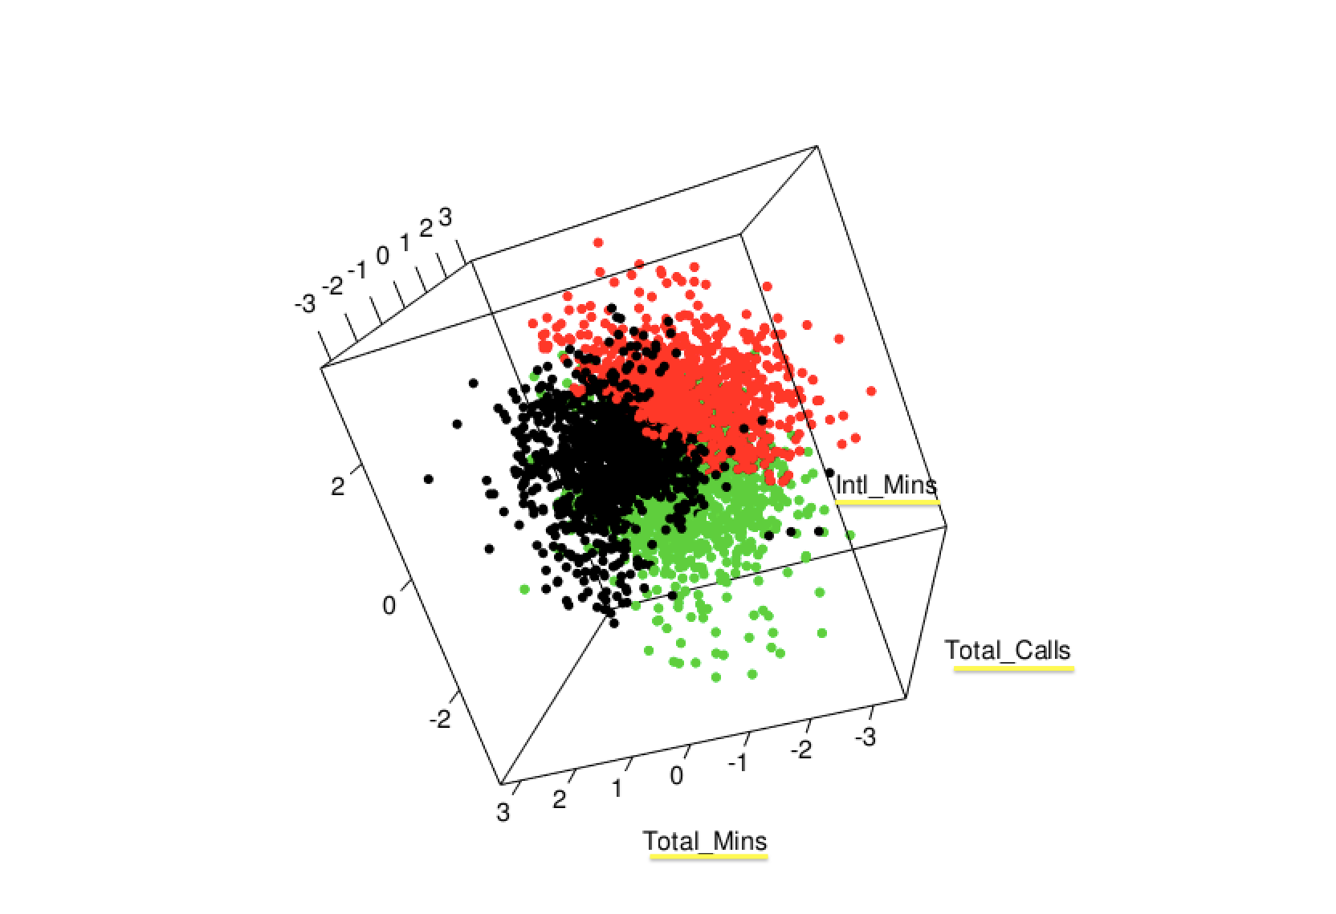
CLUSTERING - METHOD
HIERARCHICAL - WARD LINKAGE
CLUSTER SEPARATION
Classes are well separated
(The axis are scaled)

Slide 8
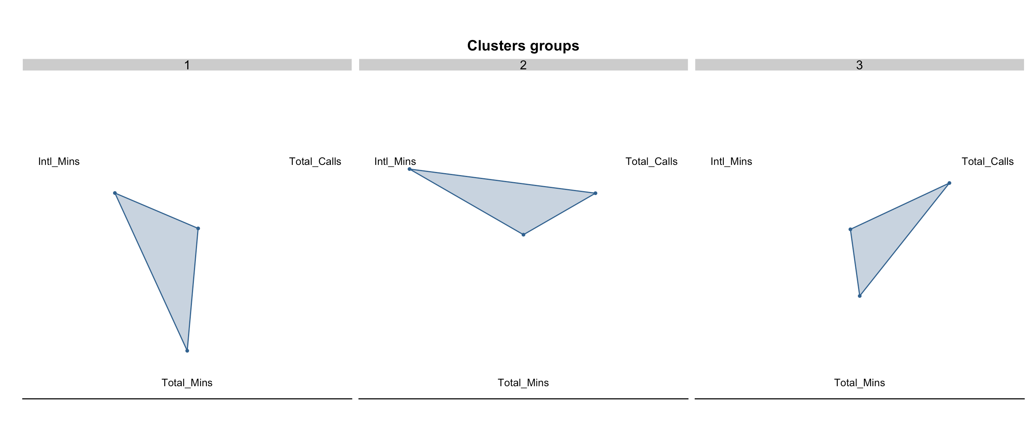
CLUSTERING – radar plot
We can see the 3 groups of customer generated.
Each group has a particular value for each variable

Slide 9
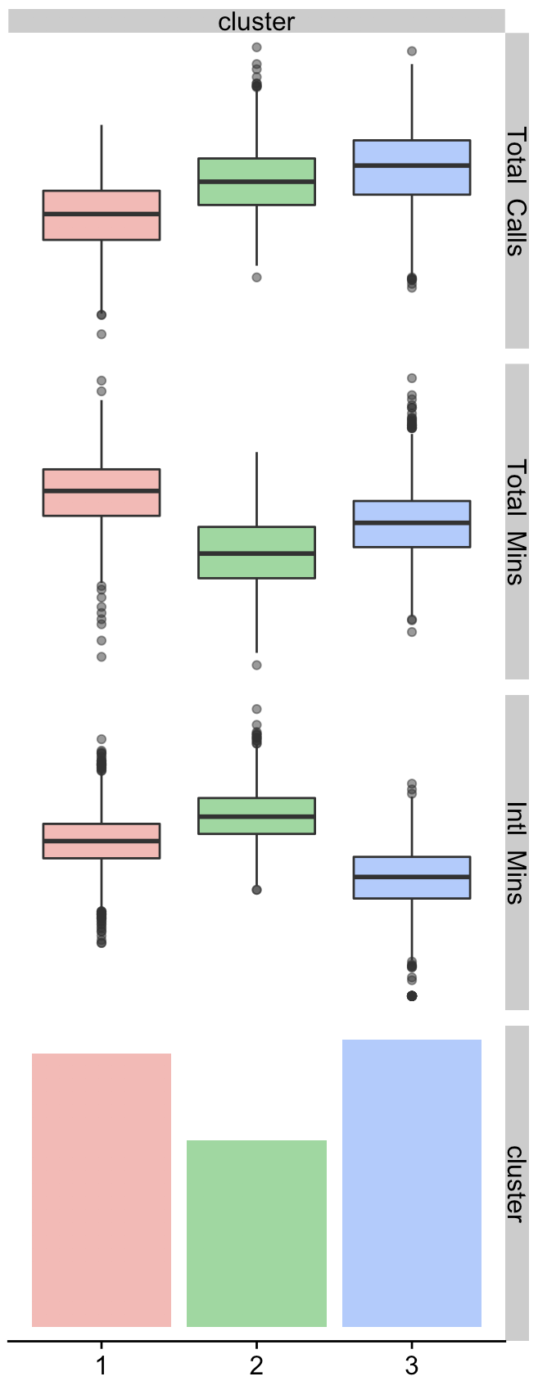
CLUSTERING - results
GROUP 1:
LONG CALLS
GROUP 2:
NORMAL CALLS
GROUP 3:
SHORT CALLS

