Slide 1
A New SAT Encoding of the At-Most-One Constraint
Jingchao Chen
Donghua University, China

Slide 2
Definition
At-Most-One (AMO) constraint:
Given X = {x₁,x₂,…,x_{n}} of n Boolean variables, at most one out of n variables in X is allowed to be true.
AMO encoding:
Convert AMO constraint to SAT problem in CNF

Slide 3
Known AMO encodings
standard AMO encoding:
AMO(X)={¬x_{i} ∨ ¬ x_{j}| x_{i}, x_{j}∈X,i<j}
sequential AMO encoding:
Logarithmic bitwise AMO encoding:
¬x_{i} ∨ a_{k} [or ¬a_{k}]
if bit k of the binary representation of i-1 is 1 [ or 0 ].

Slide 4


A summary of AMO encodings
Method | inventor | clauses | aux. vars
standard | folklore | n*(n-1)/2 | 0
bitwise | Frisch et al. | n log n | log n
sequential | Sinz | 3n-4 | n-1
2-product | This paper

Slide 5
Basic Idea of a Product Encoding
x_{qp-p+1} x_{qp-p+2} · · · · · · · · · · · · · x_{pq}
v_{q}
v_{j}
v₂
v₁
n≈pq
x_{jp-p+1} x _{jp-p+2} · · · · · · · · x_{k} · · · · x_{jp}
x_{k}→<u_{i},v_{j}>
x_{p+1} x _{p+2} · · · · · · · · · · · · · · · ·· ·x_{2p}
x₁ x ₂ · · · · · · · · · · · · · · · · · · · · ·x_{p}
u₁ u ₂ · · · · · · · · · · · · ·u_{i} · · · · · · u_{p}

Slide 6
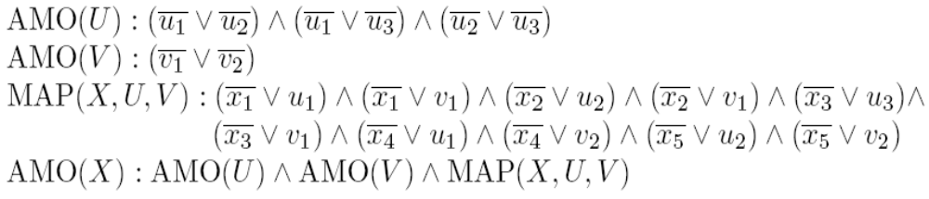
Example n=5, p=3, q=2
v₂
v₁
x₄ x₅
x₁ x₂ x₃
u₁ u₂ u₃

Slide 7
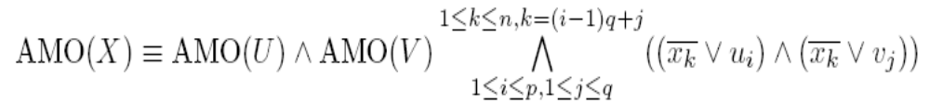
Basic formula of 2-product encoding
where X={x₁,x₂,…x_{n}}, U={u₁,u₂,…u_{p}}, V={v₁,v₂,…v_{q}}

Slide 8


Property (1) of 2-product encoding
If using the sequential encoding to encode sub-constraints AMO (U) and AMO (V), the 2-product encoding requires
2n + 3p-4 +3q-4≈ clauses and
auxiliary variables.

Slide 9


Property (2) of 2-product encoding
If using the standard encoding to encode sub-constraints AMO (U) and AMO (V), the 2-product encoding requires
2n + p(p-1)/2 + q(q-1)/2≈ clauses and
auxiliary variables.

Slide 10


Property (3) of 2-product encoding
If encoding sub-constraints AMO (U) and AMO (V) in a recursive way, the 2-product encoding requires
clauses and
auxiliary variables.

Slide 11
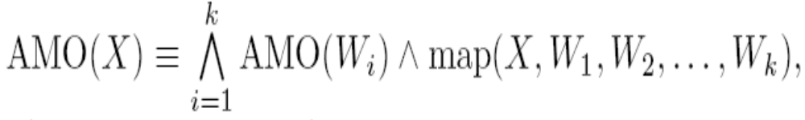
k-product encoding
map(X,W₁,W₂,…W_{k}) denotes each point in X is defined by a point in W₁×W₂×…×W_{k}. It consists of the following clauses.
|W₁|=|W₂|=…=|W_{k}|=p

Slide 12
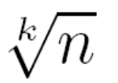


Property of k-product encoding
When |W₁|=|W₂|=…=|W_{k}|=p=2, k-product encoding become a bitwise encoding.
If using the standard encoding to encode sub-constraints AMO(W_{i}), |W_{i}|=p= , the k-product encoding of AMO requires
clauses and auxiliary variables.

Slide 13
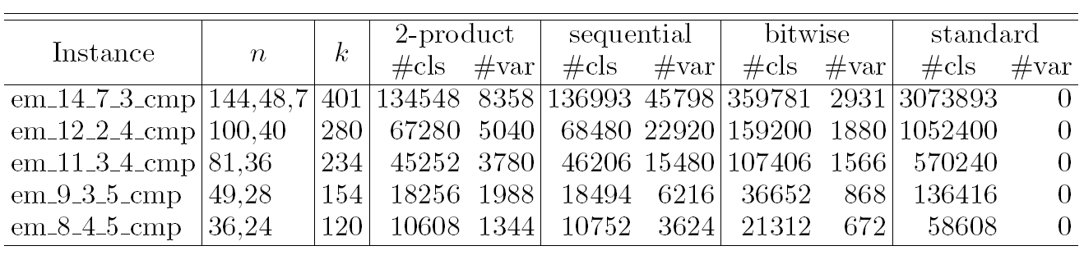
Empirical evaluation
Table 1. The number of clauses and auxiliary variables required to encode AMO constraints of edge-matching problems.

Slide 14
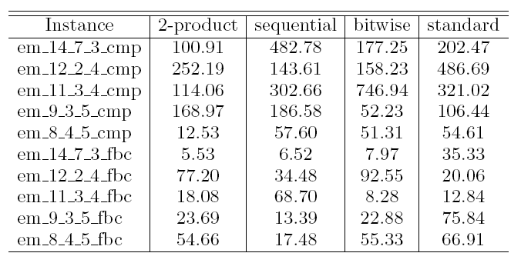
Table 2. Runtime (in seconds) required by CircleSAT to solve
edge-matching problems based on various AMO encodings.

Slide 15
Conclusions
Present four versions of the product AMO encoding
2-product encoding requires the minimal clauses
Unit propagation on product encoding achieves arc-consistency.

Slide 16
Thank you

