Slide 1
CrewGroups and MovementPlanner
- Two Applications Using Constraint Programming
Presentation at SweConsNet´02
Tomas Lidén
Carmen Consulting AB
tomas.liden@carmen.se

Slide 2
Carmen in brief
Carmen
Systems
Carmen
Consulting
Advanced scheduling products for crew, fleet and yield management
Customers: SAS, Lufthansa, BA and many more
Main office in Gothenburg
Advanced services in resource optimization, software development, planning and modelling
Customers: SJ, SAS, DB, Iberia…
Offices in Stockholm, Copenhagen

Slide 3
CrewGroups on One Page
Problem: Construct homogenous groups
Characteristics: Assignment, non-additive costs, matching, black-box
Developed during 2001 for Iberia
In production since spring 2002
Currently a CP application using ILOG Solver with set variables, one customized constraint, global&local search
Thesis work on column generation (with CP) and solving (LP relaxation) near completion

Slide 4
The CrewGroups problem:
Produce homogenous groups from a set of crew, given
  Buddy bids and anti bids
  Wanted days off (must-have or wish)
  Pre-assigned duties (courses handled differently)
  Fairness history values
  Experience level, work reduction
Constraints
Costs

Slide 5
The CrewGroups Application
General data
Carmen Report Generation
(handles rules regarding crew availability)
People data
Create input file
Input file
(plain text)
Bid data
Run CrewGroups
Log file
CrewGroups
C++
ILOG Solver 4.4
≈10 classes
≈ 4000 l.o.c.
View log
Import result
Result file
Carmen Crew Rostering
Developed on Windows NT
Deployed on Sun Sparc, Solaris 2.7

Slide 6
Structure
One Group per purser
cost function and most constraints defined here
accessors used to collect data from SubGroup during
solution search
Group
Set variables
SubGroup
One per buddy bid, single purser and cabin attendant
- aggregated data, checks on bids
Crew
Raw data
Only used for data input
Days handled with set variables. Cost and constraints applied on these set variables.
One special constraint regarding allowed patterns for days.

Slide 7
Program flow - Solve problem
Add hard constraints
and find solution
Add/remove all additional constraints
and find solution
Added in the weight order
Removed again if no solution found
Global search for cheaper solution
Iterate to minimize total cost
Add cost constraints for expensive groups
Local search for cheaper solution
Pick groups pairwise
Perform complete enumeration
Print and analyze results

Slide 8
Search heuristic, Global search
Greedy algorithm:
Select a group (variable)
  Already used and buddy bids
  With tight cost span
  Many preassigned days and/or days off
Select a subgroup (value) to assign
  Size and buddy bids
  Low cost addition
  Few preassigned days and days off
  Some special handling for quick crawl-out when all buddy bids have been assigned etc

Slide 9
Examples
 | B727 | B747 | A320
Group size | 4 | 10 | 4
Nr of crew | 113 | 481 | 798
Assignable subgroups (crew) | 53 (73) | 161 (254) | 450 (508)
Pursers (in buddy bids) | 25 (7) | 39 (36) | 175 (72)
Nr of groups in solution | 20 | 39 | 89
Cost, initial solution | 109.000 | 1.990.000 | 576.000
Cost, after all constraints | 106.000 | 1.933.000 | 564.000
Cost, after global search | 106.000 | 1.933.000 | 513.000
Cost, after local search | 97.000 | 1.829.000 | 405.000
Nr of iterations | 8 | 7 | 13
Execution time, mins (useful) | 1 (0,1) | 3 (1,5) | 87 (71)

Slide 10
Experiences learned
Performance ok
Good to handle crew availability rules in Carmen
A lot of code spent on data checking, preparation and adjustment
Object orientation worked well
Good to extend Solver classes for handling set of days and constraints on them
Hard to track reasons for domain reduction in Solver
Better in Solver 5.x
Unwanted domain reduction (spontaneous assignments)
Not found reason yet
Column generation – yields slightly better results and shorter execution times (for large problems)

Slide 11
Movement Planner on One Page
Problem: Assign new positions to captains
Characteristics: Assignment, strict seniority, bidding, “stable marriage”, few feasible solutions, user interaction
Prototype developed during 2002 together with SAS
Microsoft Access application
Java for data preparations and business rules
ILOG OPL module doing the assignment
Thesis work studied other solutions methods (IP, network, tailored algorithm) – CP wins

Slide 12
The Movement Planner Problem
2002
Retirements
2003
Groups
  Demand (variable)
  Qualification requirements
Crew
  Current position
  Seniority
  Qualification
  Age
  Bids
Movements
  Cost
  Restrictions, limits
A340
A340
FC
737
737
MD87
MD87
A340
A340
FP
737
737
MD87
MD87
Recruitments

Slide 13
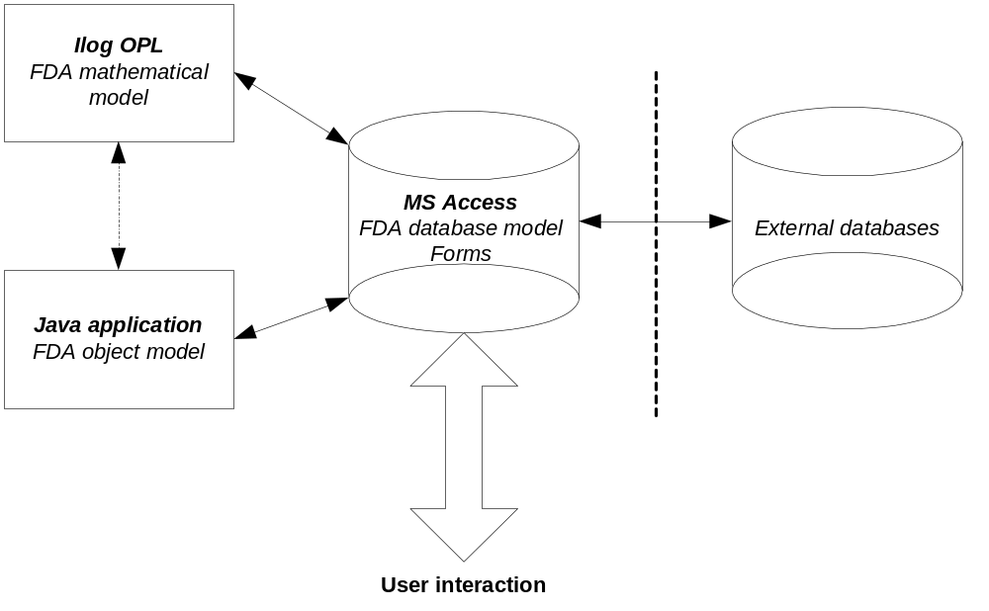
Movement Planner Architecture
FDA = Flight Duty Allotment (the SAS term)

Slide 14
Rules, Constraints, Optimization
Constraints for Seniority
and Movement limits
Cost for Movements or
Bid Fulfillment
Predicates to reduce domain
Standard search
Find cheapest solution
Assignment
Basic
Model
Business
Rules
Post
Processing
Applied
Model
Locks due to age, nr of
years per position etc
Verifying qualifications
Ranking of bids
User Interaction

Slide 15
Realistic Test Case
Assignment period 2002
2052 pilots
7 FC groups and 6 FP groups
Fixed and variable demands (± 2%)
No movement limits

Slide 16
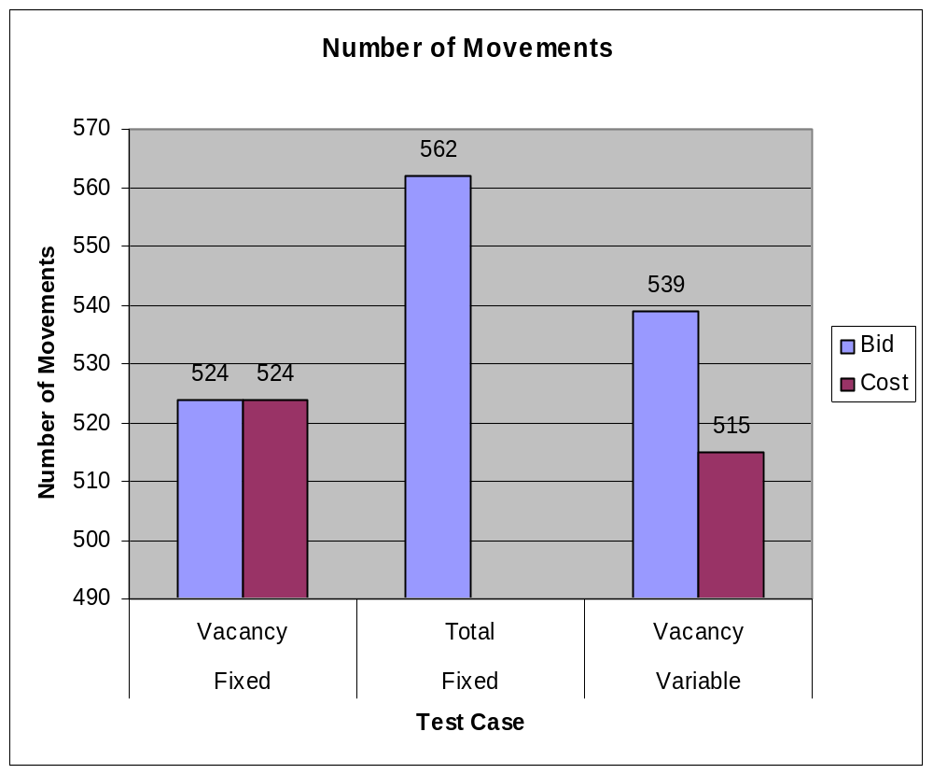
Result

Slide 17
Experiences learned
Performance ok
Good prototyping architecture
OPL good for debugging and visualization
Some database overhead

