Slide 1
Linköpings universitet
  Department of Computer and Information Science
      TCSLAB (http://www.ida.liu.se/~tcslab):
        Peter Jonsson (4 Ph.D. Students)
        Jan Małuszyński, Włodek Drabent, Paweł Pietrzak
        Ulf Nilsson (1 Ph.D. Student)

Slide 2
TCSLAB: Peter Jonsson
Algorithms:
  Fast algorithms (theory & practice)
  Unusual models:
    Quantum computing
    DNA computing
Complexity:
  Temporal & spatial problems
  CSP with disjunction

Slide 3
TCSLAB: Ulf Nilsson
TCSLAB: Ulf Nilsson
Modeling and verification using CLP
  Local and symbolic model checking using tabled CLP
  Fault isolation in robot control software
  Verification of parameterized systems using regular sets
Teaching (C)LP
  3rd year Logic Programming course (LP textbook available free of charge on-line)
  PhD courses on Constraint programming (with J.M.)
www.ida.liu.se/~ulfni/teaching.shtml

Slide 4
Locating Errors in Constraint Logic Programs
Włodek Drabent, Jan Małuszyński, Paweł Pietrzak
Department of Computer and Information Science
Linköpings universitet
{wdr, jmz, pawpi}@ida.liu.se

Slide 5
What…
locating type errors in untyped CLP programs
How…
directional types checking ⇒ verifying the program w.r.t. type specification

Slide 6
Symptoms and errors
Symptom: a discrepancy between user’s expectations and actual program behavior;
here: wrong answers or illegal calls
Error: a part of the program responsible for the symptom; here: prefixes of program clauses

Slide 7
The diagnosis problem
Find an error responsible for the symptom
Traditional aprroaches:
  Testing and tracing
  Type checking
Problems with the CLP case:
  Involved control and data flow
  CLP languages usually untyped

Slide 8
The approach
Static analysis computes types T of predicate arguments on call and on success, e.g.:
    Call-type: nqueens(nat, any)
    Success-type: nqueens(nat, list(nat))
Inspection of T by the user results in specification of expected types S .
Automatic error location based on S.

Slide 9
The types
So far in logic programming: (descriptve) types are sets of terms. We extend them to:
describe sets of constrained terms anyfd;
handle type parameters e.g.
Call-type: append(list(A),list(A),any)
Succ-type: append(list(A),list(A),list(A))

Slide 10
The types (cont’d)
New types defined using parametric regular term grammars by the user, or by the type inference tool
tree(A) -> void; t(A,tree(A),tree(A))
t(2,void,void) is in the type tree(nat)
The standard type constructor: list
e.g. list(int), list(anyfd)

Slide 11
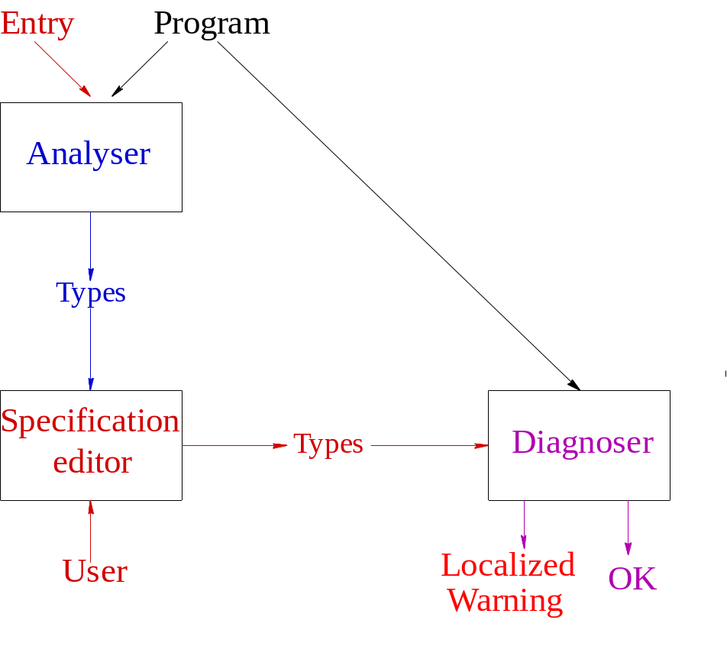
The structure of our tool

Slide 12
Diagnosis
Works interactively
Initial input:
  CLP program
  Inferred types (Analyser)
  Diagnosis request (User)
Interactions:
  Query: intended type (Diagnoser)
  Answer to the query (User)
Output: incorrect clause and atom

Slide 13
N-queens
:-entry nqueens(int,any).
nqueens(N,L):- length(L,N), L::1..N, constrain_queens(L), labeling(L,0,most_constrained,indomain).
constrain_queens([]).
constrain_queens([X|Y]):- safe(X,Y,1), constrain_queens(Y).
safe(_,[],_).
safe(X,[Y|T],K):- noattack(X,Y,K),
K1 is K+1, safe(T,Y,K1). % <- bug here
noattack(X,Y,K):- X #\= Y, Y #\= X+K, X #\= Y+K.

Slide 14
The inferred types
Call-Type: nqueens(int, any)
Succ-Type: nqueens(nat, t66)
t66 --> [nat|t49]
t49 --> []
-------------------------
Call-Type: constrain_queens(list(anyfd))
Succ-Type: constrain_queens(t60)
t60 --> []
t60 --> [anyfd|t49]
t49 --> []
…

Slide 15
Diagnosis session
After providing types for:
Call-Type: constrain_queens(list(anyfd))
Call-Type: safe(anyfd, list(anyfd), int)
Succ-Type: safe(anyfd, list(anyfd), int)
Succ-Type: constrain_queens(list(anyfd))
Succ-Type: noattack(anyfd, anyfd, int)

Slide 16
Diagnoser’s warning
…we got a warning
Clause (lines: 15 - 18)
safe(X,[Y|T],K) :- noattack(X,Y,K),
K1 is K+1, safe(T,X,K1).
suspicious.
Cannot prove call to safe(T,X,K1):
T: list(anyfd) X: anyfd K1: int

Slide 17
Features of the diagnoser
Static (no execution, no test data)
Finds all type errors
Minimal specification effort
User’s specification is memoized
Applicable to not fully developed programs (with missing fragments)

Slide 18
Demo…

Slide 19
Summary
A verification method for parametric descriptive types.
A specification language.
A technique for locating type errors.
A type inference technique.
A diagnosing tool.

