Slide 1
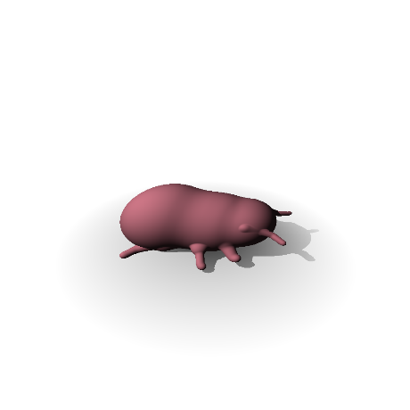
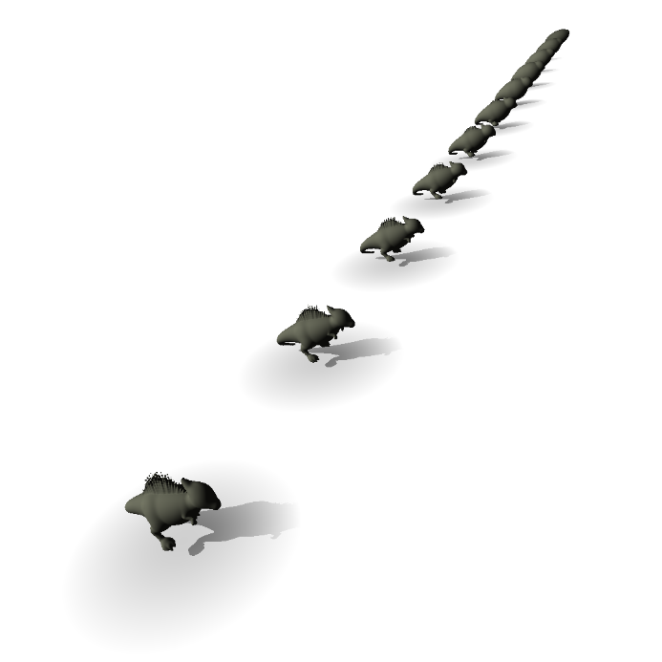
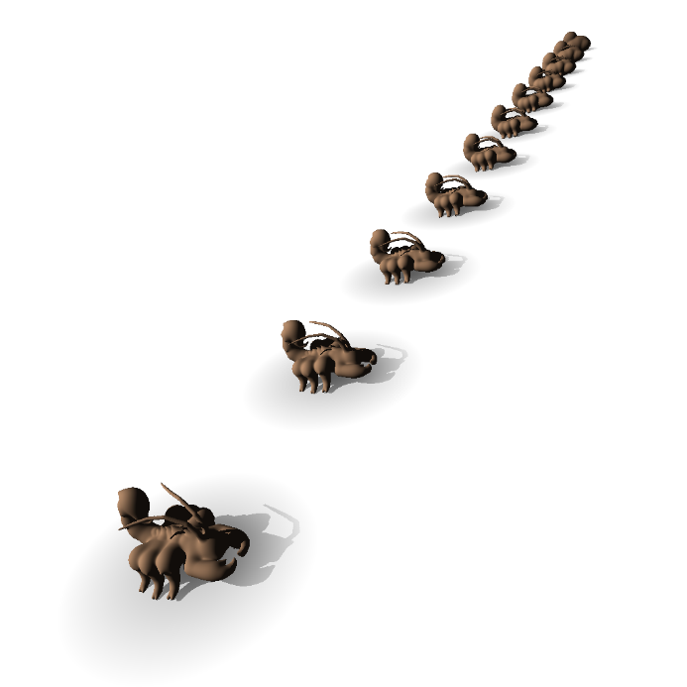
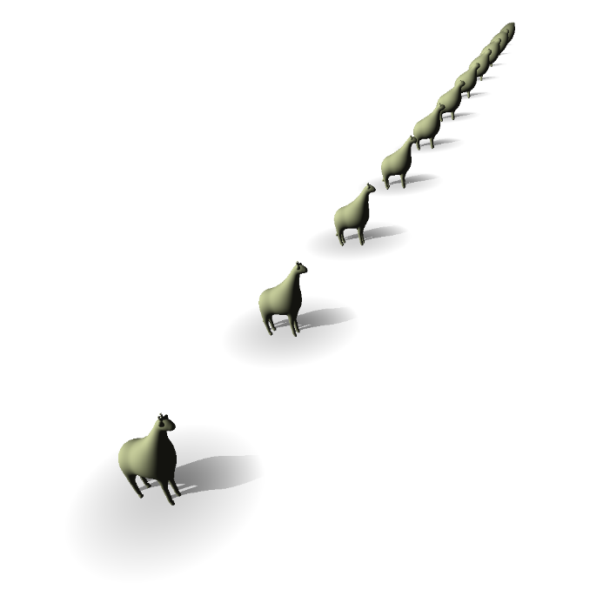
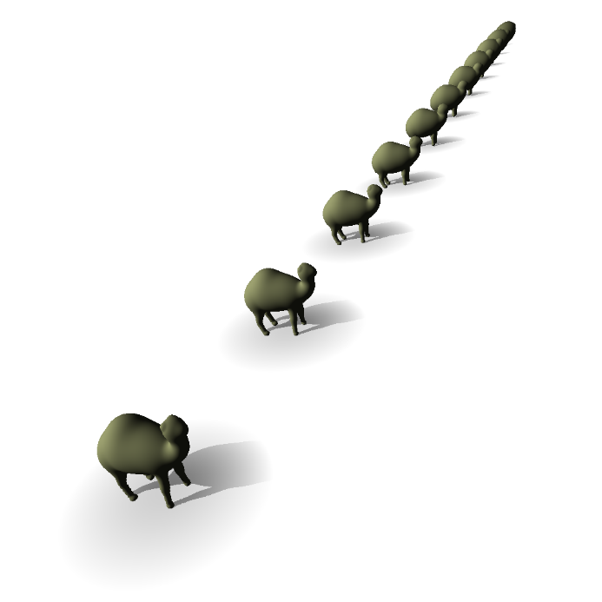
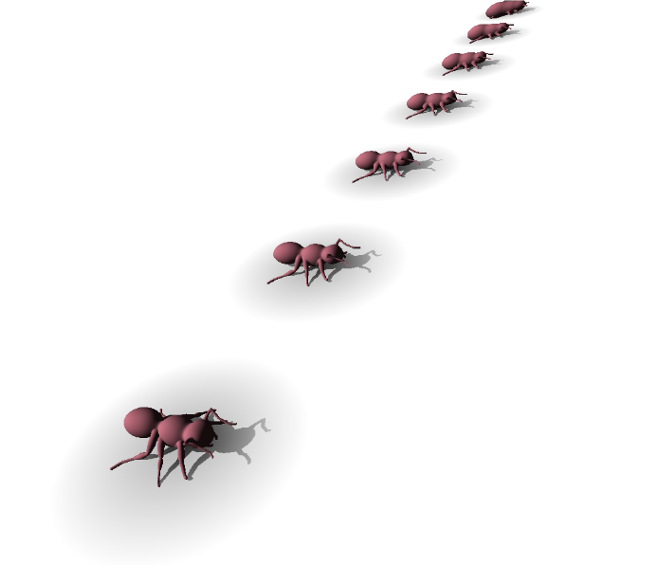
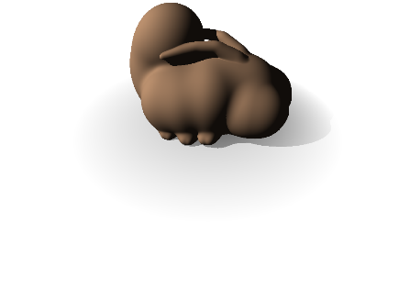


Extreme Continuous Level of Detail
for Skeleton-based Implicit Surfaces
P. Hubert-Brierre^{1,2}, MP. Cani¹, E. Galin²
¹LIX, Ecole Polytechnique/CNRS, Institut Polytechnique de Paris, France
²Université Lyon 1, LIRIS, CNRS, France
SMI 2026

Slide 3
Motivation
Skeleton-based implicit surfaces (SCALIS) are powerful for 3D representation.
However they require a high computational cost.
Notes:
Easelly editable, seamless blending of primitives, bulge free, sharp and smooth feature on same model.
For instance, the dinosorus is made from a global blend of more than 200 (two hundred) primitives. Can only be rendered alone without acceleration (realtime).

Slide 4
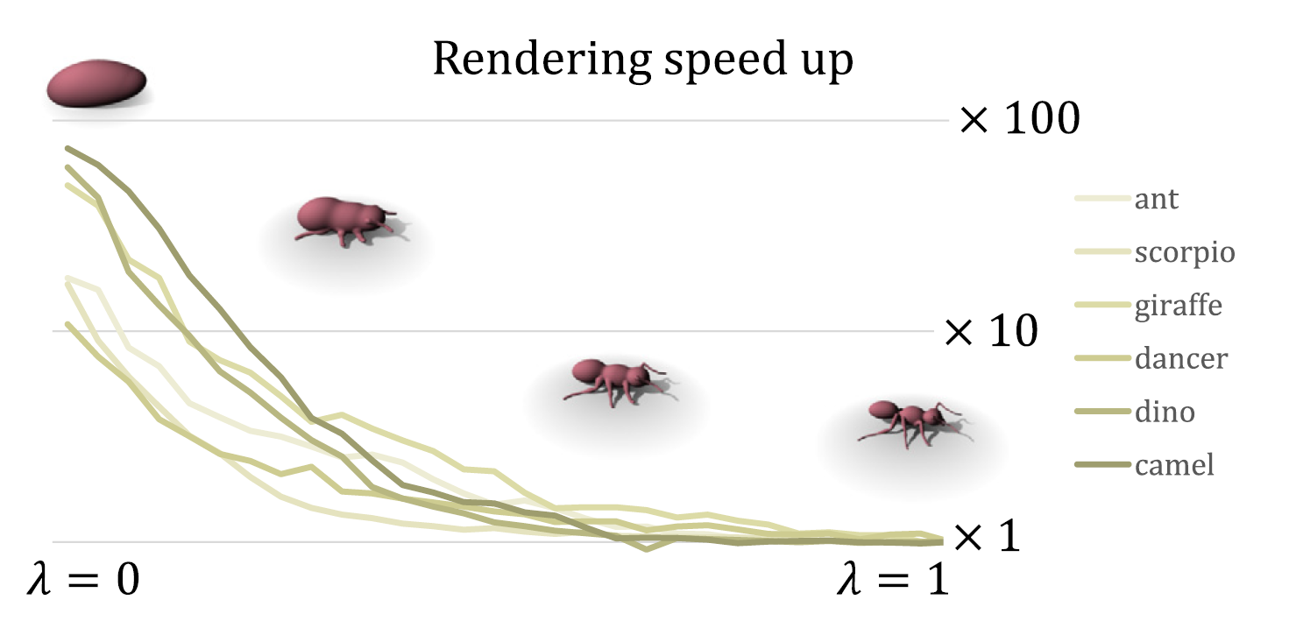
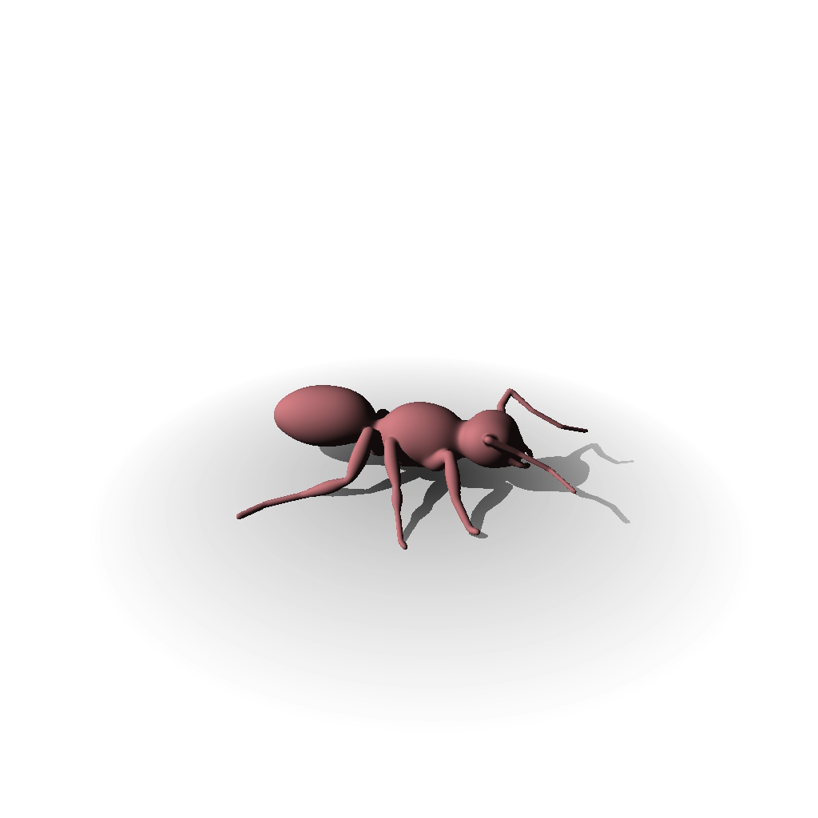
Our contribution
The first continuous LoD framework for SCALIS surfaces
Extreme simplification with topological changes
Up to 100x speedup while reducing aliasing
Notes:
Rester LONGTEMPS

Slide 6
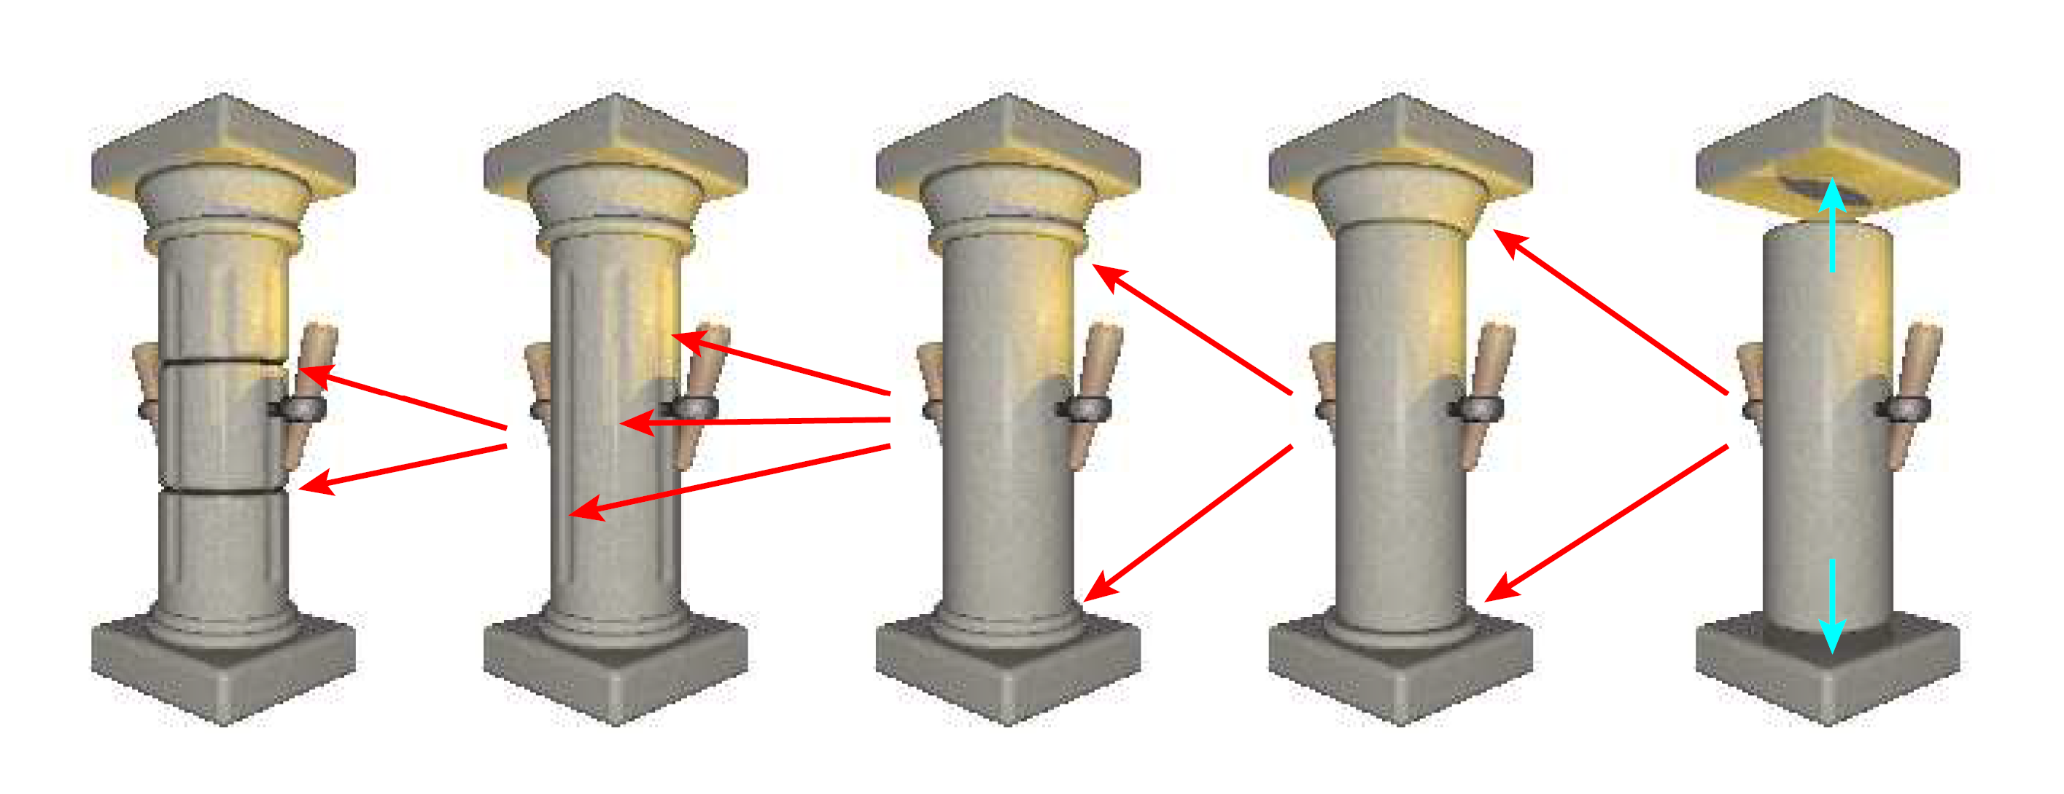
Complex Skeletal Implicit Surfaces with LoD
Aurélien Barbier, Eric Galin, and Samir Akkouche. Proceedings of WSCG (2004)
Level of Details on Blobs
Notes:
However it does not tackle the LoD transition and LoD have to be partialy made by hand.

Slide 7
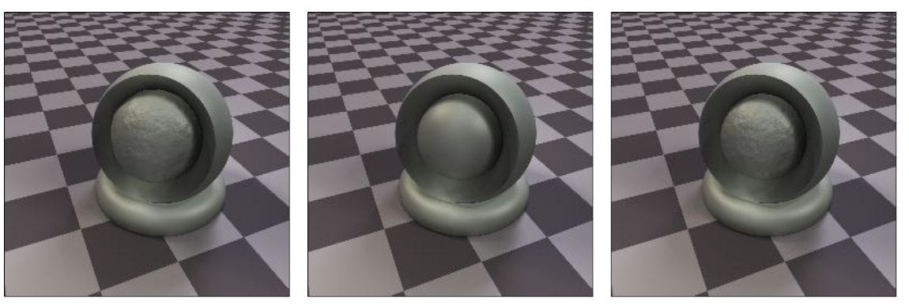
Accelerating Signed Distance Functions
Pierre Hubert-Brierre, Eric Guérin, Adrien Peytavie, and Eric Galin, Pacific Graphic (CGF, 2025)
Level of Details on Signed Distance Field (SDF)
Detail addition through normal warping
Reference
LoD
LoD + Normal warp
Notes:
Like the previous no LoD transition and generation, but less visible transition due to normal warp

Slide 8
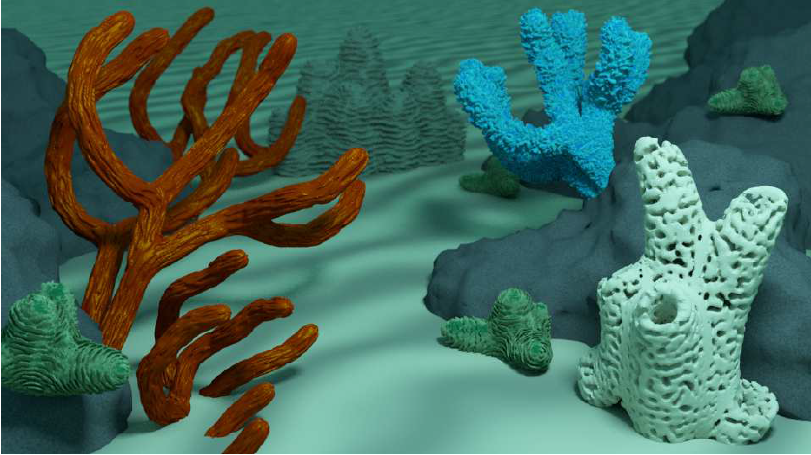
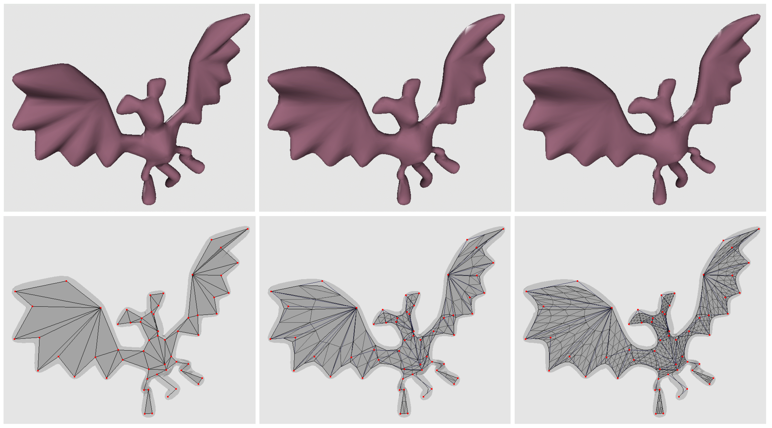
Details Addition on convolution surfaces
Adaptive Implicit Modeling using Subdivision Curves and Surfaces as Skeletons
Geometric Details on
Skeleton-Based Implicit Surfaces
Cedric Zanni, P. Bares, Ares Lagae, M. Quiblier, and Marie-Paule Cani, In Eurographics 2012 - Short Papers
Alexis Angelidis and Marie-Paule Cani, In ACM Solid modeling and applications (2002)
Notes:
Closer to our concern, convolution surfaces. Thoses two paper propose an inverse LoD approach, by adding details.
But they are not improving the computation

Slide 9
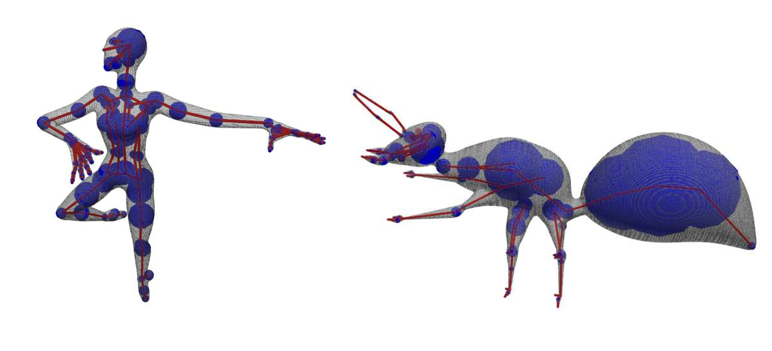
Skeleton-based convolution implicit surfaces
Integrating a potential along a skeleton
Image courtesy of C. Zanni et al.
Notes:
Stay 5 or 10s

Slide 10

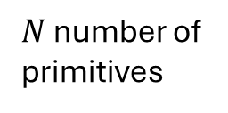
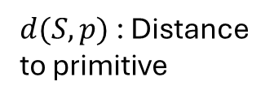



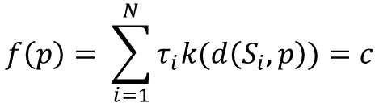
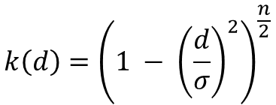
Skeleton based Implicit Surfaces
Implicit surfaces :
$$S= \left\{p ∈ℝ^{3}| f\left(p\right)=c\right\}$$
$N$ number of
primitives
$$f\left(p\right)= \sum_{i=1}^{N}{τ_{i}k(d\left(S_{i}, p\right))}=c$$
Blob:
$d(S, p)$: Distance
to primitive
$τ$: radius control
$c$: target iso value
Kernel :
$$k\left(d\right)={\left(1 − {\left(\frac{d}{σ}\right)}^{2}\right)}^{\frac{n}{2}}$$
Inverse :
$k\left(d\right)= \frac{1}{{\left(\frac{d}{σ}\right)}^{n}}$
Polynomial :
Notes:
Blobs, downside : when adding lots of primitives in a small vicinity the potential add up creating unwanted bulges artifacts. To paliate this issue convolution potential where introduced.

Slide 11
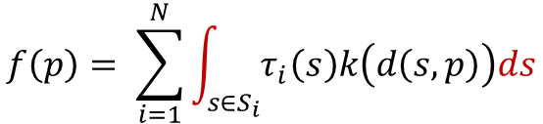
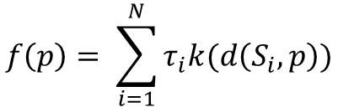
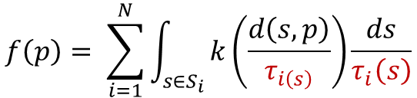
Background: Implicit Surfaces
$$f\left(p\right)= \sum_{i=1}^{N}{τ_{i}k(d\left(S_{i}, p\right))}$$
Blob:
$$f\left(p\right)= \sum_{i=1}^{N}{\int_{s∈S_{i}}{τ_{i}\left(s\right)k\left(d\left(s, p\right)\right)ds}}$$
Convolution:
$$f\left(p\right)= \sum_{i=1}^{N}{\int_{s∈S_{i}}{k\left(\frac{d\left(s, p\right)}{τ_{i\left(s\right)}}\right)\frac{ds}{τ_{i}\left(s\right)}}}$$
SCALIS:
Image courtesy of C. Zanni et al.
Notes:
Blobs, downside : when adding lots of primitives in a small vicinity the potential add up creating unwanted bulges artifacts. To paliate this issue convolution potential where introduced.

Slide 13
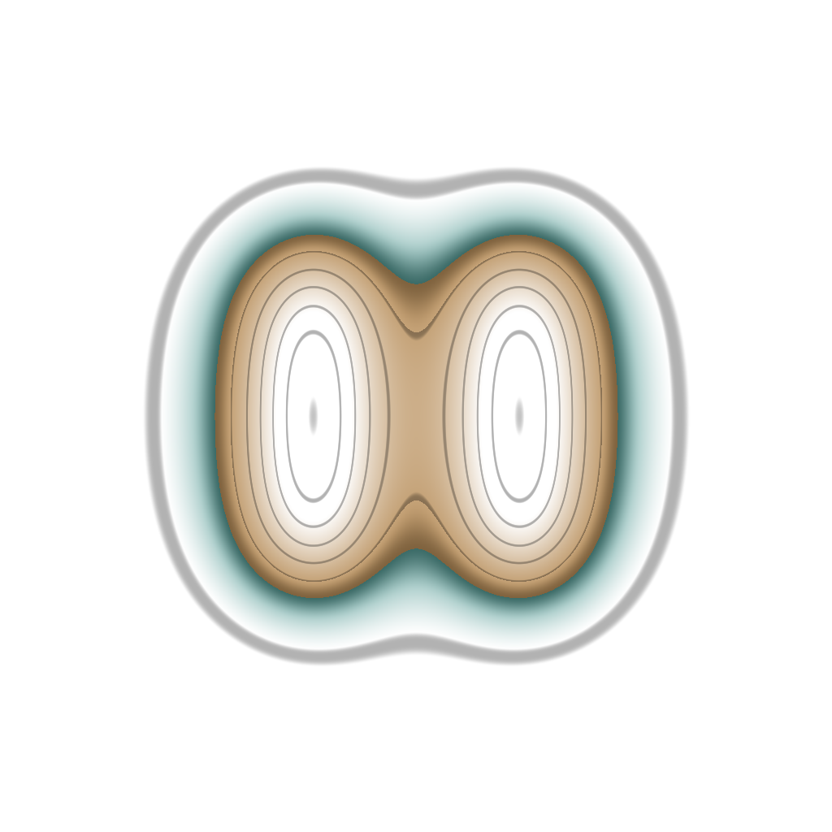
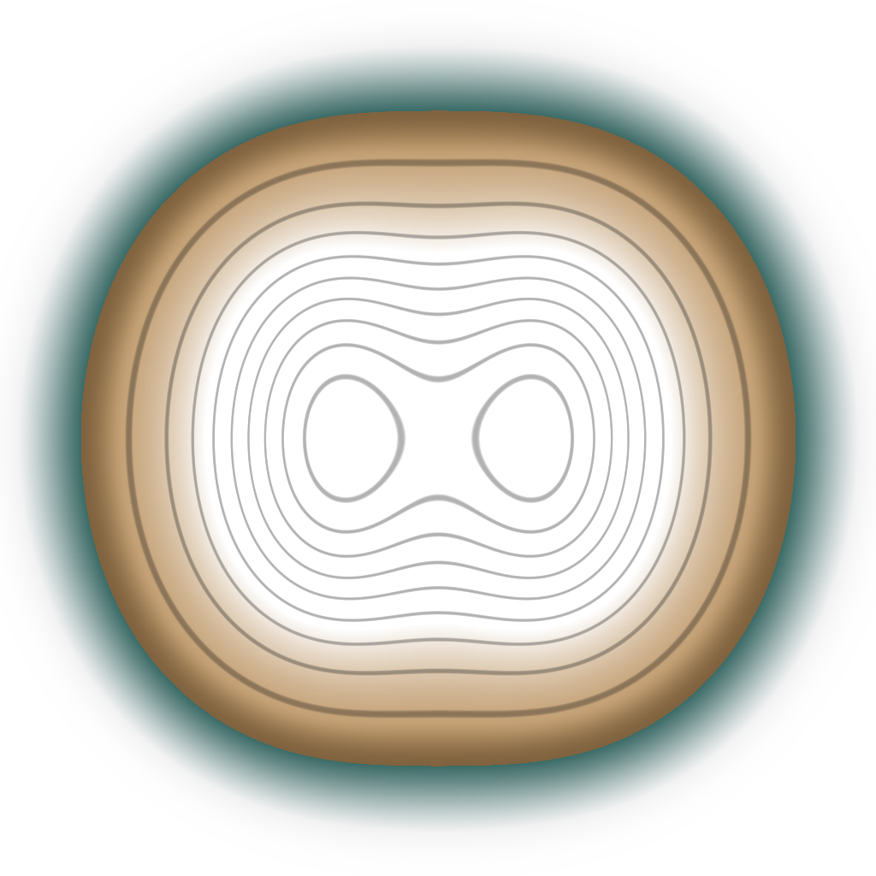
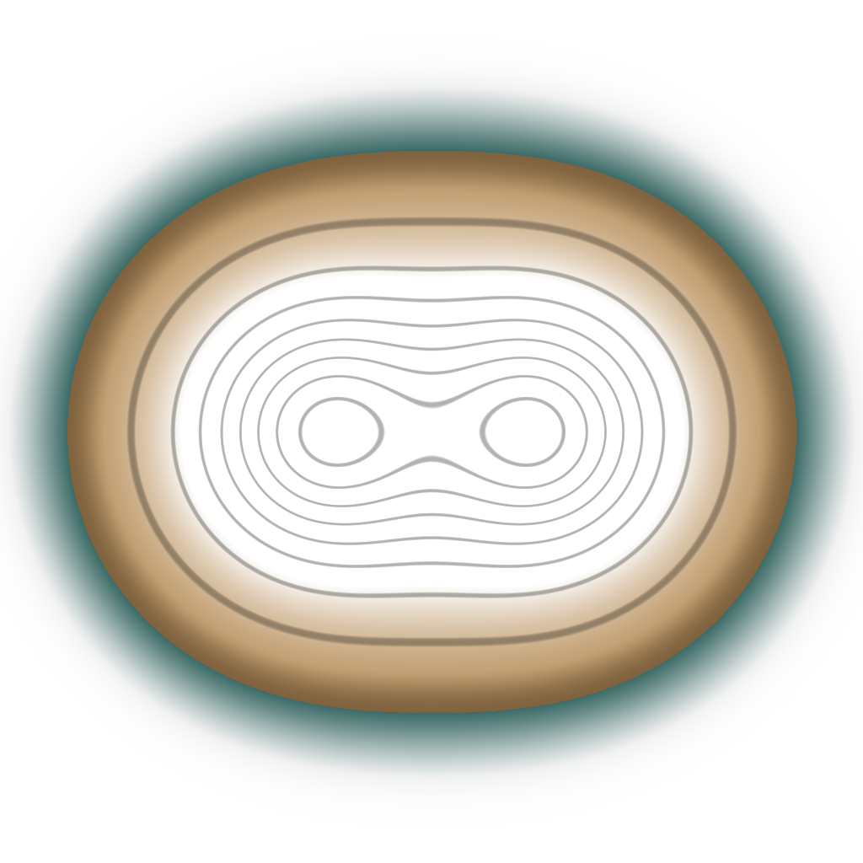
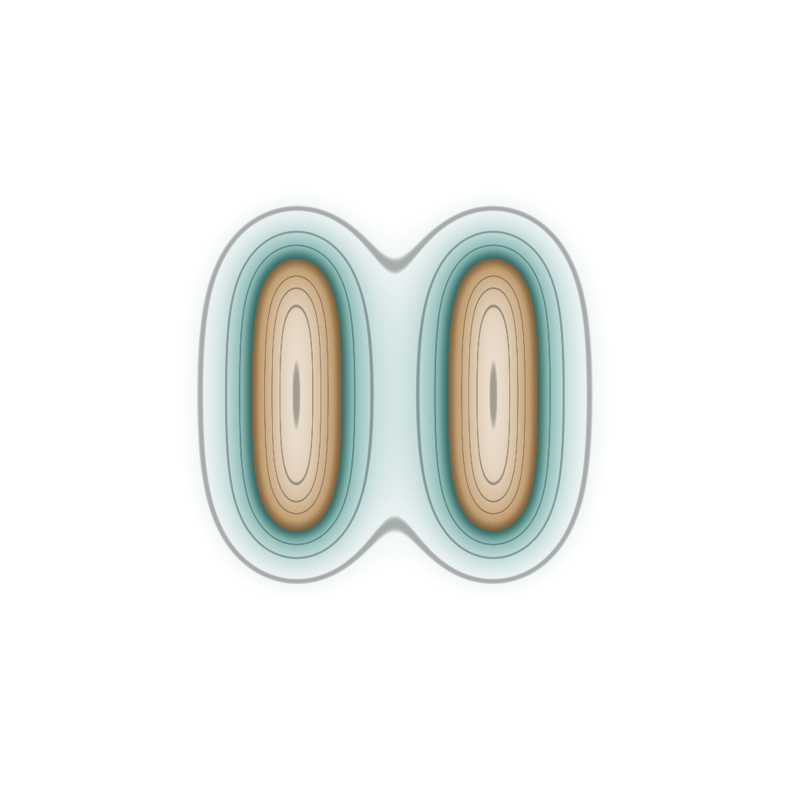
Main idea of our method
Three step algorithm:
1. Inflation
2. Skeleton Pruning
3. Deflation
Pruning
Inflation
Deflation
Notes:
And if we look closely, we can see that the deflated surfaces with points or segment are quite similar.

Slide 14
Main idea of our method
Three step algorithm:
1. Inflation
2. Skeleton Pruning
3. Deflation
Pruning
Inflation
Deflation
Notes:
And if we look closely, we can see that the deflated surfaces with points or segment are quite similar.

Slide 15
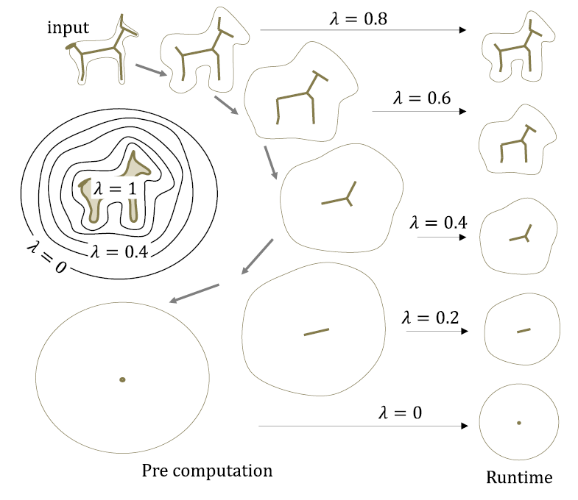
Level of Detail Parameter λ
Single scalar parameter λ ∈ [0, 1]
λ = 1: Original detailed shape
λ = 0: Fully simplified version
Steps:
  • Inflation(λ)
  • Pruning(λ)
  • Deflation(λ)
Notes:
Iso value and kernel width for Inflation
Deflation parameter for deflation
Dynamic skeleton for pruning

Slide 16
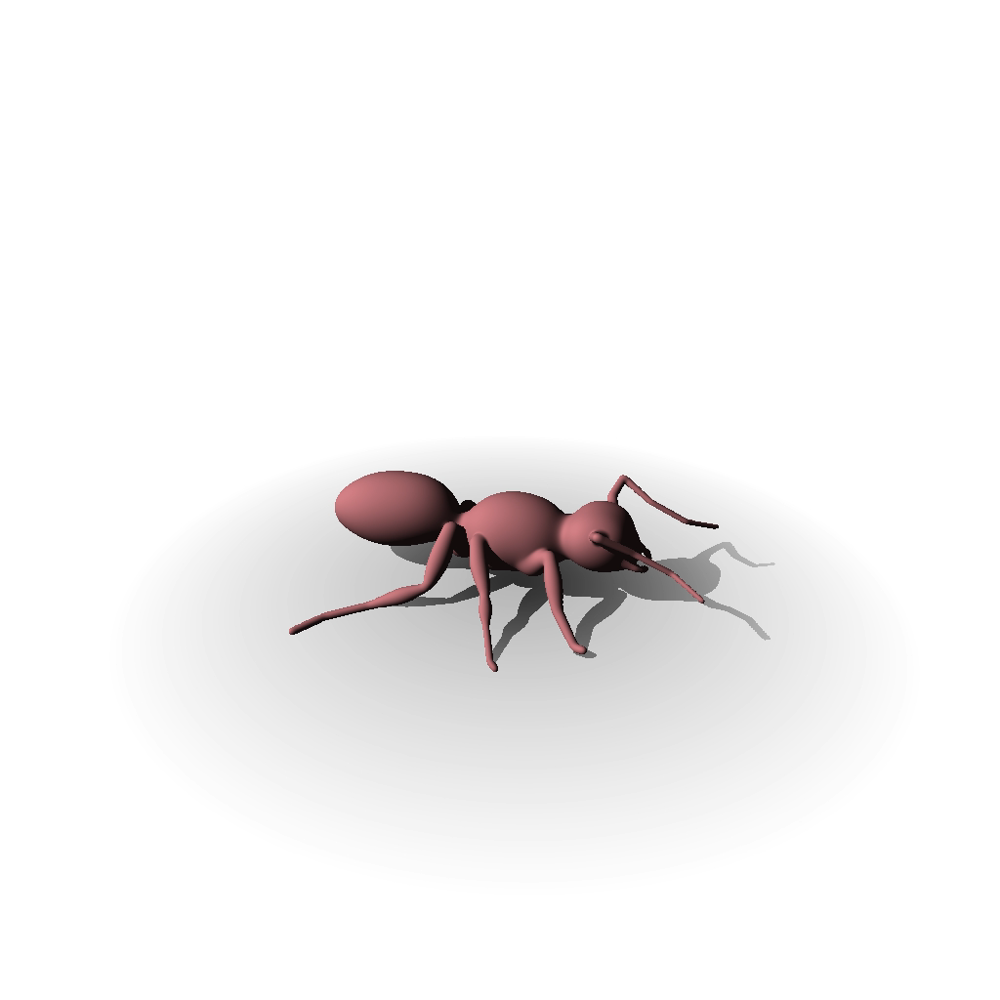



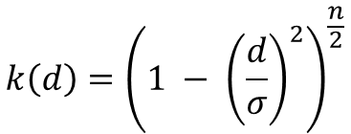
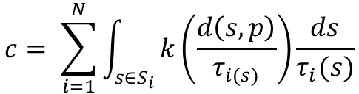

Step 1: Inflation
Modify both iso-value and kernel width to smooth details:
$$c= \sum_{i=1}^{N}{\int_{s∈S_{i}}{k\left(\frac{d\left(s, p\right)}{τ_{i(s)}}\right)\frac{ds}{τ_{i}(s)}}}$$
$$k\left(d\right)={\left(1 − {\left(\frac{d}{σ}\right)}^{2}\right)}^{\frac{n}{2}}$$
Reference iso value:
$$c^{∗}$$
Reference kernel width:
$$σ^{∗}$$
Inflated iso value:
$$c_{λ}=λc^{∗}$$
$$σ_{λ}=\frac{σ^{∗}}{λ}$$
Inflated kernel width:
Notes:
Jointly changing the targeted iso value

Slide 17
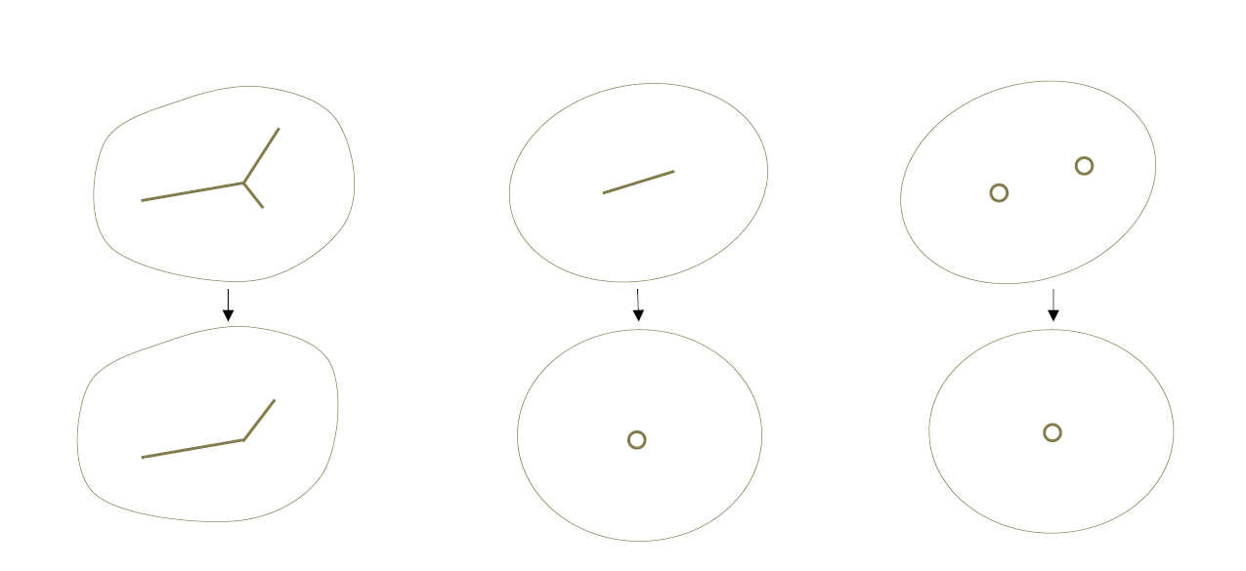


Step 2: Skeleton Simplification
Pruning operations
$$λ=1$$
$$λ=0$$
Deletion
Collapse
Merge

Slide 18
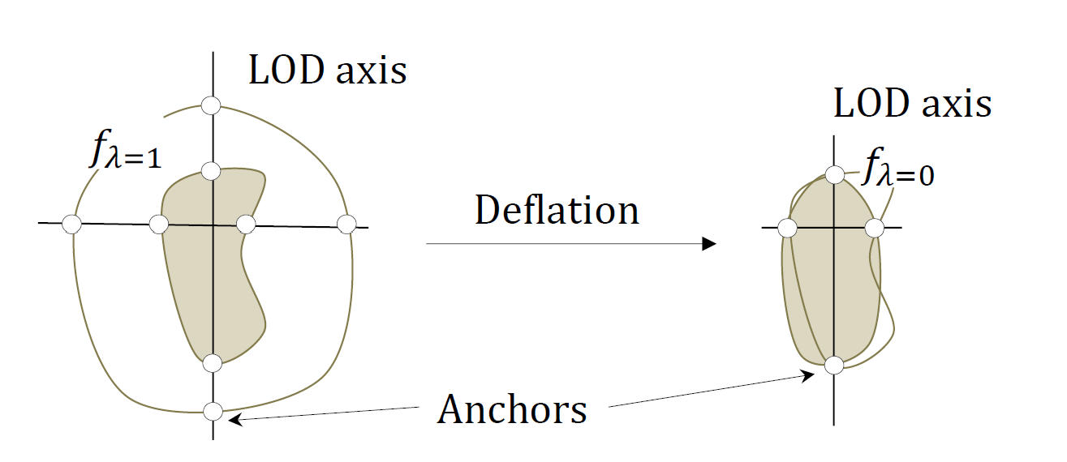
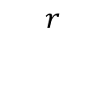
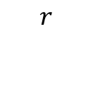
Step 3: Deflation
Uniform inflation increases volume AND distorts proportions
Solution:
Anisotropic downscaling using anchor points
$$r$$
$$r$$
Notes:
The inflation is not preserving the aspect ratio of the shape. To preserve it we introduce anchor points.

Slide 20
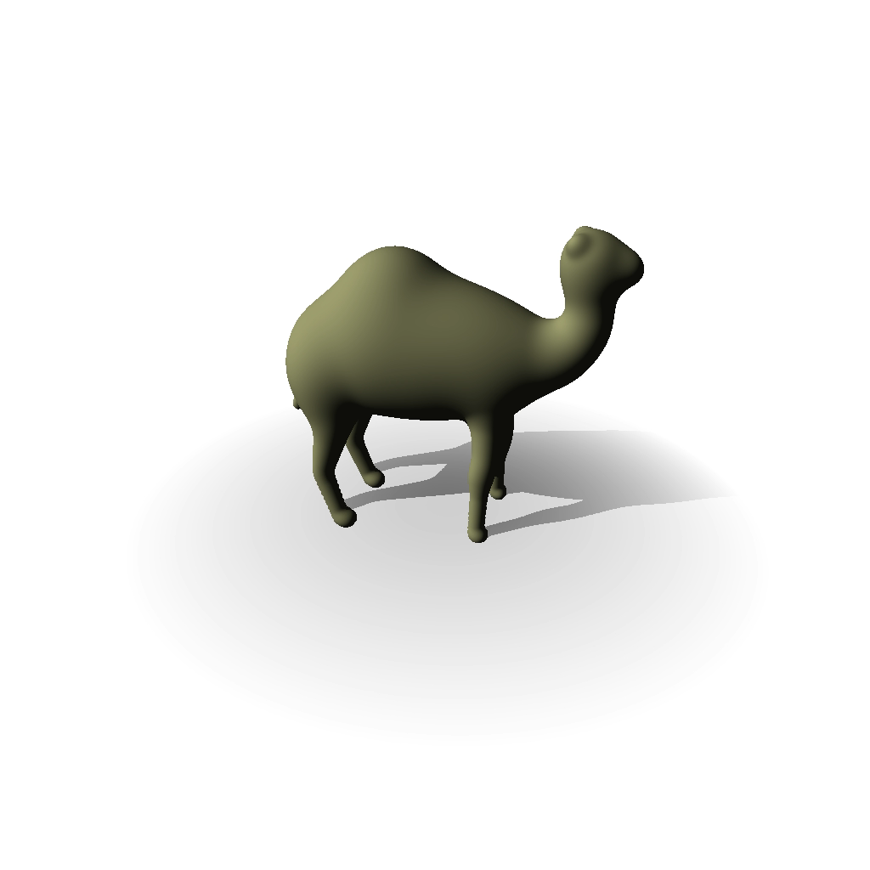
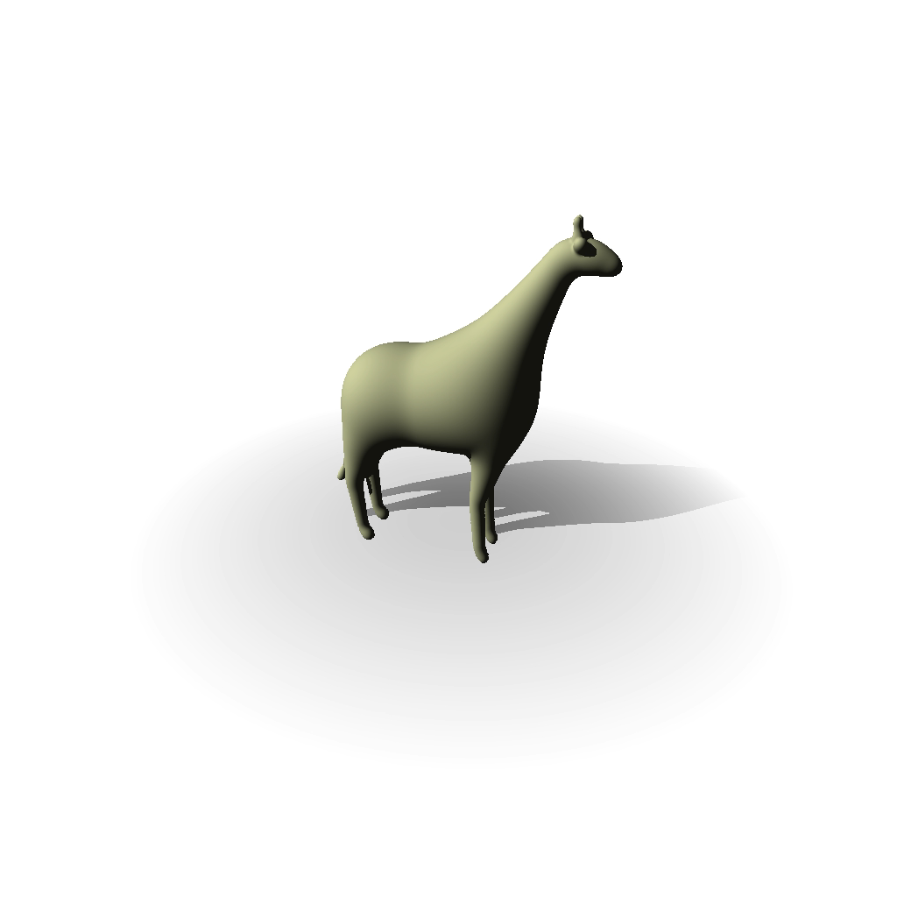
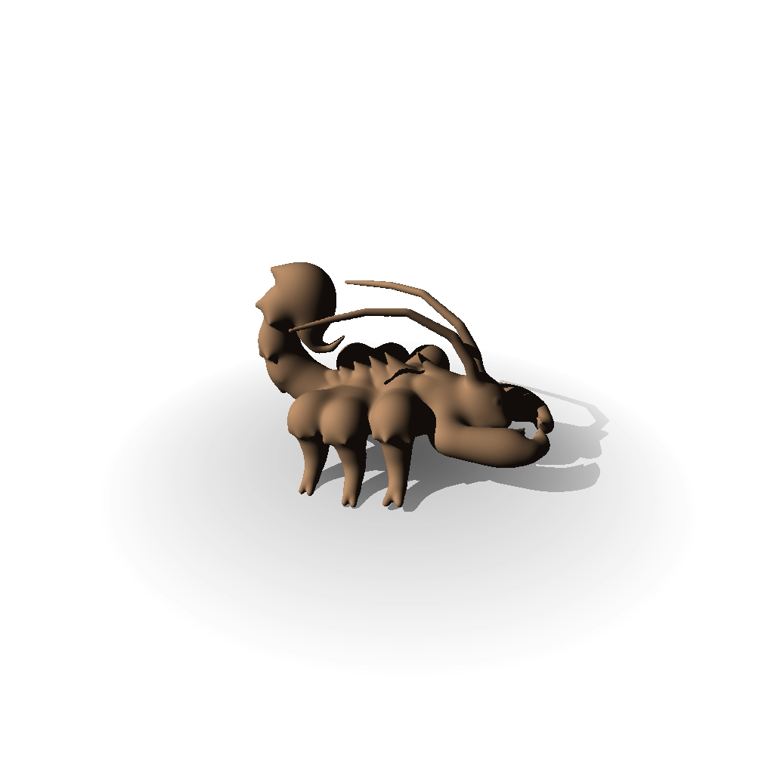
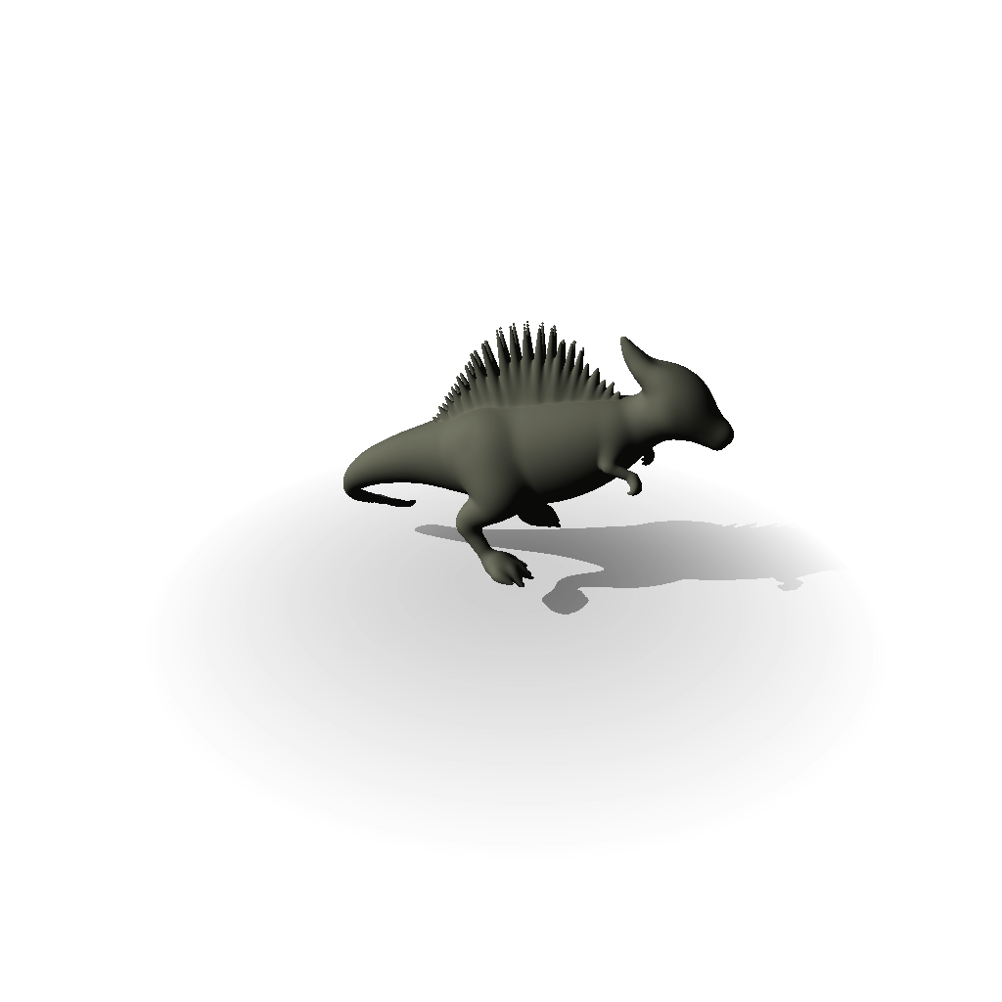

Performance Results
First extreme continuous Level of Detail method for convolution surfaces

Slide 21
Performance Results

Slide 22
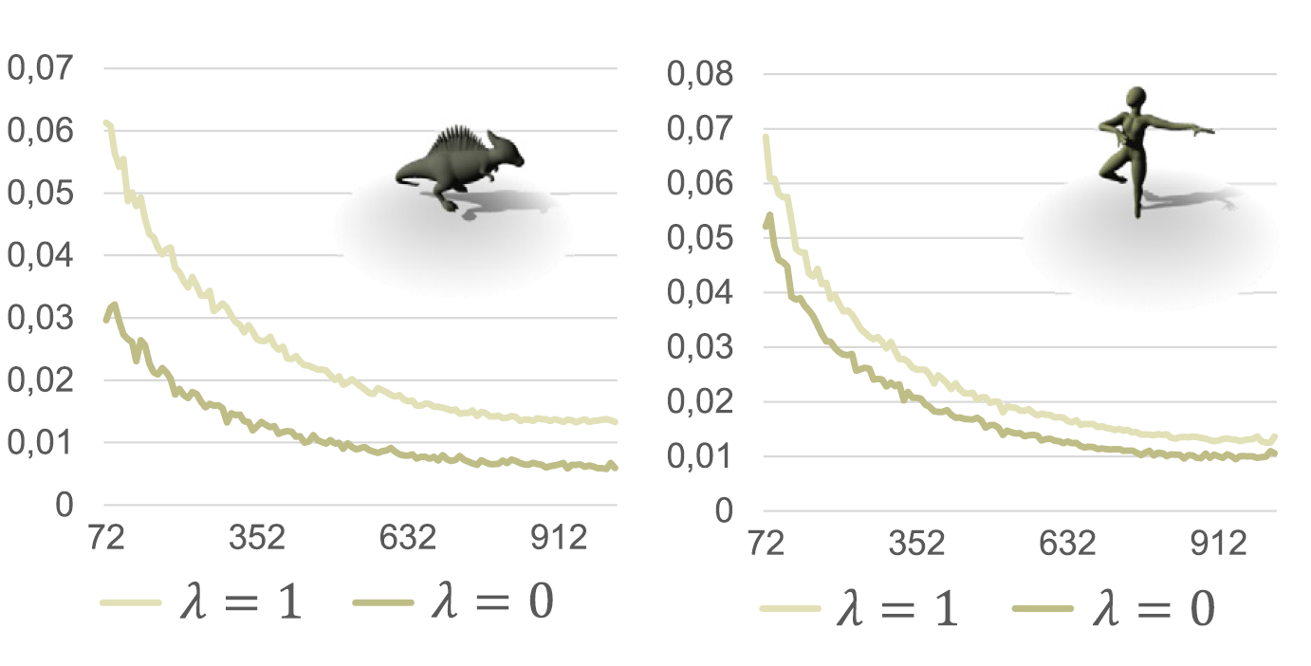
Aliasing Results
Aliasing reduction
Aliasing as a function of screen size in pixel.

Slide 24
Key Contributions
✓ First continuous LOD framework for SCALIS convolution surfaces
✓ 10-100× speedup while reducing aliasing artifacts
✓ Extreme simplification with topological flexibility

Slide 25
Limitations and future work
Spatial partitioning
  Surface inflation incompatible with bouding volume hierarchy.
Rigid shapes only
  Animation/deformation not currently supported du to the precomputations.

Slide 26
Thank You
Extreme Continuous Level of Detail for Skeleton-based Implicit Surfaces
Question time
SMI 2026

