Slide 1
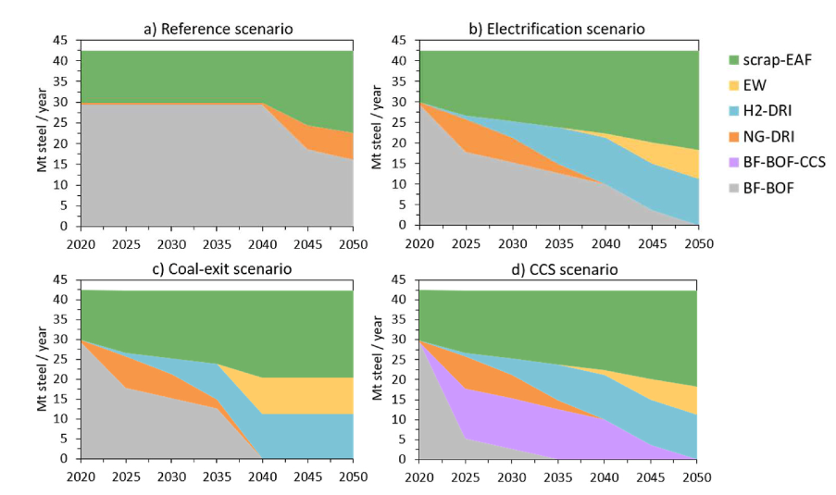
Carina Harpprecht, Tobias Naegler, Bernhard Steubing, Arnold Tukker, Sonja Simon,
Decarbonization scenarios for the iron and steel industry in context of a sectoral carbon budget: Germany as a case study,
Journal of Cleaner Production,
Volume 380, Part 2,
2022,
134846,
ISSN 0959-6526,
https://doi.org/10.1016/j.jclepro.2022.134846 .
(https://www.sciencedirect.com/science/article/pii/S0959652622044195)

Slide 2
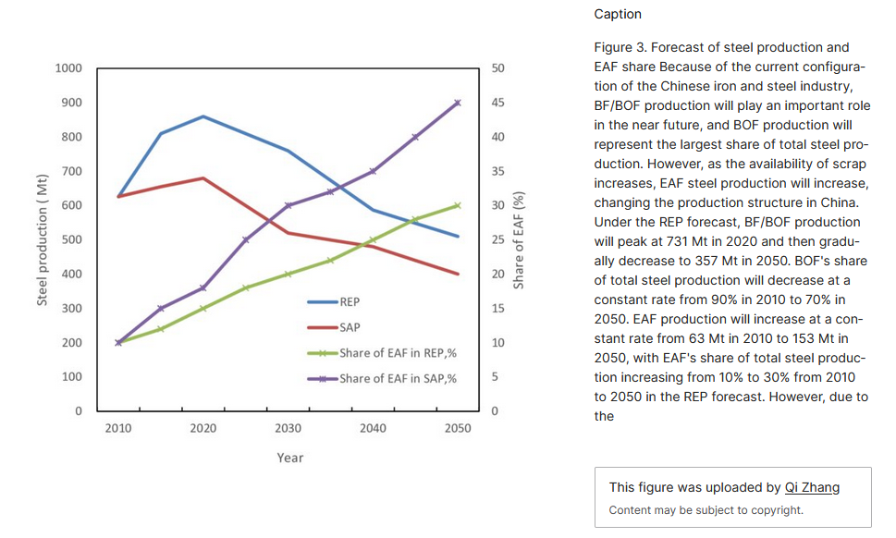
https://china.lbl.gov/publications/bottom-energy-efficiency-improvement

