Slide 1
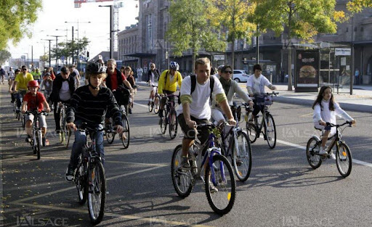
Python for Data Analysis
PETILLION Pierre ESILV S1 2021–2022

Slide 2
Sommary
I.
II.
III.
IV.
V.
VI.
Dataset
Problem
The Differents Variables
Data-Visualizations
The Differents Datasets
The Differents Models

Slide 3
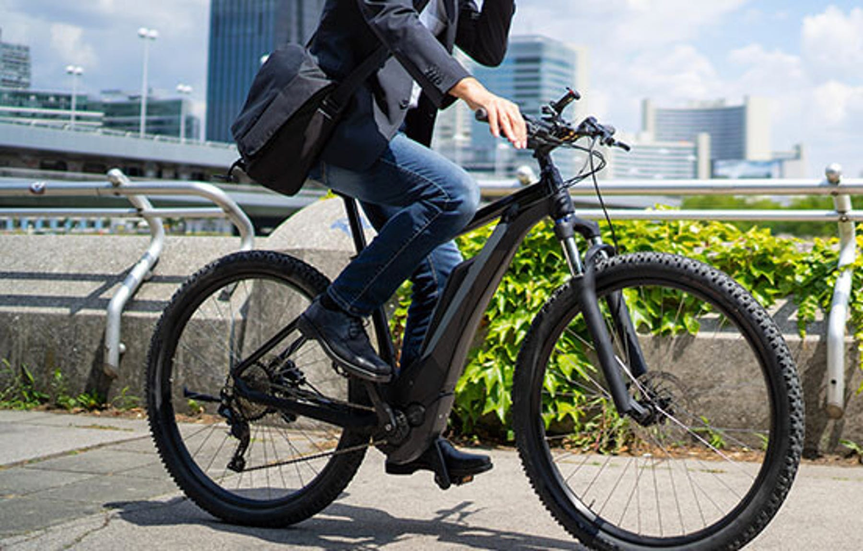
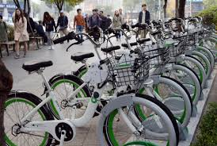
I. Dataset
The dataset contains count of public bikes rented at each hour in Seoul Bike haring System with the corresponding Weather data and Holidays information

Slide 4
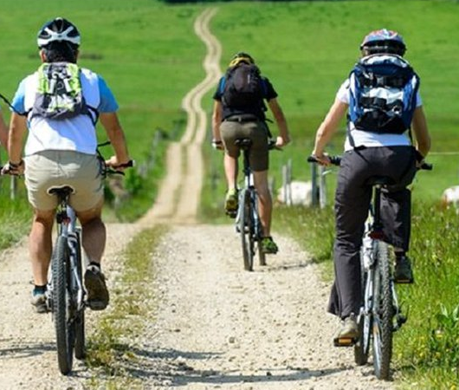
II. Problem
The crucial part is the prediction of bike count required at each hour for the stable supply of rental bikes.

Slide 5
III. The Differents Variables
The Dataset contains the following variables :
Date : year-month-day Rented Bike count - Count of bikes rented at each hour Hour - Hour of he day Temperature-Temperature in Celsius Humidity - % Windspeed - m/s Visibility - 10m Dew point temperature - Celsius Solar radiation - MJ/m2 Rainfall - mm Snowfall - cm Seasons - Winter, Spring, Summer, Autumn Holiday - Holiday/No holiday Functional Day - NoFunc(Non Functional Hours), Fun(Functional hours)

Slide 6
III. The Differents Variables
The news variables :
Split Date into 4 new variables (day, month, years and dayofweek)
Creation of a new variable Day of Week containing (Monday, …, Sunday)
Convert quantitative variables into qualitative ones

Slide 7
IV. Data-Visualizations
According to the above graphs the renting period starts in spring with a major period in summer and a rebound in October

Slide 8
IV. Data-Visualizations
Beside the morning and evening commutation hours people seem to enjoy cycling all the day long except in the early hours.

Slide 9
IV. Data-Visualizations
The graph above clearly an interest for cycling in Seoul between -1°C and 38°C witch is a quite large range of temperature.
We may notice that 23°C seems to be the optimum temperature

Slide 10
IV. Data-Visualizations
Friday is the most active day but we can observe the same peaks of use on commutation hours (8am, 6pm) every day even on sunday

Slide 11
IV. Data-Visualizations
We can conclude of the most higher rented bike possible is the Friday at 6pm during the summer whenthe temperature is of 23 degrees

Slide 12
V. The Differents Datasets
Creation of 5 différents Datasets of tests for see which one is the best :
Brut
Brut without years and the dew temperature columns
Drop variables with bad correlation
Scaling Visibility columns for try to reduce this pounds
Transform weather data columns into simple number

Slide 13
VI. The Differents Models
2 methods have very better R2 values
Lasso is the most speed execution
The best dataset is the n°2

