Slide 1
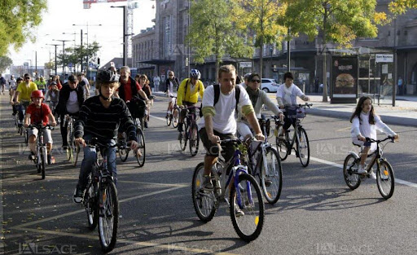
Python for Data Analysis
PETILLION Pierre ESILV S1 2021–2022

Slide 2
Sommary
I.
II.
III.
IV.
Dataset
Problem
The Different Variables
Context of the study

Slide 3
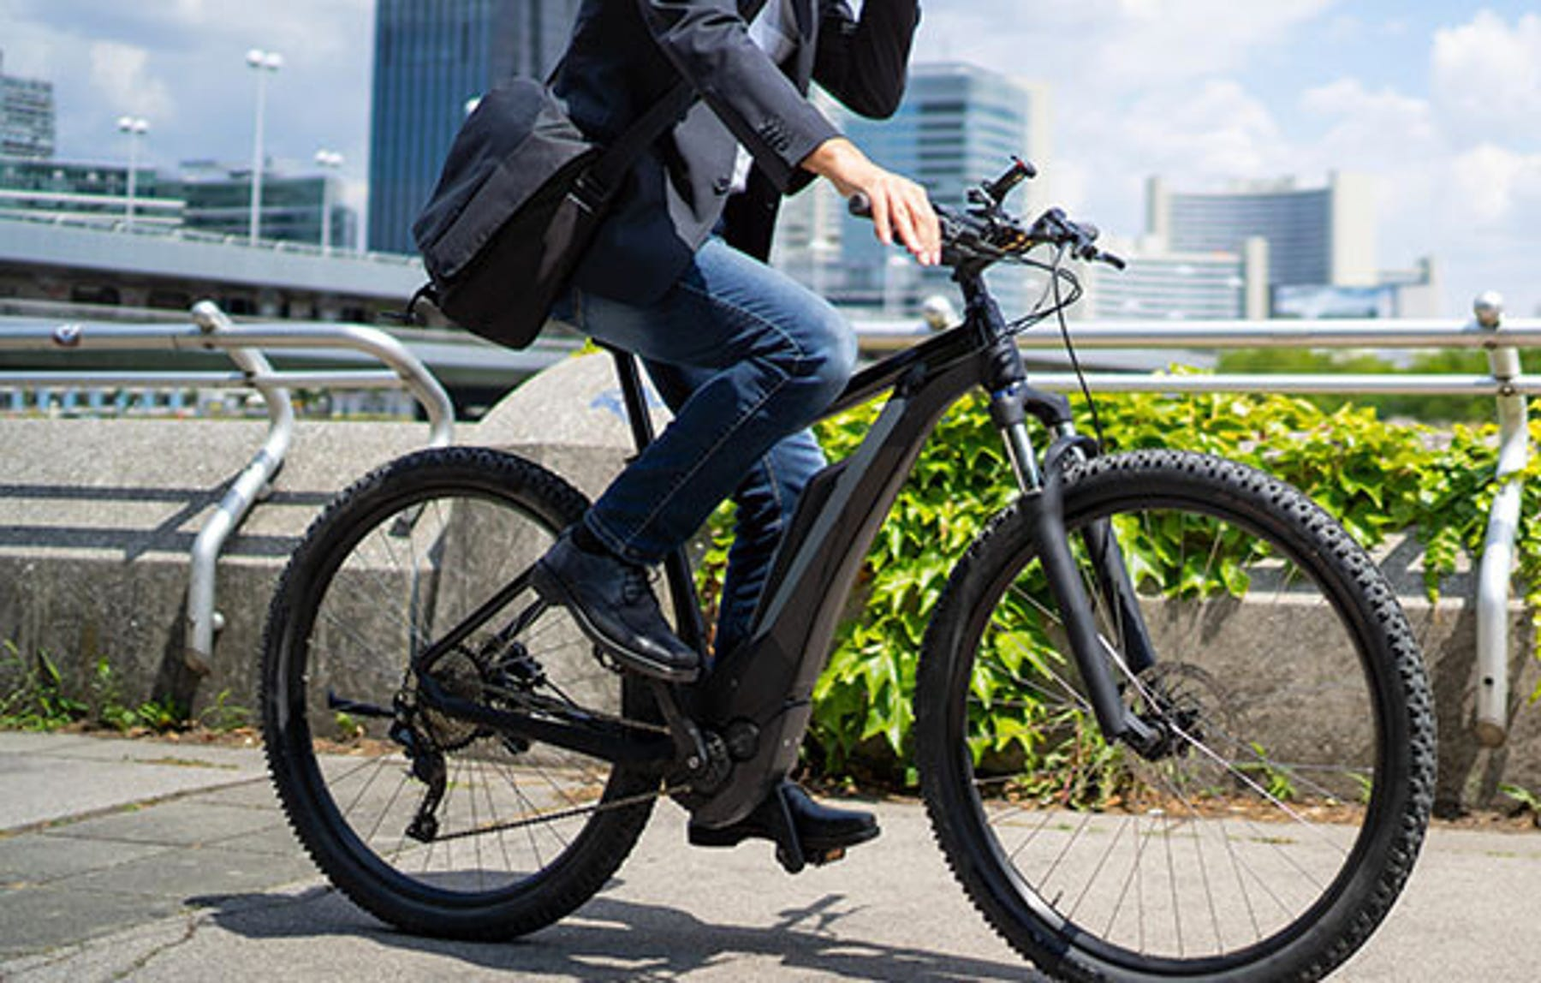
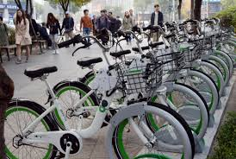
I. Dataset
The dataset contains count of public bikes rented at each hour in Seoul Bike haring System with the corresponding Weather data and Holidays information

Slide 4
II. Problem
The crucial part is the prediction of bike count required at each hour for the stable supply of rental bikes.

Slide 5
III. The Different Variables
The Dataset contains the following variables :
Date : year-month-day Rented Bike count - Count of bikes rented at each hour Hour - Hour of he day Temperature-Temperature in Celsius Humidity - % Windspeed - m/s Visibility - 10m Dew point temperature - Celsius Solar radiation - MJ/m2 Rainfall - mm Snowfall - cm Seasons - Winter, Spring, Summer, Autumn Holiday - Holiday/No holiday Functional Day - NoFunc(Non Functional Hours), Fun(Functional hours)

Slide 6
III. The Different Variables
The news variables :

Slide 7
IV. Context of the study

