Slide 1
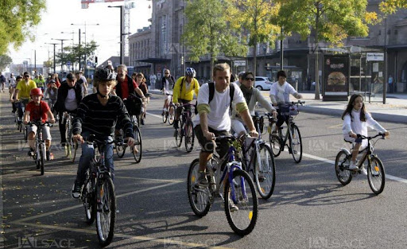
Python for Data Analysis
PETILLION Pierre ESILV S1 2021–2022

Slide 2
Sommary
I.
II.
III.
IV.
V.
VI.
Dataset
Problem
The Different Variables
Data-Visualizations
The Different Datasets
The Different Models

Slide 3
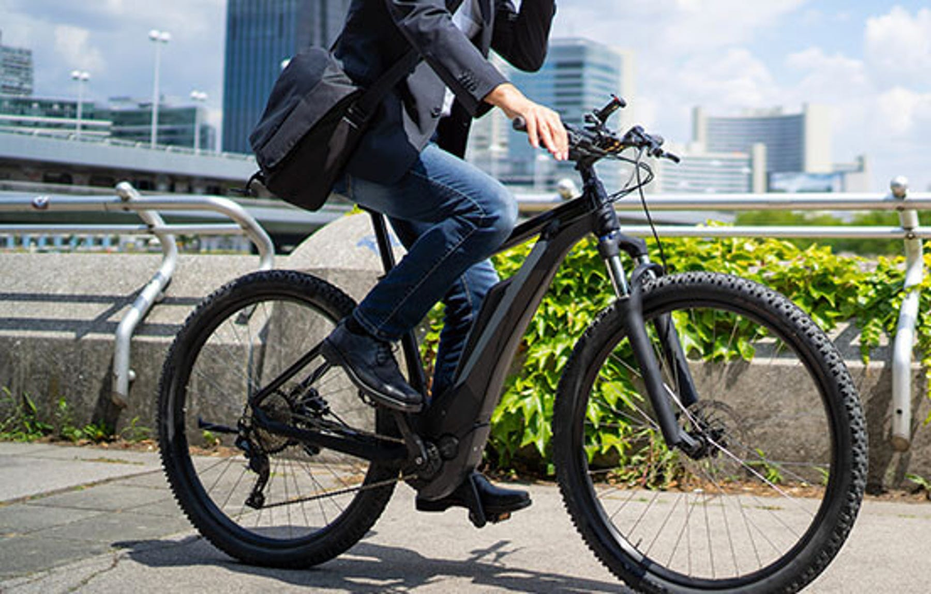
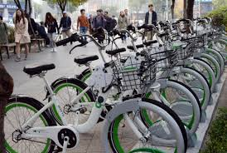
I. Dataset
The dataset contains count of public bikes rented at each hour in Seoul Bike haring System with the corresponding Weather data and Holidays information

Slide 4
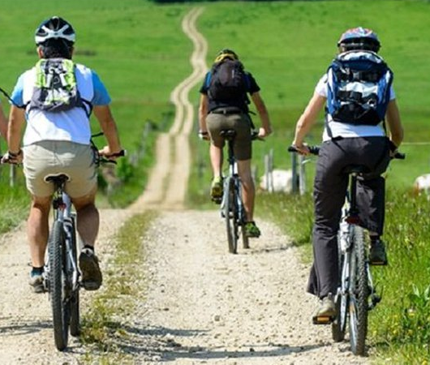
II. Problem
The crucial part is the prediction of bike count required at each hour for the stable supply of rental bikes.

Slide 5
III. The Different Variables
The Dataset contains the following variables :
Date : year-month-day Rented Bike count - Count of bikes rented at each hour Hour - Hour of he day Temperature-Temperature in Celsius Humidity - % Windspeed - m/s Visibility - 10m Dew point temperature - Celsius Solar radiation - MJ/m2 Rainfall - mm Snowfall - cm Seasons - Winter, Spring, Summer, Autumn Holiday - Holiday/No holiday Functional Day - NoFunc(Non Functional Hours), Fun(Functional hours)

Slide 6
III. The Different Variables
The news variables :
Split Date into 4 new variables (day, month, years and dayofweek)
Creation of a new variable Day of Week containing (Monday, …, Sunday)
Convert quantitative variables into qualitative ones

Slide 7
IV. Data-Visualizations
According to the above graphs the renting period starts in spring with a major period in summer and a rebound in October

Slide 8
IV. Data-Visualizations
Beside the morning and evening commutation hours people seem to enjoy cycling all the day long except in the early hours.

Slide 9
IV. Data-Visualizations
The graph above clearly an interest for cycling in Seoul between -1°C and 38°C witch is a quite large range of temperature.
We may notice that 23°C seems to be the optimum temperature

Slide 10
IV. Data-Visualizations
Friday is the most active day but we can observe the same peaks of use on commutation hours (8am, 6pm) every day even on sunday

Slide 11
IV. Data-Visualizations
Seoul people first use bikes rented for going to work and coming back home
The busiest hour is obviously 6pm on a Friday when the temperature is around 23°C during summer

Slide 12
V. The Different Datasets
Creation of 5 différent datasets for checking which one is the best :
Raw
Raw without years and the dew temperature columns
Dropping variables with bad correlation
Scaling Visibility columns for trying to reduce this pound
Converting weather data into simple numbers

Slide 13
VI. The Different Models
Linear Regression is the fastest model
The best dataset is the number 2
Bagging is providing the best r2 accuracy

