Slide 1
Module 646, GIS-Python option
Camping project
the 12th of June 2020
Pierre ANKEN, Montaine BURGER &
Nghi TRAN
Notes:
1
1
1
1

Slide 2
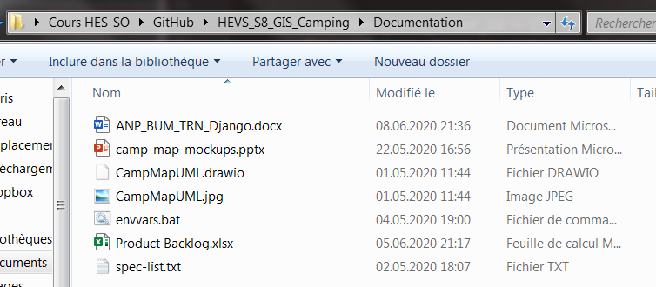
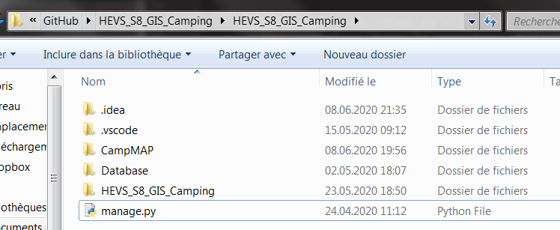
Structure of the project
Link of the Github repository: https://github.com/PierreAnken/HEVS_S8_GIS_Camping
Two separate directories: one for the documentation (all the files concerning the project progress) and one for the Django application
Structure > Setup > Design > Authentication > GIS

Slide 3
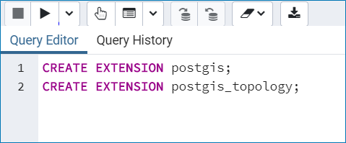
Local database
Use of pgAdmin to create the database: https://www.pgadmin.org/
Creation of an admin user:
name = admin
password = adminPWD
Privileges = can login + superuser
Creation of the database with PostGIS enabled
Structure > Setup > Design > Authentication > GIS

Slide 4

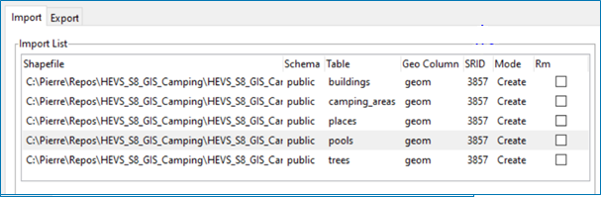
Importation of the shapes
Use of the PostGIS tool for the shapefiles
We changed the names of the tables + important to use the 3857 SRID
Structure > Setup > Design > Authentication > GIS

Slide 5
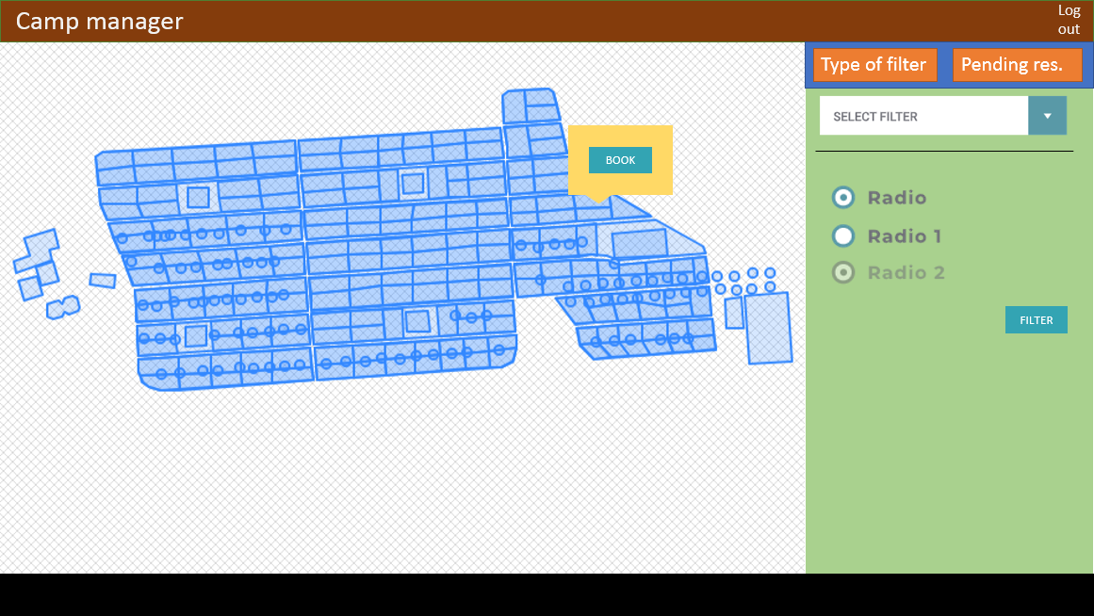
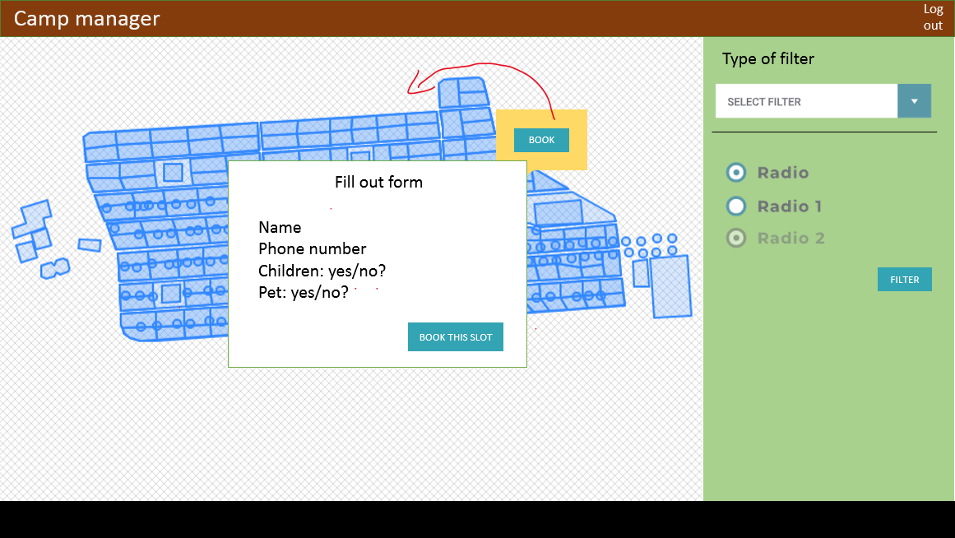
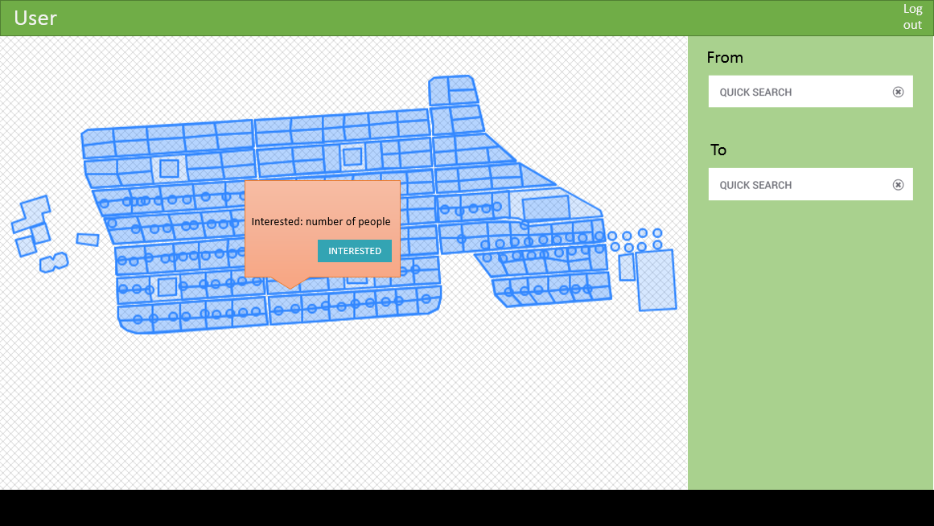
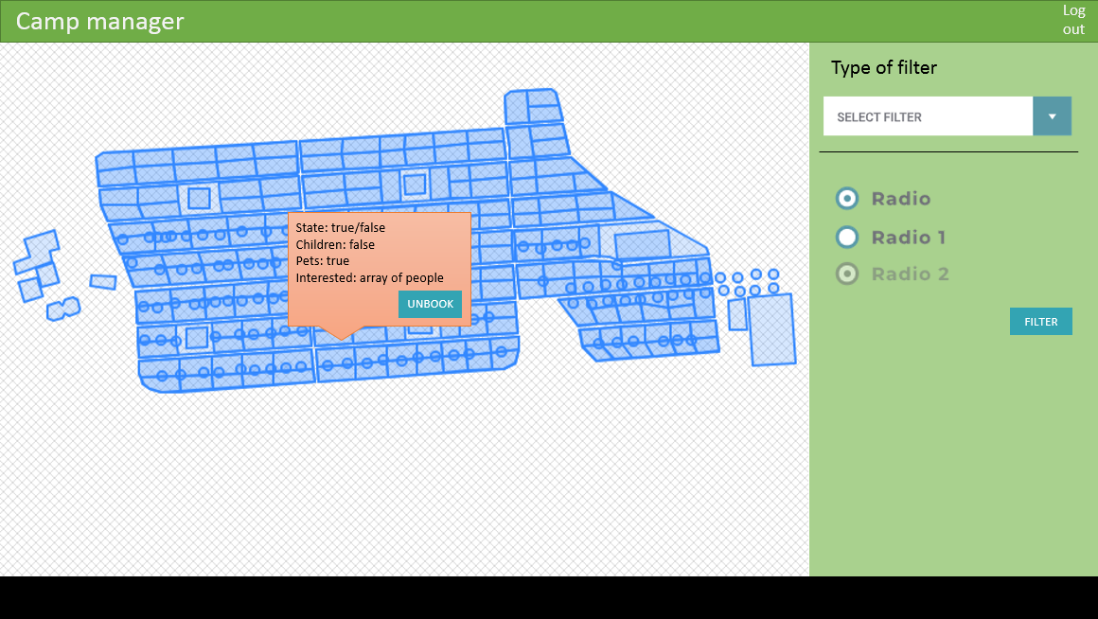
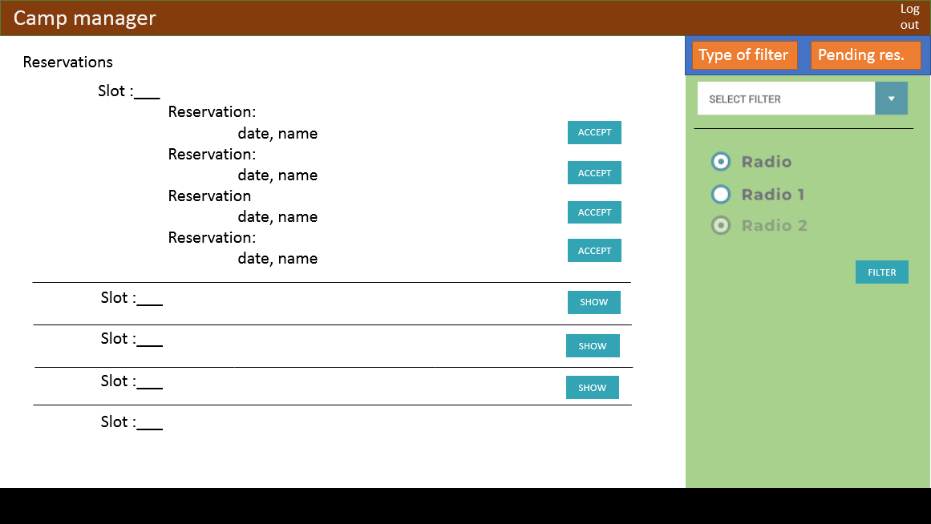
Mockups
First Teams meetings: dedicated to design the project and define the product backlog
Structure > Setup > Design > Authentication > GIS

Slide 6

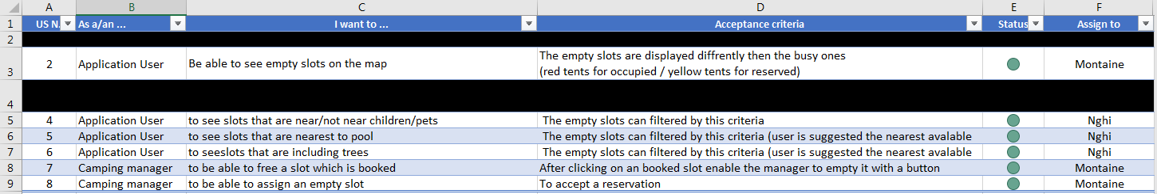
Product Backlog
Structure > Setup > Design > Authentication > GIS

Slide 7
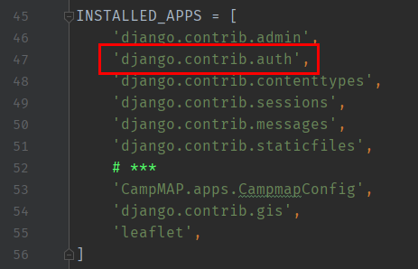
Integrated module
Our wish: manage camper and manager roles
The manager is created from the admin console
> python manage.py createsuperuser
The users can create their account from the frontend of the application
Use of the module proposed by Django: django.contrib.auth
Structure > Setup > Design > Authentication > GIS

Slide 8
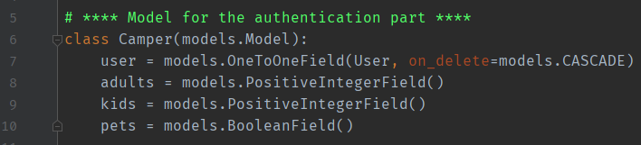
Custom user model
The Camper inherits from the base Django User
allows us to use the basic authentication features + add custom fields
Structure > Setup > Design > Authentication > GIS

Slide 9
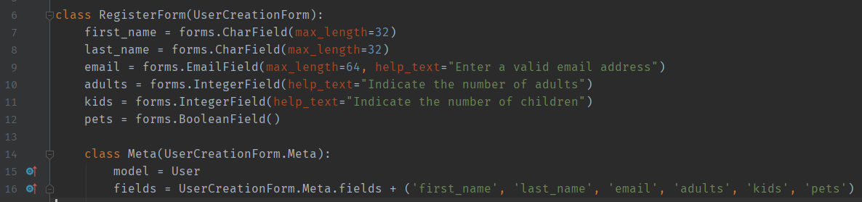
Custom registration form
To save these new added fields: rewriting of the basic registration form
Then: ability to create the registration form on the front end
Structure > Setup > Design > Authentication > GIS

Slide 10
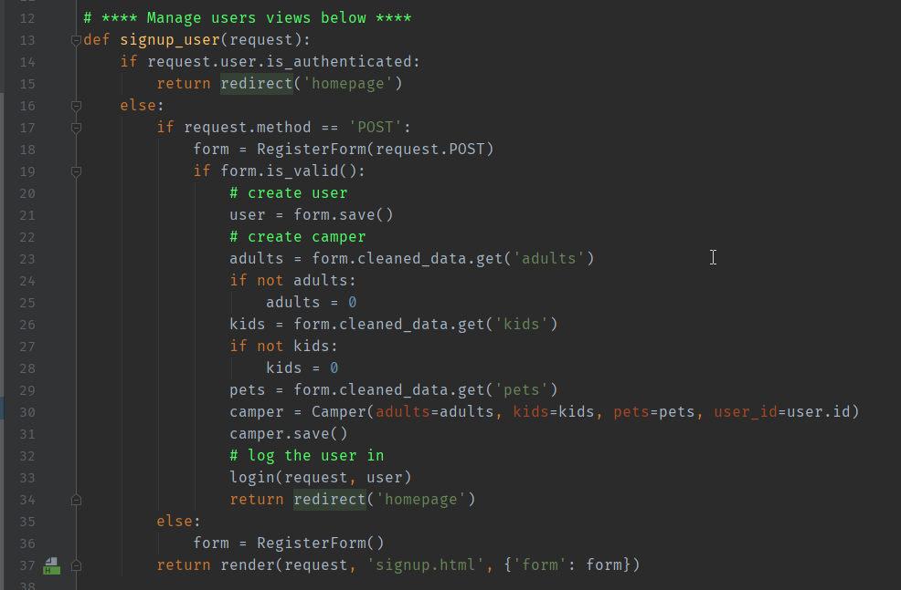
Custom registration form
We are now able to save new registrations by creating linked user and camper
Structure > Setup > Design > Authentication > GIS

Slide 11
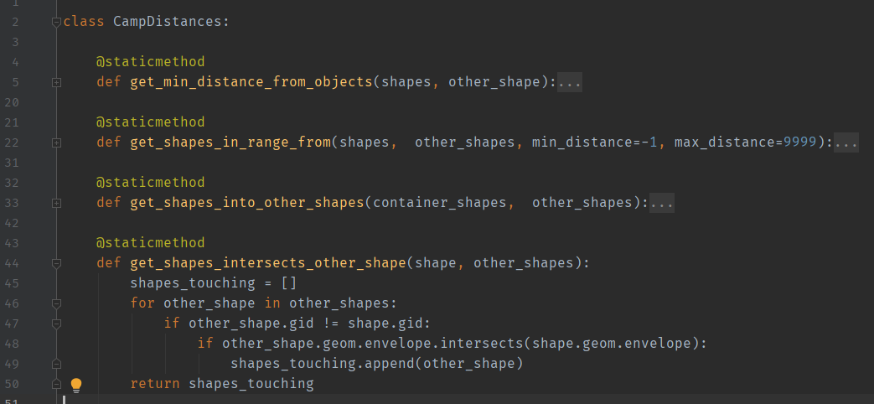
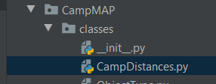
Our toolbox
A .py file that serves as a toolbox (all the classes used to manipulate and perform all the geographic functions + display of the shapes)
Structure > Setup > Design > Authentication > GIS

Slide 12
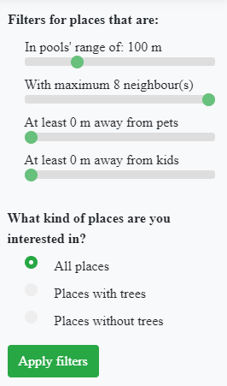
Use of the filters
We implemented 4 filters:
Pool filter – selected range
Neighbor filter – places right next to it
Pet and children filters – meters away from pets/children
Tree filter – trees inside the slot
With these, the campers are able to find the perfect place for them!
Structure > Setup > Design > Authentication > GIS

Slide 13

Demo of the application

Slide 14
 Thank you for your attention 

