Slide 1
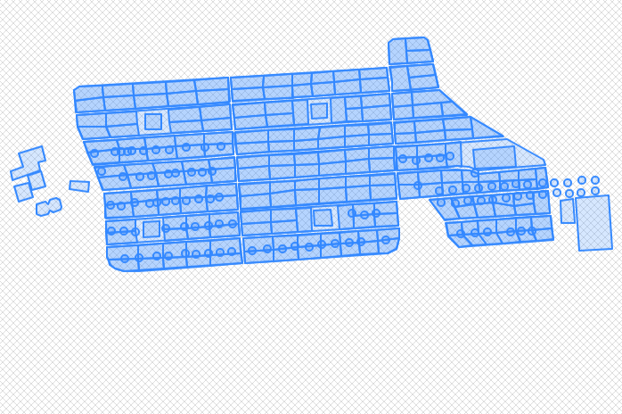

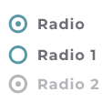

Camp manager
Log out
Type of filter
State: true/false
Children: false
Pets: true
Interested: array of people
UNBOOK
FILTER
Notes:
The menu below changes depending on what filter is used
Results will always be empty slots
Filter available:
No filter (just find empty slots) => Menu blank
By group (2-3 slots that are together and empty) => Radio button 2 or 3
Near children/ near pet => 2 sets of radio : near/not near (exclusive), children/pet (inclusive, can select both)
Near pool/tree => 2 radios pool/trees

Slide 2
Camp manager
Log out
Reservations
Type of filter
Pending res.
Slot :___
Reservation:
date, name
Reservation:
date, name
Reservation
date, name
Reservation:
date, name
ACCEPT
ACCEPT
ACCEPT
ACCEPT
FILTER
Slot :___
SHOW
Slot :___
SHOW
Slot :___
SHOW
Slot :___
Notes:
Pending reservation:
Table sorted by slot
Each slot: reservation ordered by date

Slide 3

User
Log out
From
To
Interested: number of people
INTERESTED
Notes:
Search path by entering from-to (entrance – slot XY)/ (entrance-pool)

Slide 4


Camp manager
Log out
Type of filter
BOOK
Fill out form
Name
Phone number
Children: yes/no?
Pet: yes/no?
FILTER
BOOK THIS SLOT
Notes:
The menu below changes depending on what filter is used
Results will always be empty slots
Filter available:
No filter (just find empty slots) => Menu blank
By group (2-3 slots that are together and empty) => Radio button 2 or 3
Near children/ near pet => 2 sets of radio : near/not near (exclusive), children/pet (inclusive, can select both)
Near pool/tree => 2 radios pool/trees

Slide 5
Camp manager
Log out
Type of filter
Pending res.
BOOK
FILTER
Notes:
The menu below changes depending on what filter is used
Results will always be empty slots
Filter available:
No filter (just find empty slots) => Menu blank
By group (2-3 slots that are together and empty) => Radio button 2 or 3
Near children/ near pet => 2 sets of radio : near/not near (exclusive), children/pet (inclusive, can select both)
Near pool/tree => 2 radios pool/trees

