Slide 1

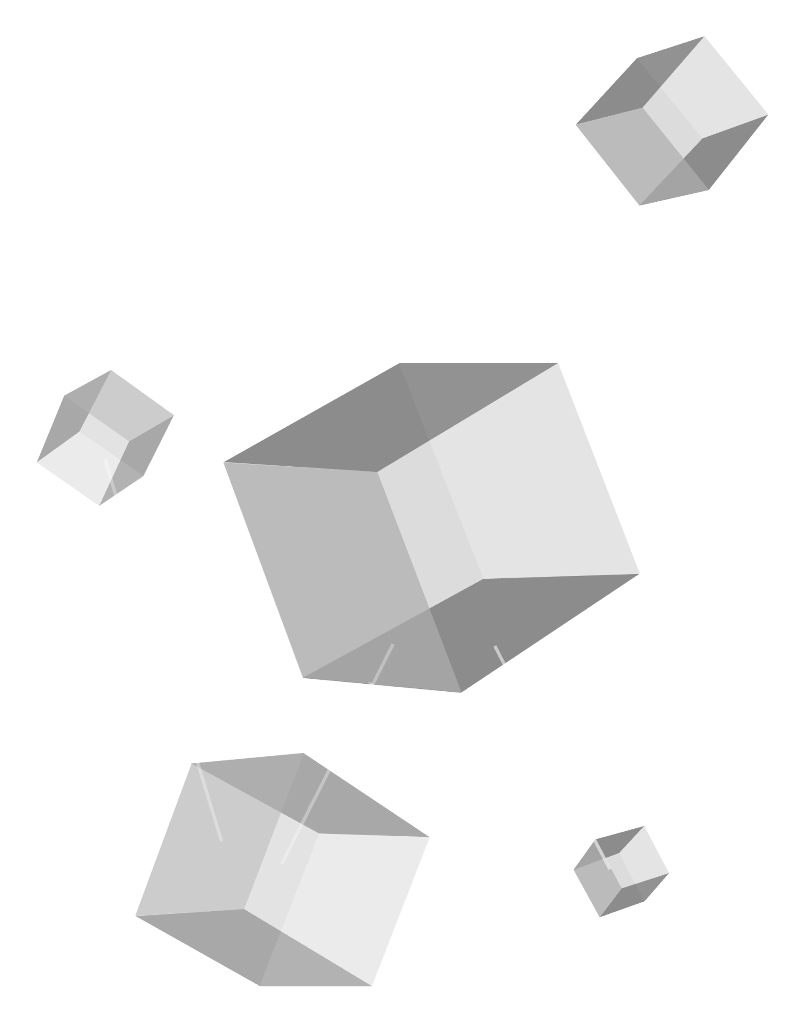


BLOCKCHAINS
AND
DISTRIBUTED LEDGERS
A technical report by Pierre Badra

Slide 2

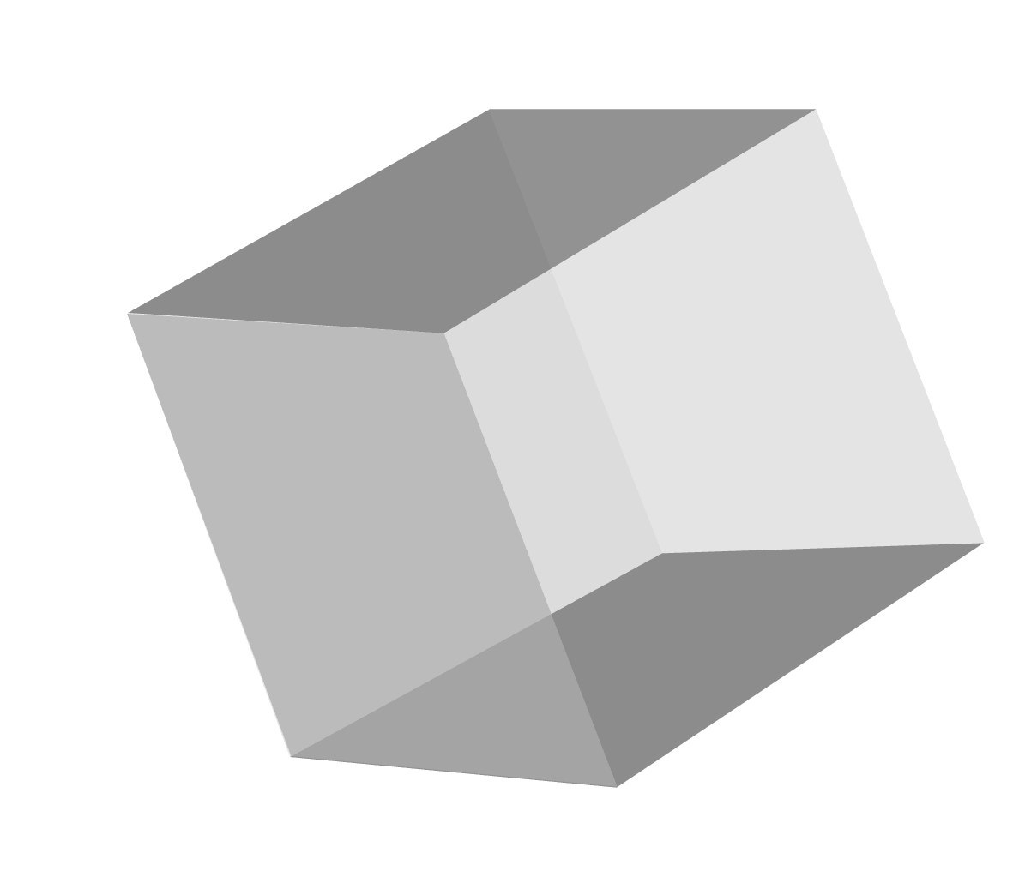
AGENDA
1. Definitions and Key Concepts
01
04
2. Overview
3. Technical Overview
4. Example / Use Case
02
4
5. Conclusion
03

Slide 3
DEFINITIONS AND KEY CONCEPTS
Block: A data structure within a blockchain that records transactions. Each block contains a hash that links it to the previous block, ensuring the chain's integrity.
Hash: An alphanumeric string assigned to a block based on its timestamp, used to link blocks together.
Immutability: The inability to change or tamper with a transaction once it's recorded on the blockchain. If there's an error, a new transaction is added to reverse it.
Consensus: A computational process to validate a block's authenticity before adding it to the chain. Most nodes on the blockchain network must agree that the new block's hash has been calculated correctly.
Peer-to-Peer (P2P) Network: A decentralised network where participants (peers) can interact directly with each other without needing a central authority.

Slide 4
DEFINITIONS AND KEY CONCEPTS (cont.)
Mining: The process of solving complex cryptographic equations to create new blocks on a public blockchain network, often associated with cryptocurrency. Miners earn cryptocurrency in exchange for this computational work.
Public Key Cryptography: A security feature that uses a pair of keys (public and private) to uniquely identify participants and secure transactions on the blockchain network.
Node: A computer within the blockchain network that maintains a copy of the ledger.

Slide 5
OVERVIEW
- A distributed ledger is a synchronized database that is shared and maintained across multiple computers (nodes) in different locations, with no central administrator or data storage
- Unlike traditional databases, every participant (node) in the network has an identical copy of the ledger that is updated and validated independently
- Changes to the ledger require consensus among participants using mathematical verification methods, making the system highly secure and tamper-resistant
- Once data is recorded, it becomes permanent and immutable - previous entries cannot be altered without detection by other nodes in the network
- Best known implementation is blockchain technology, but distributed ledgers can exist without using a chain of blocks (e.g., directed acyclic graphs)

Slide 6
WHY IS IT WORTH DISCUSSING?
- Traditional systems rely on trusted intermediaries (banks, governments) to verify transactions, creating bottlenecks and single points of failure
- Distributed ledgers eliminate the middleman, reducing costs and processing time while increasing security through decentralization
- Trust is built into the system through mathematics and cryptography rather than depending on institutions or individuals
- Enables new business models and applications that weren't possible before, from cross-border payments to automated supply chain tracking
- Particularly valuable in regions with limited access to traditional financial services or where trust in institutions is low

Slide 7
UNDERLYING TECHNOLOGIES
Cryptography: Uses advanced cryptographic techniques including hash functions and digital signatures to secure transactions and verify authenticity
Consensus Mechanisms: Protocols like Proof of Work or Proof of Stake that allow all nodes to agree on the state of the network
Peer-to-Peer Networking: Enables direct communication between participants without intermediaries, using protocols for node discovery and data synchronization
Public/Private Key Infrastructure: Allows users to securely own and transfer assets using cryptographic key pairs
Smart Contracts: Self-executing code that automatically enforces rules and agreements stored on the ledger

Slide 8
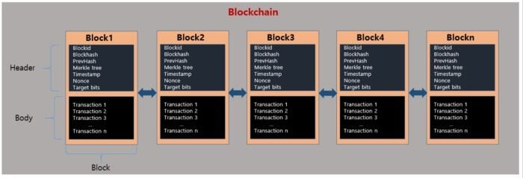
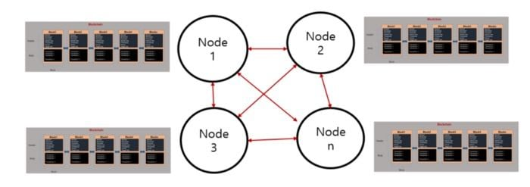
INFRASTRUCTURE
Blocks
- Each block contains a header (technical data) and body (transactions)
- Headers store critical metadata: timestamps, difficulty levels, and cryptographic hashes
- Blocks link together through unique hash references, creating an unbreakable chain
Network Distribution
- Multiple nodes (computers) maintain identical copies of the entire chain
- Peer-to-peer connections enable direct communication between nodes
- No central point of control - network remains stable if some nodes fail
Data Structure
- Blocks are immutable - once added, data cannot be modified
- Each block connects to the previous one through cryptographic links
- Forms a complete, verifiable history of all transactions

Slide 9
BENEFITS
- Distributed ledgers improve efficiency and accuracy by eliminating duplicates and reducing reconciliation efforts
- Peer-to-peer validation removes intermediaries, enabling direct verification via cryptographic consensus
- Smart contracts automate complex transactions, reducing processing time and human error
- Lowers costs by eliminating intermediaries and enabling direct peer-to-peer transactions
- Transparent ledgers provide a verifiable, auditable record accessible to authorized participants.
- Cryptographic chaining and consensus ensure immutability, preventing financial fraud

Slide 10
CHALLENGES
- Proof of Work (PoW) consensus is not scalable
- More nodes slow down transaction validation
- Reduced transaction throughput and longer confirmation times
- Smaller networks may have exploitable weaknesses
- Code-based security can introduce risks
- Standardized protocols are still evolving
- Increased risk of fraudulent applications
- Requires specialized knowledge for proper implementation
- Companies must carefully evaluate these challenges before adoption

Slide 11
FUTURE OUTLOOK
- Ongoing efforts to overcome current limitations
- Scaling solutions through on- and off-chain modifications
- Bridges between blockchain networks (e.g., Blockstream)
- Enhanced security with smart contract checkers & quantum resilience
- Greater adoption across industries
- Research on blockchain’s impact in governance, business, finance, and IoT
- Increased investment from academic institutions, governments, and businesses
- Advancements in security, privacy, scalability, and interoperability
- Expansion into new applications beyond current use cases

Slide 12

USE CASE
- Walmart partnered with IBM in 2021 to improve data tracking and management
- Blockchain used to track meat and poultry products for food quality assurance
- Tracks information between farmers, brokers, distributors, and retailers
- Consumers can easily trace product origins with transparent, trusted data
- Lessons learned
- Understand the business case before implementation
- Let the business lead the project, not just technical experts
- Start small and scale gradually
- Results
- Traced over 25 products from 5 suppliers
- Expanding the system to more products and categories
- Requiring fresh leafy greens suppliers to trace products using blockchain

Slide 13
CONCLUSION
- Blockchain and Distributed Ledger Technology (DLT) are transforming industries beyond cryptocurrency, offering verifiable trust and transparency
- These technologies drive operational efficiency and cost savings in sectors like financial services and supply chain management
- Current challenges include scalability, standardization, and security issues
- Recommendations
- Organizations should leverage blockchains to introduce new business models and enhance process efficiency and transparency
- Policymakers should Implement security standardization measures and ensure compliance with regulations
- Explore improvements in quantum resilience, AI integration, smart contract vulnerabilities, and blockchain attack prevention

Slide 14
REFERENCES
aws.amazon.com/what-is/blockchain
www.techtarget.com/searchcio/definition/distributed-ledger
www.sciencedirect.com/science/article/pii/S1319157822000891
www.investopedia.com/terms/b/blockchain.asp
www.lfdecentralizedtrust.org/case-studies/walmart-case-study
www.ibm.com/think/topics/blockchain
www.icaew.com/technical/technology/blockchain-and-cryptoassets/blockchain-articles/what-is-blockchain/history
www.techtarget.com/whatis/feature/A-timeline-and-history-of-blockchain-technology
crustlab.com/blog/what-is-the-future-of-blockchain
tech.walmart.com/content/walmart-global-tech/en_us/blog/post/blockchain-in-the-food-supply-chain.html
www.unblocktalent.com/topics/chronology/history-of-distributed-ledger-technology

