Slide 1

Capstone Project
The battle of neighborhoods
Final project of IBM Data Science Certificat Professionnel

Slide 2

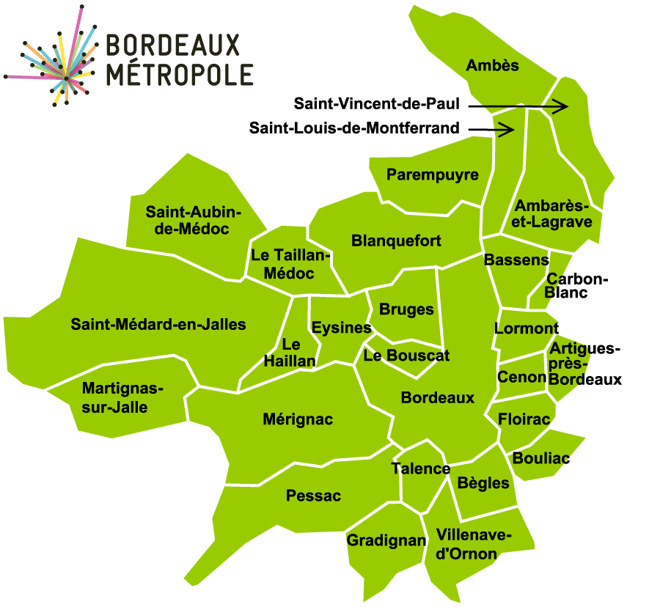



Introduction /Business Problem
Bordeaux Metropole key figures :
28 towns, many neighborhoods
+ 1,5% demographic growth per year
+ 2 000 jobs created per year

Slide 3



Introduction /Business Problem
Our objectives :
Help newcomers find the best place to move in based on their way of life
Understand real estates market structure
Clustered Bordeaux neighborhoods based on some preselected features to provide a decisional tool for both new commers & new companies

Slide 4





Data used to resolve our problem
2 dataset : providing information's on Bordeaux Metropole structure :
Town | Neighborhood | Latitude | Longitude | Polygon geometry | INSEE Code | Postal Code
Name of the town | Name of the neighborhood | Coordinates of neighborhood |  |  | Code of the town | Postal Code of the town
3 API :
Missing towns coordinates & postal code
Real estates data of the Metropol based on coordinates
Venues of the Metropol based on coordinates

Slide 5
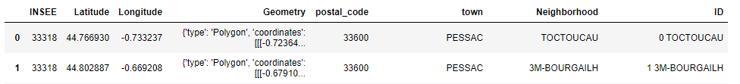
Data understanding and preparation Geographical data
Bordeaux Neighborhoods
Geosjson data of neighborhoods
Lack of 24 towns on 28
Web scrapping
Obtaining INSEE code of all Bordeaux metropole towns
Bordeaux towns
Geojson data of county towns –no information on towns name
Filter on Metropole towns thanks to INSEE code
API
Obtaining missing towns name and coordinates

Slide 6
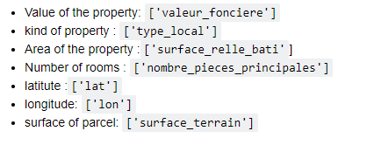
Data understanding and preparation Real estate information
Dataset of the last 5 years
https://api.cquest.org/dvf?lat={(latitude)}&lon={ longitude}&dist={RADIUS}
Main data information returned in json format :
The value do not take into account real estates
agencies fees & Notary fees

Slide 7
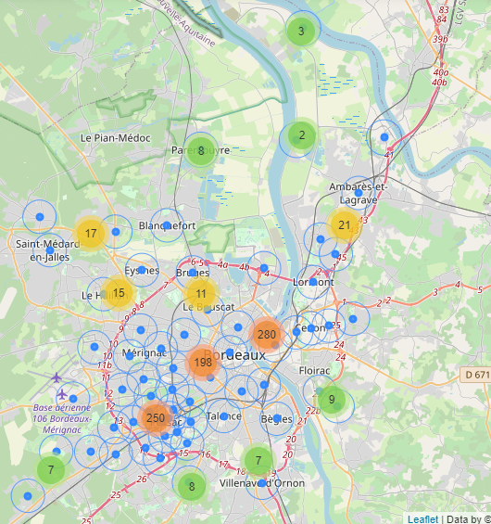
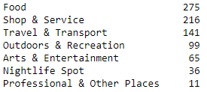
Data understanding and preparation Foursquare venues
More than 4000 results from the Foursquare API
79% of the returned venues were duplicates
Returned venues mainly from city center
Suburban area lack of data 2 to 5 results for more than 15 towns
172 unique category venues transformed into 7 parent categories to improve cluster efficiency

Slide 8
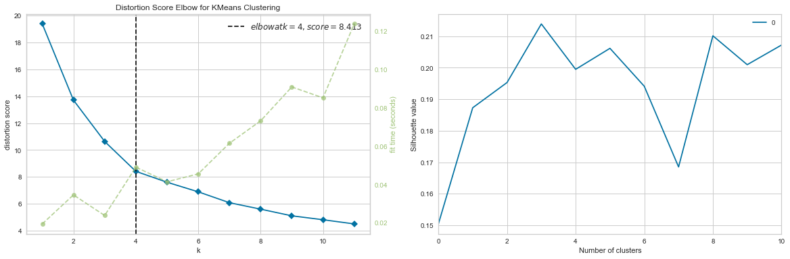
Modeling Determining the best number of clusters

Slide 9
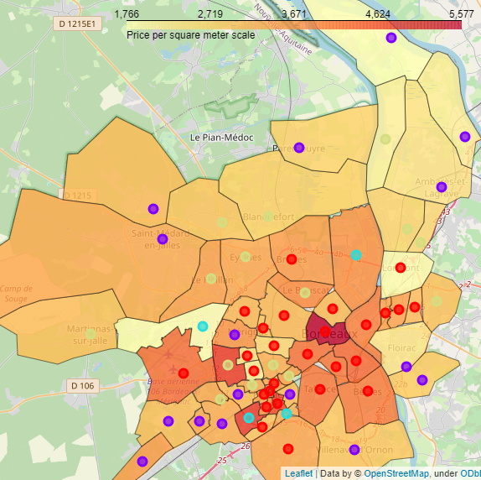
Results and discussion
Family friendly: For the people who wants a house and some shops arounds
Dynamic cities centers: Best suits for people who like to live in apartments close to all commodities
Dynamic suburbs: Suburban towns quite active with shops and activities
Business centers: These neighborhoods are business centers, not the best place to live in but perfect to install professional premises

Slide 10

Conclusion
Good first insight of Bordeaux Metropole
Some limitations due to :
No comprehensive source for neighbourhoods delimitations
Low number of foursquare venues in suburban area
Real estate market based on transactions and do not take into account in place business
To go further :
Add population density
Obtain new venues information

Slide 11
Sources
API :
https://public.opendatasoft.com ➔ towns coordinates
https://api.foursquare.com ➔ Foursquare
http://api.cquest.org/dvf ➔ real estates data
Datasets :
https://github.com/gregoiredavid/france-geojson/tree/master/departements/33-gironde ➔ towns of Bordeaux Metropole
https://www.data.gouv.fr/fr/datasets/quartiers-des-communes-sur-le-territoire-de-bordeaux-metropole/ ➔ Neighborhoods
Web page :
https://www.insee.fr/fr/metadonnees/cog/intercommunalite-metropole/EPCI243300316-bordeaux-metropole ➔ INSEE Codes of Bordeaux Metropole towns

Slide 12

Modeling

Slide 13
Draft

Slide 14
Data used to resolve our problem
Describe the data that you will be using to solve the problem or execute your idea. Remember that you will need to use the Foursquare location data to solve the problem or execute your idea. You can absolutely use other datasets in combination with the Foursquare location data. So make sure that you provide adequate explanation and discussion, with examples, of the data that you will be using, even if it is only Foursquare location data.
This submission will eventually become your Data section in your final report. So I recommend that you push the report (having your Data section) to your Github repository and submit a link to it.

