Slide 1
Least Square MonteCarlo
Extract from
https://people.math.ethz.ch/~hjfurrer/teaching/LongstaffSchwartzAmericanOptionsLeastSquareMonteCarlo.pdf

Slide 2
Recursive algorithm
At the final exercise date, the optimal exercise strategy for an American option is to exercise the option if it is in the money.
Prior to the final date, the optimal strategy is to compare:
the immediate exercise value
VS the expected cash flows from continuing, and then exercise if immediate exercise is more valuable.
Thus, the key to optimally exercising an American option is identifying the conditional expected value of continuation.
In this approach, we use the cross-sectional information in the simulated paths to identify the conditional expectation function.

Slide 3
Estimation of the continuation value
This is done by regressing the subsequent realized cash flows from continuation on a set of basis functions of the values of the relevant state variables.
The fitted value of this regression is an efficient unbiased estimate of the conditional expectation function and allows us to accurately estimate the optimal stopping rule for the option.

Slide 4
Numerical example
Consider an American put option on a share of non-dividend-paying stock.
The put option is exercisable at a strike price of 1.10 at times 1, 2, and 3, where time three is the final expiration date of the option.
The riskless rate is 6%. For simplicity, we illustrate the algorithm using only eight sample paths for the price of the stock.
These sample paths are generated under the risk-neutral measure and are shown in the following matrix.

Slide 5
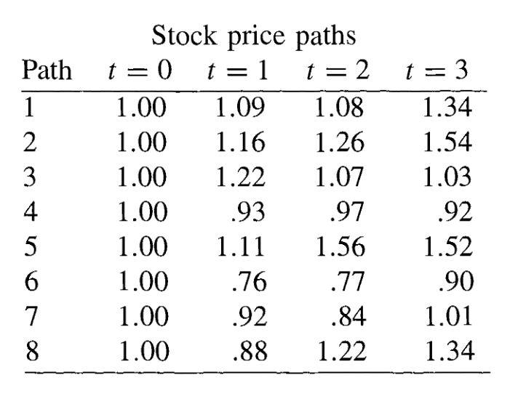

Slide 6
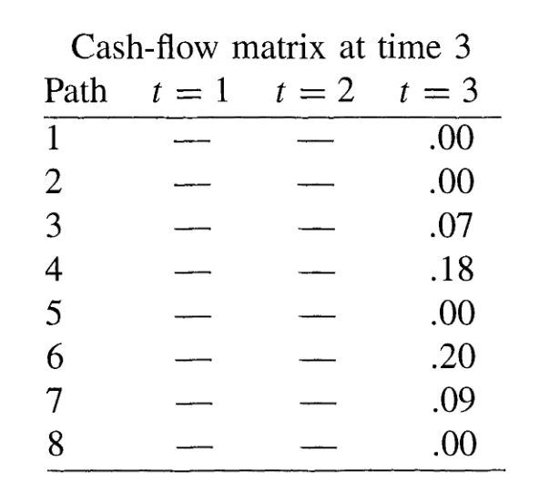
Our objective is to solve for the stopping rule that maximizes the value of the option at each point along each path.
Since the algorithm is recursive, however, we first need to compute a number of intermediate matrices.
Conditional on not exercising the option before the final expiration date at time 3, the cash flows realized by the optionholder from following the optimal strategy at time 3 are:

Slide 7
If the put is in the money at time 2, the optionholder must then decide whether to exercise the option immediately or continue the option's life until the final expiration date at time 3.
From the stock-price matrix, there are only five paths for which the option is in the money at time 2.
Let X denote the stock prices at time 2 for these five paths and Y denote the corresponding discounted cash flows received at time 3 if the put is not exercised at time 2.
We use only in-the-money paths since it allows us to better estimate the conditional expectation function in the region where exercise is relevant and significantly improves the efficiency of the algorithm.

Slide 8
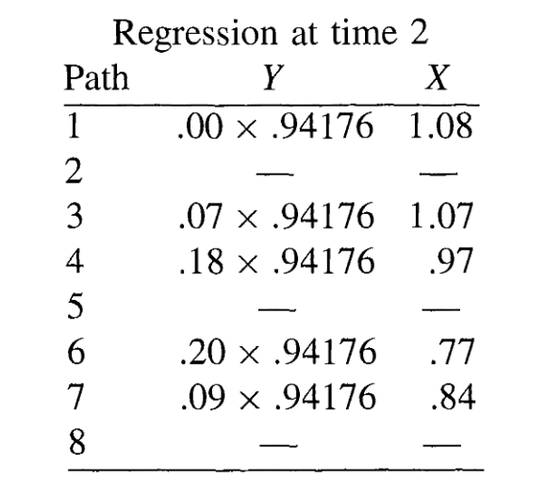
The vectors X and Y are given by the nondashed entries below.

Slide 9
Polynomial regression
To estimate the expected cash flow from continuing the option's life conditional on the stock price at time 2, we regress Y on a constant, X, and X².
This specification is one of the simplest possible. The resulting conditional expectation function is
E[ Y | X ] = -1.070 +2.983X -1 .813X²

Slide 10
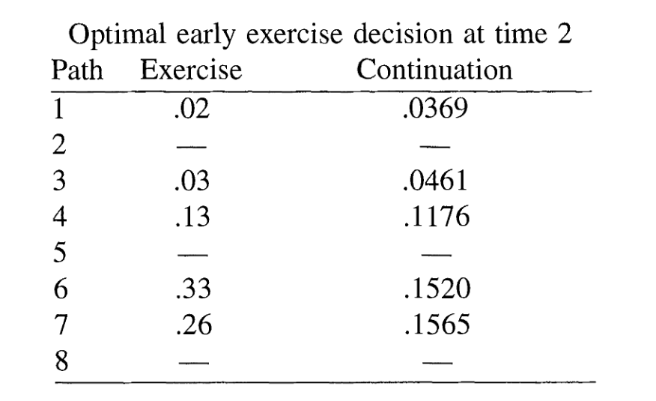
We now compare the value of immediate exercise at time 2 with the value from continuation.

