Slide 1
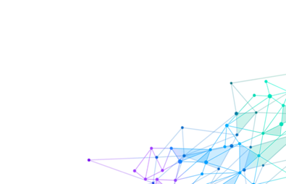
Microsoft AI Platform – Access Personas
Microsoft ML & AI Products
Consume (Pre-built AI Models)
Build your own
(Customizable & Custom AI Models)
Cognitive Services
(pre-built)
CoreML & Vision CNTK, TensorFlow
(pre-trained)
Custom
Cognitive Services
(Custom Vision, Custom Speech)
Automated Machine Learning
Azure Machine Learning Studio
Visual Interface
Notebook VMs
Azure Databricks
Machine Learning Server
SQL Server 2016 - 2019
Azure ML Service
Machine Learning .NET
VS Tools for AI, R, Python
Azure ML Python SDK
Easier / Less control / Application Developers
Harder / Full control / Data Scientists
Novice ML & AI knowledge | Intermediate ML & AI knowledge | Advanced ML & AI knowledge
Consume pre-built AI models | Build your own AI models with PaaS tools | Build your own AI models however your like
Compute is provided for Azure services | Compute is provided for Azure services (via PaaS) | Provide your own compute AI infrastructure (cloud, on-premises) or leverage Azure PaaS compute services
No coding required for building models. Code only for consuming models | UI web driven & code-first development environments | Code-first development environments for building & consuming AI/ML models
Azure PaaS & pre-build model customer support | Azure PaaS customer support. Custom models are responsibility of developer. | Azure PaaS, IaaS & software (i.e. SQL Server) customer support. Custom models are responsibility of developer
Azure cloud services utilized | Azure cloud services utilized | Azure cloud services utilized or 100% on-premises options

Slide 2




Machine Learning – Multiple Authoring Experiences
Automated
Machine Learning
Visual Interface
Code-First
Notebooks & IDEs

Slide 3
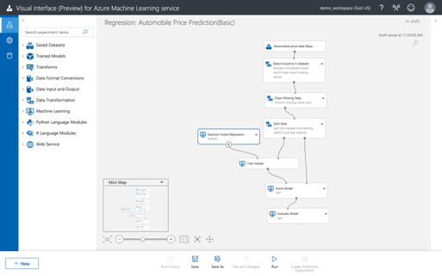
Automated Machine Learning
Allows data scientists, analysts, and developers to build ML models with high scale, efficiency, and productivity all while sustaining model quality

Slide 4

Visual Interface for Azure Machine Learning service (Public Preview)
Visual workflow to build, test, and deploy ML models more easily and efficiently

Slide 5
Code-First Notebooks & IDEs
Use a cloud-based notebook server, Visual Studio or another AI IDE

Slide 6
WALKTHROUGH Automated ML – Azure Portal – Titanic Dataset Walkthrough: https://github.com/bartczernicki/MachineLearning-AutomatedML-Titanic

