Slide 1
Azure Cognitive Services Strategy
Bart Czernicki @bartczernicki
Last Updated: 2/2019

Slide 2
Microsoft AI Platform
AI SERVICES
AI TOOLS
CONVERSATIONAL AI
TRAINED SERVICES
CUSTOM SERVICES
CODING & MANAGEMENT TOOLS
Bot Framework
Cognitive Services
Azure Machine Learning
VS Tools for Machine Learning
Azure ML Studio
Azure ML Workbench
AI INFRASTRUCTURE
Others (Pycharm, Jupyter notebooks…)
AI ON DATA
AI COMPUTE
DEEP LEARNING FRAMEWORKS
Cosmos DB
SQL
DB
SQL
DW
Data Lake
Spark
DSVM
Batch AI
ACS
Edge
Cognitive Toolkit
TensorFlow
Caffe
CPU, GPU, FPGA
Others (Scikit-learn, MXNet, Keras, Gluon…)

Slide 3
AI Ethics & Compliance
Starts with Ethics & Compliance
AI Ethics
Core AI Ethics infused into the Cognitive Services
Developed with Ethical Principles and work on the following principles
No denial of services – automated decision or recommender systems
No risk of harm – AI systems that can cause significant harm
No infringement on human rights – AI systems that create a significant restriction of human rights, including personal freedom or privacy
Compliance & Privacy
Full GDPR compliance on Azure Cognitive Services. All GA services are compliant in two areas
Data Processors – Most enterprise friendly. Microsoft DOES NOT retain data for building/improving models
Majority of our services are data processors
Data Controllers – Services that do retain data & Microsoft can use it to improve models
Only for Bing related Cognitive Services
As a customer, you have control of your data retention on the Microsoft AI platform

Slide 4
Cognitive Services AI -> Pre-Built & Customizable AI
Goal is to empower all AI personas and developers
Microsoft ML & AI Products
Consume
(Pre-Built AI)
Developers
Build Your Own
(Custom AI)
Domain Matter Experts
Cognitive Services will continue to add services around Pre-Built AI and Custom AI (*)
Pre-Built AI Cognitive Services – surfaced via REST API endpoints, ready to consume by AI developers
Target Persona: Application Developers
Customizable AI Cognitive Services - surfaced via a concept we call Active Learning with specialized web UI portals for each custom service. Active Learning allows humans to provide a feedback loop to improve the performance of the overall system. REST APIs included for automation and prediction endpoints.
Target Persona: Subject Matter Experts
Delivery Format: Active Learning + Specialized Web Portal + REST/SDK

Slide 5
Cognitive Services AI -> Pre-Built & Customizable AI
Goal is to empower all AI personas and developers
Microsoft ML & AI Products
Consume (Pre-built AI)
Build your own (Custom AI)
Cognitive Services
CoreML & Vision CNTK, TensorFlow
(pre-trained)
Customizable
Cognitive Services
(Custom Vision, Custom Speech etc.)
Azure Machine Learning Studio
Azure Notebooks
Automated ML
Azure DSVM
Azure Databricks
Machine Learning Server
SQL Server 2016/2017/2019
VS Tools for AI, R, Python
Machine Learning .NET
Azure ML service
Azure ML Python SDK
Easier / Less control / Application Developers
Harder / Full control / Data Scientists
Novice ML & AI knowledge | Intermediate ML & AI knowledge | Advanced ML & AI knowledge
Consume pre-built AI models | Build your own AI models with PaaS tools or specialized web portals | Build your own AI models however your like
Compute is provided for Azure services | Compute is provided for Azure services (via PaaS) | Provide your own compute AI infrastructure (cloud, on-premises) or leverage Azure PaaS compute services
No coding required for building models. Code only for consuming models | UI web driven & code-first development environments | Code-first development environments for building & consuming AI/ML models
Azure PaaS & pre-build model customer support | Azure PaaS customer support. Custom models are responsibility of developer. | Azure PaaS, IaaS & software (i.e. SQL Server) customer support. Custom models are responsibility of developer
Azure cloud services utilized | Azure cloud services utilized | Azure cloud services utilized or 100% on-premises options

Slide 6
Containers for Azure Cloud, On-Premises & Edge
Run on Azure or on-premises
Flexible Consumption & Deployment Model
Can run via Azure REST APIs hosted by Microsoft
Can run using Docker Containers (wherever Docker runs(*))
Benefits
Control over data: Allow customers to use Cognitive Services with complete control over their data
Control over model updates: Provide customers flexibility in versioning and updating of models deployed in their solutions. Customers can stay on a specific Docker version
Portable architecture: Enable the creation of a portable application architecture that can be deployed in the cloud, on-premises and the edge. Containers can also be deployed directly to Azure Kubernetes Service, Azure Container Instances, or to a Kubernetes cluster deployed to Azure Stack.
High throughput / low latency: Provide customers the ability to scale for high throughput and low latency requirements by enabling Cognitive Services to run in Azure Kubernetes Service physically close to their application logic and data

Slide 7
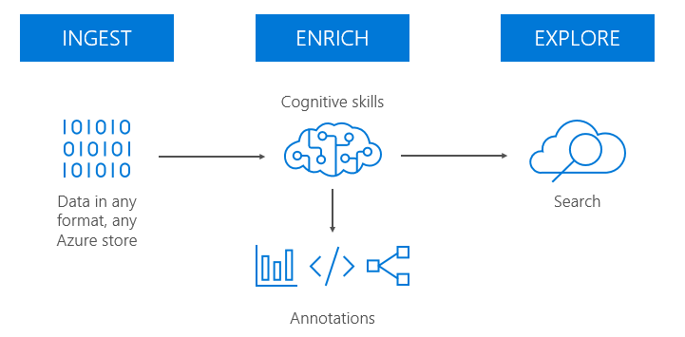
Simplified Billing & Bundling of Services
Simplifying billing & bundling services
Simplified Billing
Recent introduction of simplified billing via a single API key
Single API tied to a region allows multiple services to share a single billing price point & tier
Single API key can be used for Docker operationalization of Cognitive Services
Upcoming changes will simplify this further
Bundling
Certain Cognitive services gravitate to each other (“tribes”)
Plan on bundling some of that functionality together in services
Cognitive Search Skill Sets -> Text Analytics, OCR, Document management
Domain Specific Pre-Built Services
Vertical Industry integration into pre-built services

