Slide 1
An open source and cross-platform machine learning framework
ML.NET
Bart Czernicki
Technical Architect – Advanced Analytics & AI
baczerni@microsoft.com
@bartczernicki
https://www.linkedin.com/in/bartczernicki

Slide 2














Your platform for building anything
DESKTOP
WEB
CLOUD
MOBILE
GAMING
IoT
ML
.NET

Slide 3
What is ML.NET?
Another Microsoft AI & Machine Learning Framework?
Focus on .NET Developers
Empower existing .NET developers to craft AI & ML solutions
Leverage existing skillsets in C#, .NET, Visual Studio, ASP.NET, Windows Forms, UWP etc.
Leverage existing applications, web applications and infuse ML functionality (standard app lifecycle)
Open Source
Delivered via NuGet package(s)
Open Source with source code available on GitHub: https://github.com/dotnet/machinelearning
Open: Can track releases, future versions etc.
Fast release cadence
No cost license (FREE) & permissive MIT license: Commercial use, distribution etc.
Part of .NET Core 3.0: Currently works with .NET Core 2.x, formally part of .NET Core 3.0
Cross-platform: Windows, macOS & Linux (wherever .NET Core is supported)
Built on Standards
Standard ML algorithms are incorporated with ML best practices in mind
Integration with ONNX (Open Neural Network Exchange) – Interoperable Artificial Intelligence
Ability to import/export models between different Operating Systems, frameworks, languages (Python/R)

Slide 4




Where is ML.NET used?
You are probably have used it already without knowing!
Bing Ads (Ad Predictions)
Excel (Chart Recommendations)
Power Point (Design Ideas)
Windows 10 (Windows Defender)
+ more

Slide 5
Where is ML.NET used?
PowerPoint Use-Case
Example Use Case
PowerPoint Designer with ML.NET
Replaced rules-based engine with local machine learning based models using ML.NET

Slide 6
Where does ML.NET Fit Into Microsoft AI
Powerful code-first framework, requires a developer skillset
Microsoft ML & AI Products
Consume (Pre-built AI)
Build Your Own (Custom AI)
Cognitive Services
CoreML & Vision CNTK, TensorFlow
(pre-trained)
Custom
Cognitive Services
(Custom Vision, Custom Speech)
Azure Machine Learning Studio
Azure Notebooks
Azure DSVM
Azure Databricks
Machine Learning Server
SQL Server 2016/2017/2019
VS Tools for AI, R, Python
Machine Learning .NET
Azure ML service
Azure ML Python SDK
Easier / Less control / Application Developers
Harder / Full control / Data Scientists
Novice ML & AI knowledge | Intermediate ML & AI knowledge | Advanced ML & AI knowledge
Consume pre-built AI models | Build your own AI models with PaaS tools | Build your own AI models however your like
Compute is provided for Azure services | Compute is provided for Azure services (via PaaS) | Provide your own compute AI infrastructure (cloud, on-premises) or leverage Azure PaaS compute services
No coding required for building models. Code only for consuming models | UI web driven & code-first development environments | Code-first development environments for building & consuming AI/ML models
Azure PaaS & pre-build model customer support | Azure PaaS customer support. Custom models are responsibility of developer. | Azure PaaS, IaaS & software (i.e. SQL Server) customer support. Custom models are responsibility of developer
Azure cloud services utilized | Azure cloud services utilized | Azure cloud services utilized or 100% on-premises options

Slide 7
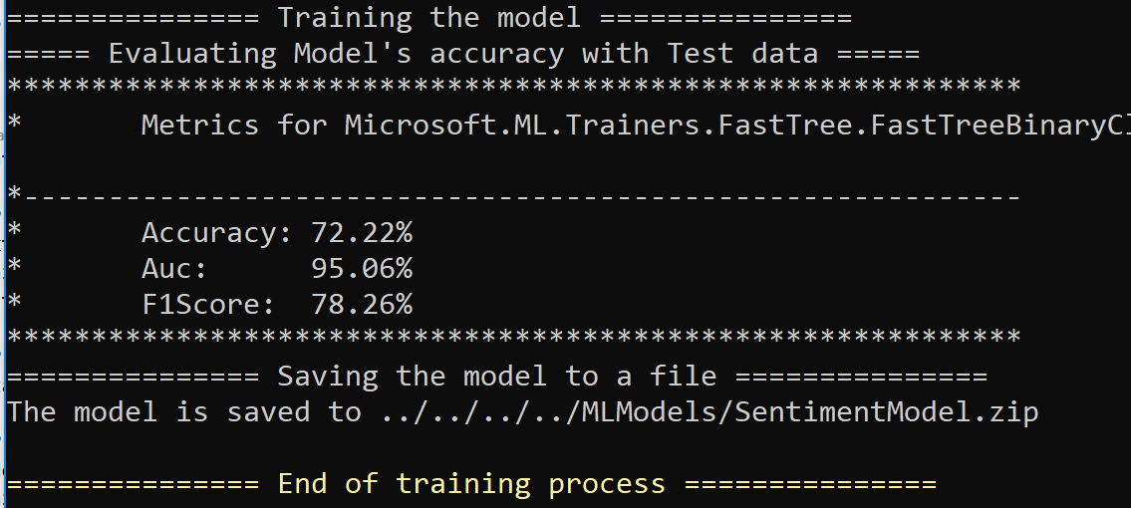
ML.NET – Code-First Framework
Sentiment Analysis: Train a Model (C#)
private static ITransformer BuildTrainEvaluateAndSaveModel(MLContext mlContext)
{
// STEP 1: Common data loading configuration
var textLoader = SentimentAnalysysTextLoaderFactory.CreateTextLoader(mlContext);
var trainingDataView = textLoader.Read(TrainDataPath);
var testDataView = textLoader.Read(TestDataPath);
// STEP 2: Common data process configuration with pipeline data transformations
var dataProcessPipeline = mlContext.Transforms.Text.FeaturizeText("Text", "Features");
// STEP 3: Set the training algorithm, then create and config the modelBuilder
var modelBuilder = new Common.ModelBuilder<SentimentIssue, SentimentPrediction>(mlContext, dataProcessPipeline);
var trainer = mlContext.BinaryClassification.Trainers.FastTree(label: "Label", features: "Features");
modelBuilder.AddTrainer(trainer);
// STEP 4: Train the model fitting to the DataSet
Console.WriteLine("=============== Training the model ===============");
modelBuilder.Train(trainingDataView);
// STEP 5: Evaluate the model and show accuracy stats
Console.WriteLine("===== Evaluating Model's accuracy with Test data =====");
var metrics = modelBuilder.EvaluateBinaryClassificationModel(testDataView, "Label", "Score");
Common.ConsoleHelper.PrintBinaryClassificationMetrics(trainer.ToString(), metrics);
// STEP 6: Save/persist the trained model to a .ZIP file
Console.WriteLine("=============== Saving the model to a file ===============");
modelBuilder.SaveModelAsFile(ModelPath);
return modelBuilder.TrainedModel;
}

Slide 8
What Can I Build with ML.NET?
Examples standard ML experiments you can build
Sentiment Analysis
Forecasting
Supervised Classification
Predictive maintenance
Image classification
Recommendations
Object detection
Customer segmentation
And more! Samples @ https://github.com/dotnet/machinelearning-samples

Slide 9
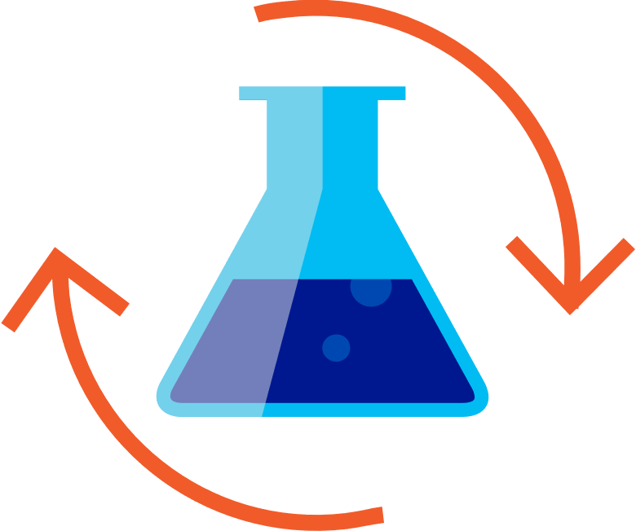

ML.NET – How Do I Build Models?
Typical Machine Learning Workflow
Prepare Your Data
Build & Train
Run
Load Data
Extract Features
Train Model
Evaluate Model
Model Consumption

Slide 10
ML.NET – Getting Started & Demos
Getting Started with ML.NET
Demo - Getting Started with ML.NET
Bringing in ML.NET into your project
Related NuGet packages
https://www.nuget.org/profiles/MLNET
Demo – Cross-Platform Machine Learning
.NET Core & Machine Learning on macOS
GitHub Location of Demo
https://github.com/bartczernicki/baseballhof-macos

Slide 11












ML.NET and ONNX Integration
Open and Interoperable Artificial Intelligence
CPU
GPU
FPGA
ASIC
With ML.NET you enable your organizations to continue to grow with using the latest popular open-source AI & Machine Learning frameworks, while being able to consume these models in existing .NET investments. This means models trained in different ecosystems can be brought directly next to your .NET business application business logic without having to change/re-platform your applications.

Slide 12
ML.NET – Advanced Demo with ONNX
Integration with ONNX
Demo – Advanced ML.NET Demo
Build multiple models leveraging .NET memory caching
Dynamically change the Required Features and Labels
Persist the models in an ONNX format
https://github.com/bartczernicki/MLDotNet-BaseballClassification
Integrate with Visual Studio AI Tools
Integrate with WinML Tools

Slide 13
ML.NET Resources
Online Links and Information
Main GitHub Page
https://github.com/dotnet/machinelearning
Main source code repository. Access to releases, reported bugs, upcoming project Kanban charts
ML.NET Documentation
https://docs.microsoft.com/en-us/dotnet/machine-learning/
Coalesced area for ML.NET guides & documentation
ML.NET Cookbook
https://github.com/dotnet/machinelearning/blob/aa302109eaddf3c3e3be01ae89865e479f6d16d6/docs/code/MlNetCookBook.md
Document that provides small code samples on how to perform certain tasks in ML.NET (i.e. load data)
ML.NET Samples (End-to-end)
https://github.com/dotnet/machinelearning-samples
ML.NET samples organized by ML tasks (i.e. Classification, Regression etc.)
Unpublished ML.NET Samples
https://github.com/dotnet/machinelearning/tree/master/docs/samples/Microsoft.ML.Samples
Some more advanced code samples, usage of specific algorithms, usage of ONNX transforms etc.
List of Related ML.NET NuGet Packages
https://www.nuget.org/profiles/MLNET

