Slide 1





Machine learning
Solution Exercices Cours 1 1
David Rousseau

Slide 2

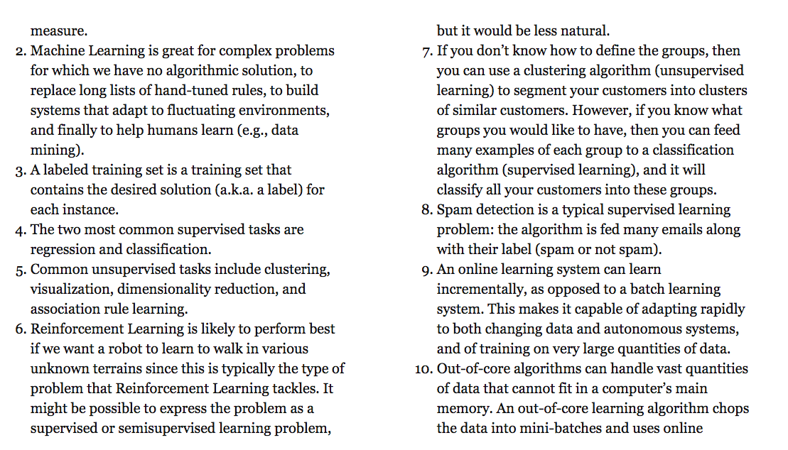

Slide 3
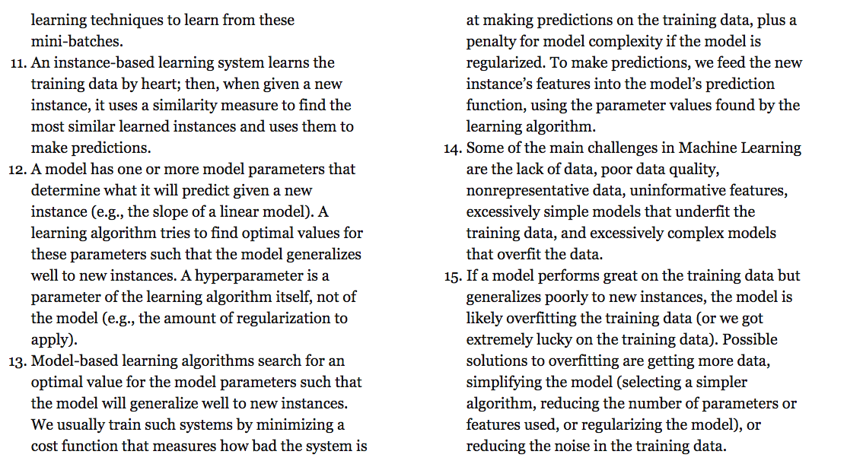

Slide 4
