Slide 1





Machine learning
Cours 7 : Arbres de décision
David Rousseau

Slide 2
Decision tree
6
The (binary) decision tree
5
4
x₁>3
x₂
3
2
x₂>3
x₂>2
1
1
2
3
4
5
6
7
8
x₁>6
x₁>7
x₁

Slide 3
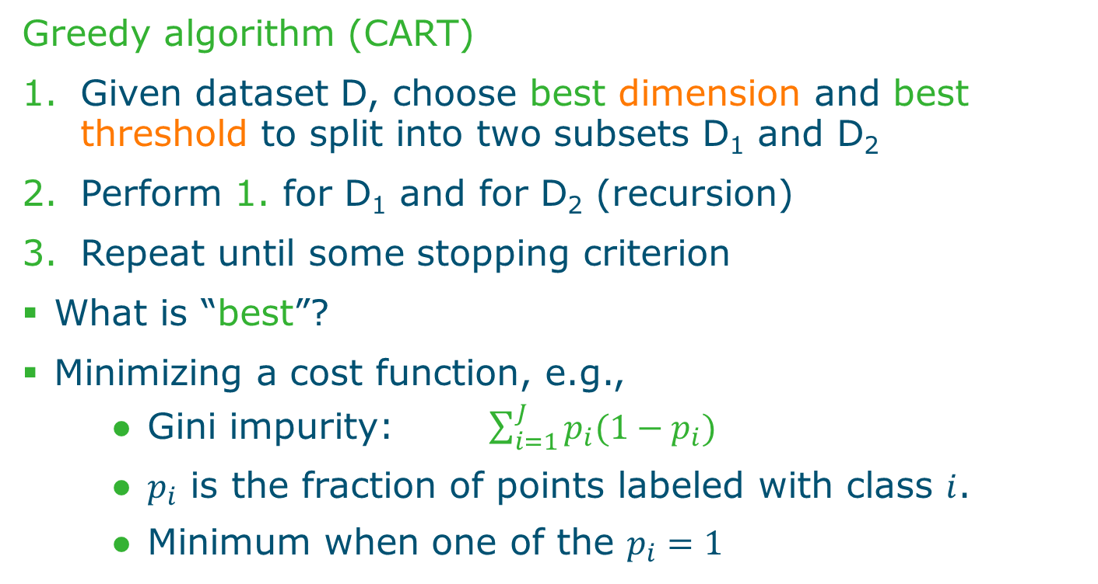
Decision-tree learning
Greedy algorithm (CART)
Given dataset D, choose best dimension and best threshold to split into two subsets D₁ and D₂
Perform 1. for D₁ and for D₂ (recursion)
Repeat until some stopping criterion
What is “best”?
Minimizing a cost function, e.g.,
Gini impurity: $\sum_{i=1}^{J}{p_{i}(1−p_{i})}$
$p_{i}$ is the fraction of points labeled with class $i$.
Minimum when one of the $p_{i}=1$

Slide 4
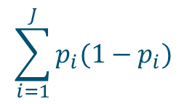
Decision-tree learning
6
 | #O1 | #X1 | #O2 | #X2 | Gini1 | Gini2 | Gini
X₁>1 | 1 | 1 | 6 | 7 | 0.50 | 0.50 | 1.00
X₁>3 | 3 | 3 | 4 | 5 | 0.50 | 0.49 | 0.99
X₁>4 | 4 | 4 | 3 | 4 | 0.50 | 0.49 | 0.99
X₁>5 | 4 | 5 | 3 | 3 | 0.49 | 0.50 | 0.99
X₁>6 | 5 | 6 | 2 | 2 | 0.50 | 0.50 | 1.00
X₁>7 | 5 | 8 | 2 | 0 | 0.47 | 0.00 | 0.47
X₂>1 | 1 | 2 | 6 | 6 | 0.44 | 0.50 | 0.94
X₂>2 | 2 | 3 | 5 | 5 | 0.48 | 0.50 | 0.98
X₂>3 | 2 | 5 | 5 | 3 | 0.41 | 0.47 | 0.88
X₂>4 | 4 | 6 | 3 | 2 | 0.48 | 0.48 | 0.96
X₂>5 | 5 | 7 | 2 | 1 | 0.49 | 0.44 | 0.93
5
4
x₂
3
2
1
1
2
3
4
5
6
7
8
x₁
$$\sum_{i=1}^{J}{p_{i}(1−p_{i})}$$

Slide 5
Decision-tree learning
6
x₁>7
5
4
x₁>6
x₂
3
2
x₂>3
1
1
2
3
4
5
6
7
8
x₁>3
x₁>3
x₁
x₂>2

Slide 6
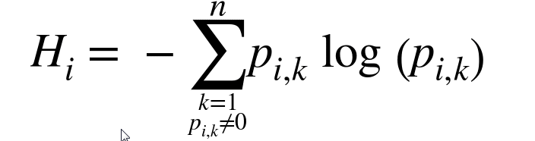
Exercise
Other impurity coefficient exists, for instance entropy
Build again the decision tree with the entropy
So which one shoud we choose ?
Gini Impurity tends to isolate the most frequent class in its own branch of the tree while entropy tends to produce slighly more balanced trees

Slide 7
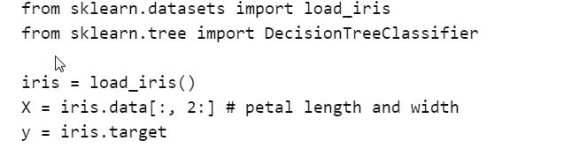

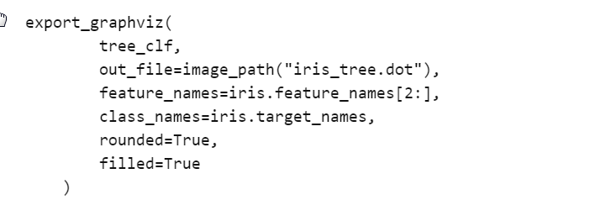
Decisions Tree with Sci-kit learn

Slide 8
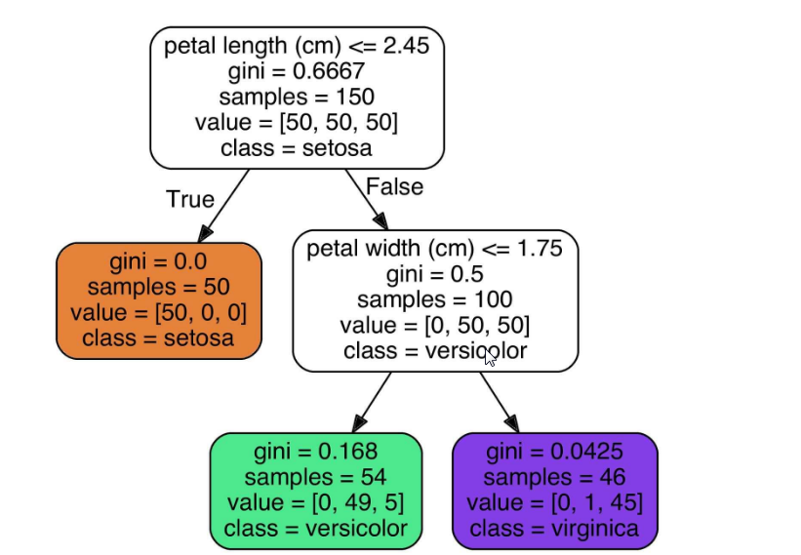
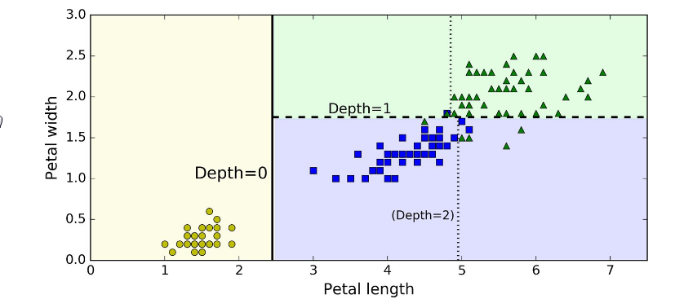


Visualization

Slide 9
Estimating class probabilities
A Decision tree can also estimate the probability that an instance belongs to a particular class k
First it traverses the tree to find the leaf node fo this instance and then it returns the ratio of training instances of class k in this node
For instance you found a flower whose petals are 5 cm long and 1.5 cm wide. The corresponding probability is 49/54 of being a Iris-Versicolor

Slide 10
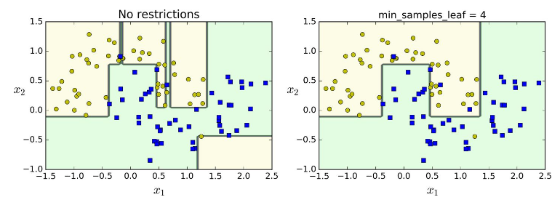
Regularization
Decision trees make very few assumptions about the training data (as opposed to linear models, … which assume that the data is li,ear for example).
However, to avoid overfitting the training data, you need to restrict the Decision trees freedom during training.
« Regularization paramaters : » restrict the maximum depth, the minimum samples per leaf or alternativelly prune the tree based on statistical test

Slide 11
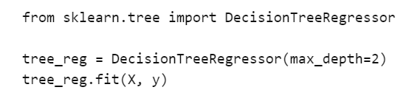
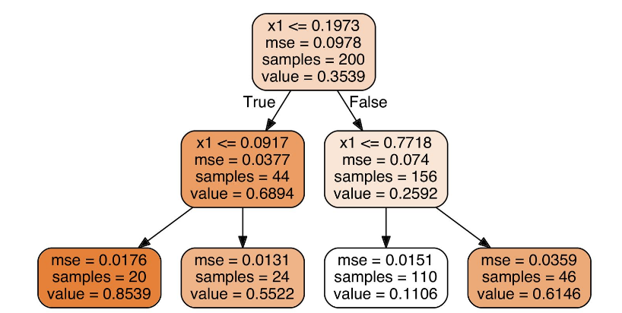

Regression
Decision trees are capable of performing regression tasks
Example on a noisy quadratic dataset with max_depth=2
The tree is very similar to a classification tree
Each node is now associated to a predictied value
For example x1=0.6 gives value 0.1106
In the Cart algorithm a MSE function is minimized

Slide 12
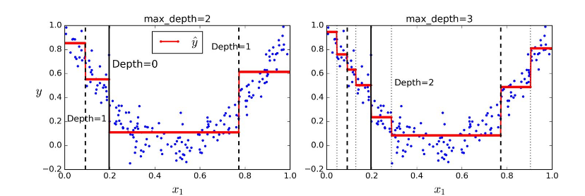
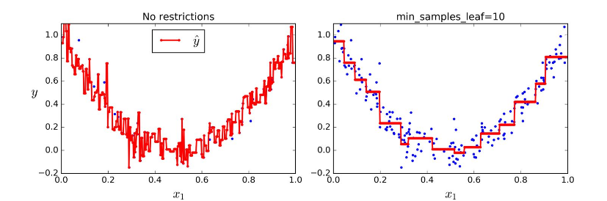
Regression in action

Slide 13
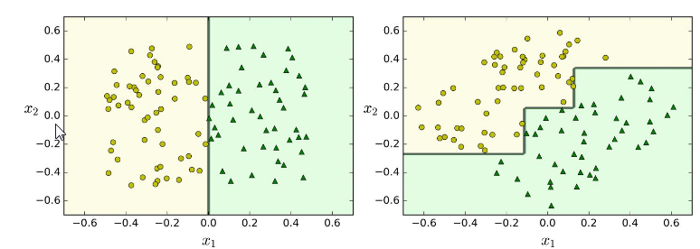
Decision tree limitations
Because they fix vertical and horizontal decision rules decision trees are sensitive to data set orientation… solution make a PCA before decision tree
Also because Decision tree takes binary hard decision they are very sensitive to noise

Slide 14
Decision tree sum up
Advantages
Simple to interpret, white-box method
Can handle numerical and categorical data
Little data preparation
Fast
Disadvantages
Susceptible to noise
Greedy algorithm is locally optimal
Chance of overfitting
Random forest target these disadvantages

Slide 15
Random forest
Random forest is a collection of decision trees
Each tree is trained on a bootstrap sample of the training data (random sampling with replacement)
Each node considers a random subset of dimensions
As a consequence, each DT is different
At runtime:
The new observation is classified by all N trees
Majority vote
Additionally provides uncertainty information

Slide 16
Classification using a random forest
3/4
1/4

Slide 17
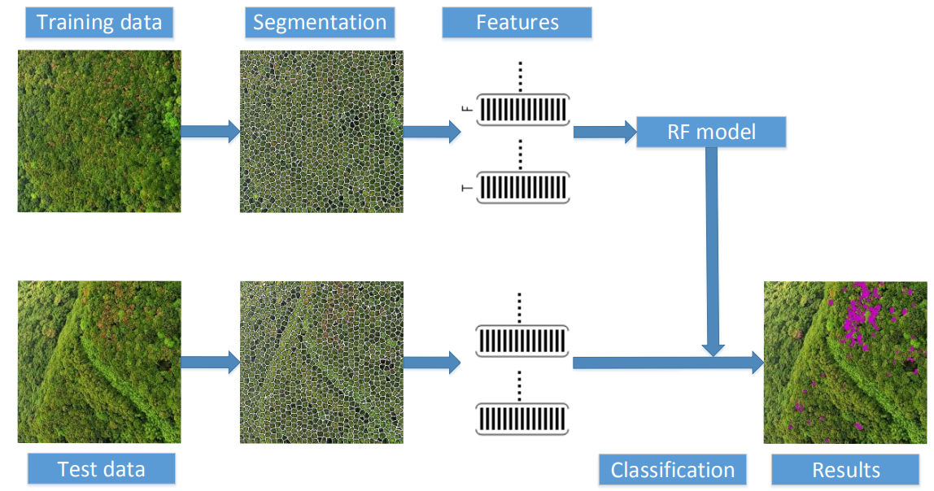
Random forest to detect infected forest areas
Images are pre-segmented into superpixels
Features: mean, variance and min/max of RGB values
(Yuan & Hu, 2016)

Slide 18
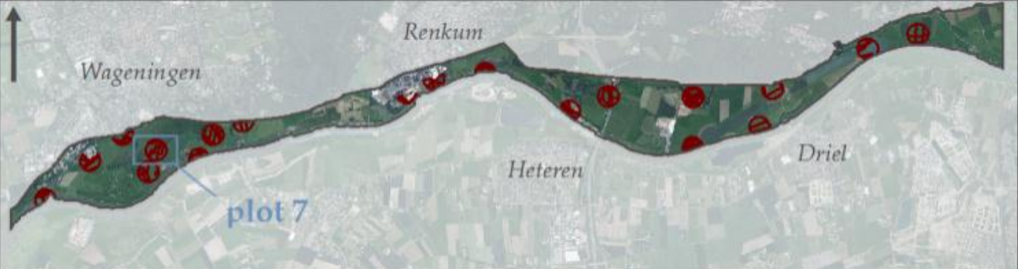
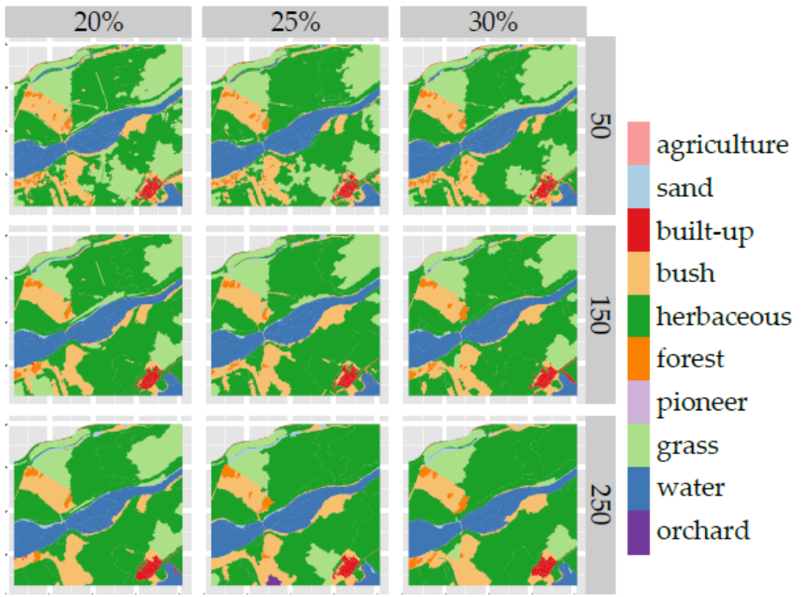
RF for classification of vegetation
RF trained to automatically produce vegetation maps from aerial images
936 ha
Features
Spectral (R, G, B, and NIR)
Topographical
Textural
Geometrical
Ten vegetation classes
(Kooistra, Kuilder &Mucher, 2014)

Slide 19
Next course
Réduction de dimension
David Rousseau

