Slide 1





Machine learning
Exercices Cours 7 1
David Rousseau

Slide 2
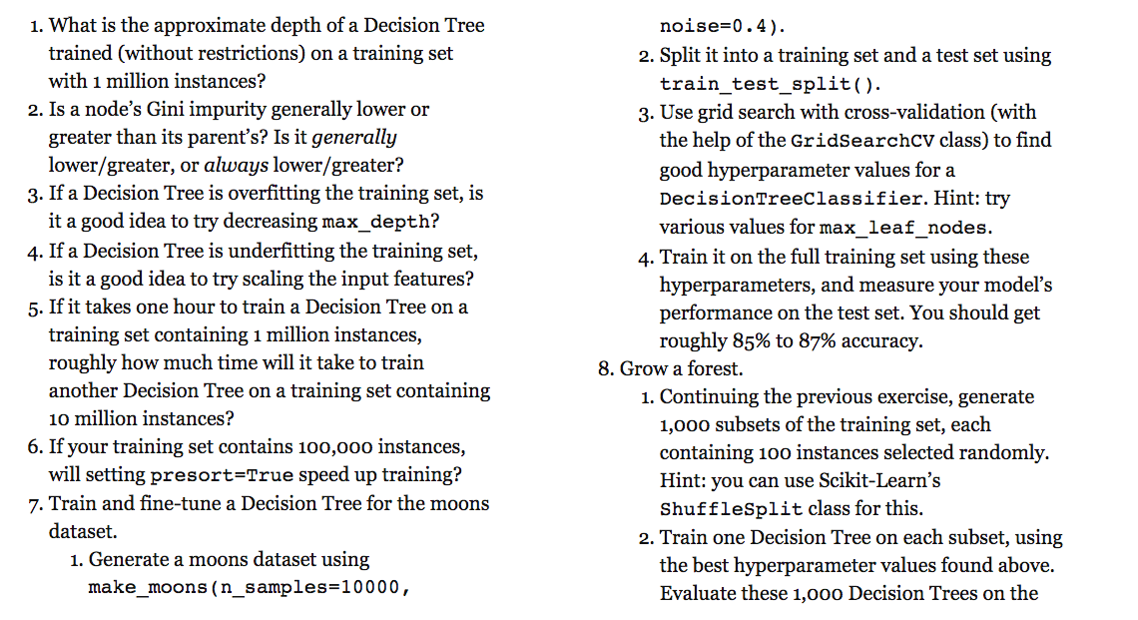

Slide 3
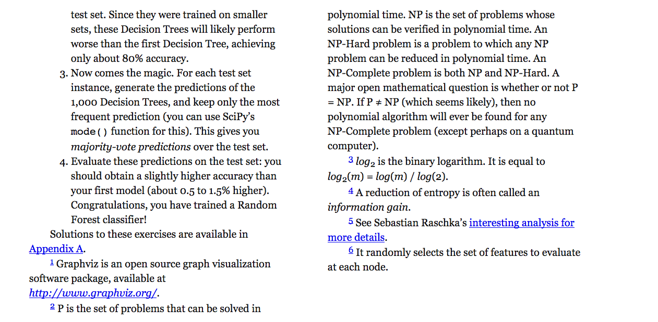

Slide 4
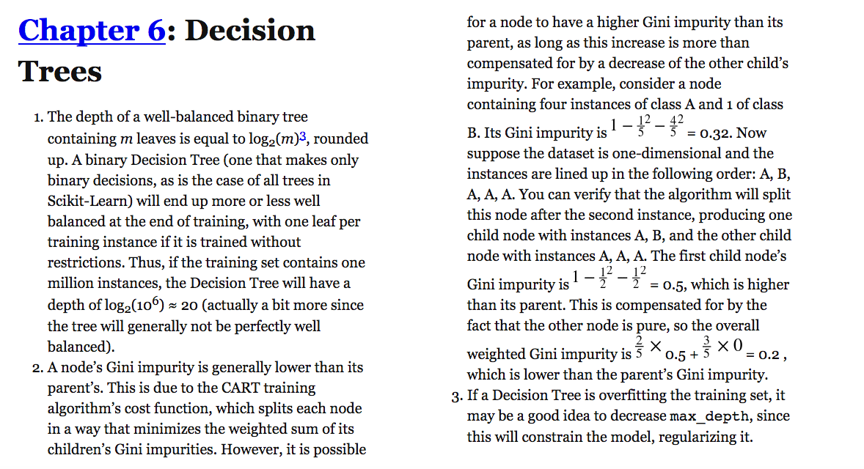
Solutions

Slide 5
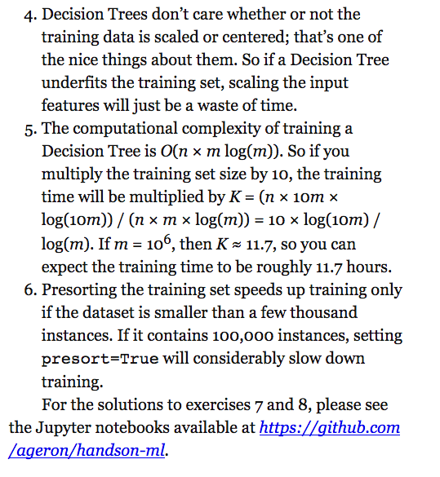
Solutions 2

Slide 7
