Slide 1


Networked System Security
Jamming
Module TAs: Moritz Wiese, moritzw@kth.se
Kewei Zhang, kewei@kth.se
Panos Papadimitratos
http://www.ee.kth.se/nss

Slide 2
Outline
  Wireless security issues
  Eavesdropping
  Jamming
  Random number generation
EP2500 NETWORKED SYSTEMS SECURITY
2015-11-13
2015-11-13

Slide 3
Security in Wireless Systems
Inherent openness in wireless communications channel: Common attacks at the physical layer
  Eavesdropping
    Needs more powerful solutions compared to wire-line
    But at least, there are some conventional techniques
  Jamming attacks (Denial-of-service)
    Error correcting codes (at a higher layer)
    Physical layer solutions
      Coding theory and information theory based approaches
      Beam-forming (signal processing based approaches)
      Spread spectrum techniques
EP2500 NETWORKED SYSTEMS SECURITY
2015-11-13
2015-11-13
EP2500 NETWORKED SYSTEMS SECURITY

Slide 4

Eavesdropping (confidentiality)
Wireless networks
Cryptography
  At higher layers of the protocol stack
  Based on the assumption of limited computational power at Eve
  Vulnerable to large-scale implementation of quantum computers
Wireless networks
  Open nature → intercept the transmission of secret keys
  Lack of infrastructure (key distribution)
  Dynamic topology (key management)
Eve
Security
Reliability
Encrypt with Key
Encoding
Channel
Decoding
Decrypt with Key
Alice
Bob
EP2500 NETWORKED SYSTEMS SECURITY
2015-11-13
2015-11-13
EP2500 NETWORKED SYSTEMS SECURITY

Slide 5
Physical layer solutions
Confidentiality
Information-theoretic security
  Idea: use the inherent randomness of medium (the difference between the channels)
  Eliminate the key management issues: lower complexity and resources
  No assumption on Eve’s computational power
  No assumption on Eve’s available information
  Unbreakable, provable, and quantifiable (in bits/sec/hertz)
Eve
Security and Reliability
Secure Encoding
Channel
Decoding
Alice
Bob
EP2500 NETWORKED SYSTEMS SECURITY
2015-11-13
2015-11-13
EP2500 NETWORKED SYSTEMS SECURITY

Slide 6
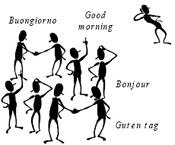
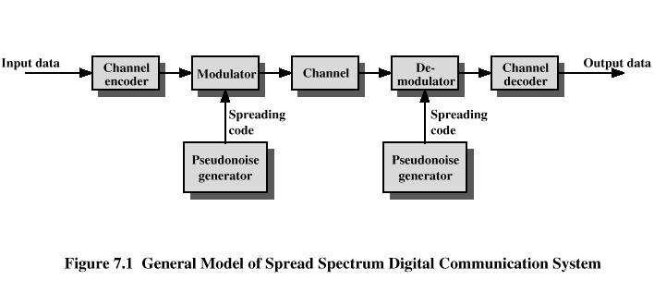
Anti-jamming solutions
Physical layer approaches
Coding theory and information theory based approaches
Beam-forming (signal processing based approaches) or cooperative jamming
Spread spectrum techniques
  At the physical layer
  Based on the assumption of limited knowledge at Eve
  Code Division Multiple Access (CDMA)
EP2500 NETWORKED SYSTEMS SECURITY
2015-11-13
2015-11-13
EP2500 NETWORKED SYSTEMS SECURITY

Slide 7
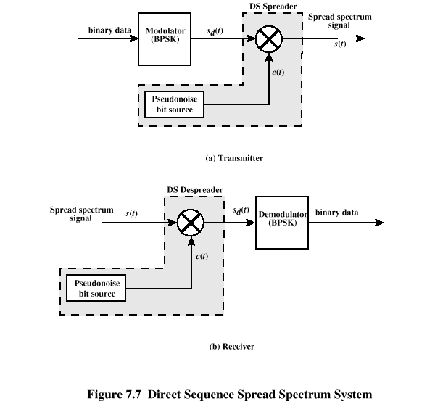
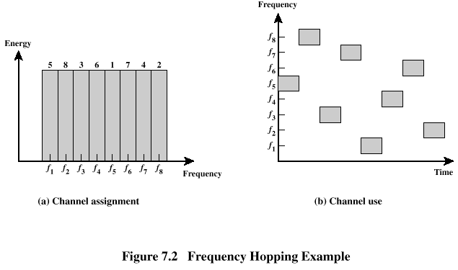
Spread spectrum techniques
Direct Sequence (DS)
  The modulated signal is multiplied by a spreading code
Frequency Hopping (FH)
  Signal hops from frequency to frequency at fixed intervals
  The frequency sequence is dictated by the spreading code
Time Hopping (TH)
Jamming
Narrowband
Filter
Data Signal
with Spreading
Original
Data Signal
Data Signal
Receiver
De-spreading
Input
EP2500 NETWORKED SYSTEMS SECURITY
2015-11-13
2015-11-13
EP2500 NETWORKED SYSTEMS SECURITY

Slide 8
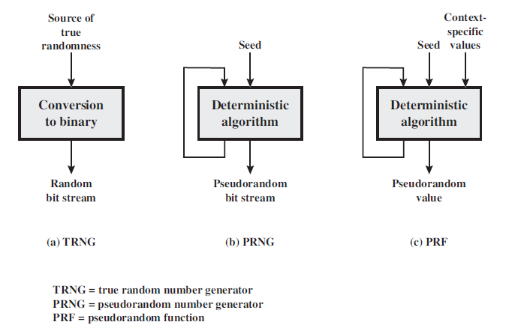
Random number generation
Must be sent to receiver: securely
EP2500 NETWORKED SYSTEMS SECURITY
2015-11-13
2015-11-13
EP2500 NETWORKED SYSTEMS SECURITY

Slide 9
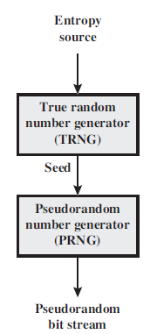
Pseudorandom Number (PN) sequences
Deterministic (non-random) sequence
  Looks random: in some well-defined statistical sense
    Uniform distribution of bits
    Independence: No one subsequence in the sequence can be inferred from the others
    Some statistical tests
EP2500 NETWORKED SYSTEMS SECURITY
2015-11-13
2015-11-13
EP2500 NETWORKED SYSTEMS SECURITY

Slide 10








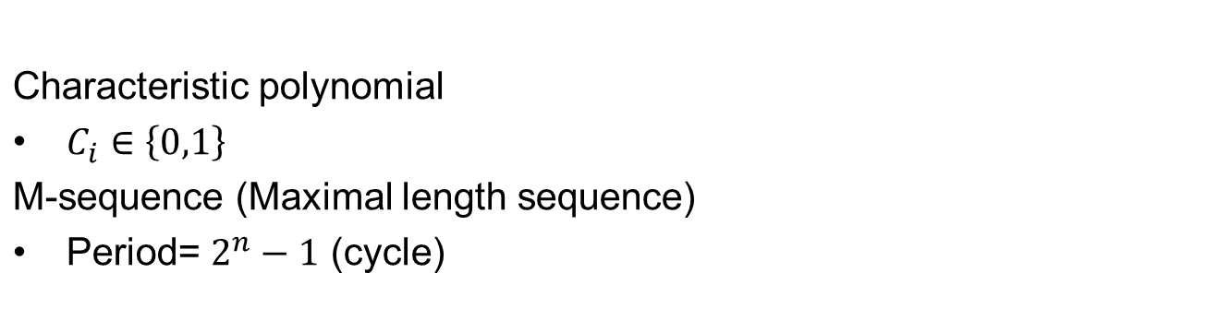
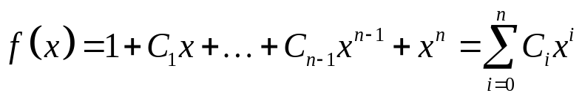
Linear Feedback Shift Registers (LFSRs)
output
EP2500 NETWORKED SYSTEMS SECURITY
2015-11-13
2015-11-13
EP2500 NETWORKED SYSTEMS SECURITY

Slide 11
An exercise
Jamming in Frequency Hopping Spread Spectrum
A transmitter-receiver pair wishes to communicate k messages (pieces of data)
Transmission time for each message = T ms
Number of available channels (frequency bands) = C
Transmit one message over one channel chosen uniformly at random
After T ms hop to another channel chosen uniformly at random independent of the previous channel
Jammer can prevent communication on C_{jam} channels chosen uniformly at random
After T ms, the jammer chooses a new set of C_{jam} channels chosen uniformly at random independent of the previous set
If k messages have to be transmitted, how many tries does this require?
Hint: Binomal distribution
EP2500 NETWORKED SYSTEMS SECURITY
2015-11-13
EP2500 Networked Systems Security
2015-11-13
2015-11-13
EP2500 NETWORKED SYSTEMS SECURITY

Slide 12

Questions?
EP2500 NETWORKED SYSTEMS SECURITY
2015-11-13
2015-11-13

