Slide 1
Empirical study of the relationship between Android's API calls and code defect
Pierre Gérard

Slide 2
Study
Research questions :
Is there a correlation between Android API calls and code defect ?
If so, is this correlation may be a direct relation ?
Data
Client->API calls.
Based on static analysis of code.
Issues in code
Based on user/developpers report.

Slide 3
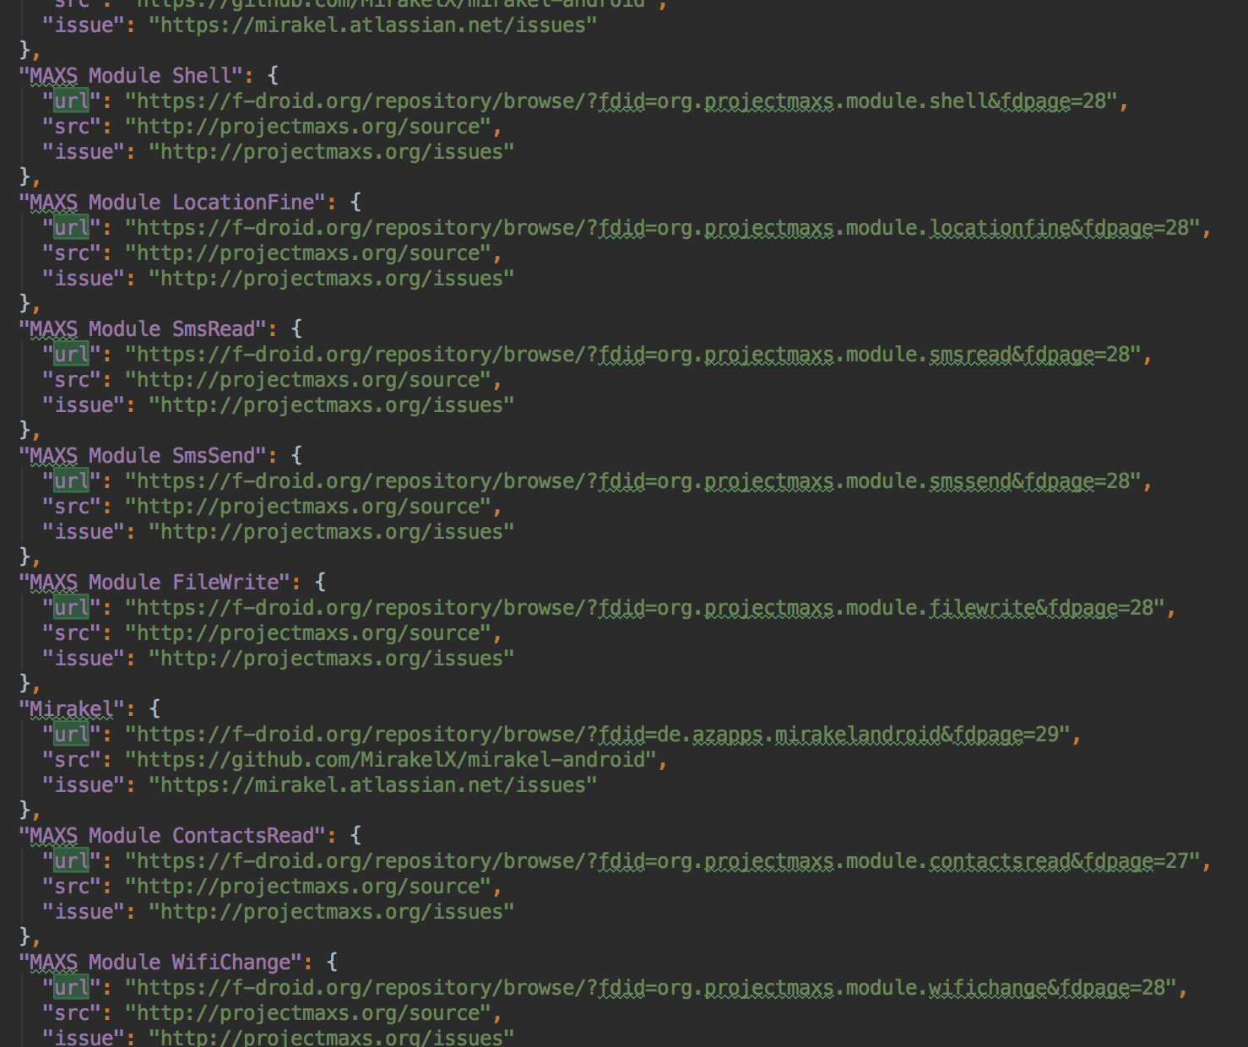
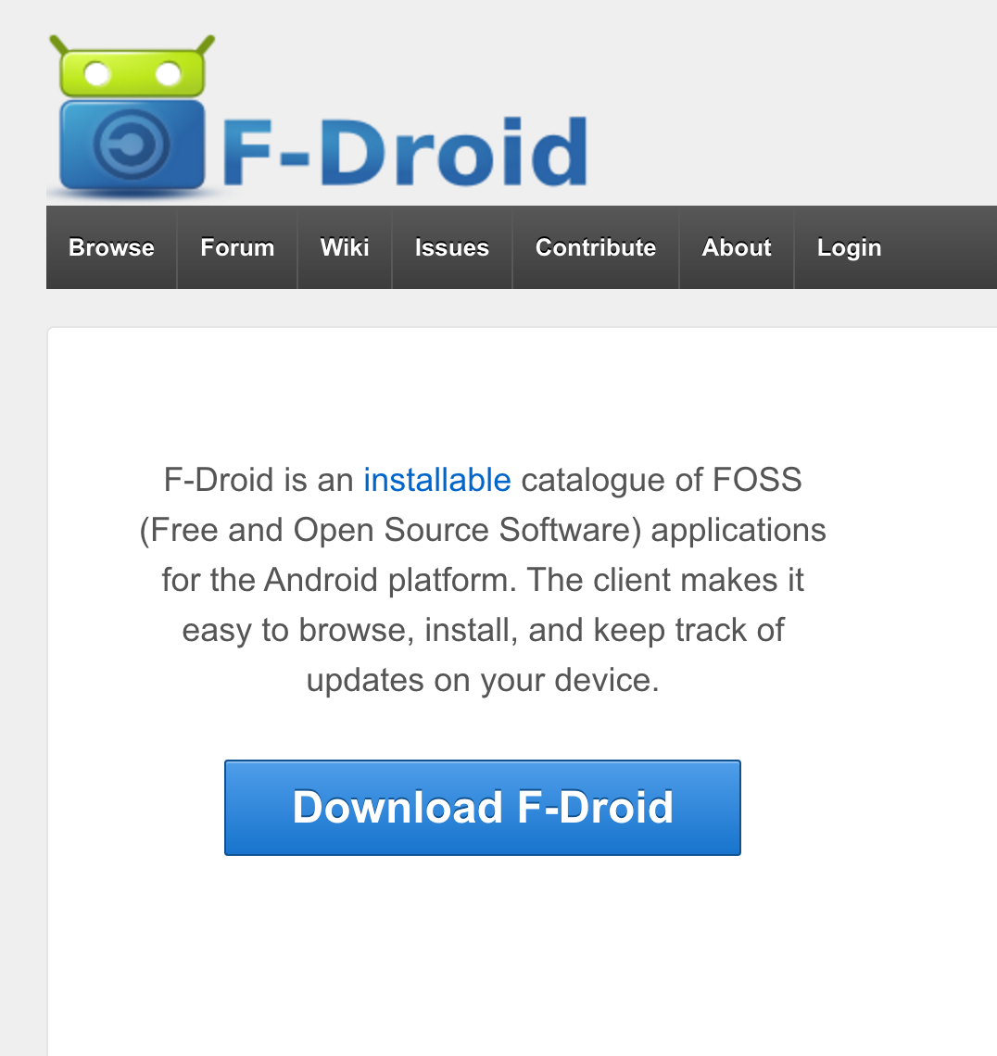
Data collection
1151 GitHub repo
14 GitHub repo
Those that are the most important in term of number of issues (totaling 26000)
26 Jira repo
F-Droid
1661 Open source Repository
Others

Slide 4
Limits for data collection
Github’s API : 5000 authenticated requests per hour
Data take time to collect …
But More data implies better confidence in result …

Slide 5
Defect identification
Collect all closed issue on GitHub
For every issue, find commit linked, if any.
For every commit, find class concerned.

Slide 6
Dependancy identification
Use of the following tools : java-callgraph (Georgios Gousios, Institute for Computing and Information Sciences, Radboud Universiteit Nijmegen)
For each class identify calls to an Android API.
Exemple for the following class : MainActivity

Slide 7
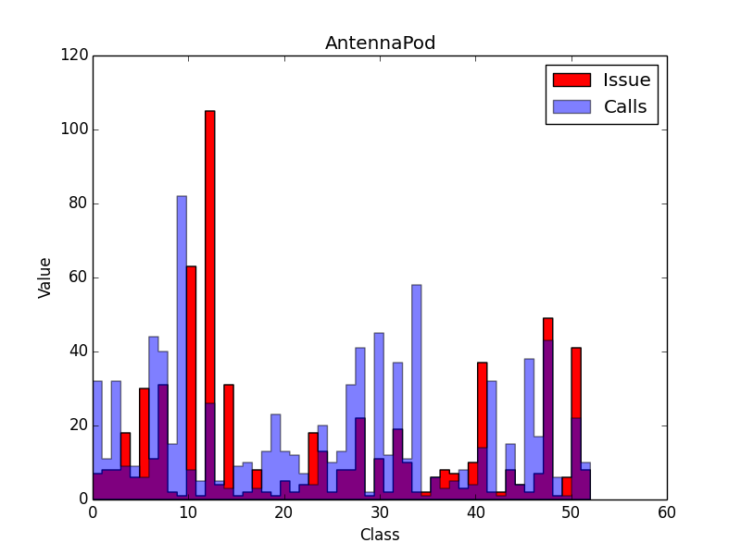
Example : AntennaPod

Slide 8
Roadmap
Test for the 13 others applications
Use metrics to study the relationship
Better handling of class inside class
Better identifying of Android API
Try with different scope (method instead of class)
Take into account commit size
Take into account class/method size
…

Slide 9
Questions / ideas for improvement
?
(Source available on : github.com/PierreGe/empirical-study )

