Slide 1

ChIPseq data analysis
Master 2 GenE2
ChIPseq workshop
2022/2023
[Students' first and last names]
[Title]

Slide 2
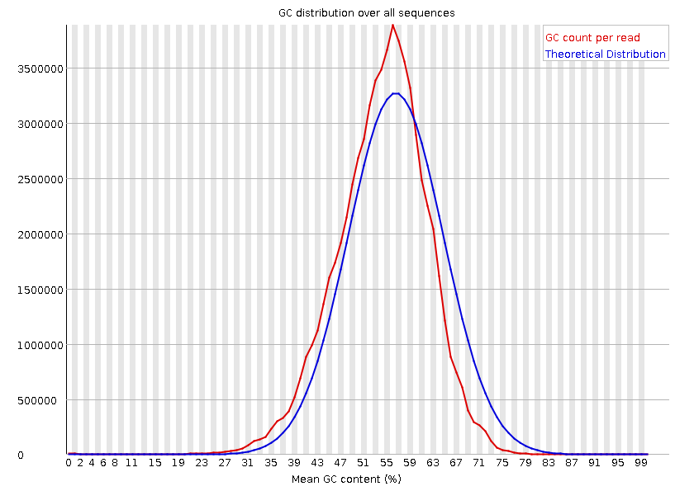
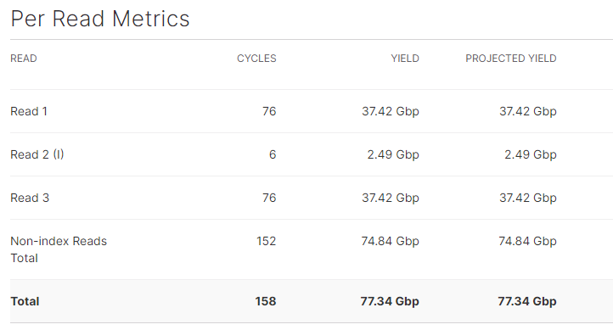
Figure 1 : Complete legend of the figure
Table 1 : Complete legend of the table

Slide 3
Introduction
Very brief general introduction
Explicitly write-down the biological/technical question you aim to tackle in the report
Presentation of the data
How is the output of the sequencing run?
What about the quality of the sequencing?
Methods
If the method has been already used during the “big data” workshop, just cite the program and the key parameters.
Otherwise provide a brief description of what you have done and how.
1

Slide 4
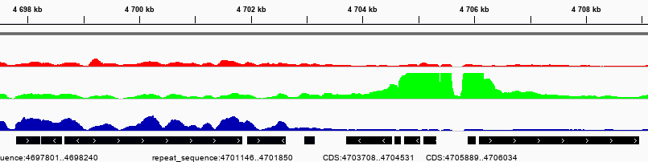
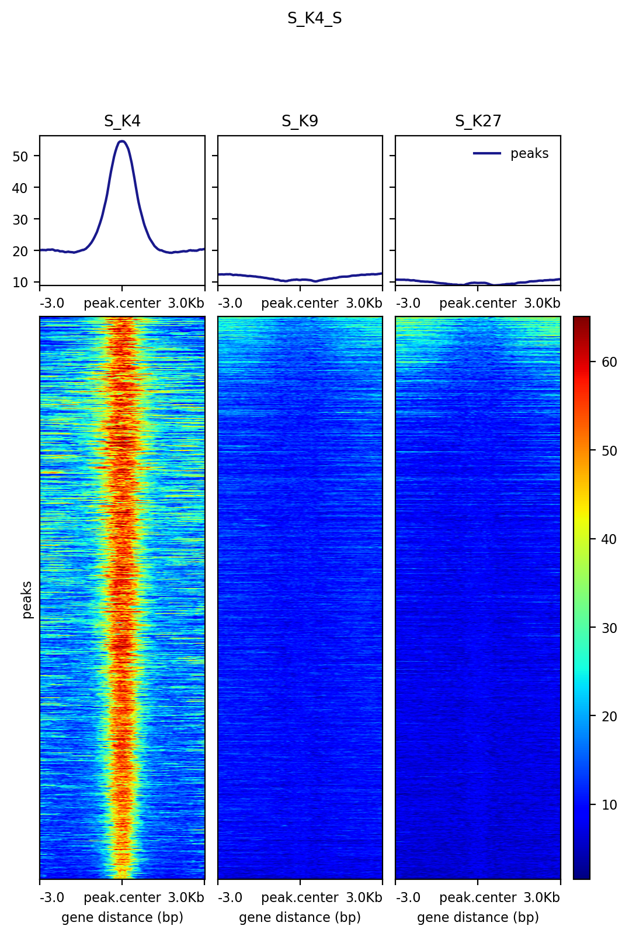
Figure 2 : Complete legend of the figure
Figure 3 : Complete legend of the figure

Slide 5
Results of the analysis + intrepretation
Here, your aim is to answer (to the best as the data can) a biological/technical question raised in the introduction.
Select the piece of data you need to provide to support your reasoning.
- Describe general observations of the ChIP data. If a replicate has been excluded, justify why.
- The data presented in this section should demonstrate how the experiment’s objectives (= answer to biological/technical question) have been met.
- In the text, convey the main findings of the experiment. Text and findings must be supported by the Figures (and/or tables).
- Interpret your findings in light of the field’s knowledge.
2

Slide 6
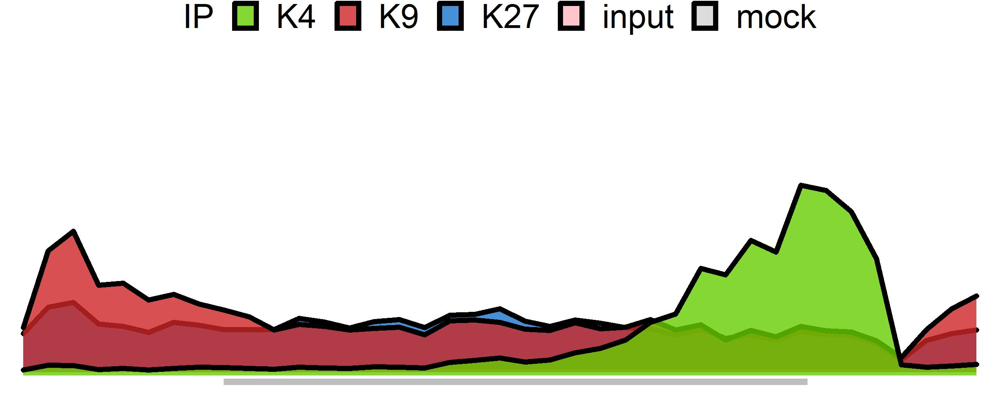
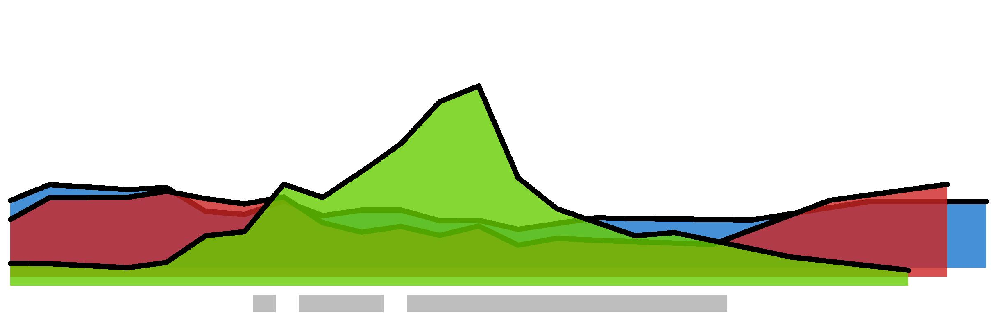
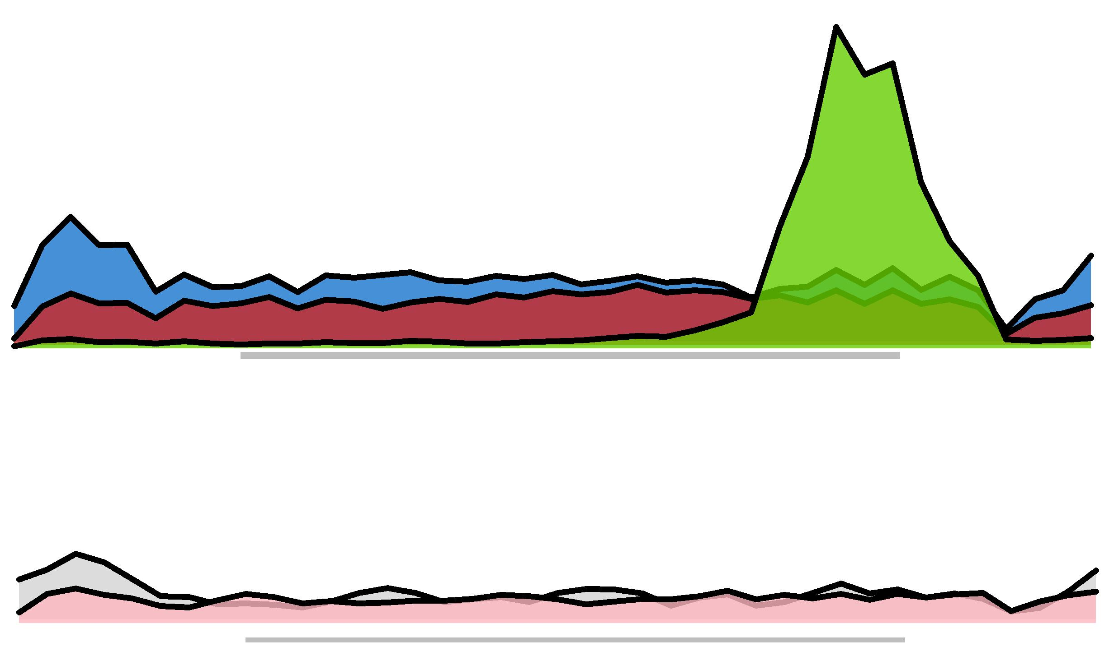
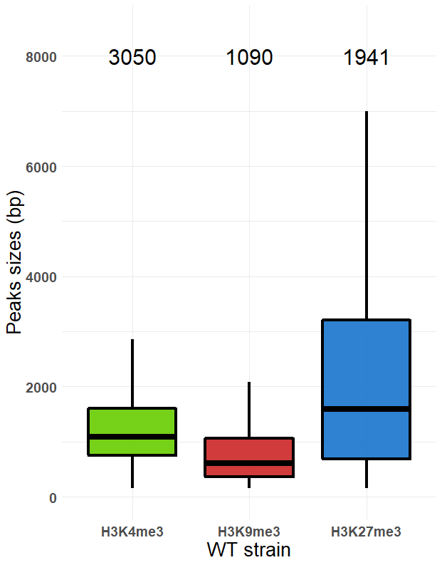
Figure 4 : Complete legend of the figure
6000
3050
1090
1941
4000
sizes (bp)
2000
0
H3K4me3
H3K9me3
H3K27me3
Figure 5 : Complete legend of the figure

Slide 7
Conclusion
Summarize the main findings. Comment on the quality of the ChIPseq. Conclude on the biological relevance of your results.
No new information should be given in the conclusion
Propose further work or potential improvements identified during the experiments/analyses.
3

