Slide 1


Input
IP1
IP2
30µl
30µl
30µl
1:5 dilution of an aliquot
6 µl + 24 µl H₂O
Diluted
Input
Diluted
IP1
Diluted
IP2
30µl
30µl
30µl

Slide 2
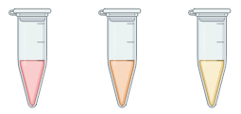
20 µl
H₂O
20 µl
H₂O
5 µl
5 µl
Std-1
Std-2
Std-3
Diluted Input : 12µl
Diluted IP1: 6 µl
Diluted IP2: 6 µl

