Slide 1

ChIPseq data analysis
Master 2 GenE2
ChIPseq workshop
2022/2023
[Students' first and last names]
[Title]

Slide 2
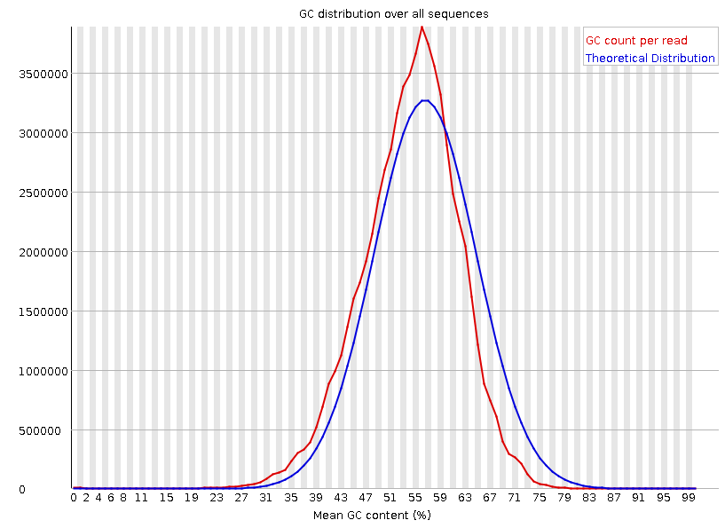
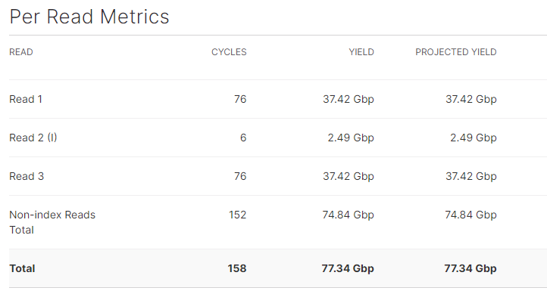
Figure 1 : Complete legend of the figure
Table 1 : Complete legend of the table

Slide 3
Introduction
Very brief general introduction
Presentation of the data
How is the output of the sequencing run?
What about the quality of the sequencing?
Methods
If the method has been already used during the “big data” workshop, just cite the program and the key parameters.
Otherwise give a brief description of what you have done.
1

Slide 4
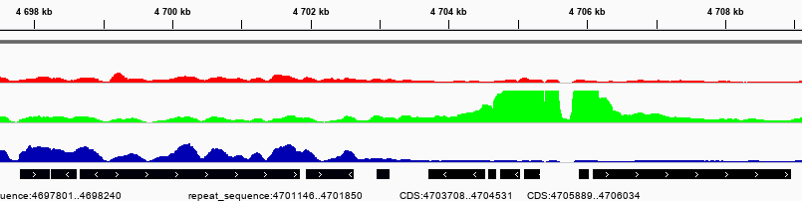
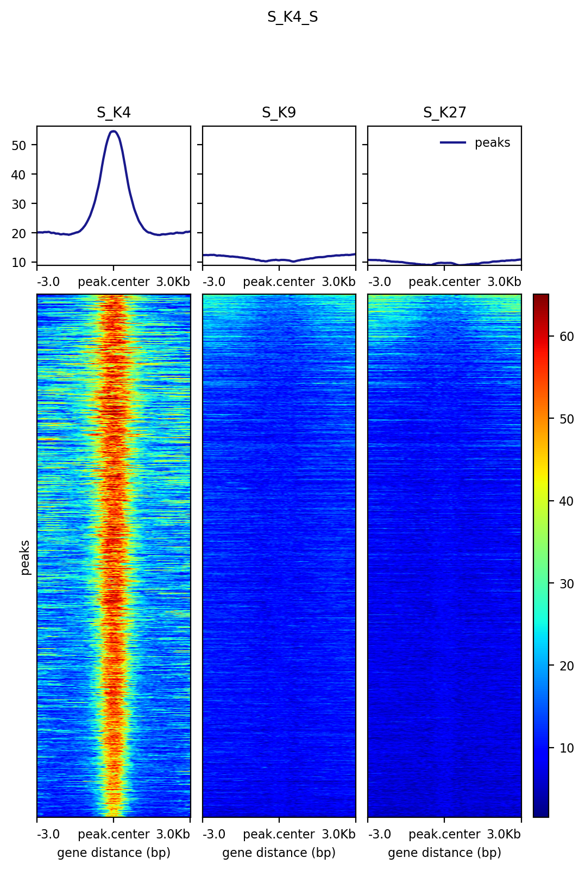
Figure 2 : Complete legend of the figure
Figure 3 : Complete legend of the figure

Slide 5
Results of the analysis
Main features of the ChIP results.
Focus on specific characteristics.
Show important results only.
2

Slide 6
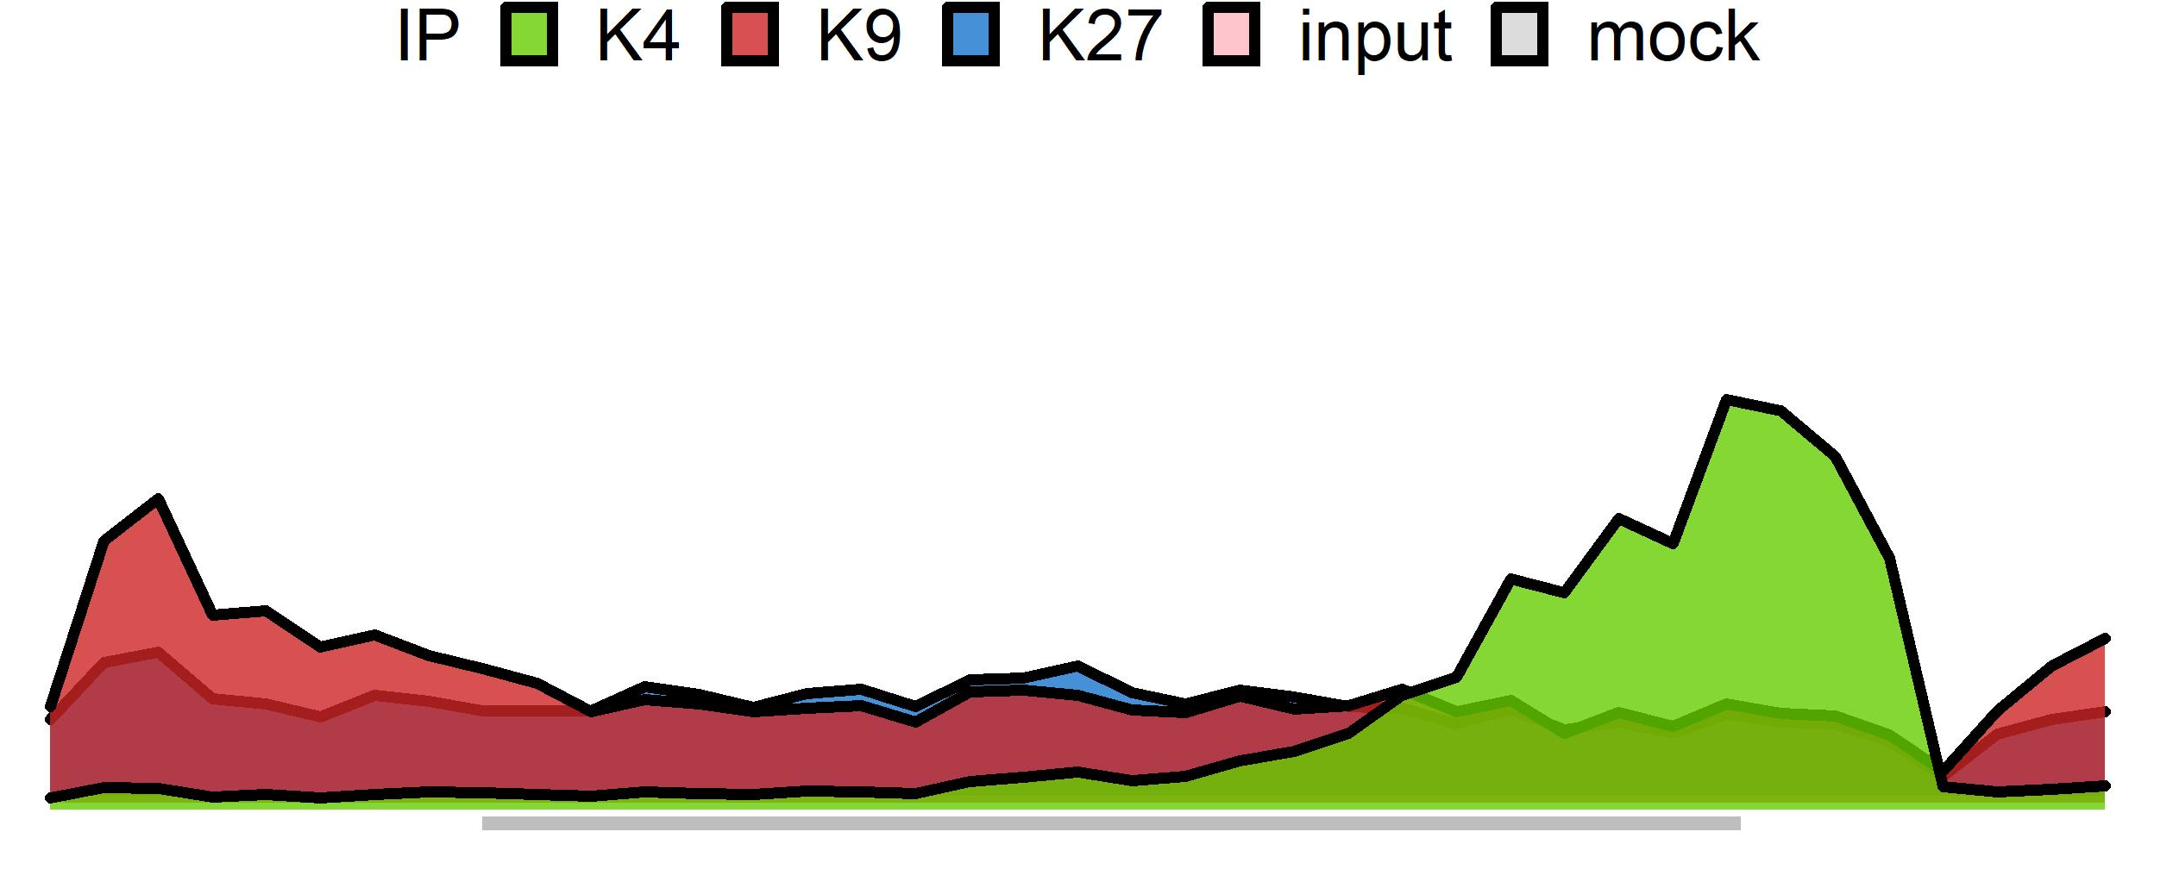
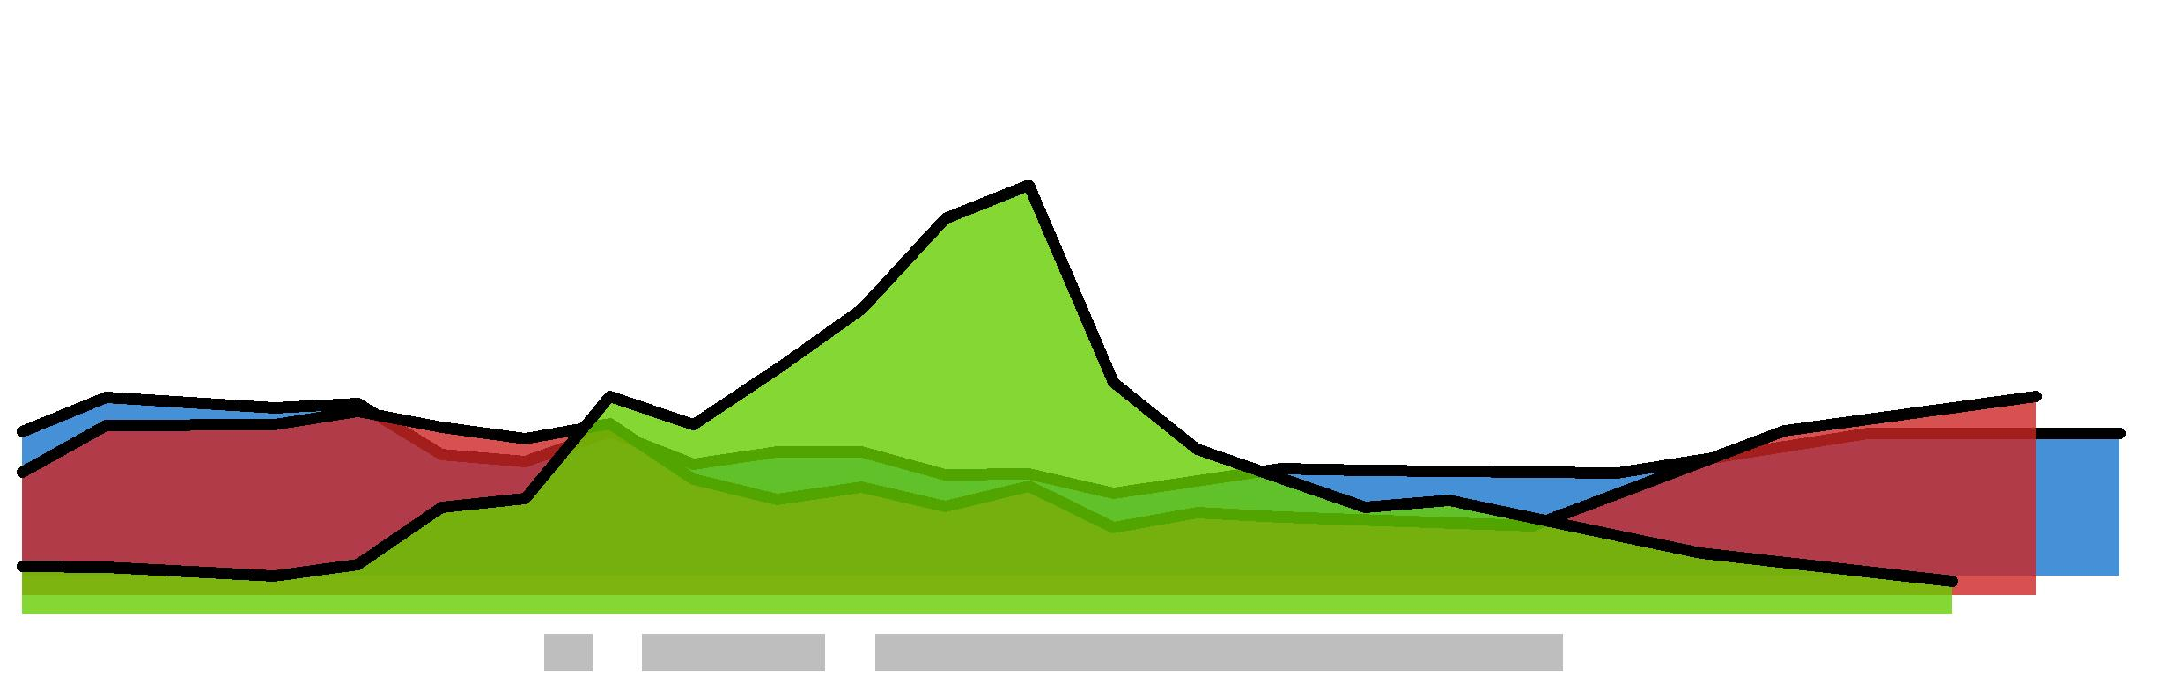
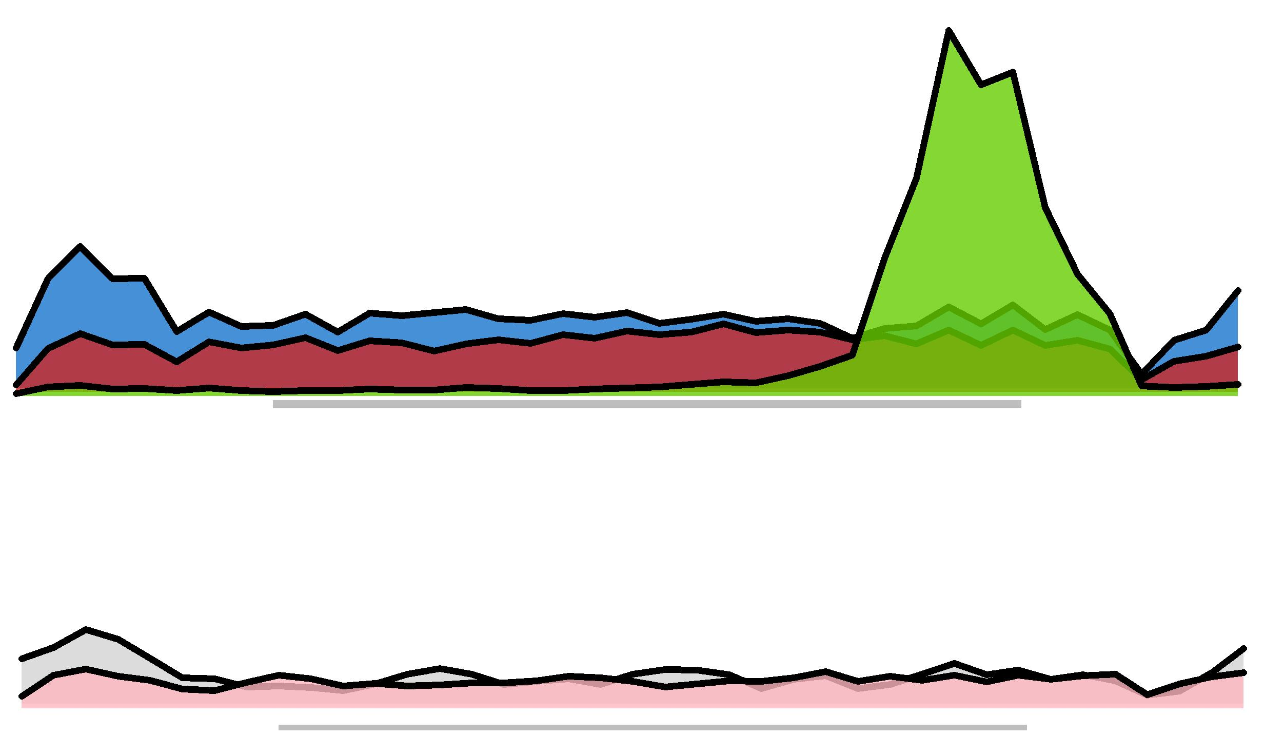
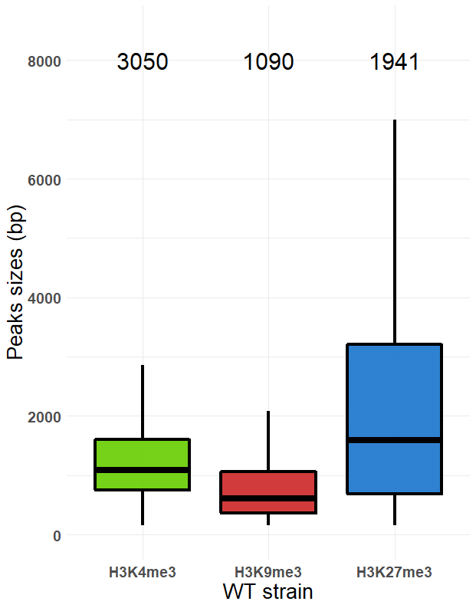
Figure 4 : Complete legend of the figure
6000
3050
1090
1941
4000
sizes (bp)
2000
0
H3K4me3
H3K9me3
H3K27me3
Figure 5 : Complete legend of the figure

Slide 7
Conclusion
Comment on the quality of the ChIPseq.
Biological relevance of the results.
Further study.
3

