Slide 1
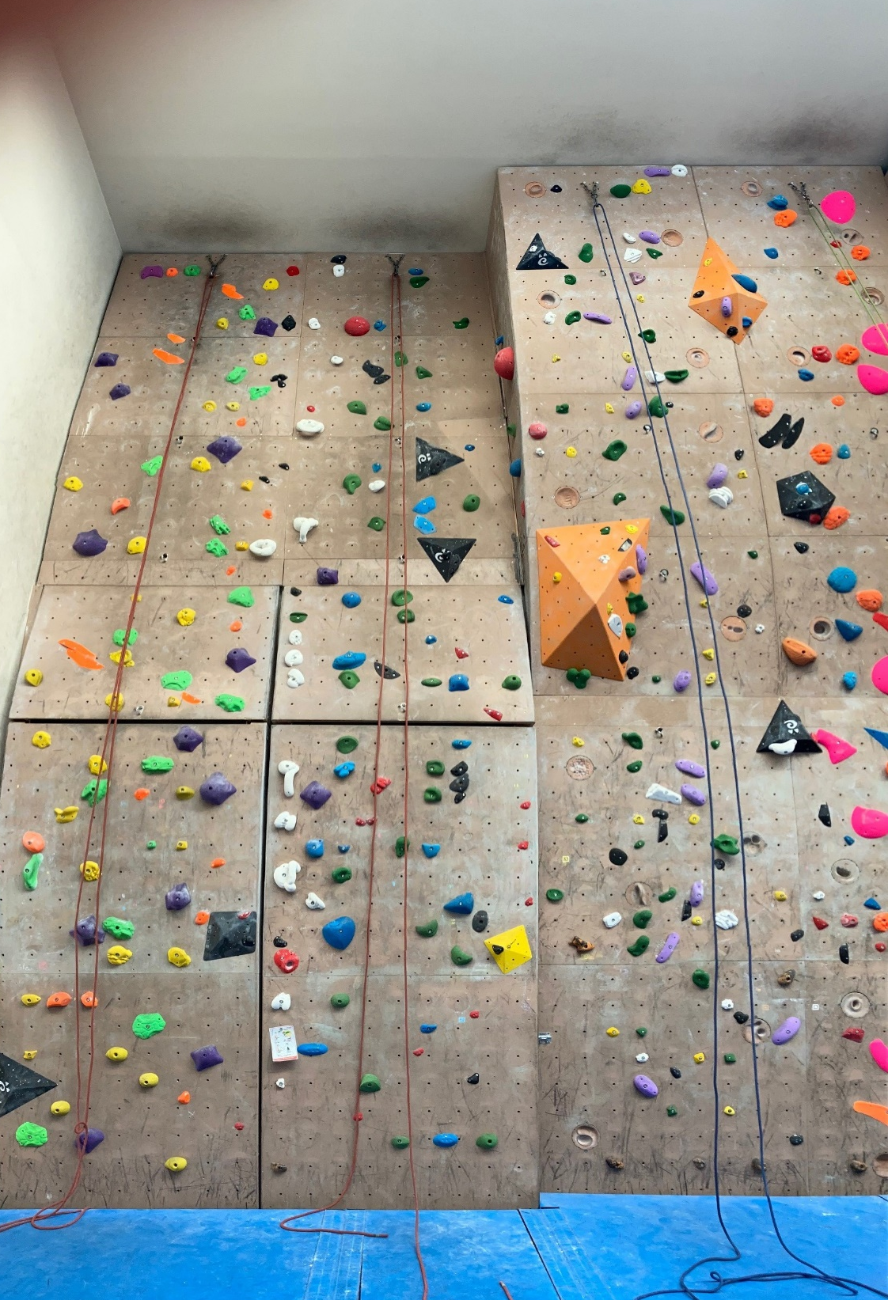
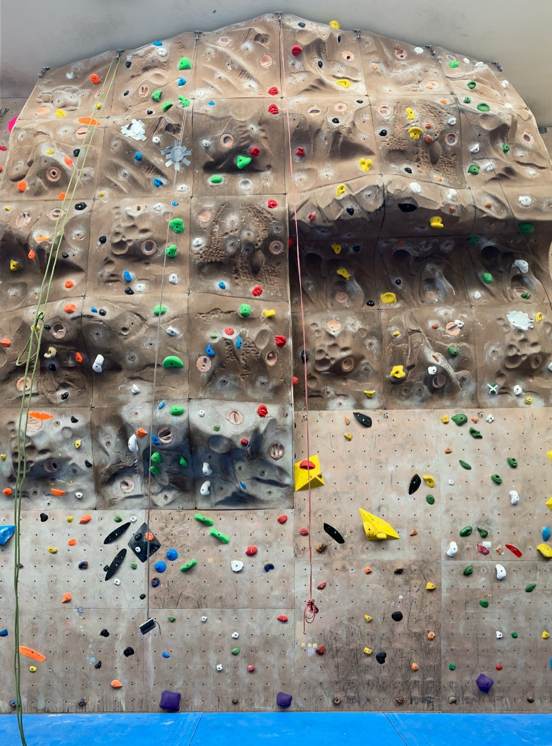
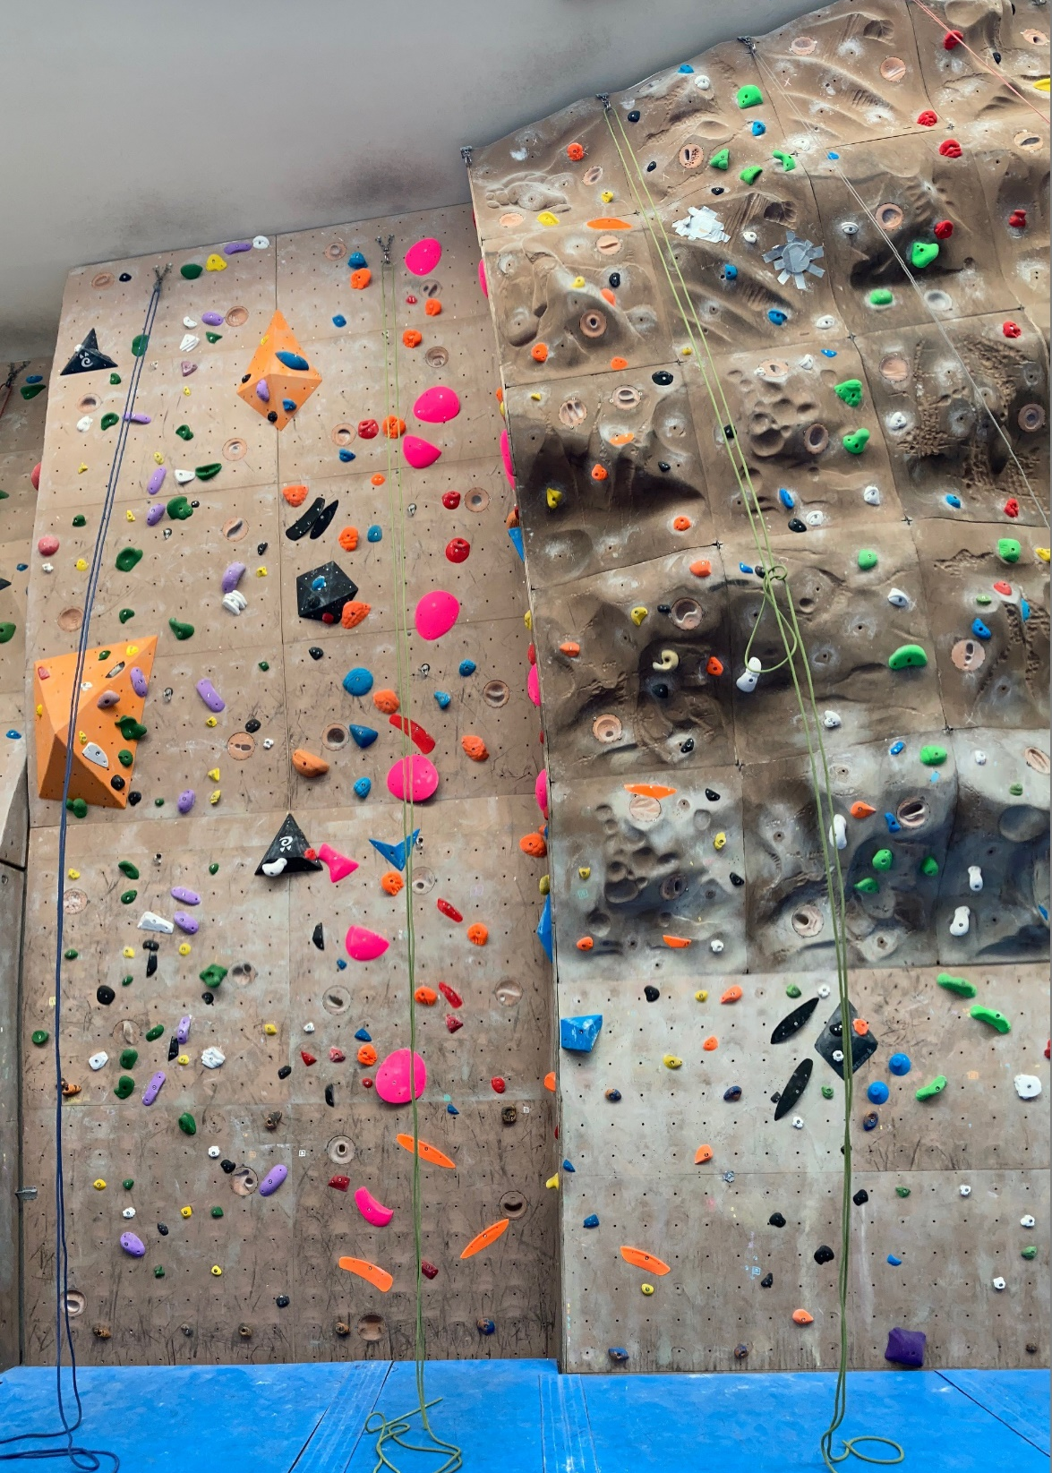
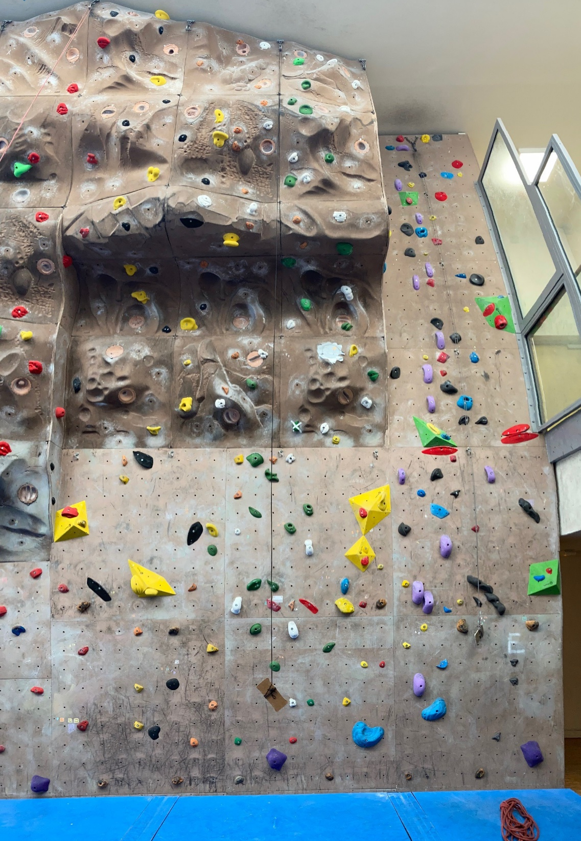
09/2022 V2
8
7
9
6
10
11
5
3
4
12
1
2
7
7A
7A+
7B
6B
6C+
6A
6C+
6B+
6B
6A
6
6A/B
6A
6A
6B+
6B+
6A
5
5C+
5B
5B+
5B+
5B+
5C
5B+
5B
5B
5A
5B
5C+
5B
4
4
4
4
4
initiation
initiation

