Slide 1

Final Year Project · 2025 / 26
Clock-counter profiling
of GPU memory loads
Mapping the four PTX cache modifiers across
L1 → L2 → DRAM on Ampere (RTX 3060 Ti)
Pierre Khoury · BSc CS with AI · University of Sussex
Supervisor: [Supervisor Name]

Slide 2
What we'll cover
01
Why AI kernels are slow
06
Methodology · clock64 + NCU PMU side by side
02
Memory-bound vs compute-bound · and why NCU counters matter
07
Results · 1000-LDG timing, all on one page
03
GPU architecture · RTX 3060 Ti + cache hierarchy
08
Timeline + advisor meetings (pointer chains, megainstructions)
04
Nano-benchmarking · sub-instruction profiling
09
Relevance · Intel NEX / PTP, the timing-instruction lineage
05
Similar work · KPerfIR · CuAsmRL
9 sections · ≈ 15 min talk + 5 min Q&A
V4

Slide 3
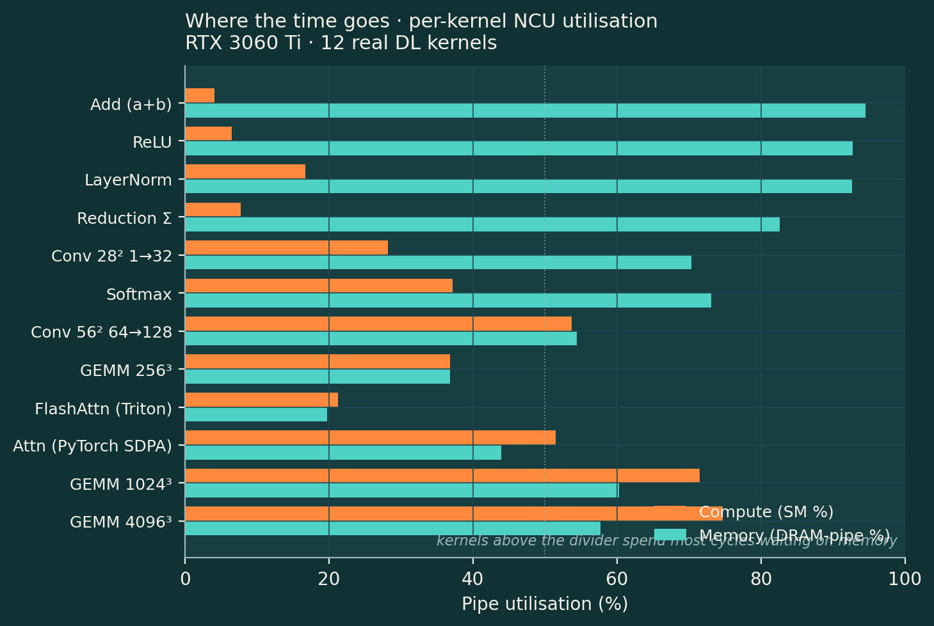
01
Why AI kernels are slow
/ GPUs do two things · compute (FLOPs) and move bytes.
/ Most AI kernels finish a load long before the next FLOP issues.
/ NCU shows it directly: SM-pipe % vs DRAM-pipe %.
/ On my RTX 3060 Ti, 9 of 12 real DL kernels are memory-bound.
/ Only big square GEMMs cross the 50/50 line.
Takeaway
If you want a faster AI kernel, the per-load cost
is what you have to attack · not the per-FLOP cost.
Source: NCU runs in relevance_slide/kernel_zoo_summary.csv (RTX 3060 Ti, SM86)
ref: forums.developer.nvidia.com/t/247658 · §1 / 9

Slide 4
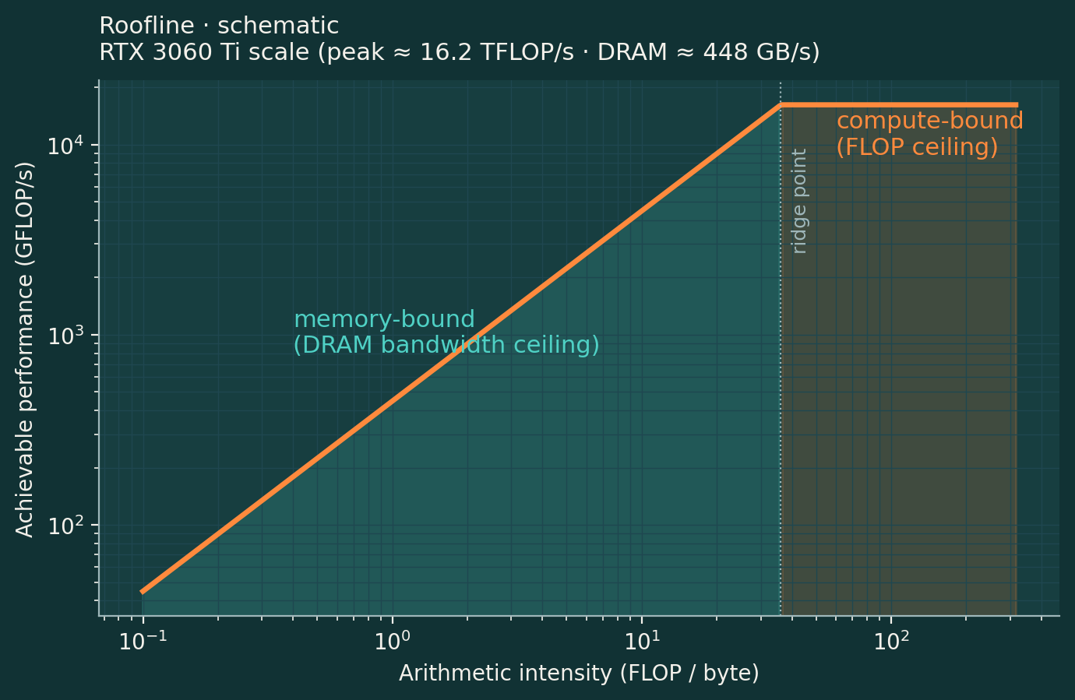
02
Memory-bound vs compute-bound · why NCU counters matter
/ Roofline: a kernel sits left of the ridge (memory-bound) or right (compute-bound).
/ Side defines the optimisation target · bytes moved vs FLOPs issued.
/ Source code alone can't tell you which side: depends on WS, cache state, modifier choice.
/ NCU PMU counters read the hardware directly · SM-pipe %, DRAM-pipe %, sector hits.
/ Without the counter, you optimise blind.
Why this slide exists
Every later slide assumes we can tell memory-bound from compute-bound.
NCU counters are the only ground truth · clock64 alone can't.
Roofline figure: schematic to RTX 3060 Ti scale (peak ≈ 16.2 TFLOP/s, DRAM ≈ 448 GB/s)
ref: forums.developer.nvidia.com/t/247658 · §2 / 9

Slide 5
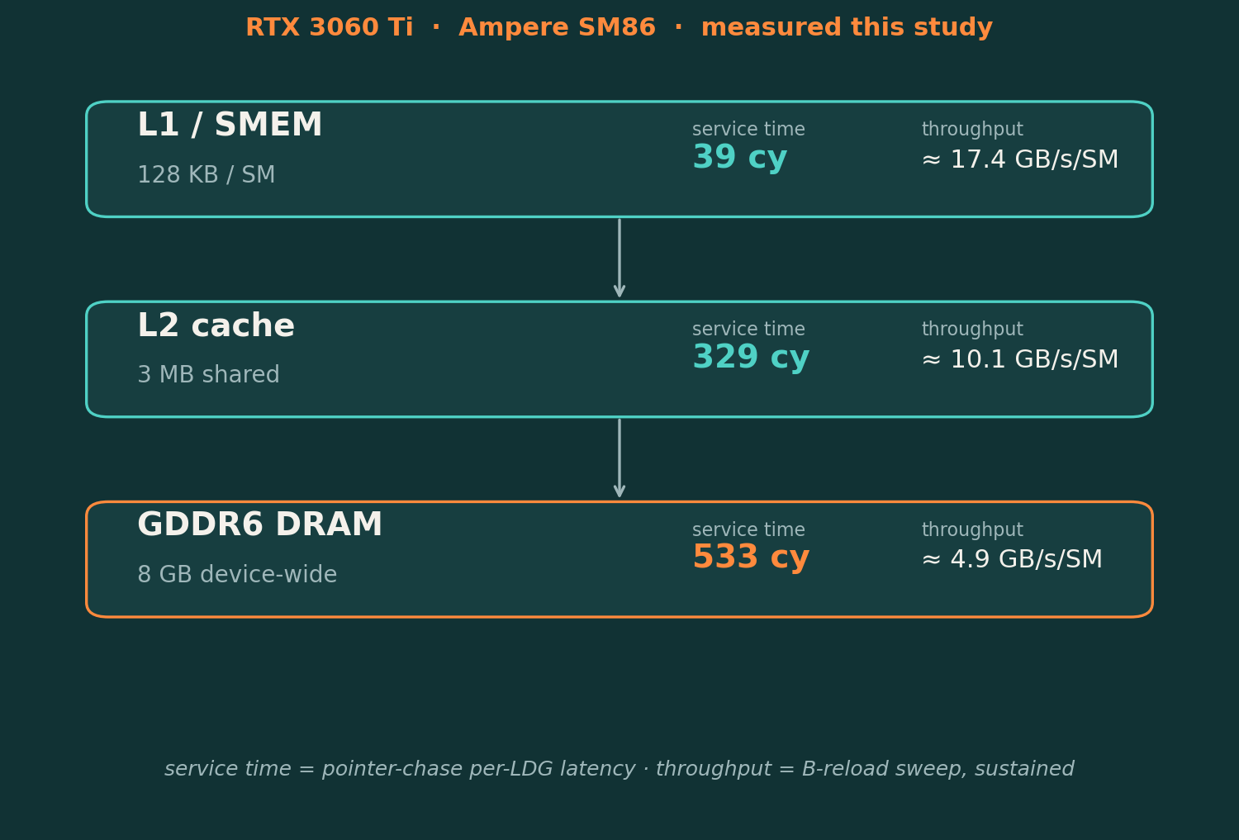
03
GPU architecture · RTX 3060 Ti
/ Ampere SM86 · 38 SMs, 1.68 GHz SM clock.
/ Per-SM L1D + SMEM · 128 KB unified partition.
/ Per-die L2 · 3 MB shared across all SMs.
/ GDDR6 DRAM · 8 GB device-wide, off-chip.
/ Three tiers · and PTX modifiers pick which one serves a load.
What the latencies cost
L1: 39 cy · L2: 329 cy · DRAM: 533 cy
8.4× ratio L1→L2 · biggest lever in the hierarchy.
Latency numbers: pointer-chase, SM86 (paper §Hierarchy Latency)
§3 / 9

Slide 6
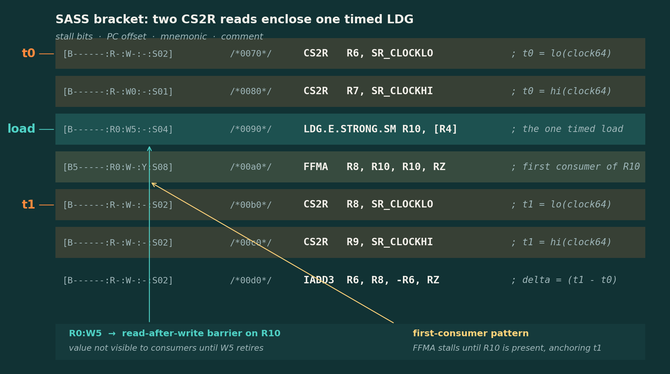
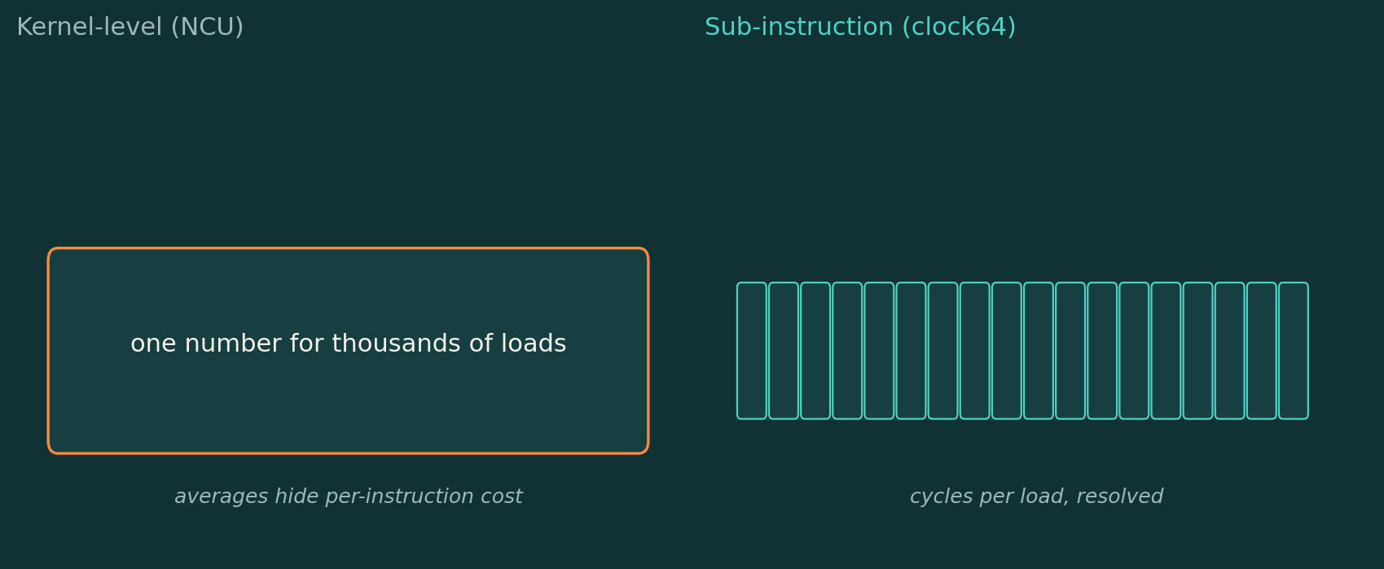
04
Nano-benchmarking
/ Read clock64 before and after a small instruction window.
/ Time 1000 back-to-back LDGs → divide → per-load cycles.
/ Pointer-chase keeps ONE load in flight · resolves a single tier.
/ Pipelined sweep keeps MANY in flight · exposes modifier policy.
/ Both use the same bracket. Different question, same instrument.
Why kernel-level isn't enough
NCU averages thousands of loads into one number.
A 290-cycle L2 fill bleeding into the next bracket can
reverse a modifier ranking · invisible at kernel level.
Bracket pattern: paper §Clock Instrumentation (clock64 / CS2R)
§4 / 9

Slide 7
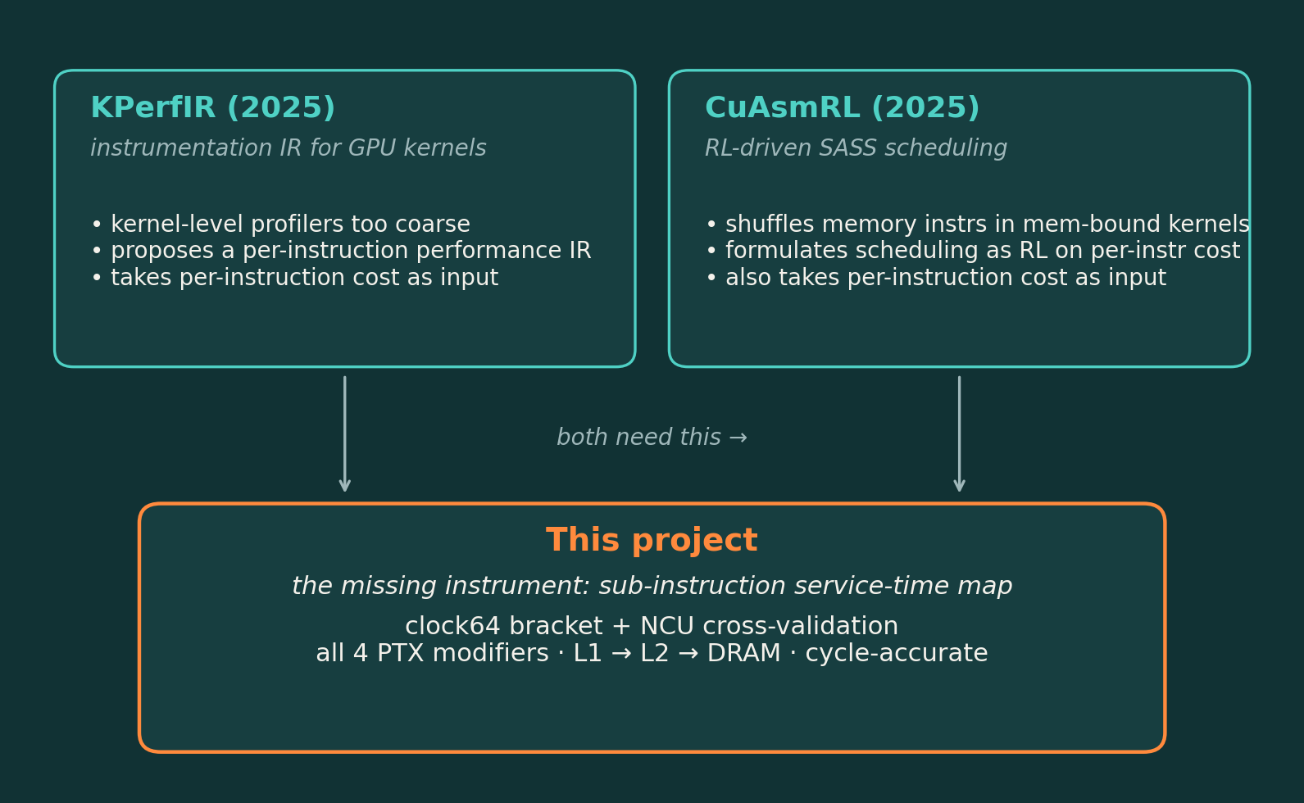
05
Similar work · and what's missing
/ KPerfIR · instrumentation IR for GPU kernels.
/ CuAsmRL · RL that reorders SASS memory instructions.
/ Both treat per-instruction memory cost as an INPUT.
/ Neither one publishes the instrument that produces it.
/ We sit in that gap · the per-LDG service-time map.
Framing
Profile the EXECUTION side of GPU kernels.
Cycle-accurate, per-instruction, hardware-validated.
Refs: KPerfIR 2025, CuAsmRL 2025 (paper §Prior Work)
§5 / 9

Slide 8
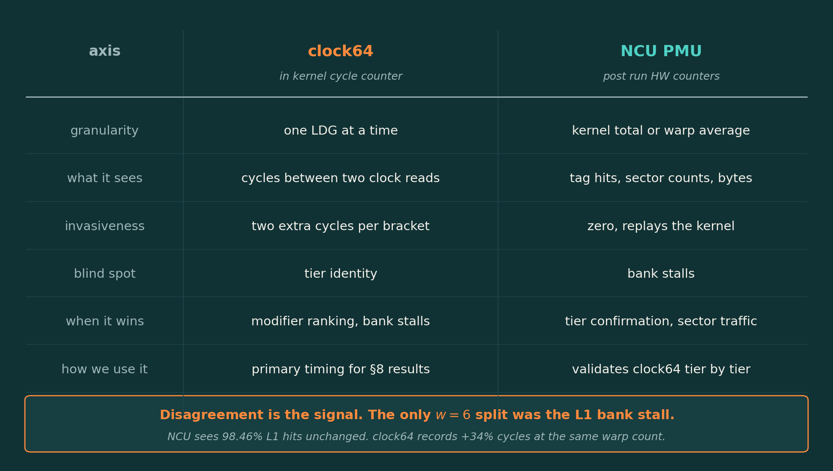
06
Methodology · two instruments, jointly
/ clock64 reads cycles between two SASS instructions.
/ NCU PMU reads tag hits, sectors, bytes · post-hoc.
/ Different physical signals · agreement licenses both.
/ Disagreement is the interesting part (e.g. bank stall).
/ Neither alone is enough; together they triangulate.
Why this combination
clock64 is fast and per-instruction but tier-blind.
NCU sees the tier but averages thousands of loads.
Source: paper §Clock Instrumentation, §NCU as Independent Confirmation
§6 / 9

Slide 9
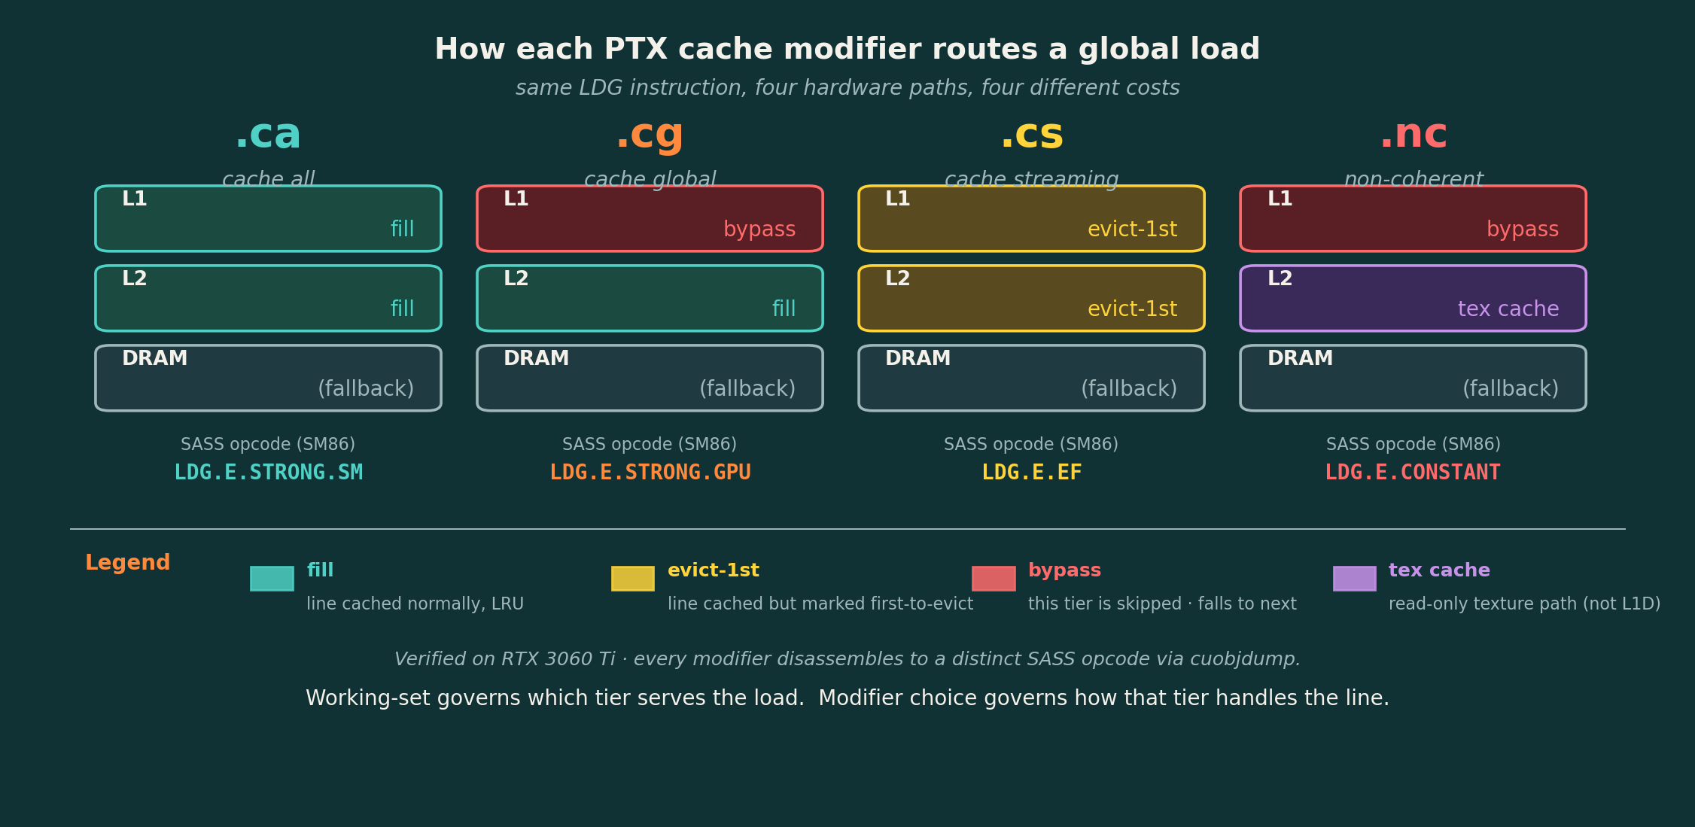
07
What each cache modifier actually does
Verified on RTX 3060 Ti (SM86) via cuobjdump · see §6 for methodology
§7 / 9

Slide 10
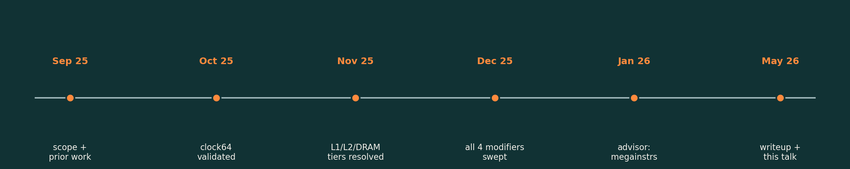
08
Timeline + what advisor meetings gave me
What the supervisor pushed me toward
/ Don't stop at "per-LDG cycles" · see the chain of dependent loads as a structure (a tree).
/ If you can describe the traversal up front, the scheduler can prefetch · that's a megainstruction.
/ Pointer-chase is the smallest version of that idea · one node deep, one path.
/ Megainstruction = many nodes, one issue · exposes parallelism the compiler currently can't see.
/ Discussed Jan 2026 (next slide: the godbolt / tree screenshots from those calls).
Supervisor meetings, 2026-01-23 session · full screenshots overleaf
§8 / 9

Slide 11
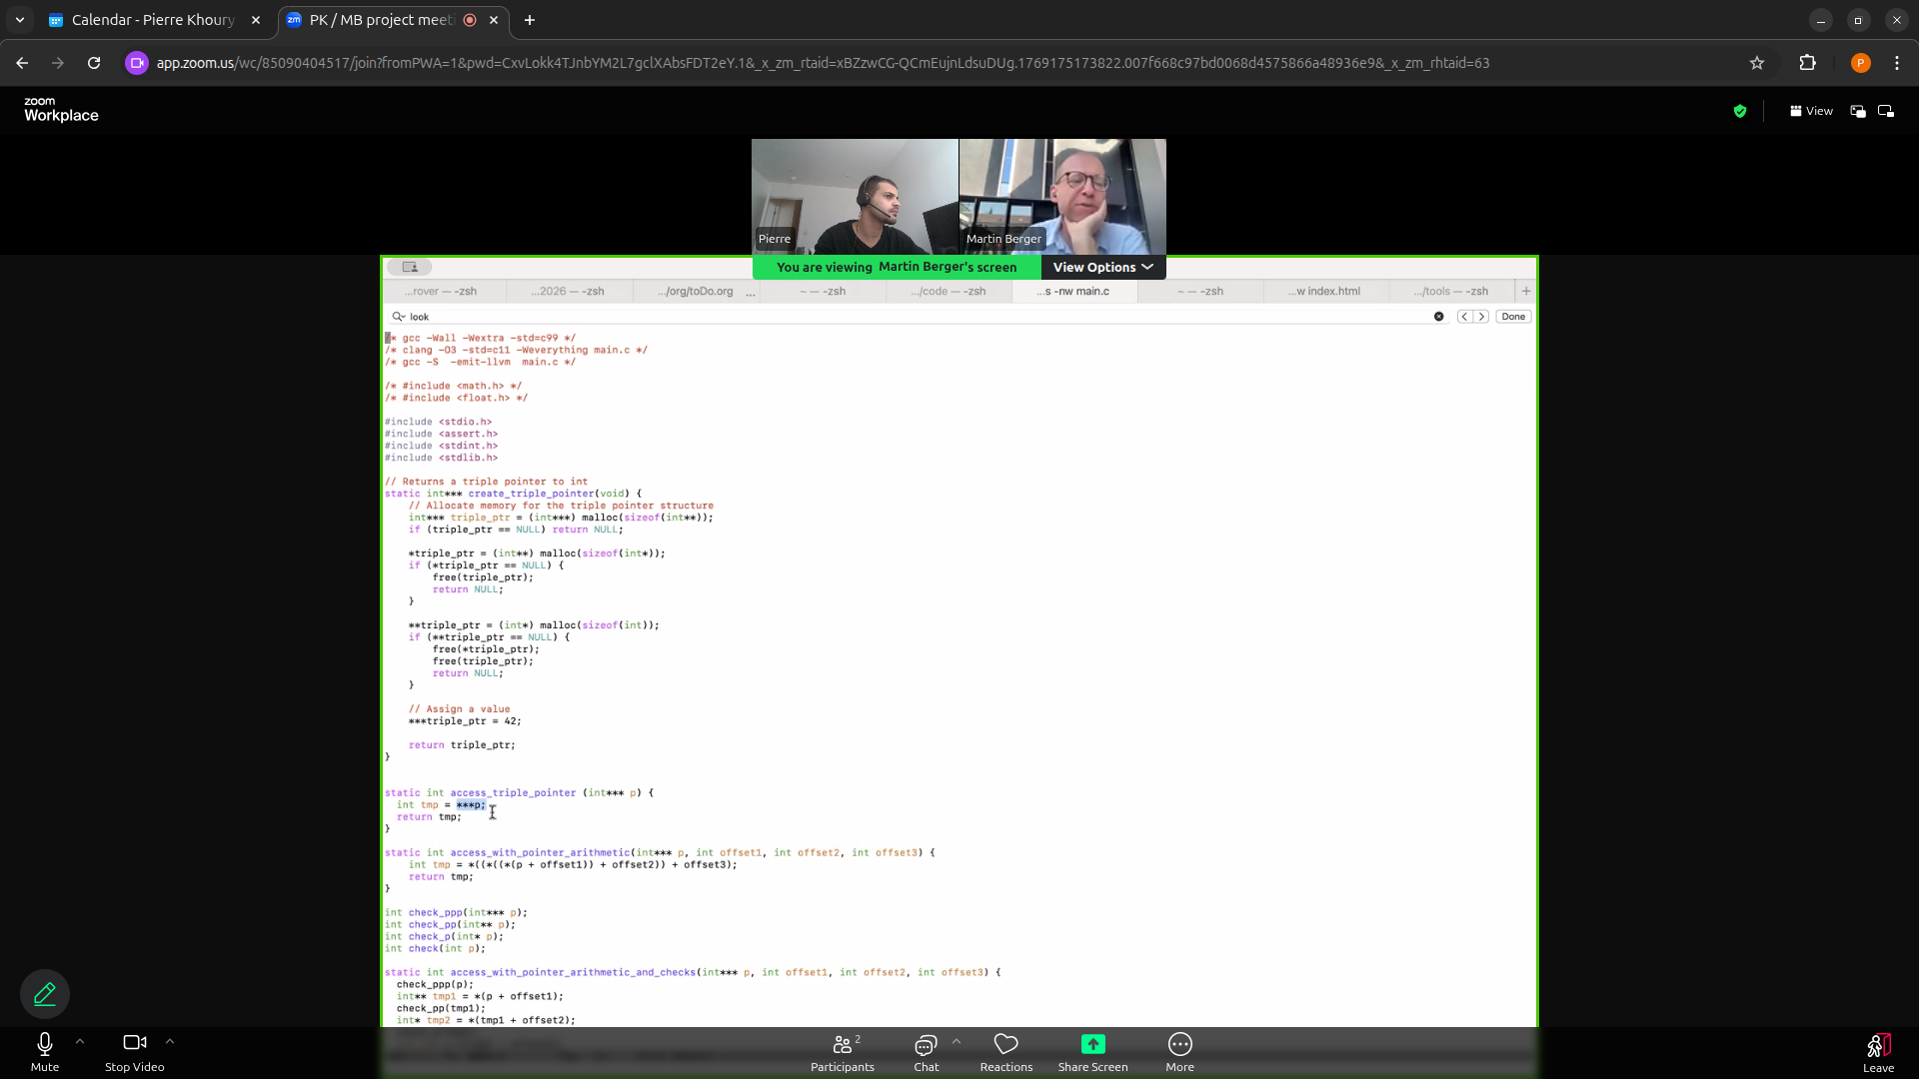
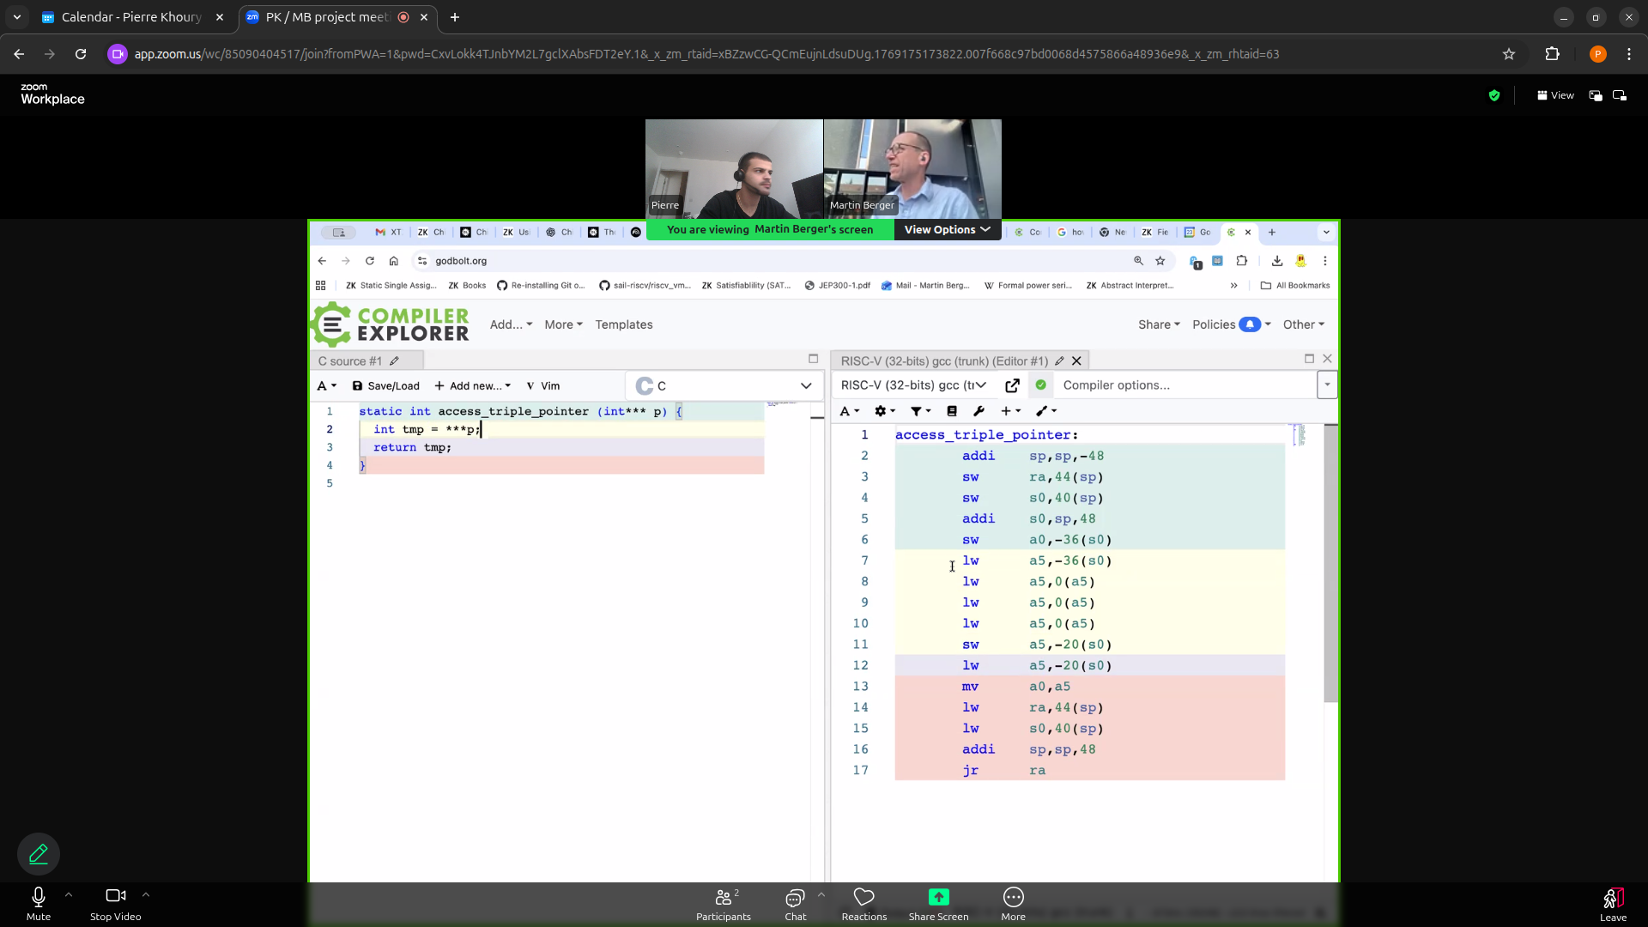
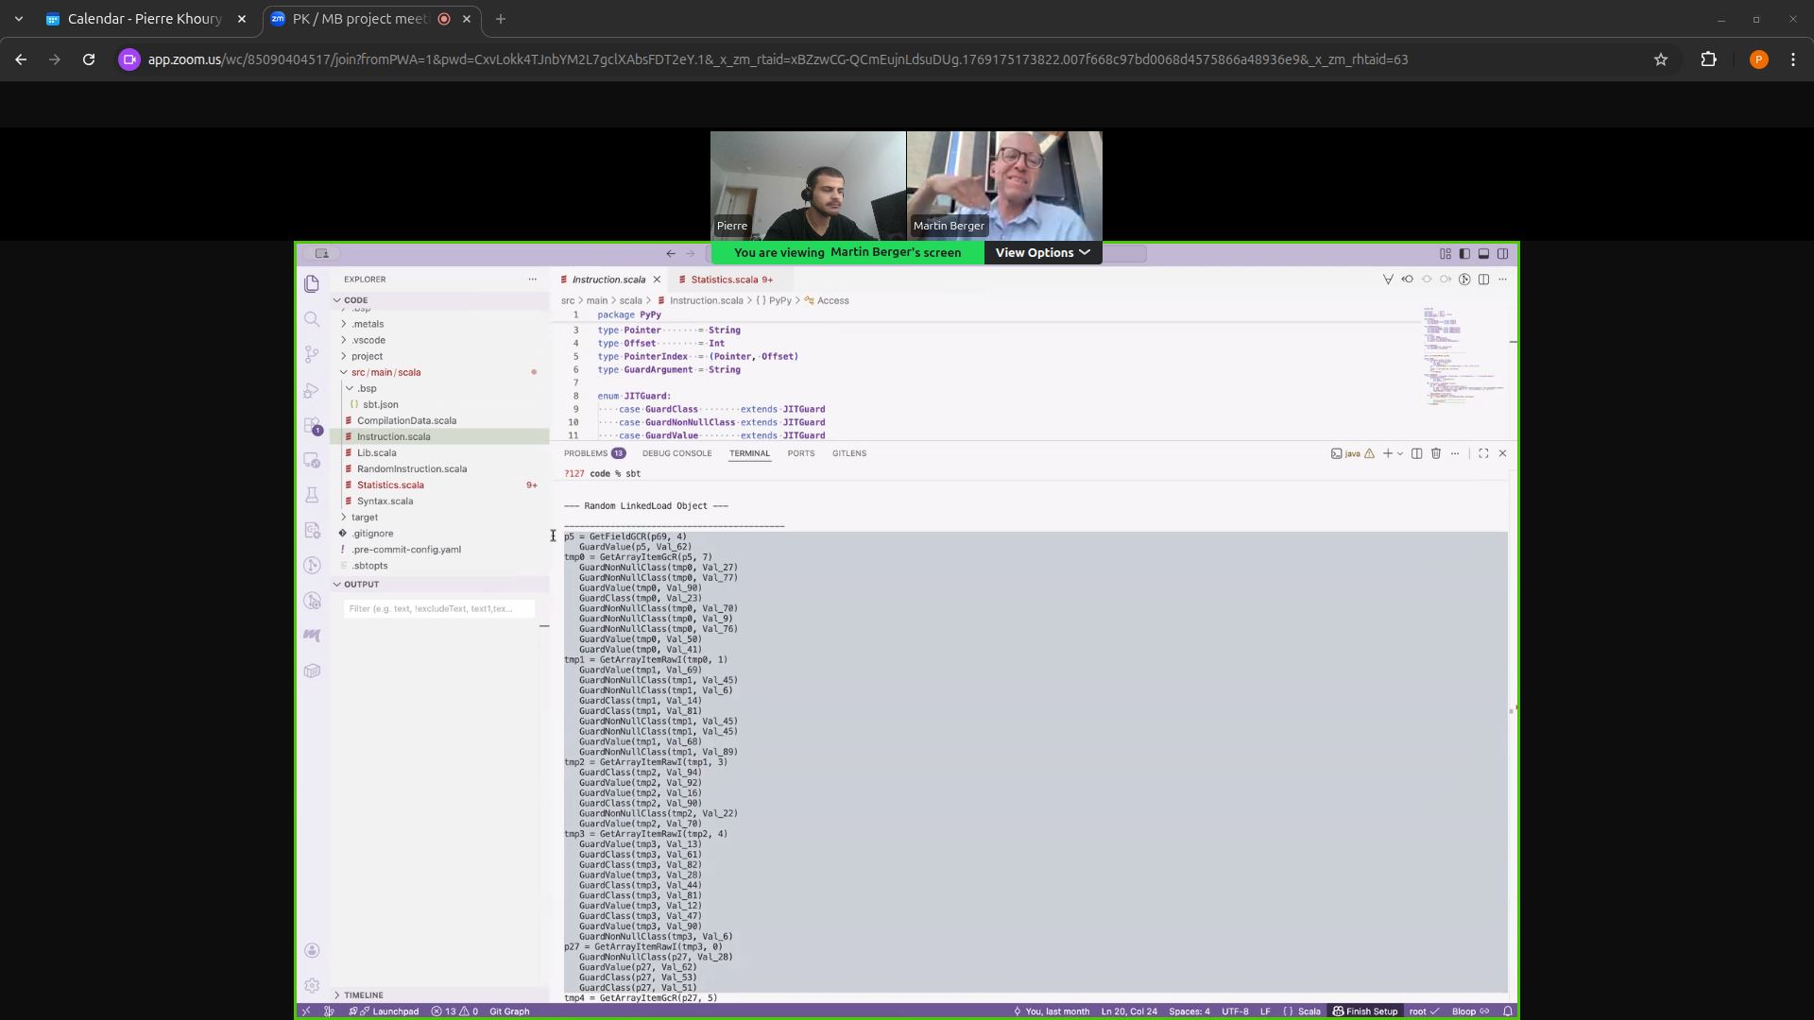
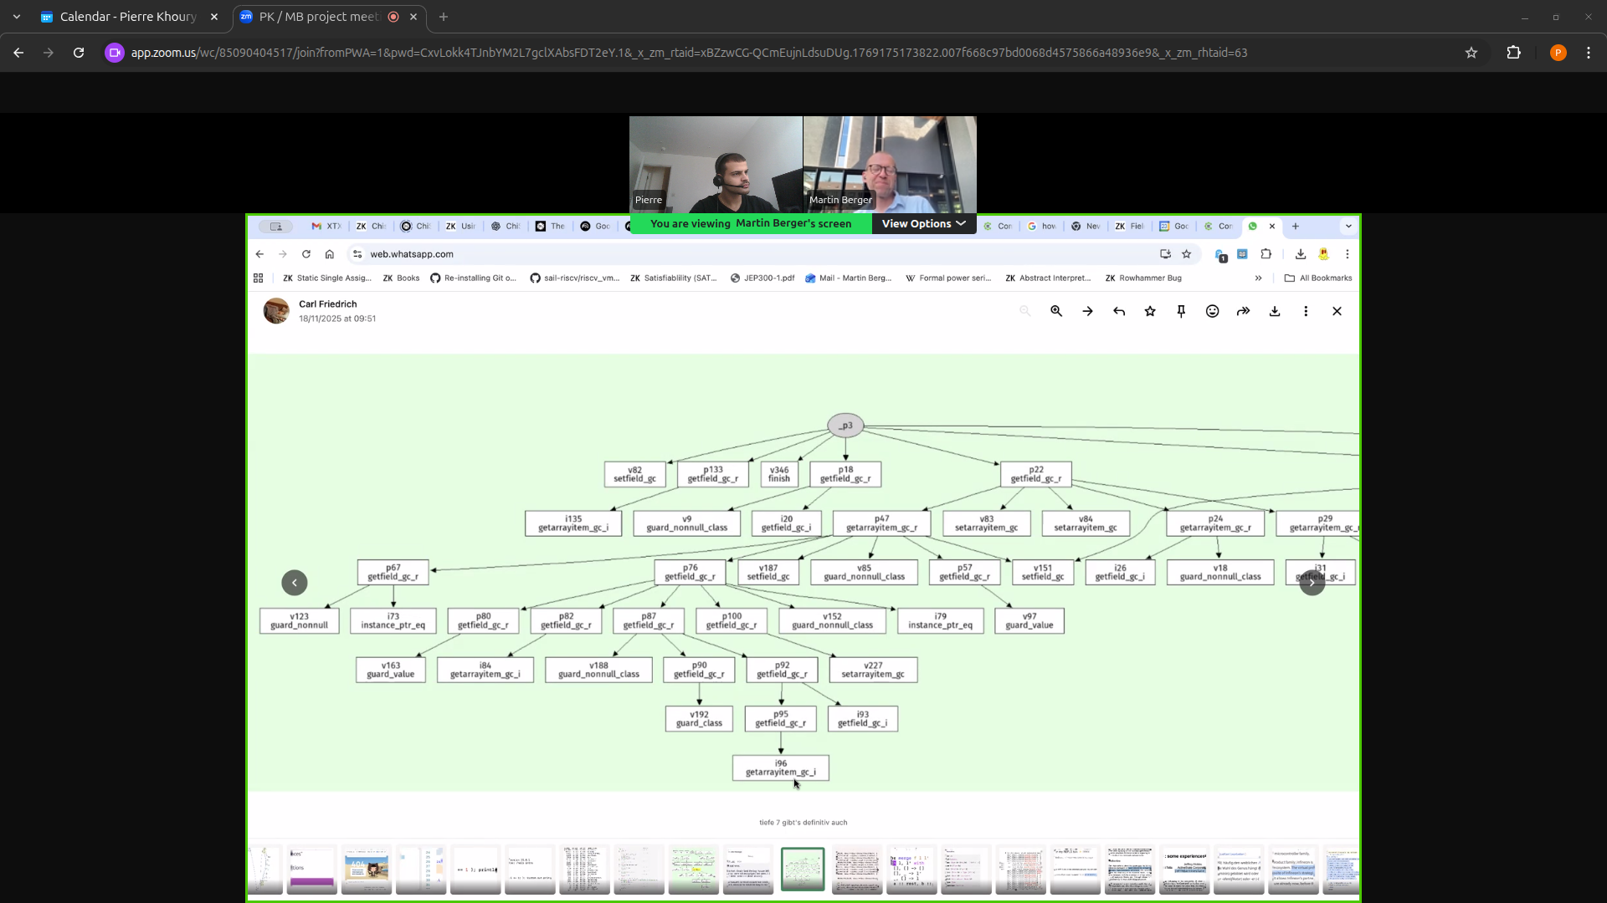
08
Advisor meeting captures · 23 Jan 2026
Starting point · the pointer-chase kernel
godbolt: pointer-chase lowers to a chain of dependent loads
Path: ~/Documents/pointer_chasing_v1/pointer-chase-megaop/docs/screenshots/
§8 / 9 (cont.)
Generated SASS · the literal instruction stream we're profiling
The tree · dependency graph behind a megainstruction prefetch

Slide 12
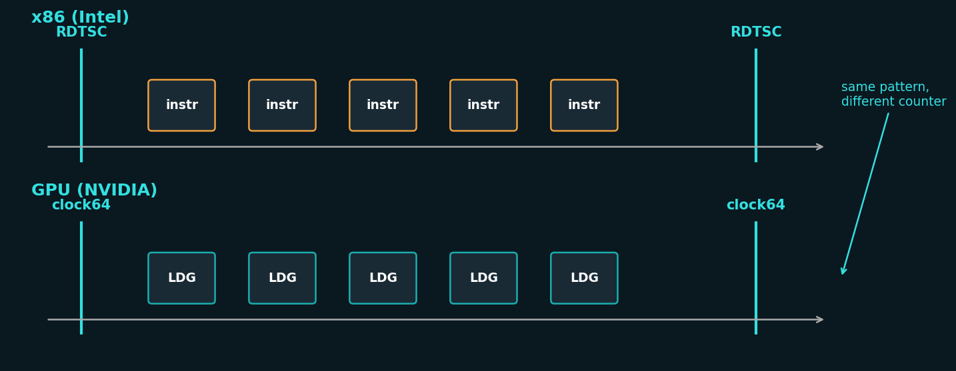
09
Relevance · where I learned this pattern
13 months at Intel · NEX, PTP team
/ NEX = Network & Edge · Ethernet controllers, time-sync silicon.
/ PTPv2.1 / IEEE 1588-2019 · sub-µs cross-host clock alignment.
/ Day job: bracket C instructions with RDTSC on a single core.
/ TPAUSE / serialising fences pin the measurement window.
/ Average many iterations to dig the signal out of jitter.
/ Same pattern, different counter: x86 RDTSC ↔ GPU clock64.
Why it transferred
The bracket-around-one-instruction methodology works on any
ISA that exposes a free-running cycle counter.
x86 RDTSC bracket · same shape as the GPU clock64 bracket on §4
Intel NEX / PTP placement, 13 months · methodology lineage
§9 / 9

