Slide 1



IOC : Input/Output controller
Each IOC manages a set of PVs and makes them available to the network.
Each PV has:
A name (the record name),
A type (e.g., double, integer, string),
A direction (read, write, or both).
https://www.slac.stanford.edu/grp/ad/docs/model/matlab/cheatsheet.html?utm_source=chatgpt.com

Slide 2
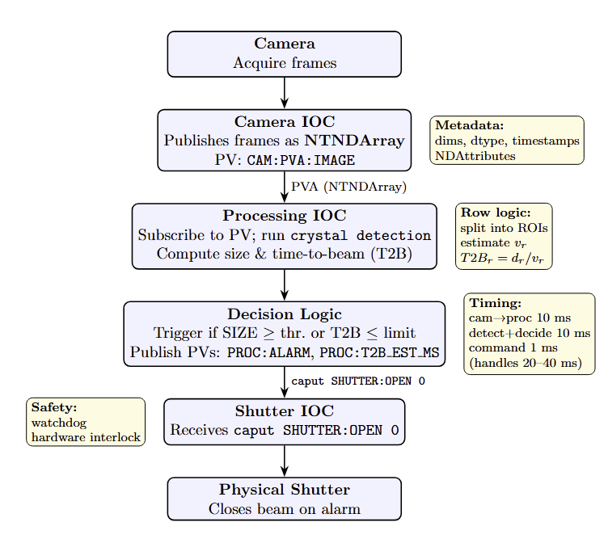
Framework

Slide 3
Communication on EPICS
Who to talk to ?
Axel Wallace

Slide 4
Project Management
github ?
Code used ?

