Slide 1
Document Image Analysis
Layout Analysis

Slide 2
The challenge
Detect and classify the different areas of the medieval book.
100 images
Ground truth
We know what we are supposed to obtain
Train a model ?
Each of us will work on different areas
We might have some work to do together at the beginning
Evaluation
Percentage of pixels labeled correctly (640x960)

Slide 3
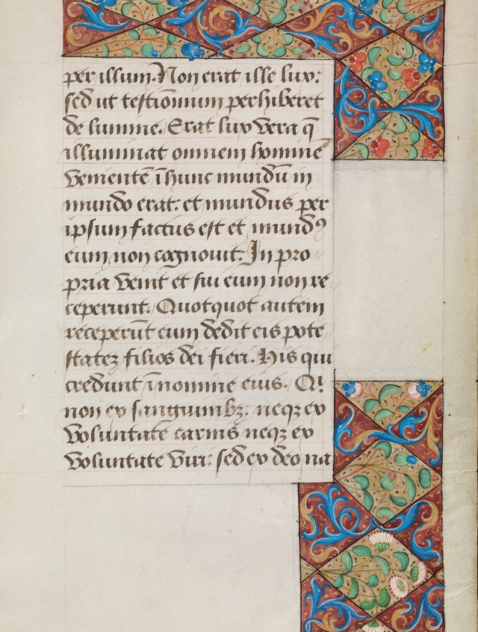
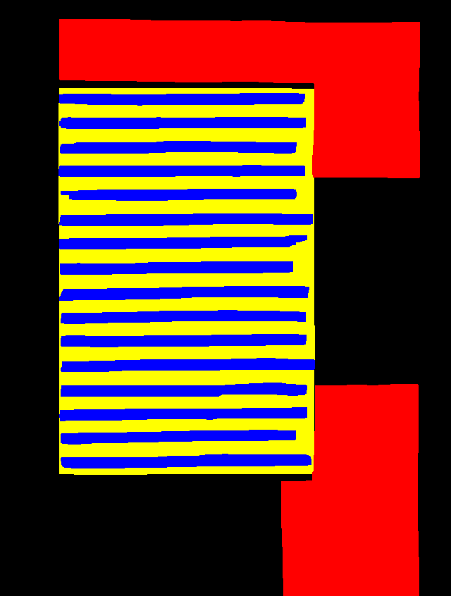
About the data
Good :
- Black borders around the decorations
- Even some artifacts around the text zone
Bad:
- There is black lines in some empty zones
- Sometimes even on the template there is some pixels that are hard to classifie
- There is shadow on the border of the page. So colour of the background changes

