Slide 1
US water systems & Public Health
Pierre Mishra

Slide 2
1. For a SDWA violation, which factors pertaining to public water systems can pose ‘acute health risks’ to the population?
2. Are such violations increasing over time?

Slide 3
1. During a SDWA violation, which factors pertaining to public water systems can pose ‘acute health risks’ to the population?
2. Are such SDWA violations increasing over time?

Slide 4
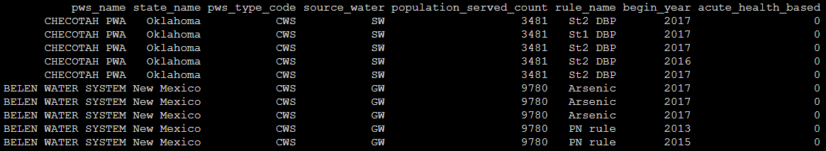
Dataset
Safe Drinking Water Act Violations (1988-2019), Environmental Protection Agency
PREDICTORS
RESPONSE

Slide 5
Response variable
Acute Health Risk (0 or 1)
If violations cause an immediate illness
Binary variable
RESPONSE

Slide 6
Predictor Variable I
Source of water
Groundwater or surface water
Categorical variable
PREDICTORS

Slide 7
Predictor variable II
Population served
Continuous variable
PREDICTORS

Slide 8
Predictor Variable III
Type of Public Water System
A) Community water system (CWS)
B) Transient non-community water system (TNCWS)
C) Non-transient non-community water system (NTNCWS)
PREDICTORS

Slide 9
Predictor Variable III
Type of Public Water System
A) Community water system (CWS)
Systems serving at least 25 year-round residents. Example – Homes, apartments etc that are occupied as primary residences.
B) Transient non-community water system (TNCWS)
Systems serving less than 25 of the same people over six months per year. Example – A drinking water well serving campground or a highway rest stop.
C) Non-transient non-community water system (NTNCWS)
Non-community systems serving at least 25 of the same persons over six months per year. Example – Schools or hospitals having their own source of water.

Slide 10
Model I ( ~ source_water + pws_system + population_served )
Logistic Regression using logit
Likelihood
Y ~ dbern(q)
Logit(q) = intercept + beta * X
Prior
beta ~ dnorm(0,0.1)

Slide 11
Results I
Y = -4.49 + 1.21*surface_water + 0.308*pws_type_NTNCWS + 0.99*pws_type_TNCWS – 0.0000027*population_served

Slide 12
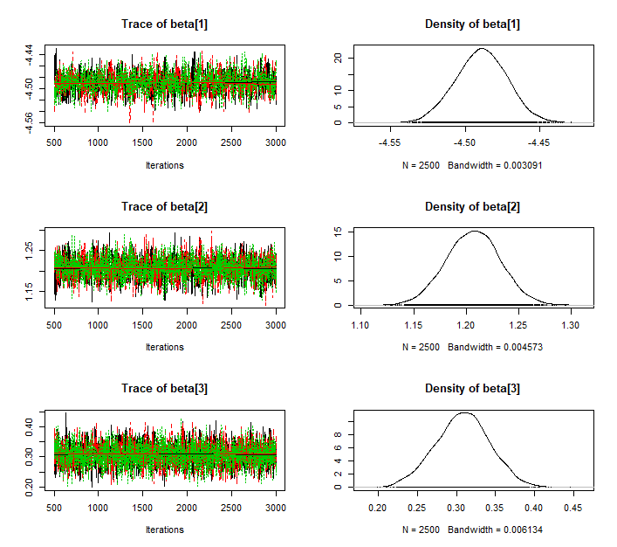
Results I
Beta[1] = Intercept (Groundwater & CWS)
Beta[2] = Surface Water
Beta[3] = NTNCWS

Slide 13
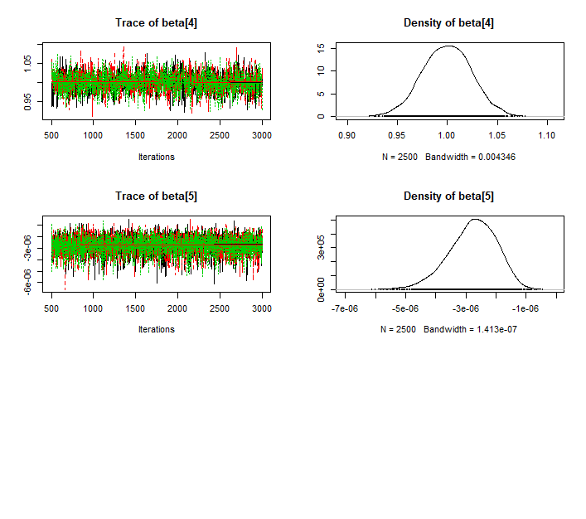
Results I
Beta[4] = TNCWS
Beta[5] = Population_served

Slide 14
Model II ( ~ state * begin_year)
Poisson regression model using log link function
Aggregated the violations into count data by states
file:///C:/Users/Peaceful%20Pierre/Documents/Academics/Spring%202020/Bayesian%20Inference%20Models/Final%20project/Violations%20Trend%20by%20State.html
Likelihood
Y ~ pois(lambda)
Ln(lambda) = intercept + beta * X
Prior
beta ~ dnorm(0,0.1)

Slide 15
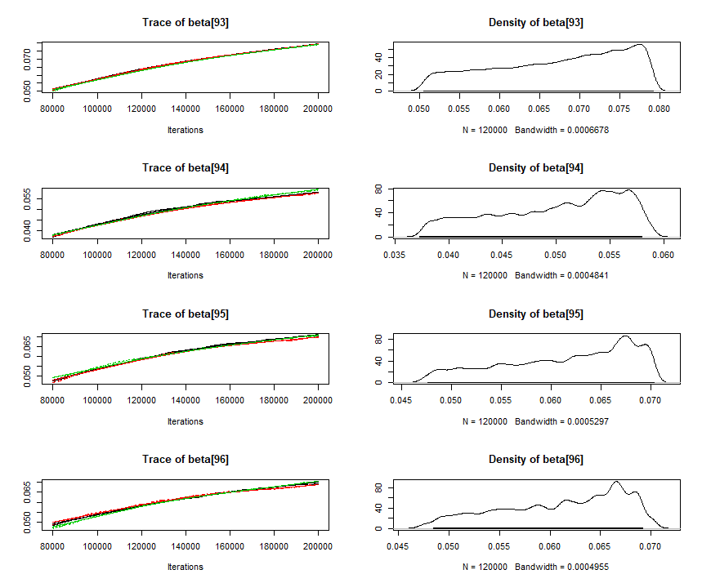
Results II
Did not converge…

Slide 16
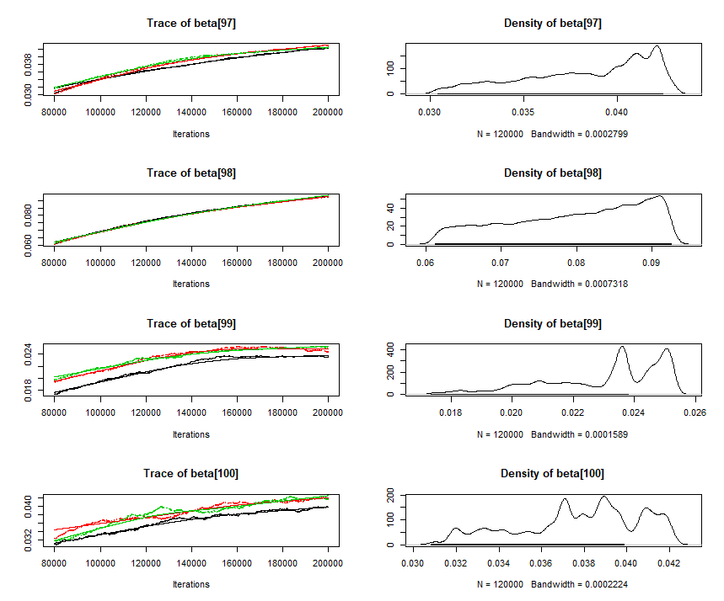
Results II
Did not converge…

Slide 17
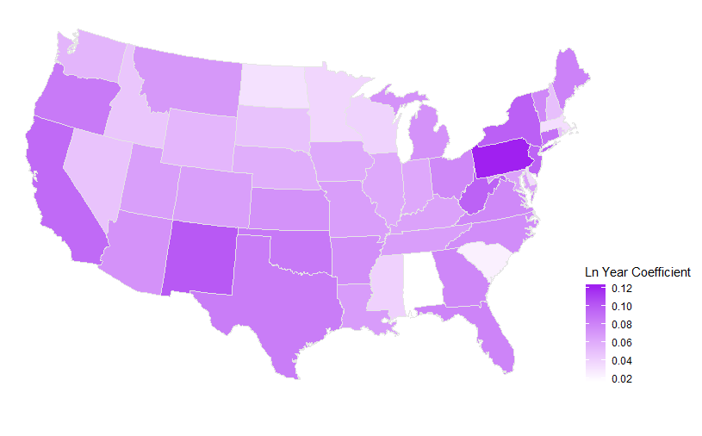
Results II

Slide 18
Thank You !

